Slide 1


Gap Analysis Past and Future
Jörg Schulz, Alexandra Nunes, Peter Albert, EUMETSAT
and many contributors to various parts of gap analysis
Notes:
CEOS (the Committee on Earth Observation Satellites): September, 1984 is made up of 55 Agencies from all around the world committed to coordinating their satellite Earth observation programs and sharing data for a more sustainable and prosperous future. These satellite observations are critical for environmental monitoring, meteorology, disaster response, agriculture and many other applications (take a look at these case studies) that can improve life on Earth and save lives.
CEOS organizations currently operate 112 satellites. These satellites and their related systems operate simultaneously and serve both interdisciplinary and international activities; therefore, international discussion and cooperation are critical to their success.
CGMS: 19 September 1972, 16 members + 6 observers, coordinates the meteorological observing system. The main goals of the coordination activities of the Coordination Group for Meteorological Satellites are to support operational weather monitoring and forecasting as well as climate monitoring, in response to requirements formulated by WMO, its programmes and other programmes jointly supported by WMO and other international agencies.

Slide 2
Gap Analysis
Action Plan & Creation of conditions to deliver CDRs
ECV Inventory
Gap Analysis & Recommendations
ECV Inventory fully describes current and planned implementation arrangements (ECV-by-ECV) within the Architecture;
Updated continuously with versions of Inventory, gap analysis, action plan created annually with approval from CEOS and CGMS;
Recommendations and Coordinated Actions inform space agency planning, improve availability and interoperability of climate data;
Feeds material for all future responses to the GCOS IP.
2018

Slide 3
Gap Analysis Topics
Related to the objectives of the WG Climate the gap analysis addresses three topics:
An assessment of ECVs and their ECV Products where no data records exist or are not planned;
An assessment of the existing and planned climate data records with respect to the fulfilment of criteria, published by GCOS, that provides guidance to climate data record providers on the sustainable process to generate CDRs, and on the quality required to be able to serve known climate applications;
An assessment of 8 ECVs (Carbon Dioxide, Methane, Precipitation, Sea Surface Temperature, Sea Surface Salinity, Land Surface Temperature, Leaf Area Index, and Above-ground Biomass) and their associated ECV Products with respect to a more optimised use of past and current satellite measurements and an analysis of missing measurements in the future, which would prevent the generation of CDRs for specific ECV Products.
Notes:
An assessment of ECVs and their ECV Products where no data records exist or are not planned. ECV Products provide further detail of specific geophysical quantities that can be derived from satellite measurements;
An assessment of the existing and planned climate data records with respect to the fulfilment of that criteria, published by GCOS, that provides guidance to climate data record providers on the sustainable process to generate CDRs, and on the quality required to be able to serve known climate applications. The analysis has been performed for all GCOS ECVs and their ECV Products. The ECV Inventory was designed to assess against GCOS criteria in [RD-1], [RD-2] and [RD-8], but not systematically against [RD-7];
An assessment of 8 ECVs (Carbon Dioxide, Methane, Precipitation, Sea Surface Temperature, Sea Surface Salinity, Land Surface Temperature, Leaf Area Index, and Above-ground Biomass) and their associated ECV Products with respect to a more optimised use of past and current satellite measurements and an analysis of missing measurements in the future, which would prevent the generation of CDRs for specific ECV Products.

Slide 4
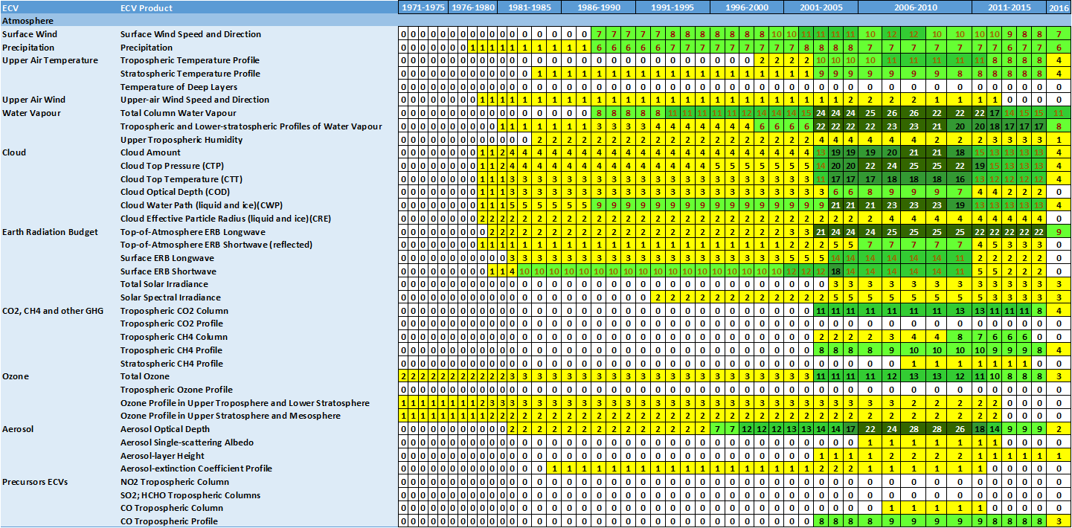
Existing Atmospheric ECV Products

Slide 5
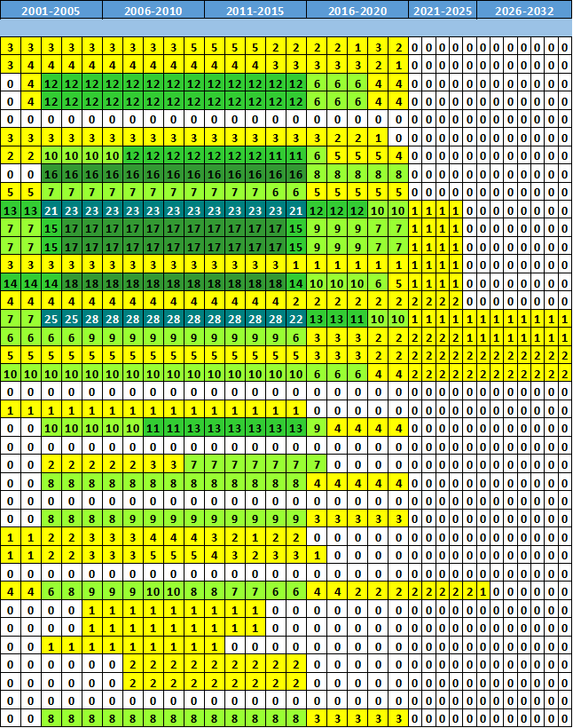
Planned Atmospheric ECV Products

Slide 6
Atmospheric ECVs
  All ECVs are partially covered, although a dense population only exists for the period 2001-2010;
  For existing CDRs, five ECV Products (Temperature of Deep Layers, Tropospheric Ozone and CO₂ Profiles, and NO₂, SO₂ and HCHO Tropospheric Columns) have no entries in the ECV Inventory. However, Temperature of Deep Layers does not constitute a real data gap because data records are known to exist for this ECV even though they are not currently registered in the inventory;
  For planned CDRs, very few plans exist for the extension of CDRs beyond 2020. For 4 ECV Products (Total Solar Irradiance, Tropospheric CO₂ Profile, Stratospheric CH₄ Profile, and CO Tropospheric Column) no entries exist in the ECV Inventory. However, some limitations in the Inventory for planned CDRs has now been identified, so in some cases these gaps may not be real. Improvements to the inventory will be made for the next update.

Slide 7
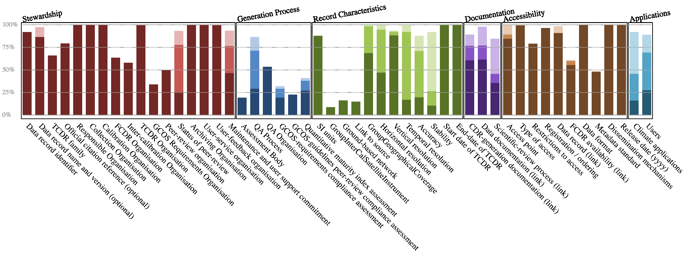
Analysis against GCOS criteria

Slide 8
Individual ECV analysis SST
Technology | Instrument | Mission | Launch | EOL | WMO relevance for SST | CEOS relevance for SST | No. current CDRs in ECV Inventory | No. future CDRs in ECV Inventory | Comments
Cross-nadir infrared sounder | IMG | ADOES | 17/08/1996 | 30/06/1997 | Primary | N | - | -
 | AIRS | Aqua | 04/05/2002 | 2018 | Primary | Y | 9 | 8 | No gaps in the use of AIRS.
 | TES-nadir | Aura | 15/07/2004 | 2018 | Primary | N | - | -
 | IASI | Metop-A Metop-B | 19/10/2006 17/09/2012 | 2018 2018 | Primary | Y | - - | - - | EUMETSAT plans to release reprocessed SST in 2019
 | CrIS | SNPP | 28/10/2011 | 2018 | Primary | N | - | -
 | GIIRS | FY-4A | 10/12/2016 | 2021 | Primary | N | - | -
 | HIRS/2 | NOAA-6 NOAA-7 NOAA-8 NOAA-9 NOAA-10 NOAA-11 NOAA-12 NOAA-13 NOAA-14 TIROS-N | 27/06/1979 23/06/1981 28/03/1983 12/12/1984 17/09/1986 24/09/1988 14/05/1991 09/08/1993 30/12/1994 13/10/1978 | 31/03/1987 07/06/2986 29/12/1985 13/02/1998 30/08/2001 16/06/2004 10/08/2007 21/08/1993 23/05/2007 27/02/1981 | Very High | N | - - - - - - - - - - | - - - - - - - - - -
 | VAS | GOES-4 GOES-5 GOES-6 GOES-7 | 09/09/1980 22/05/1981 28/04/1983 26/02/1987 | 22/11/1988 18/07/1990 01/07/1989 11/01/1996 | Very High | N | - - - - | - - - -
 | SOUNDER | GOES-8 GOES-9 GOES-9 (GMS backup) GOES-10 GOES-10 (S-America) GOES-11 GOES-12 GOES-12 (S-America) GOES-13 GOES-14 GOES-15 | 13/04/1994 23/05/1995 22/05/2003 25/04/1997 01/12/2006 03/05/2000 23/07/2001 10/05/2010 24/05/2006 27/06/2009 04/03/2010 | 05/05/2004 22/05/2003 24/07/2006 01/12/2006 02/12/2009 05/12/2011 10/15/2010 16/08/2013 2018 2018 2020 | Very High | Y | - - - - - - - - - - - | - - - - - - - - - - -

Slide 9
Recommendations
Recommendation #15: The SST-VC should foster further work on SST ECV products in regards to the improvements that may be possible by better exploiting/integrating geostationary, historic IR sounders and C-band radiometers.
Recommendation #16: C-band microwave radiometer measurements for all-weather SST:
  (Short term) All efforts to maximise the life time of AMSR-2 on JAXA’s GCOM-W1 should be supported.
  (Mid-term) The possibility of an AMRS-2 on GCOM-W2 should be prioritised; full data sharing in regards to MWI instruments of the FY-3 series and HY-2B.
  (Longer term) Agencies with operational mandates should develop and fund a sustainable plan, with redundancy, for observations from C-band microwave conical scanning radiometers.

Slide 10
Actions
WGClimate Coordinated Actions
Actionee | Action # | Description | Action feedback/closing document | Deadline | Status | Comments
VC-SST | 16 | The CEOS SST-VC to work with GHRSST on future utilisation of the mentioned data sources and regularly inform WGClimate on the progress which shall become measurable in the ECV Inventory as well. | Telecon with VC-SST lead needed. | 31 Jan 2019 | OPEN | Science,C-SST SST lead needed
WGClimate | 17 | CEOS and CGMS Agencies with experience in microwave radiometry to help maximise the lifetime of the AMSR-2 instrument on GCOM-W1. | Assess status | SIT-34 | OPEN
WGClimate | 18 | CEOS and CGMS Agencies to strive to ensure that the needed C-band microwave data are made publicly available and can be used for the generation of climate data records. | Check availability, maybe with WGISS, then point out what is missing. May strive for CEOS and/or CGMS Plenary action. | 47th CGMS and 33rd CEOS Plenary | OPEN | Data Access
WGClimate VC-SST | 19 | CEOS and CGMS Agencies with interests in and/or mandates for developing C-band microwave radiometers to coordinate their efforts to arrive at an operational capability, and coordinate their efforts with WGClimate and the SST-VC. | Telecon with VC-SST lead needed. | 31 Dec 2019 | OPEN | Science, VC-SST SST lead needed

Slide 11
Main targets: Comparison #2/#3
  Assess content of the ECV Inventory: population (distribution per domain, existing / planned), absolute gaps, agencies’ contributions
  Assessment against GCOS criteria
  Revisit set of ECVs / ECV Products targeted by previous gap analysis (CO2, CH4, Precipitation, Land Surface Temperature, Leaf Area Index, Above-Ground Biomass, Sea Surface Temperature, Sea Surface Salinity) and assess evolution, cross-referencing with the Recommendations and Actions

Slide 12
Main targets: ECVs for detailed analysis
  Draft proposal, based on analysis of GCOS-IP actions:
    Atmosphere
      Aerosols
      Lightning
      Surface Winds
      Upper-air winds
      Water Vapour UT/LS
    Land
      Fire
      Land Cover
      Soil Moisture
      FAPAR
      Glaciers
    Ocean
      Sea Level
      Sea State
      Ocean-surface heat flux
  Considerations
    Workload
    Expertise
    Other (relevance, cycles, …) > Scatterometry? Limb sounding?
Help from WCRP for analysis would be appreciated:
GEWEX for ocean surface heat flux and associated state variables;
SPARC for Water Vapour UT/LS
Need matter experts in parameter and remote sensing (instrument knowledge)
Availability between May - September

