Slide 1
Status of the Architecture for
Climate Monitoring from Space
Werner Balogh
WMO Space Programme Office
WGCLimate-10, Marrakech, Morocco
20 March 2019

Slide 2
Contents
Climate Architecture Background
Cg-18 Resolution
Cg-18 Climate Architecture Event

Slide 3
I. Climate Architecture
Background

Slide 4
Background
Discussions on the development of an “Architecture for Climate Monitoring from Space” were initiated by Jim Purdom and Tillmann Mohr around 2005-2009
Aimed to engage “R&D space agencies” in the same way as operational space agencies were engaged in weather monitoring
Led to Resolution 19 (Cg-XVI) of World Meteorological Congress in 2011

Slide 5
Resolution 19 (Cg-XVI)
WMO Resolution 19 (Cg-XVI) of 2011, requested WMO to
“to develop an architecture ... for climate monitoring as a component of the future WIGOS and GFCS, for consideration by Congress”,
as a “major initiative of the WMO Space Programme”, and
“in coordination with satellite operators, CEOS, CGMS, GCOS, GEO and WCRP”.
Notes:
Document contains description of logical view composed of four pillars and contains general views on the physical view.

Slide 6
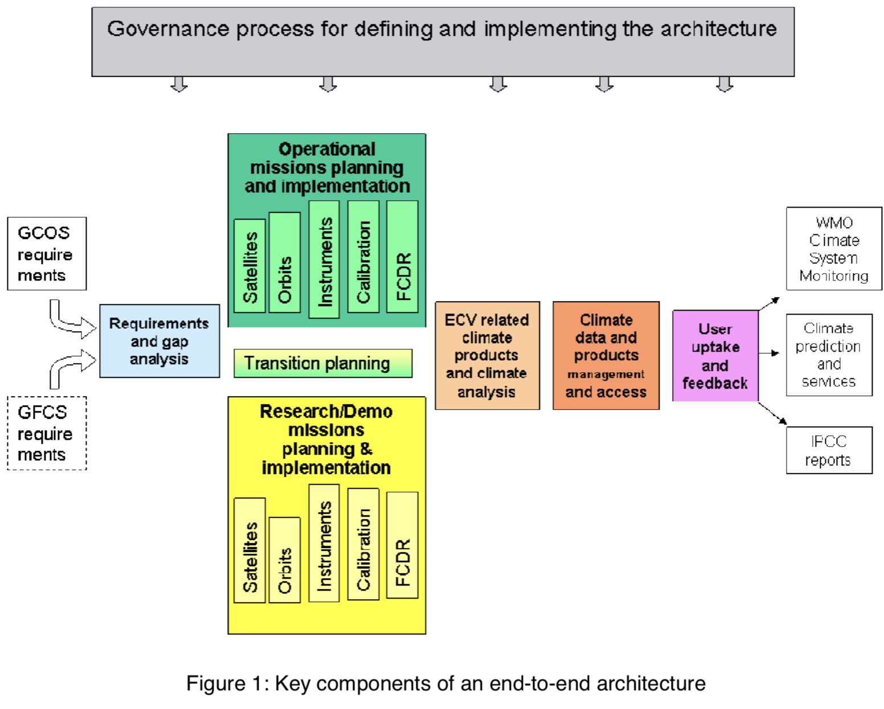
Res 19 (Cg-XVI) Concept Document
A Concept Document was annexed to the resolution, describing the key-components of an end-to-end architecture

Slide 7
Achievements 2011-2015
2011: Report on “Strategy Towards an Architecture for Climate Monitoring from Space” (CEOS, CGMS, WMO)
2013: Establishment of CEOS-CGMS Working Group on Climate (WGClimate)
2015: Report on “Satellite for Climate Services: Case Studies for Establishing an Architecture for Climate Monitoring from Space”
First CEOS-CGMS Inventory of Essential Climate Variables (ECVs)
OSCAR/Space listing relevant EO satellites/missions for gap analysis

Slide 8
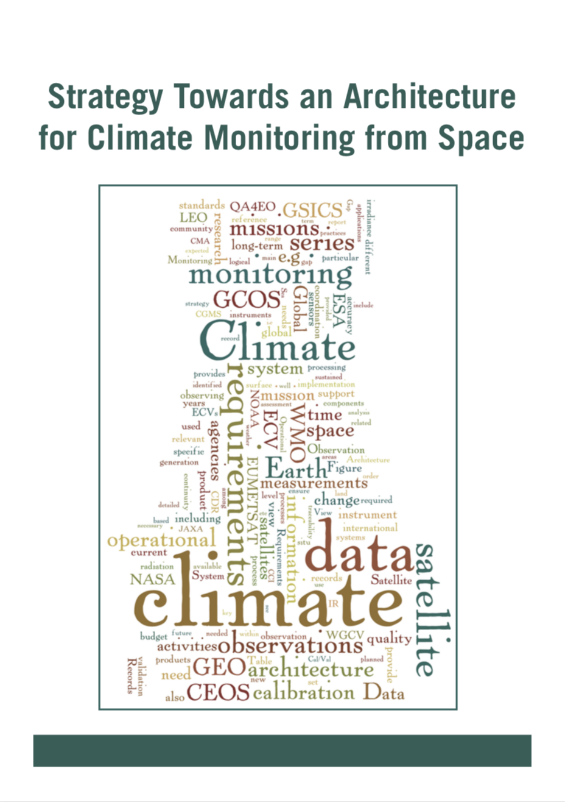
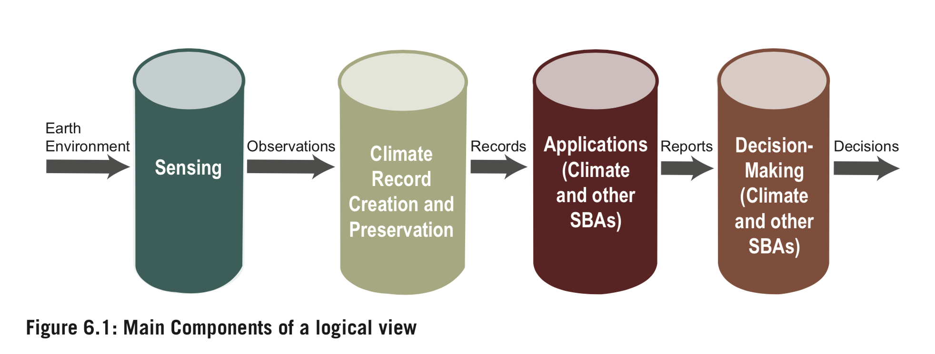
Climate Monitoring Architecture
Strategy Towards an Architecture for Climate Monitoring from Space (2013)
  Terminology
  Logical View
  Implementation Roadmap

Slide 9
Cg-XVII in 2015
World Meteorological Congress Cg-17 (2015)
4.2.2.23 Congress underlined the importance of the continued development of the Architecture for Climate Monitoring from Space as a key WIGOS contribution to GFCS Observation and Monitoring component, and it requested the Executive Council and ICG-WIGOS to actively monitor and coordinate this development. Congress noted that WMO is an active member of the joint working group on climate established by CEOS and CGMS, with the major responsibilities for coordinating the development of the physical Architecture for Climate Monitoring from Space in the partnership with all relevant space agencies and satellite operators.
4.2.4.16 As suggested by the Consultative Meetings on High-level Policy on Satellite Matters, Congress underscored the need for the satellite operators and the Secretariat to pursue the development of the Architecture for Climate Monitoring from Space with a view to ensure seamless continuity of climate monitoring satellite programmes, comparability of measurements, provisions for continuity and contingency, and traceability to reference standards. Congress further encouraged satellite operators to pursue a dialogue with WCRP and GCOS in order to address the grand science challenges of WCRP in an end-to-end integrated approach.

Slide 10
Developments Since 2015
WGClimate ECV Inventory 2.0 and Gap Analysis, Action Plan
Development of WIGOS and Vision for WIGOS in 2040
WMO
WMO Paper ”Concept for the physical view of the architecture for climate monitoring from space”
2030 Agenda for Sustainable Development and Paris Climate Change Agreement - Integrated Global Greenhouse Gas Information System (IG3IS) – need for operational monitoring
CEOS/CGMS AC/VC Whitepaper on CO2 and CH4 monitoring
Shift from research to operational missions
Copernicus System – operational Greenhouse Gas (GHG) mission aimed for 2025
WMO Governance and Constituent Body Reform and WMO Earth System Approach

Slide 11
Climate Monitoring Architecture Status
Many elements of the architecture for climate monitoring from space are already in place today:
  GCOS (Requirements)
  CEOS/CGMS Working Group Climate (ECV Directory)
  WIGOS/CGMS Baseline
  Gap Analysis Processes (WMO RRR, CGMS-Vision)
  Users increasingly identified
  ….
Need for a holistic description of the architecture in response to Resolution 19 (Cg-XVI) to be presented to Cg-18

Slide 12
II. Cg-18 Resolution

Slide 13
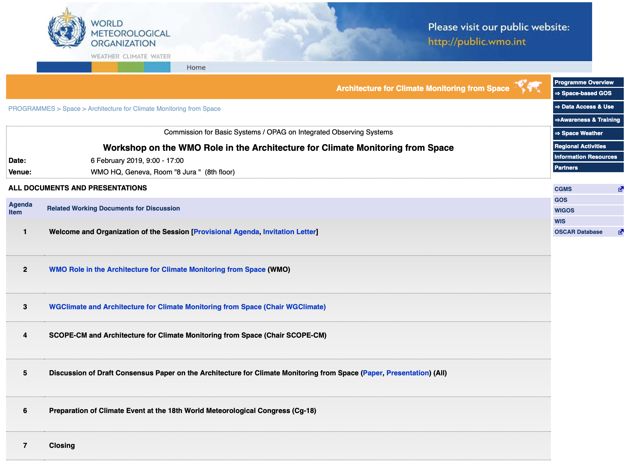
6 February – WMO Workshop
See http://www.wmo.int/pages/prog/sat/meetings/Climate-architecture-workshop.php

Slide 14
Resolution for Cg-18
Workshop held at WMO on 6 February 2019
Agreed on title, scope and elements of a Draft Resolution
Preparation of Draft Resolution for Cg-18
Submitted for review at WGClimate-10

Slide 15
Scope and Purpose
Title “Status of the architecture for climate monitoring from space”
Audience: WMO Congress (high level)
Paper Length: ~4-5 pages
Purpose
  Respond to resolution 19 (Cg-XVI) and inform Cg-18 on progress made.
  “to provide the basis for … processes and capabilities to be implemented, and activities to be pursued, in order to monitor climate from space in a globally coordinated and efficient framework”.
  Reflect consensus of all relevant stakeholders on the status of the architecture for climate monitoring from space as of 2019.
  Provide a basis for agreeing on and planning the next necessary steps towards full implementation of the architecture.
  Describe the WMO role in the architecture for climate monitoring from space.

Slide 16
Elements
Reflect background history.
Confirm importance of the architecture.
Describe architecture and its status.
Reflect, acknowledge and appreciate achievements.
Recognize contributions of all stakeholders.
Request continued support of space agencies.
Endorse its continued implementation.

Slide 17
Roadmap for the Resolution
Final review by WGClimate-10
Seek acknowledgement at CEOS-SIT-34
Seek acknowledgement at CMGS-47
Seek endorsement by Cg-18

Slide 18
Timeline for the Resolution
Today (6 February 2019)
  Provide advice and input on first draft of consensus paper
SCOPE-CM Meeting (7-8 February 2019)
  Discuss and agree on future role of SCOPE-CM
IPET-SUP-5 (11-13 February 2019)
  Present, receive advice and input, refine paper
WGClimate (18-22 March 2019)
  Review paper
Document Deadline for Cg-18 (1 April 2019)
CEOS-SIT (2-5 April 2019)
CGMS-47 (20-24 May 2019)
Cg-18 (3-15 June 2019)
  Endorse

Slide 19
III. Cg-18 Climate
Architecture Event

Slide 20
Proposed Cg-18 Climate Event
Decision 35 (EC-70):
  “(3) To request the Secretary-General to invite the CEOS-CGMS Joint Working Group on climate to give a demonstration of the architecture for climate monitoring from space at the Congress-18.”
Support endorsement of the Architecture Resolution at Cg-18
Number of Cg-18 parallel events strictly limited
WMO aiming to meet requirements of Decision 35 (EC-70)
Dates considered: 6-7 June 2019

Slide 21
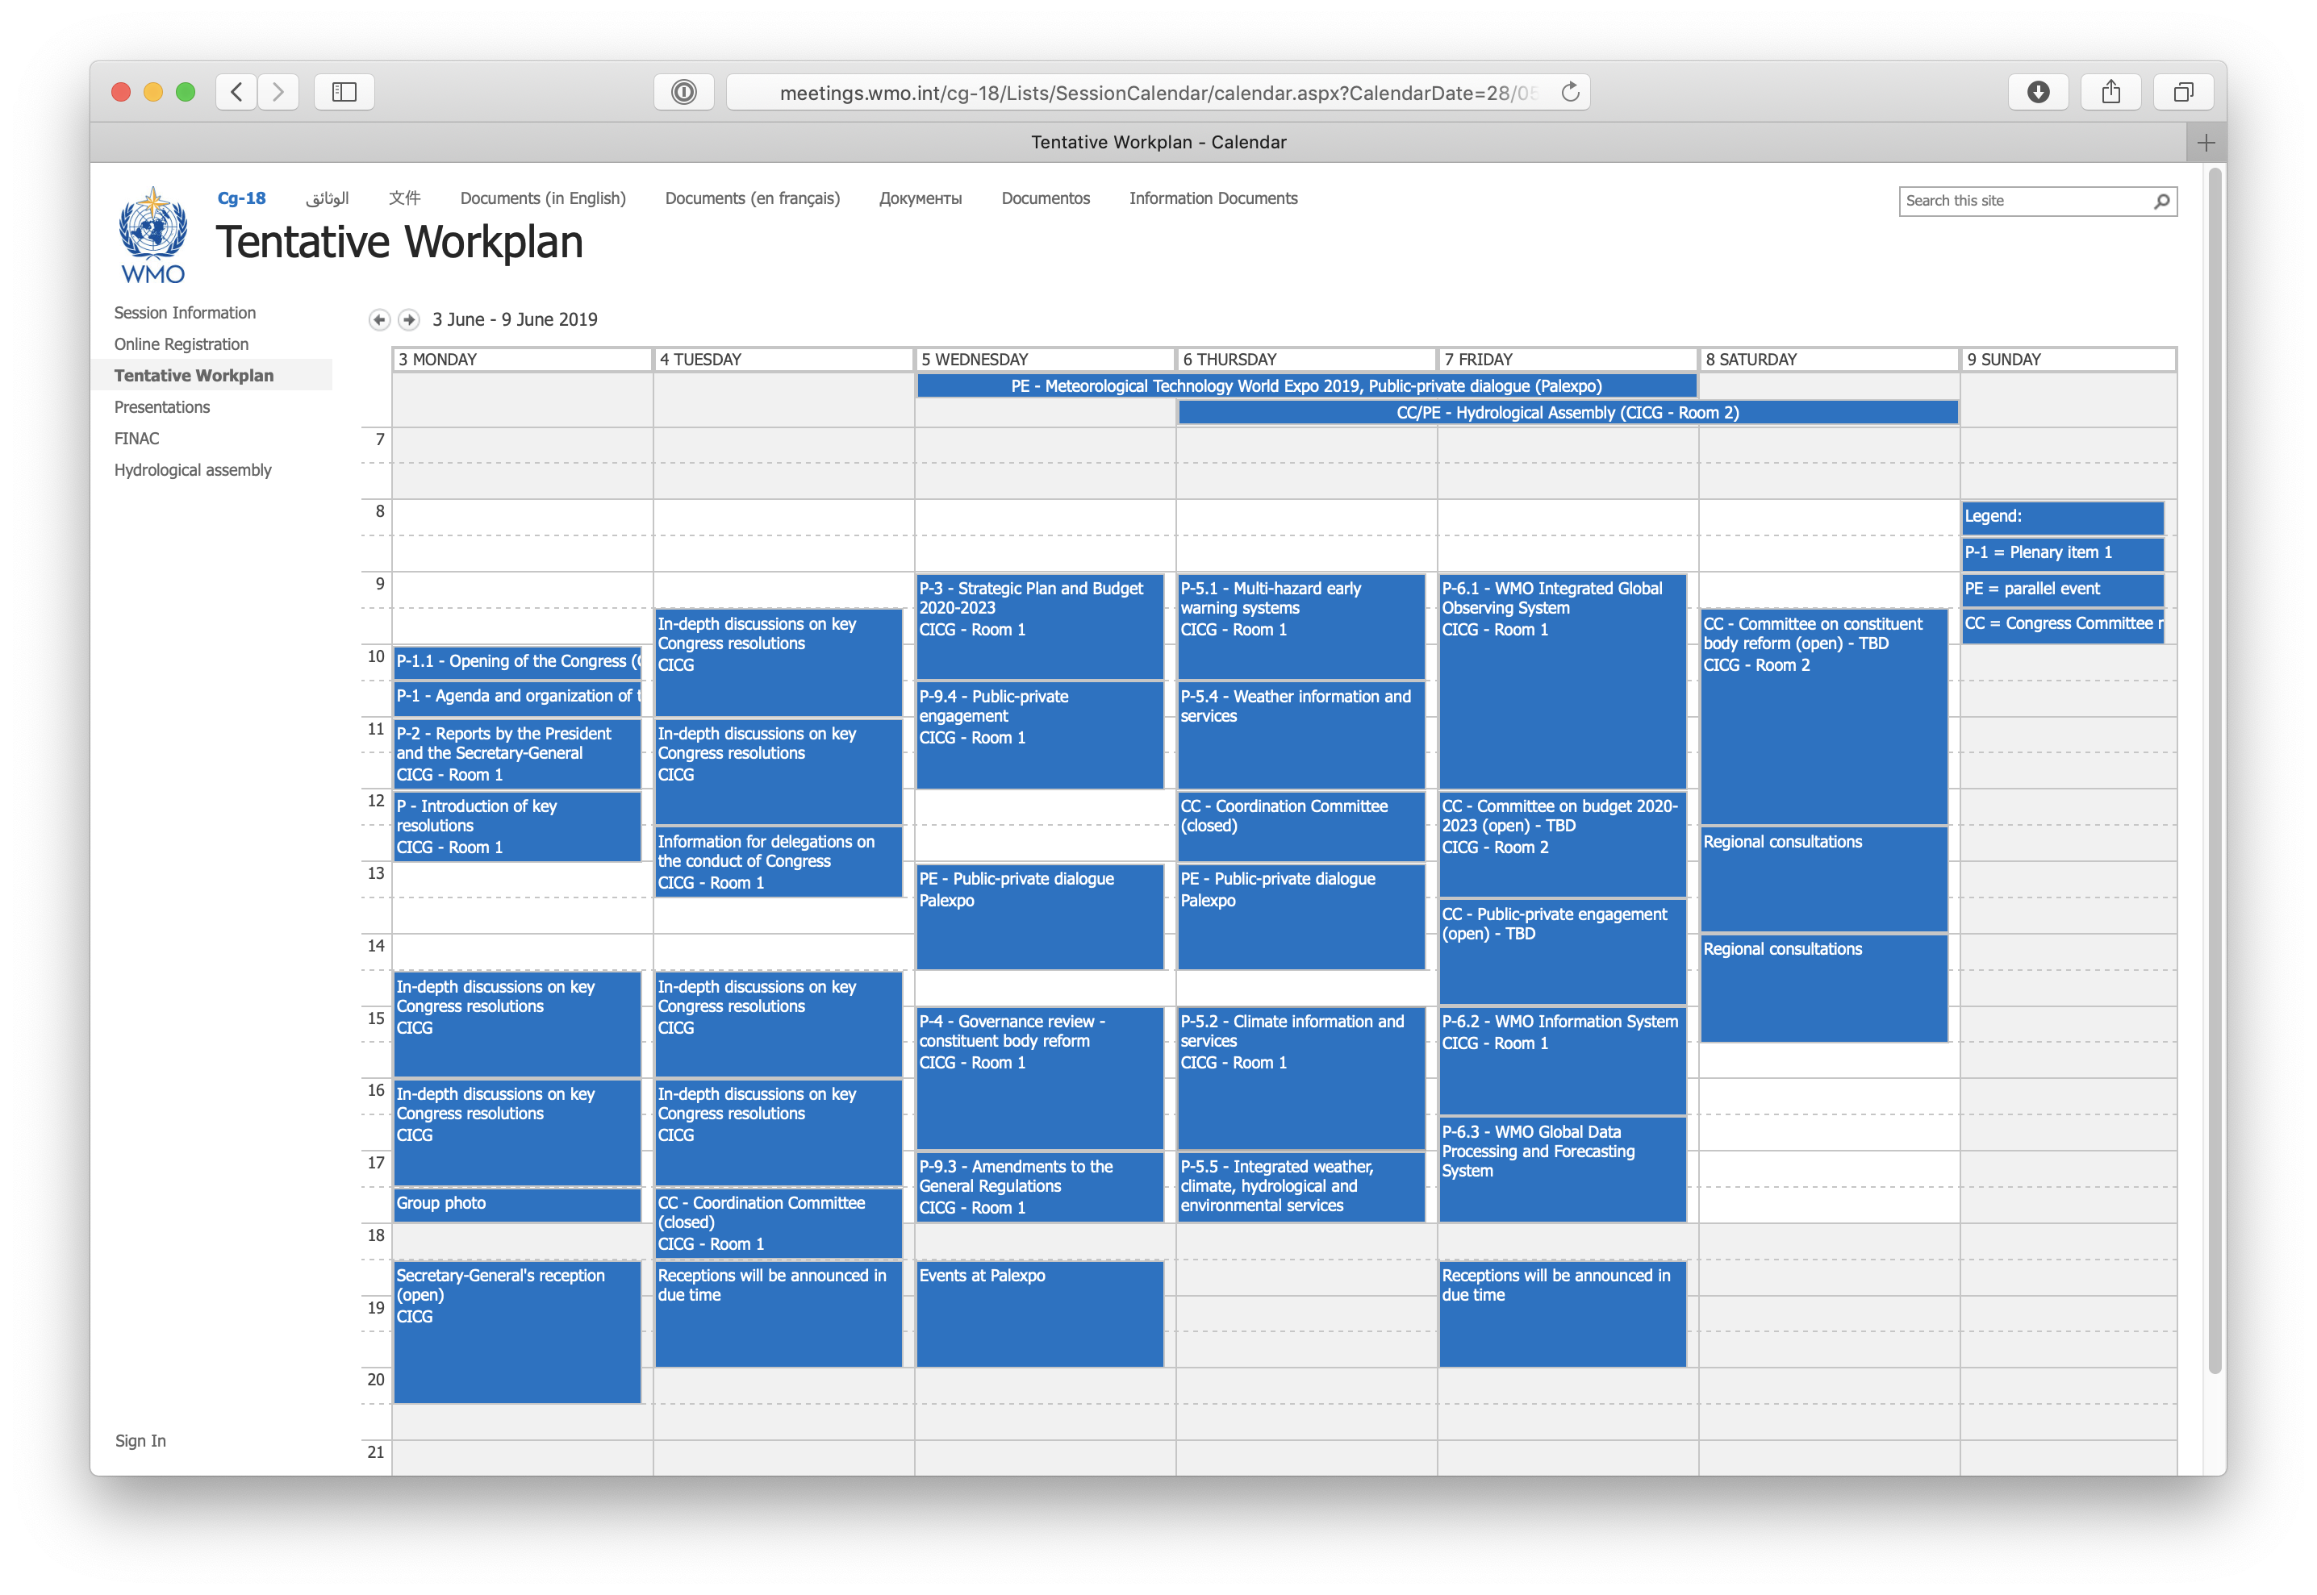

Slide 22
Proposed Agenda Cg-18 Climate Event
1. | Welcome and Introduction | WMO (SG or ASG) | 5 mins
2. | Architecture for Climate Monitoring from Space (Overview presentation) | CEOS/CGMS WGClimate | 15 mins
3. | Using Essential Climate Variables (ECVs)/Climate Data Records | Head of Copernicus Climate Change Service | 15 mins
4. | Space Agency Planning | CEOS/CGMS WGClimate | 15 mins
5. | Conclusions | EUMETSAT (SG) and WMO (SG or ASG) | 5 mins

Slide 23
http://www.wmo.int/sat

