Slide 1
Space Climate Observatory
WG Climate Meeting – Marrakech, 20th March 2019
Dr. Selma Cherchali
CNES, SCO Program Director

Slide 2
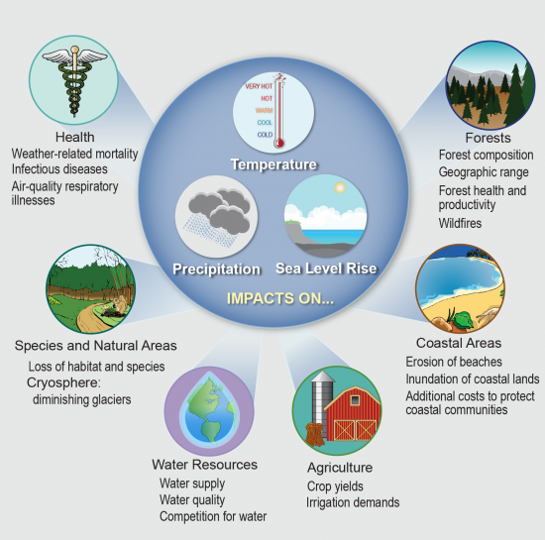

Space Climate Observatory
SCO Concepts – Need for a coordinated assessment of Climate Change Impacts
Potential effects of climate change
What are we going
to do?
Source. Climate Change Impacts in the United States: The Third National Climate Assessment

Slide 3
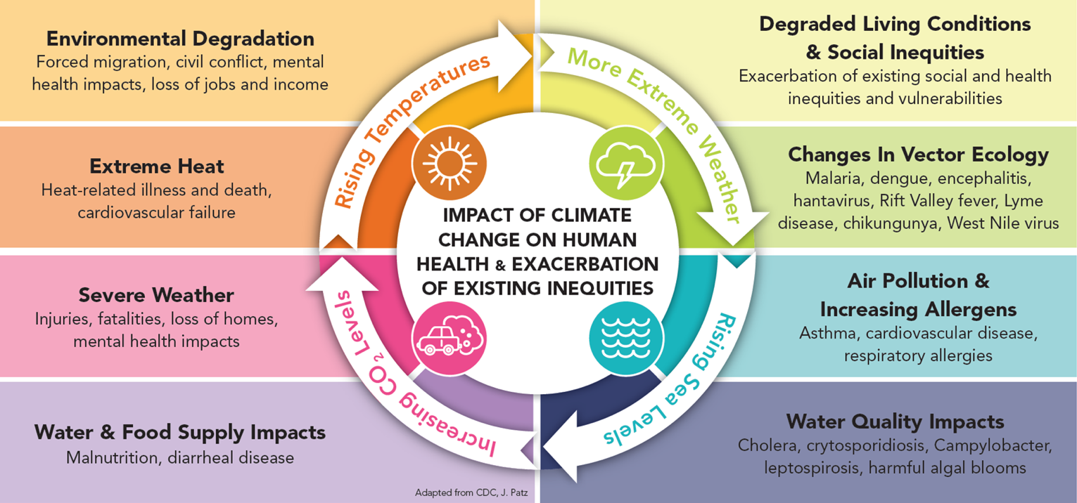
Space Climate Observatory
SCO Concepts – Need for a coordinated assessment of Climate Change Impacts
Societal Impacts

Slide 4
Space Climate Observatory
SCO Concepts – Main Objectives
“Space Climate Observatory”
A world observatory of
the climate change and its impacts
  Satellite data
      Earth observations at regional, national and local level
      … and in-situ data, research modelling
  Climate change and its impacts
      Humankind, both as anthropogenic causes and as the victims of the impacts (temperature increase, sea level rise and hazards…)
  a joint Observatory
      A World Heritage system
  → http://spaceclimateobservatory.org

Slide 5
Space Climate Observatory
SCO Concepts – Main Objectives
  Respond to Adaptation needs through international coordination
  A global monitoring of CC impacts is so far poorly structured
  Case studies in various contexts have been developed but
    Many methodological approaches are challenging and/or not shared
  Contribute to the assessment of impacts of CC in different SBA (water, food security, coastal areas, air quality,..)
  Precise impact’s CC monitoring
    Regional, National, Local scale
    Will raise awareness, stimulate and support decision making
Required international coordination specifically focused on impacts of Climate Change

Slide 6
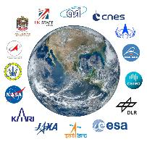


Space Climate Observatory
SCO Concepts – Main Objectives
Principles
  Science based Program
  Not alone !
      A country, an agency, an institution…
      could not make it for all the World/Planet
  Involvement and cooperation with wide range of bodies
      GEO, CEOS, CGMS and UN Agencies
      National organizations, Ministries, local entities…
  Building on the exiting capabilities and programs
  Co-construction
      At international but also national level
        Across sectors, institutions, research community, and sub-national area (territories)
      At level of populations
        Metrics and social indicators to measure the appropriation and acceptance by stakeholders
      Communities of development (Sharing of capabilities (expertise, computing)
      Make available to others, freely
      Exchange of use, best practice
CO DESIGN

Slide 7



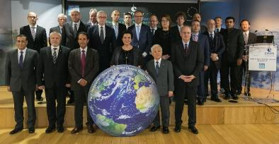
Space Climate Observatory
SCO Concepts – Need for a coordinated assessment of Climate Change Impacts
SCO Policy Drivers
…
Illustration by David Parkins
Nature 514, 30–31, Oct. 2014
One Planet Summit – Paris, December 11th, 2017

Slide 8
Space Climate Observatory
SCO Concepts – Main Objectives
Precise impact’s CC monitoring
    Regional, National, Local scale
  By making full access, use and benefit of multi-source data
    Best use of synergies between data providers (from satellite, in-situ, model, socio-economic research)
  Co-construction of both knowledge and expertise (scientifically, technically and geographically)
    Products and services
  Develop effective and relevant communication/outreach activities and educational measures
    Will raise awareness, stimulate and support decision making

Slide 9
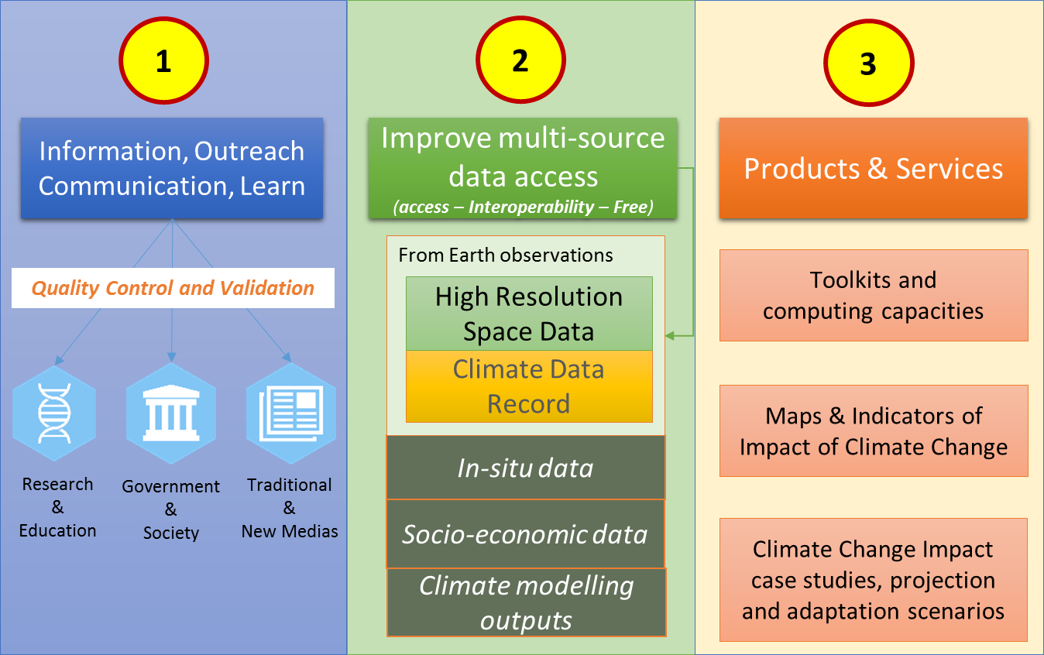
Space Climate Observatory
SCO Concepts – Main Objectives

Slide 10
Space Climate Observatory
2 – Data access
By making full access, use and benefit of multi-source data
Satellite EO data
(global & fine scales)
Derived EO Products
(Land use, DEM, water…)
ECVs
In-situ data
Models data
Climate Data Records
Climate Change Impact
Maps &
Indicators
of Impact of CC
+
Socioeconomic data
Climate Projections

Slide 11
Space Climate Observatory
3 – Products & Services
Feedback
Example
“C3S”
End Users
Feedback
Products & Services Access
Feedback
“New” developments
Adapted at the scale of Regional/National/Local scales
Co-construction
  Communities of development
  Make available to others, freely
  Exchange of use, best practices
Request
Scenario, future projections

Slide 12
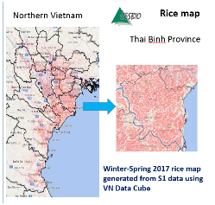
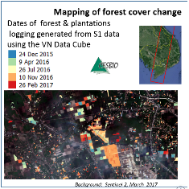
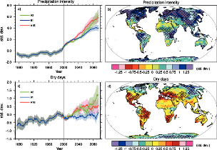
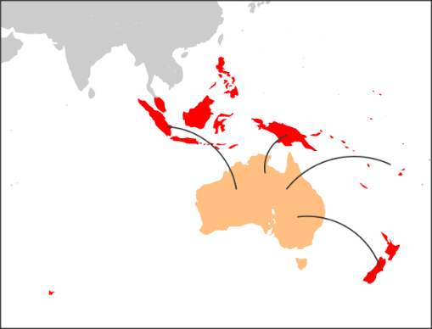
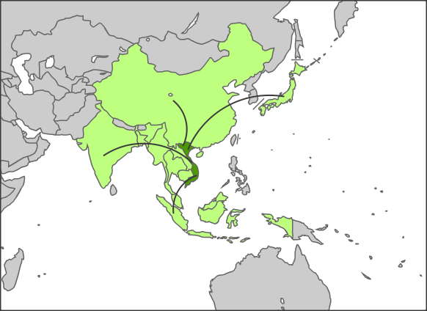

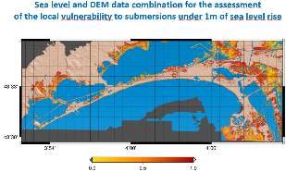
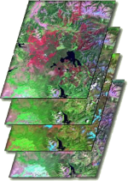
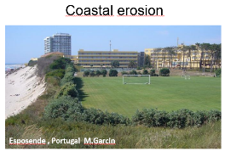
Space Climate Observatory
Illustration of future scenario and international contributions
Coordinator: Australia (CSIRO)
User needs: Coastal areas, Water quantity & quality…
International HUB
Regional
Tools, Data, Products, Scenario
Regional
Coordinator: Vietnam (VAST-VNSC-Mekong Commission)
User needs: Foot security (Rice), Forest…

Slide 13















Space Climate Observatory
SCO Concepts – SCO the international landscape
National SCO
Data Center
Space Agencies
International
Organization
National SCO
Products & Services
…
…
SCO – HUB
Data access, Information, Products & associated Services
but always
but always
End Users

Slide 14
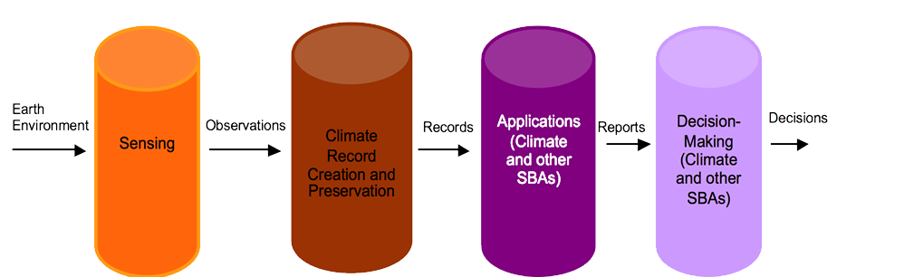
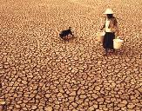

Space Climate Observatory
SCO Concepts – SCO the international landscape
Feedback
ECVs
ECV inventory and gap analysis
Regular updates carried by CEOS-CGMS WG Climate (last exercise : 2016 - 2017)
Improvement / extension of the datasets (e.g. CCI / CCI+)
C3S : ECV provider
Adapted from WIGOS-ICG 18/03/2013
Feedback
CNES 4th contributor after NASA, EUMETSAT and ESA in the last update of the ECV Inventory
Reference Document: “Implementation of the climate monitoring architecture from space”, 2013

Slide 15
Space Climate Observatory
Space Climate Observatory Meeting Friday, 1st February 2019 - CNES, HQ, Paris
  Objective #1: Discuss and converge on the SCO concepts
  Objective #2: Discuss and build on potential contributions and commitments by partners in SCO implementation
  Objective #3: Discuss and converge on implementation and planning
  Objective #4: Discuss and converge on governance

Slide 16
Space Climate Observatory
Agenda Meeting Friday, 1st February 2019 - CNES, HQ, Paris
9:00 9:10 | Welcome Remarks Jean-Yves Le Gall - CNES President Dr. Marie Hélène Vuillemin Tusseau – Scientific Director of Environment, Agronomy, Ecology, Earth System and Universe Sciences for the French Ministry of Higher Education, Research and Innovation
9:20 | Strategic importance of observing climate change and its Environmental Impacts from Space – Dr. Anny Cazenave – Director for Earth Sciences at the International Space Science Institute (Bern, Switzerland)
9:30 | Objectives of the meeting – Dr. Selma Cherchali (CNES)
9:40 | SCO Concepts ( SCO Program Definition): Dr. Selma Cherchali Need for a coordinated assessment of Climate Change Impacts SCO main objectives SCO in the international landscape SCO Users and Service Discussion: All
10:30 | Coffee break – Group Photo
11:00 | SCO Concepts Discussion: All
Significant experiences in Climate Change impact assessment: Presentations
11:20 | Cooperation opportunities under SCO in the Australia - South Pacific region– Dr. Alex Held (CSIRO)
11:30 | China SCO Data & Information Service Center (DISC)- Dr. Zhengqiang Li (CNSA)
11:40 | European Climate Change Service (C3S) – M. Hugo Zunker (European Commission)
11:50 | Indonesia Satellite Based Meteorological Disaster Early Warning System – M. Halimurrahman (LAPAN)
12:00 | Climate change impact indicators on water resources in Morocco based on spatial data – Dr. Amal Layachi (CRTS – Maroco)
12:10 | Mexican Space Application through Eos for monitoring climate impact – Dr. Francisco Javier Mendieta (AEM)
12:20 | Toward a Space Climate Observatory in Vietnam – Dr. Vu Anh Tuan (VNSC)
12:30 | Potential UAE Project Contribution towards SCO - M. El Kaissi (Eau, Space Government - United Arab Emirates)
12:35 Lunch Offer
14:00 | SCO implementation and planning Presentation of the proposal ( SCO Program Definition): Dr. Selma Cherchali Discussion : All
15:15 | SCO International governance Presentation of the proposal ( SCO Program Definition): Dr. Selma Cherchali Discussion on the principles: All
16:30 | SCO International Protocol Agreement: Emilie Le Bert (CNES)
16:45 | Coffee break
17:15 | Summary: Dr. Pierre Tabary (CNES) Next steps: Dr. Selma Cherchali (CNES)

Slide 17
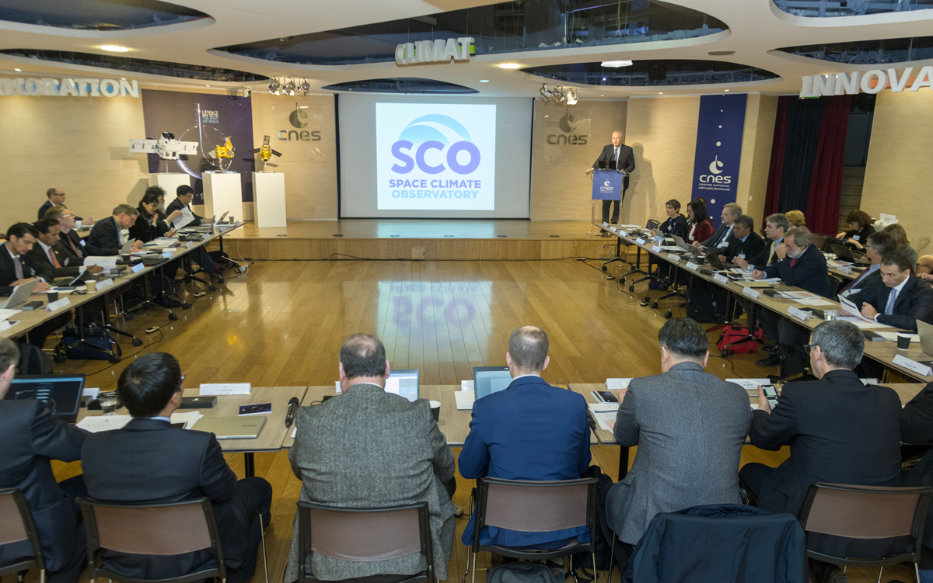
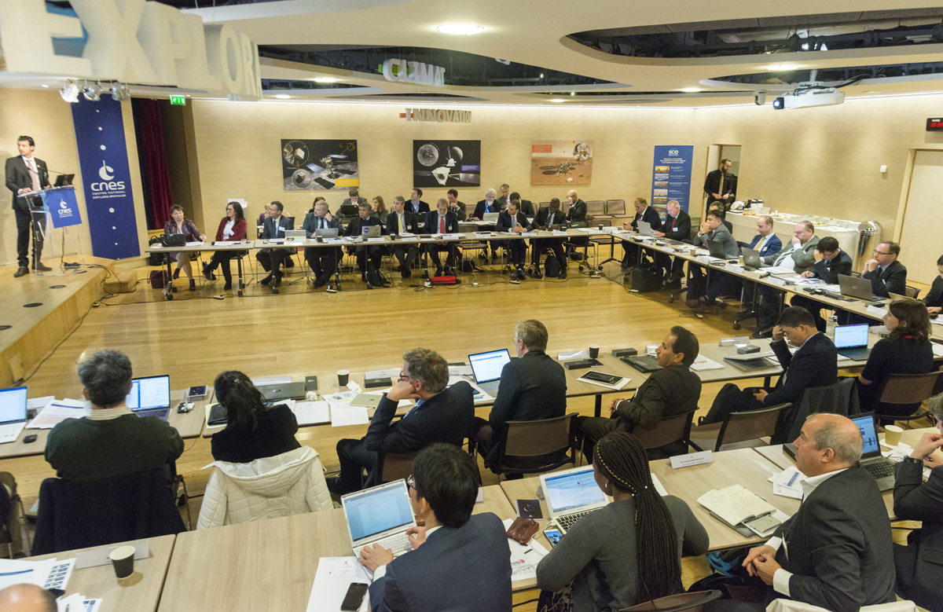
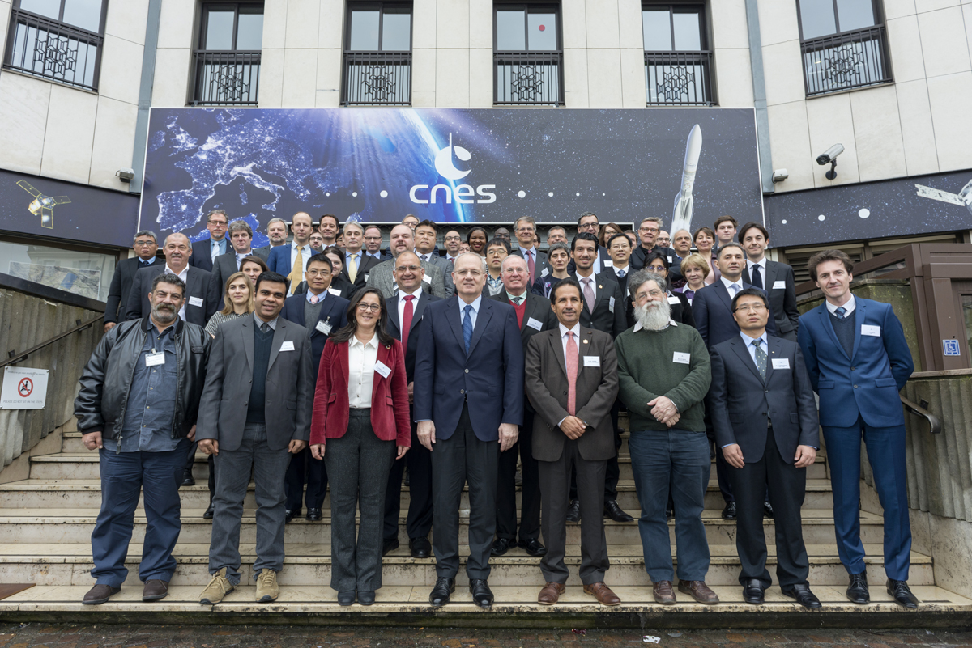
Space Climate Observatory
Space Climate Observatory Meeting Friday, 1st February 2019 - CNES, HQ, Paris
    Ceremony Signature of the SCO
    Joint Declaration of Interest, Biarritz
    August 24-27, 2019
    Set up of a Steering Committee
SCO 1st International Meeting – CNES HQ Paris, 1st February 2019
  SCO 1st International Meeting – CNES HQ Paris, 1st February 2019
  More than 50 participants from all over the world
  Representing more than 25 national space and national agencies, and 4 international organizations
  Very fruitful interactions which clearly demonstrates a common willingness to act together towards a common goal → joining forces and collaborating to address the monitoring of climate change impacts

Slide 18
Space Climate Observatory
Summary – Scope and perimeter
    Program definition document greatly appreciated
    The scope of SCO is now much clearer.
    The articulation of SCO with other international programs and initiatives is better understood (“pulling the same rope in the same direction”, “SCO really bridges a gap“, …)
    The focus on the climate change impacts (pillar 3 of the space-based architecture for climate monitoring) is highly appreciated ;
    It is recognized that there is a strong need to structure international collaboration on climate change impact monitoring
    Need to adopt the high-quality standards and guidelines that have ben developed (in particular in the frame of WG Climate for the production of the ECVs) for all information generated within SCO. Important for the credibility of the community and the consistency of the communication.

Slide 19
Space Climate Observatory
Summary – Scope and perimeter
    SCO seen as a very good way to bridge the gap between science and society, and to develop trans-disciplinary collaborative research and development (e;g. coupling environmental and socio-economic data)
    Essential to build upon local (e.g. traditional knowledge) / national expertise / tools / initiatives / infrastructures
    SCO could be a unique opportunity (“multiplier”) to “industrialize” or “replicate” local climate change impacts studies / initiatives and generalize them massively.
    SCO is seen as a means to also catalyze national coordination and effort on CC impacts;
    SCO is seen as a very good way to obtain more feedbacks from end-users, maximize the use of CDRs and gain insight into the needs for future space programs (e.g. develop of new indicators).
    Scope of SCO is wide and ambitious, in particular its communication and outreach component. Will need further discussions.

Slide 20
Space Climate Observatory
Summary – National experiences in CC impact assessments
Numerous National plans/strategies in place to understand, monitor and adapt CC impacts;
Contribution of spatial technologies/space capabilities in understanding Climate, for the management of natural resources (SDG goals)
Develop of indicators for decision making processes
Strong involvement of the research community in the development/validation/use of indicators;
Regional/national/local scales of key importance:
  key interests/requests from local stakeholders,
  Easier coordination (e.g. implementation of regional RI Datahub/platform)
  Ready to use applications (end-users requests);
  Methods and best practices transferable.
  Make best use of existing initiatives and programs related to impacts CC (e.g C3S)
Free and open data access promoted;
Interoperability : should use existing standards to be chosen between SCO members (like WMO...)

Slide 21
Space Climate Observatory
Summary - Implementation
    It is time for action : Base of the SCO implementation – not only politic
    Need to go fast but also step by step – not get locked wit chicken and eggs issues
    → Need prompt feedback on the SCO program definition document
    Everybody is invited within the next weeks to react to the draft declaration of interest that will be proposed just after this meeting.
    Contribution are based on existing programs and in kind participation at the start – This may evolve based on progress

Slide 22
Space Climate Observatory
SCO Concepts- SCO Users and Service
Technical Outcomes
  Improved multi-source data web-based access
    Free access to existing Data products generated outside the SCO
    Free access to Data products generated by the SCO and SCO Contributors
  Full description of Climate Change impact Case Studies performed
    Climate change impact descriptive sheets
    Open source code implementing the specifically designed impact study

Slide 23




Nairobi 8-10 March 2019 - 2nd Global Session of the
UN SCIENCE-POLICY-BUSINESS FORUM ON THE ENVIRONMENT
SCO Presented at the opening and closing of the 2nd SPB Forum Session
SCO Confirmed as a model project by the SPB Forum Data Working Group chaired
by Gilberto Camara (GEO)
GEO Secretariat proposed that SCO GEO Initiative (under evaluation) participates to
the GEO Knowledge Hub
Nairobi 8-10 March 2019
SCO Presented on the SPB Forum Stand with scenarios and use cases presented
SCO Presented on the World Situation Room Stand as an example of scientific & data input
Nairobi 14 March 2019
3rd Edition of the One Planet Summit
SCO cited by Arona Diedhiou (IRD) at the One Planet Summit as the main on-going project on
climate change impact together with Make Our Planet Great Again
Participation of Jean-Yves Le Gall in the French Presidential Delegation to represent the SCO
Arona Diedhiou (Climate Expert – IRD, IPCC) cited SCO as a Major Program on Climate Change Issues

Slide 24
Space Climate Observatory
SCO Concepts – SCO the international landscape
  Some preliminary feedbacks
  WG Climate Chair (CEOS-CGMS-GCOS) recommendations :
    that it might be advantageous if SCO were to address pillar 3 of the architecture, in order to enhance the uptake of CDRs into applications
  GCOS is pleased that it’s role has been recognised and requested that planned feedback mechanisms and the advisory role of GCOS be maintained (See Governance Part)
  WMO confirmed the finding from the WMO/EC earlier case studies that satellite data fulfils only parts of what is needed for applications. These original case studies done in 2013 should be seen as very embryonic, and maybe the SCO could be used to develop further and more detailed case studies of satellite applications for climate research/services

Slide 25
Space Climate Observatory
SCO Concepts – SCO the international landscape
From the perspective of WG Climate (October 2018), the SCO might become useful in the context of CEOS/CGMS if it were to:
  Focus on impact studies and the tailoring of the associated inputs, with a particular emphasis on the illustration/promotion of the use of CDRs, as well as (where appropriate):
    Identifying opportunities conditions for delivering further Climate Data Records
    Suggesting optimization of the planning of future satellite missions and constellations to expand existing and planned Climate Data Records
    Support GCOS in defining observational requirements for particular applications/services

Slide 26
Space Climate Observatory
Next steps
Signature of the Joint Declaration of interest open for signature from first week of April
Ceremony of the signature in Biarritz (25-27 August) next to G7 meeting
Set up the Steering Committee
    Improvement of the Program Definition Document
    Implementation Plan for the next two years
    Governance : put in place the different governing structures (General Assembly, Scientific – Users -Observers Committees).
    Develop concrete outputs (e.g. indicators and scenarios) in targeted areas and defined them as “proofs of concept” : pilot use cases
      Develop an “extensive” knowledge on impact case studies worldwide

Slide 27
Space Climate Observatory
SCO Concepts- SCO Users and Service
SCO Added-Value
  Key role of Earth Observation data (Satellite and in-situ)
    High resolution data, multi-missions data, ECV
    Expert tools and processing chains
    In-situ data
  Data, results and indicators produced from studies
    Study reports
    Specific indicators
  International coordination
    Facilitating agreements between different initiatives and partnership
    Methodology reproduced, adapted in quasi similar contexts
    SCO missions/objectives will be deployed in each country by national stakeholders through their dedicated infrastructure and organization
  An international shared Data portal
    Sharing input data, protocols, knowledge and processing methodology
    International dissemination – products and associated expertise
    Improving global knowledge and awareness about the impacts of CC – available to all

