Slide 1

Lessons learned from a-decade long GOSAT observations
Committee on Earth Observation Satellites
Akihiko KUZE
(Earth Observation Research Center, Japan Aerospace Exploration Agency)
CEOS WGClimate
Marrakech, Morocco
March, 2019

Slide 2
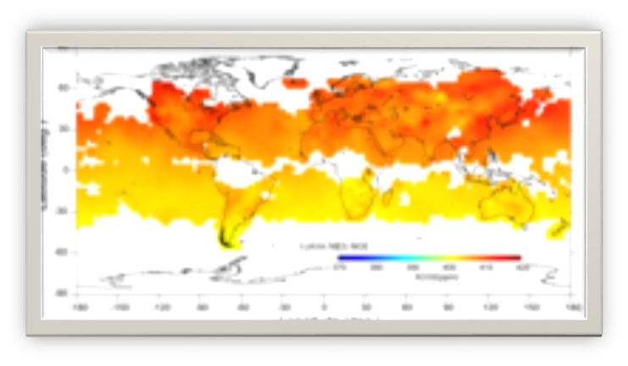
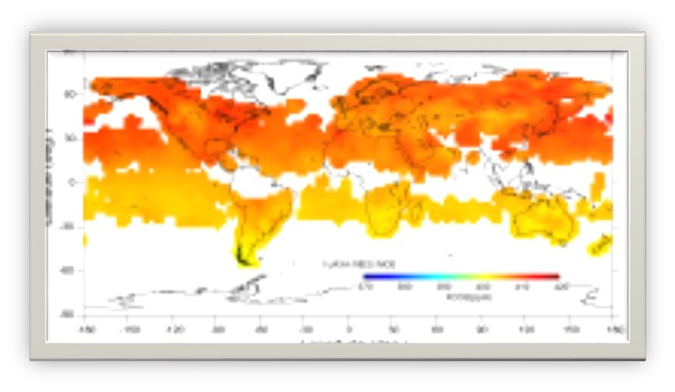
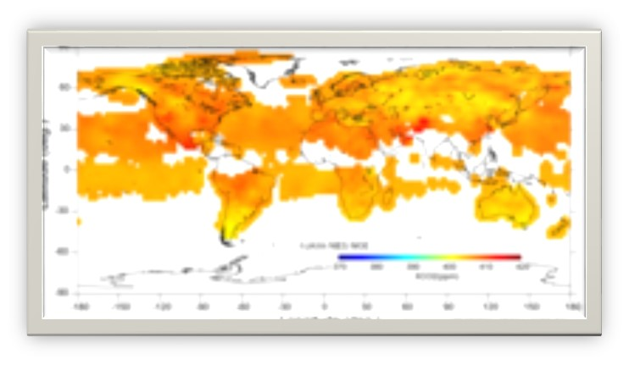

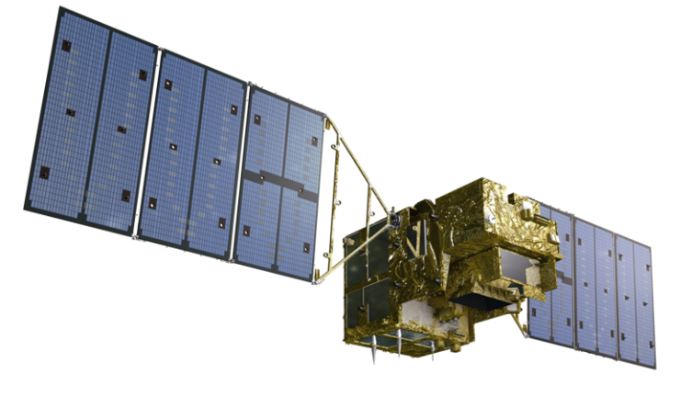
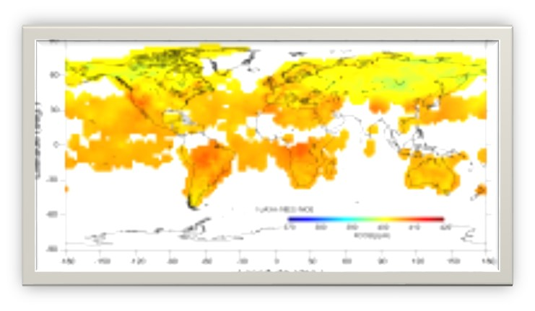
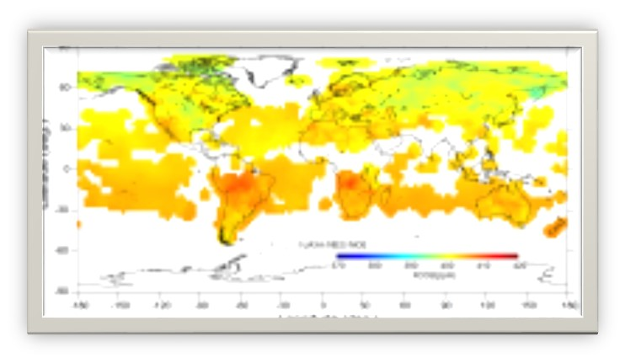
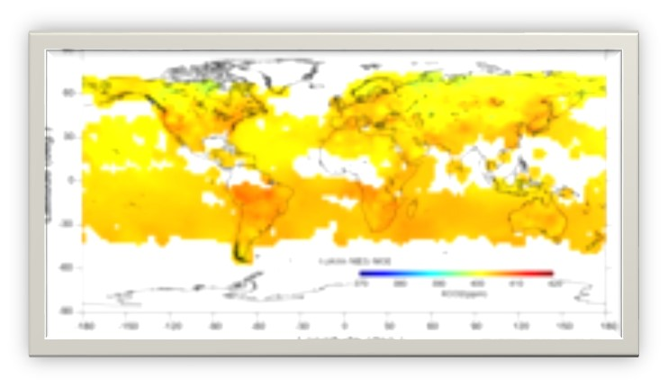
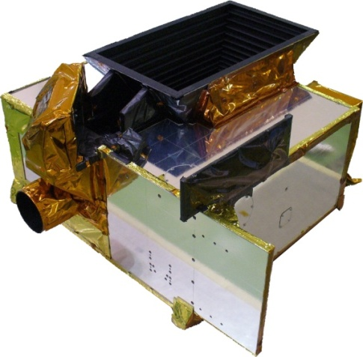
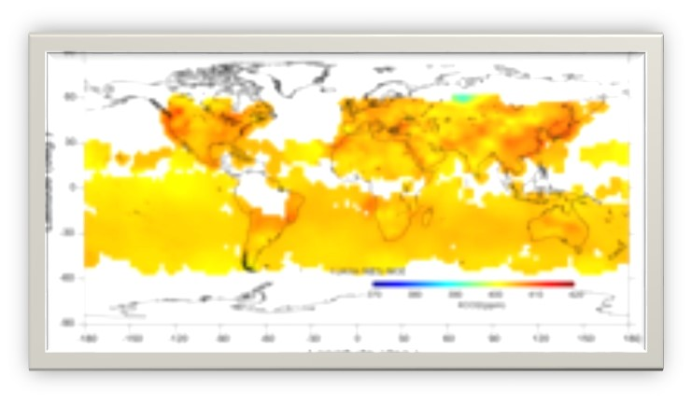
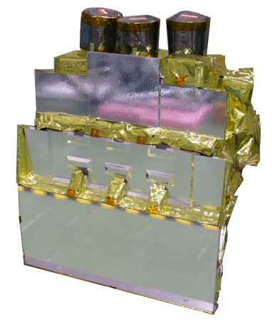


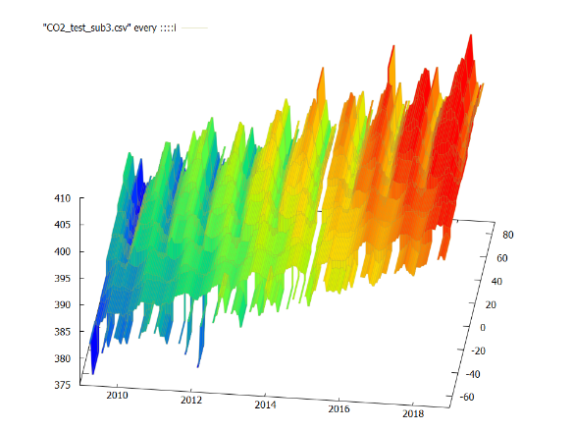
Decade-long Observation by GOSAT
10th anniversary on Jan. 23, 2018
GOSAT & GOSAT-2 Organization
  GOSAT is the joint project of JAXA, MOE (Ministry of the Environment) and NIES (National Institute for Environmental Studies).
MOE
JAXA
Thermal And Near infrared Sensor for carbon Observation
TANSO-FTS
SWIR/TIR FTS
TANSO-CAI
Sensor development
Satellite development
H-IIA launch
Satellite operation
Data acquisition
Calibration
UV, Visible, SWIR Imager
Global CO₂ density
NIES
  Algorithms development
  Data use for science
  Validation
2
https://data2.gosat.nies.go.jp/gallery/fts_l3_swir_co2_gallery_en.html

Slide 3
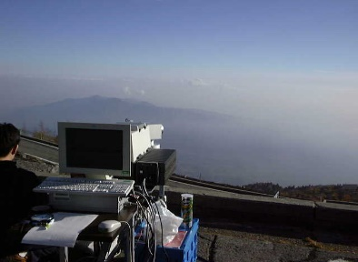
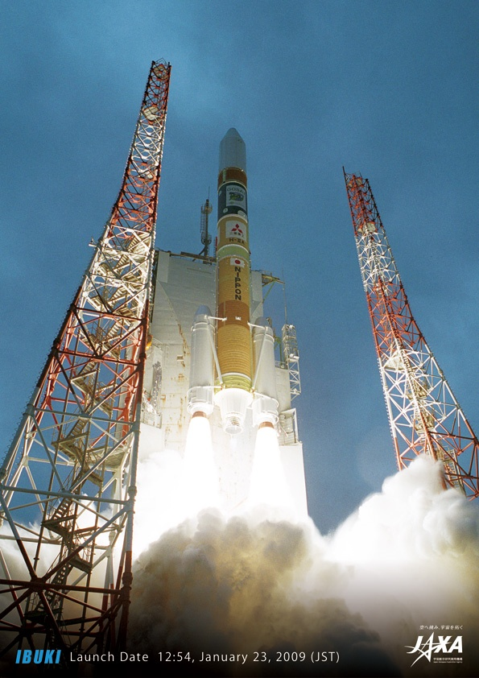
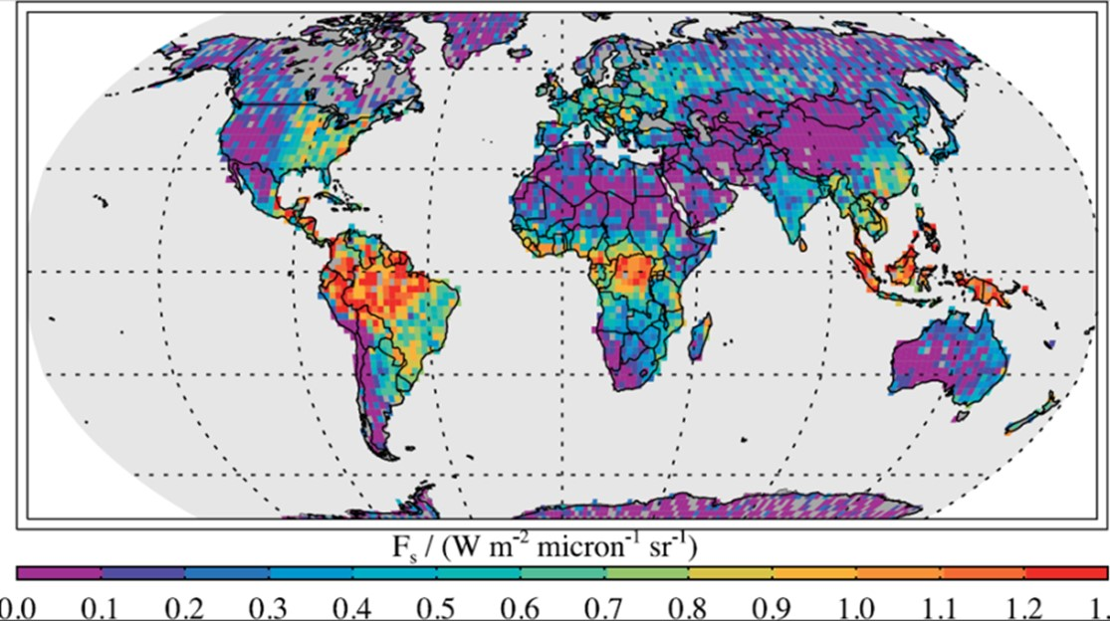
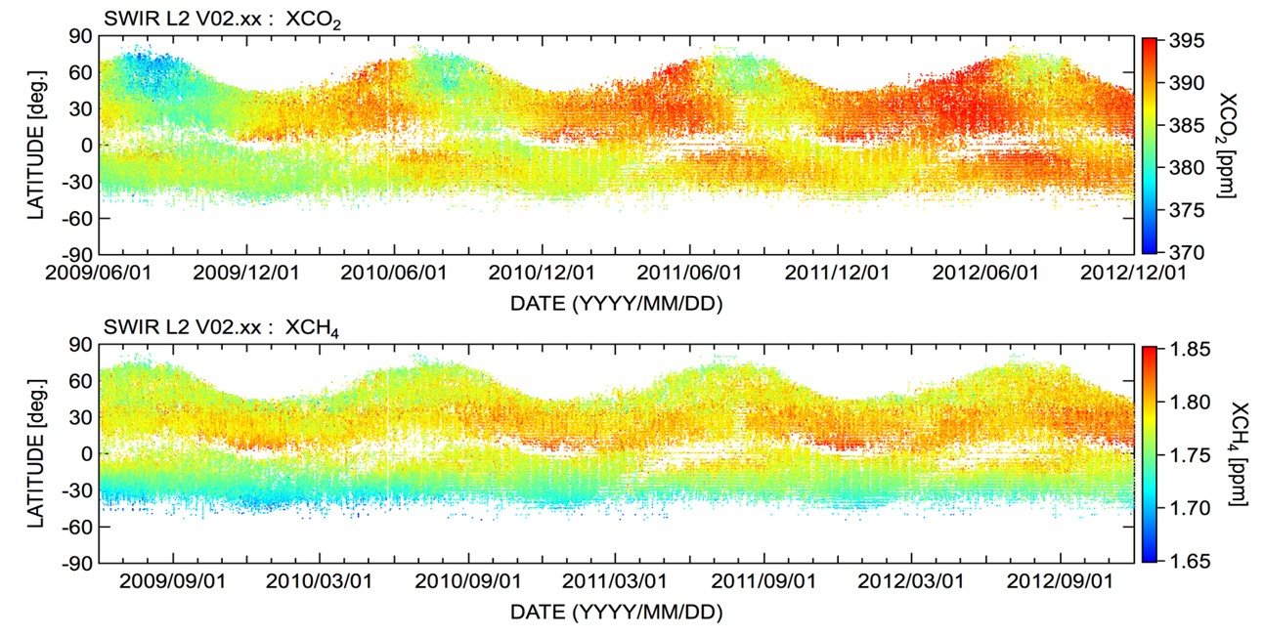
Before 2009 GOSAT Launch
The first 5 years in space 2009 – 2014 design life
1997
The Kyoto Protocol at COP 3, GHG observation by a laboratory FTS
2003
GOSAT project started
2009
The Greenhouse Gases Observation Satellite
“IBUKI” (GOSAT) is the world’s first spacecraft to measure the concentrations of carbon dioxide and methane, the two major greenhouse gases, from space.
2009, June Frankenberg et al., GRL 2011
2011
The accuracy of 2 ppm or 0.5% for CO₂
and 13 ppb or 0.7% for CH₄
Chlorophyll Fluorescence measurement from Space
2014
GOSAT 5-year design life
Fully redundant system
(by Y. Yoshida (NIES))
3

Slide 4
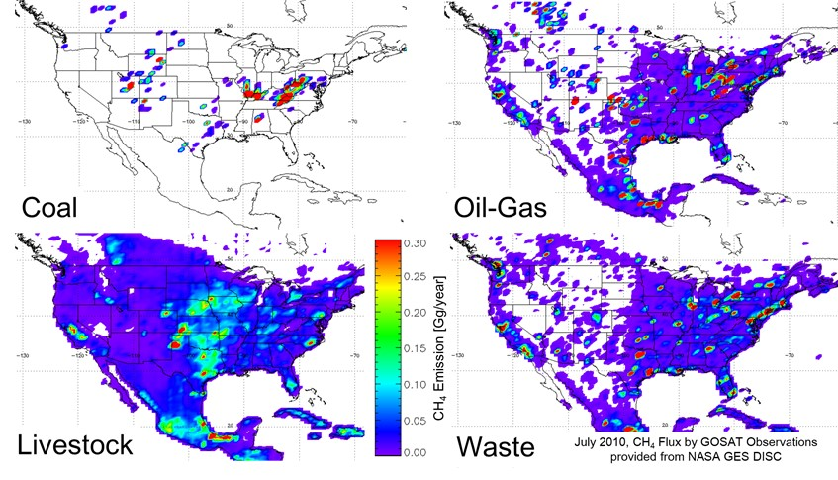
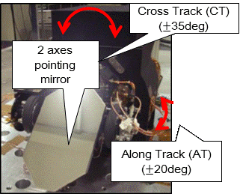
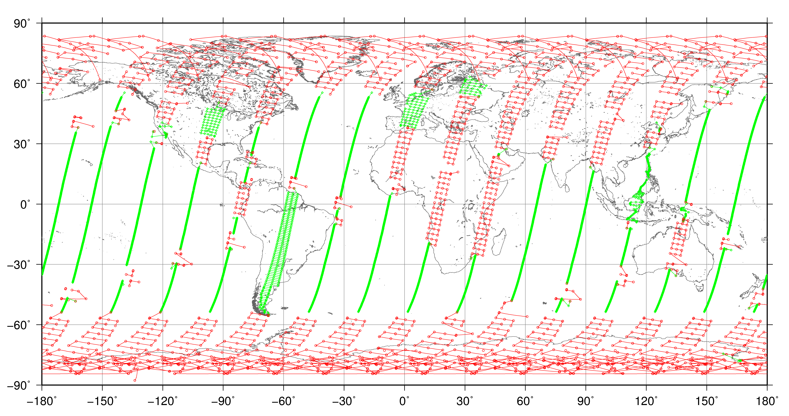
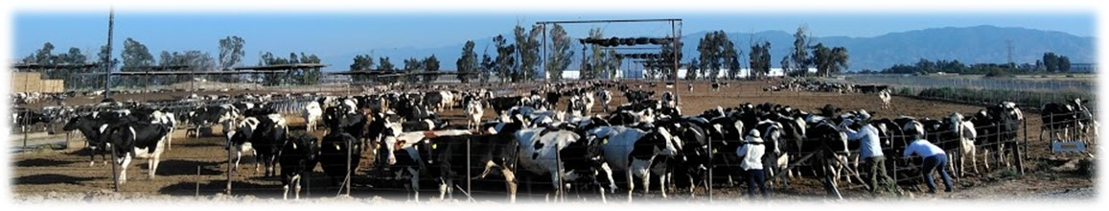
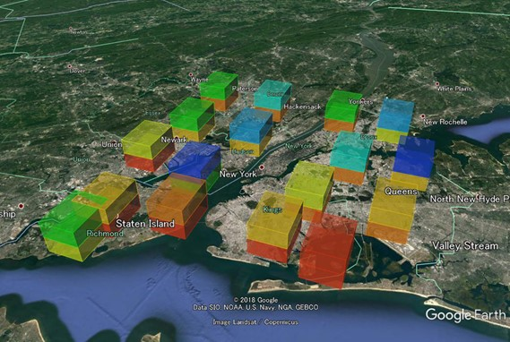
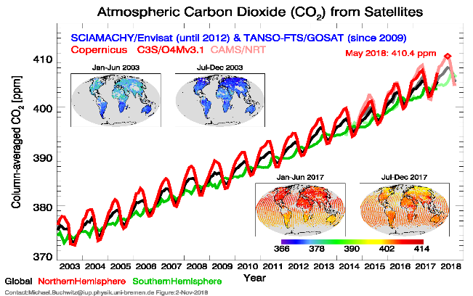

The next 5 years in space
2014 – until now
2015
60
With GOSAT
2016
The Carbon Monitoring System (CMS) CH₄ Flux for North America data set contains estimates in North America based on an inversion of the GEOS-Chem chemical transport model constrained by GOSAT.
US CH₄ Emission (inventory vs. GOSAT)
EDGARv4.2 (Model), the 2012 EPA inventory (EPA, 2014) and GOSAT (Turner et al., 2015, ACP)
July 2010
https://mirador.gsfc.nasa.gov/
2017
Targeting CH₄ large emission source and mega cities with an agile pointing system by uploading the pointing-angle table every day.
2019
CO₂ partial column density 17 targets per orbit
Dec 27, 2017 New York City
An ensemble of SCIAMACHY/ENVISAT (until April 2012) and TANSO-FTS/GOSAT (since mid 2009)(Buchwitz et al.)
4
Buchwitz et al.
North American CH₄ emissions using prior information on source locations

Slide 5


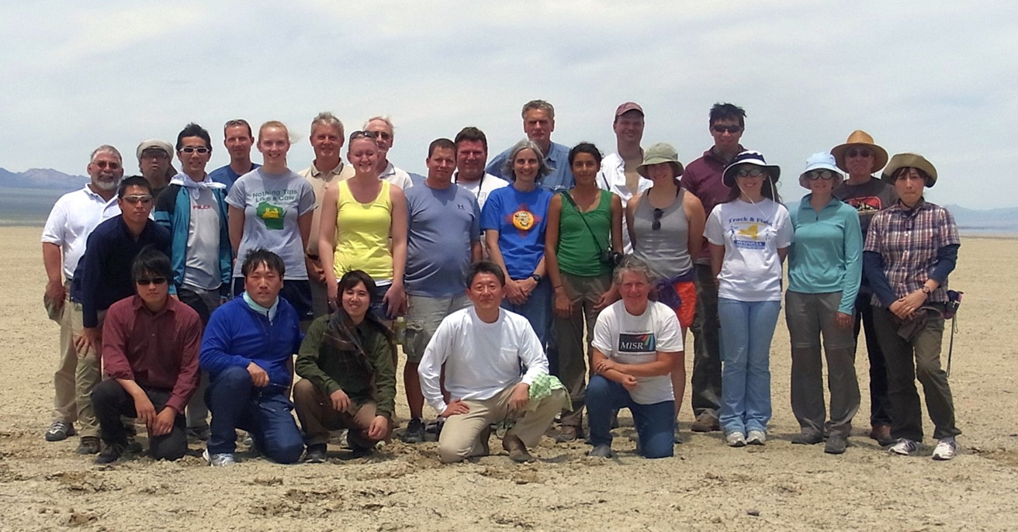
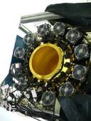
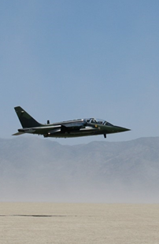
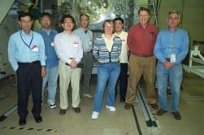
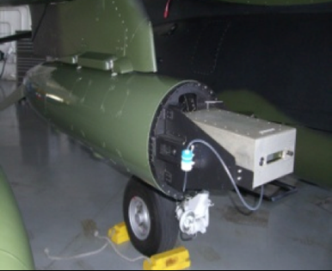
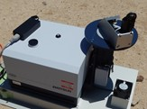
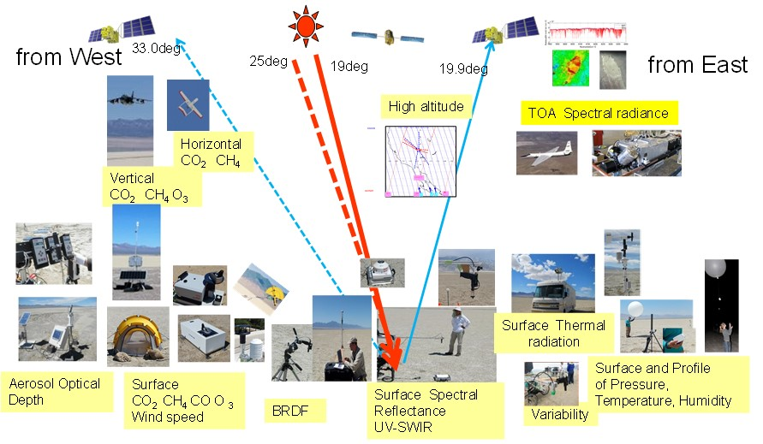
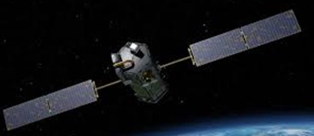
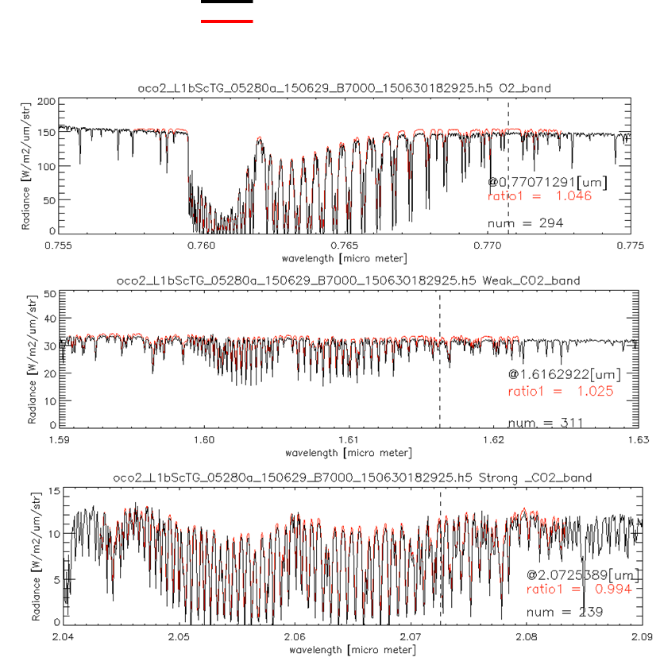
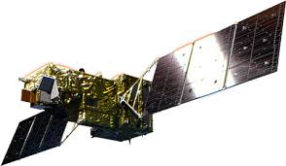

Inter comparison
GOSAT, GOSAT-2, OCO-2, OCO-3
2008 09 10 11 12 13 14 15 16 17 18 19
Radiometric calibration
Prelaunch
X-CAL
Annual Vicarious Calibration at the desert playa in Nevada
CO₂ & CH₄ profile
In situ CO₂ and CH₄ on AJAX
XCO₂ & XCH₄
Column with EM-27 FTS
Coincident Target
GOSAT OCO-2
Calibrated GOSAT and OCO-2 radiance spectra agrees within 5% for all bands.
5

Slide 6
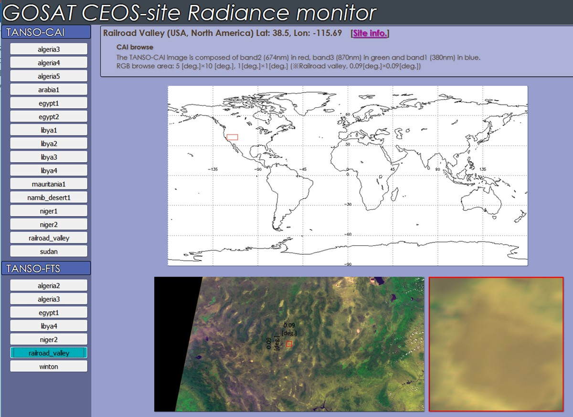
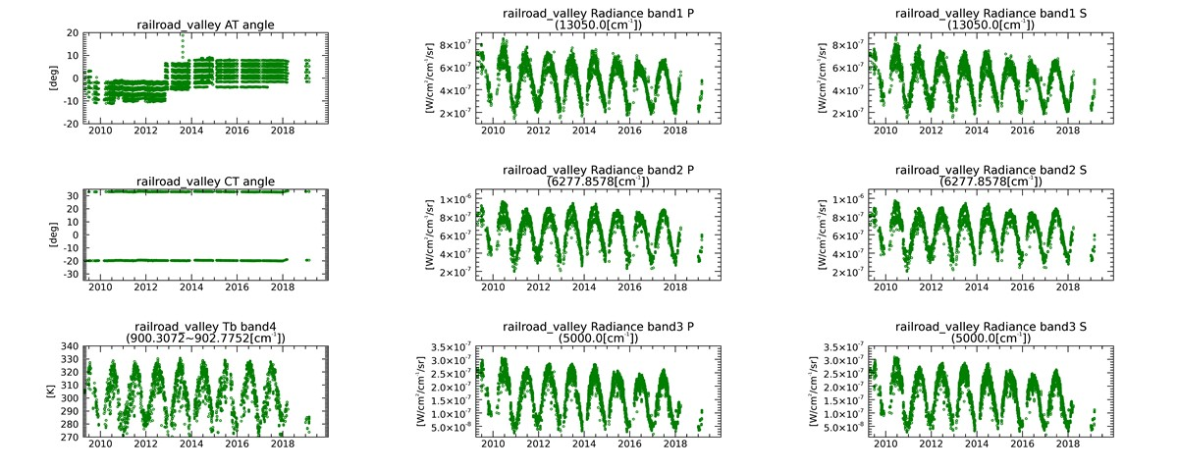
A Decade long GOSAT radiance spectra data over CEOS calibration sites
https://www.eorc.jaxa.jp/GOSAT/CEOS_monitor/
6

Slide 7

XCO₂ Scatter plots of ACOS GOSAT (B7) - OCO-2
and time dependency of their difference
(a) ± 3.33 ppm
(b) ± 1.48 ppm
(c)± 2.79 ppm
The time series of $∆$ XCO₂ from Sep. 2014
2014/09～2016/05 XCO₂ Level2 matchup
Agreement: (ACOS-GOSAT B7.3 vs. OCO-2 B7)
< 0.57 ppm over Land (high gain) Error probably due to ono-flat Topography
< 0.17 ppm over Ocean
< 0.19 ppm over Land (desert)
Kataoka et al. (2017) MDPI
7

Slide 8
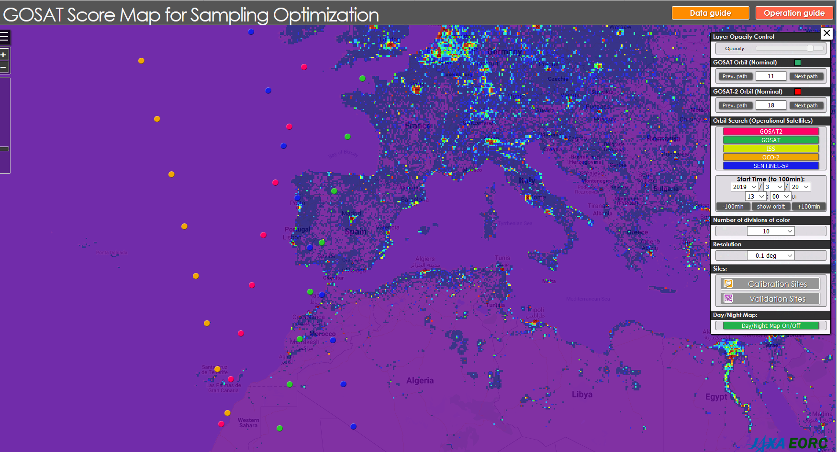
GHG Satellites Constellation
as of UT12, March 20, 2019
GOSAT, GOSAT-2, Sentinel 5, OCO-2, TanSat, ISS
8
ODIAC CO₂ emission source map and Calibration and Validation site
https://www.eorc.jaxa.jp/GOSAT/GOSAT_Optimization/index.html

Slide 9
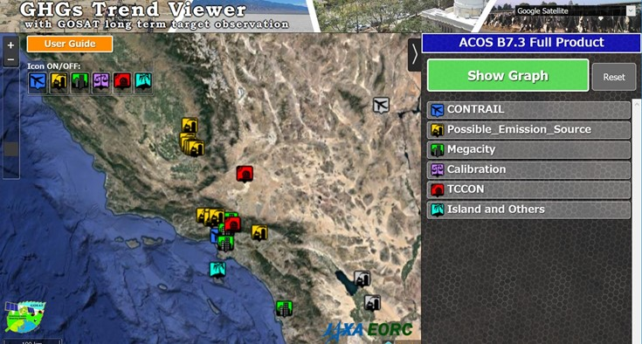



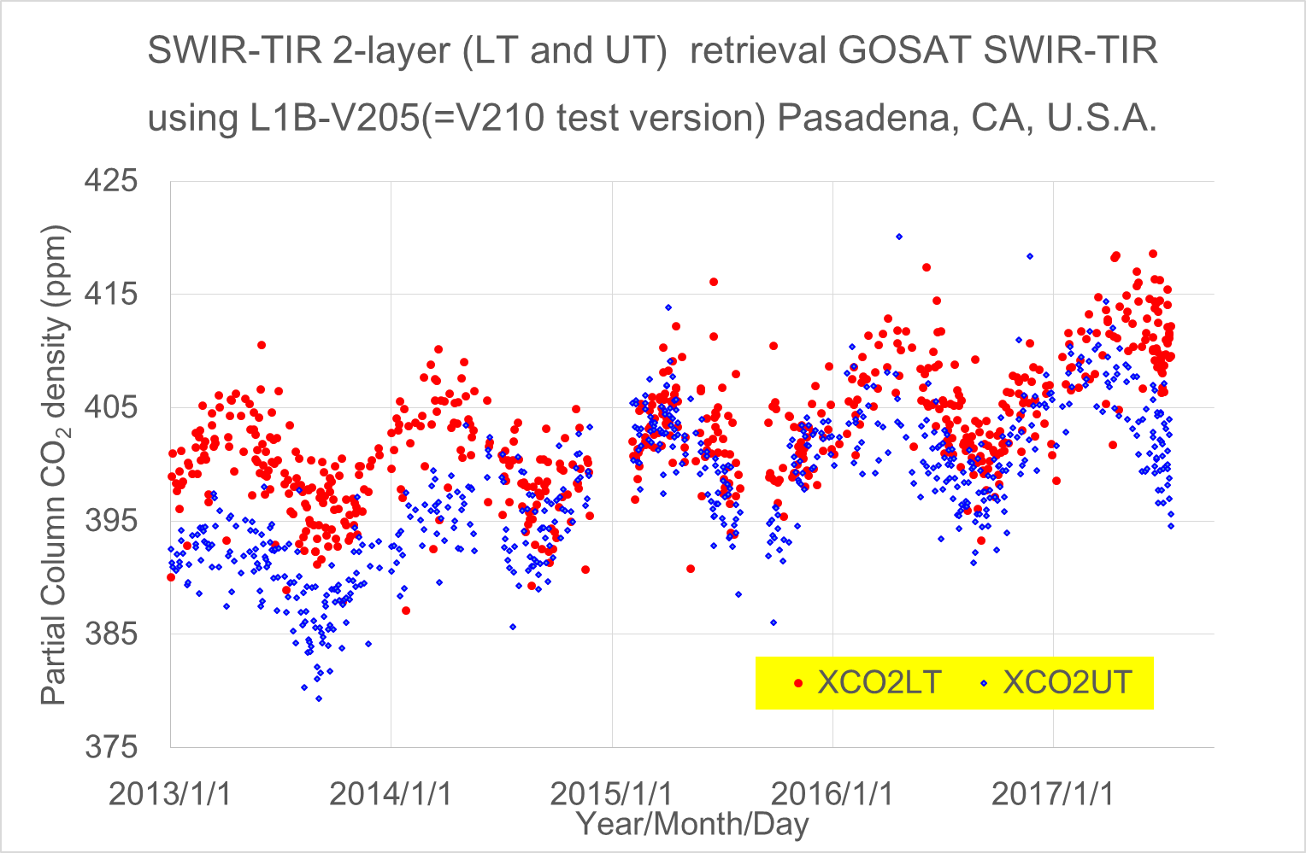
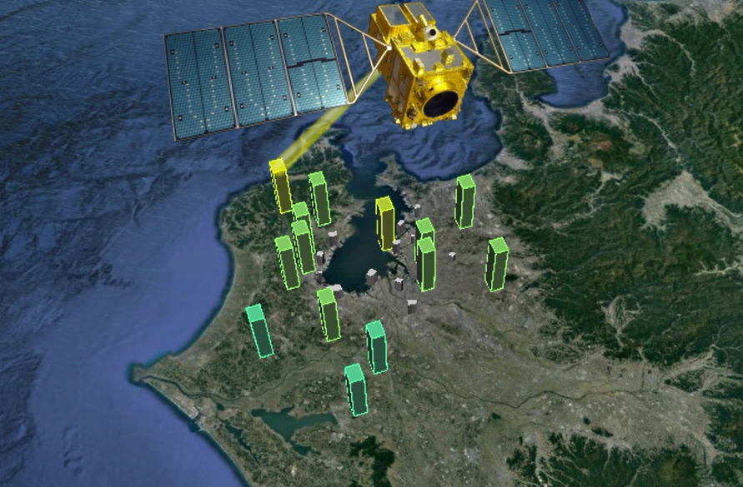
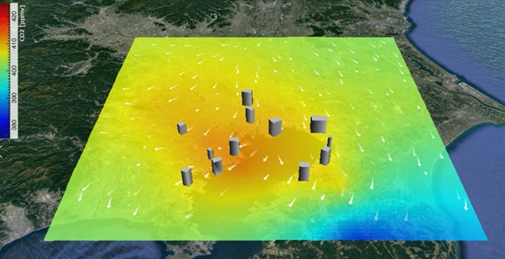
A decade long dataset and new research products http://www.eorc.jaxa.jp/GOSAT/product.html#trendviewer
GOSAT measures both solar reflected light from the Earth’s surface (SWIR) and thermal emission from the Earth’s atmosphere (TIR) providing CO₂ partial-column densities of UT and LT.
Upper Troposphere (UT)
http://www.eorc.jaxa.jp/GOSAT/CO2_moitor/index.html
long-term trend data of the selected targets, including the large point sources of methane (CH₄) and intensive observations of selected mega cites.
Lower Troposphere (LT)
Local Emission
9

Slide 10

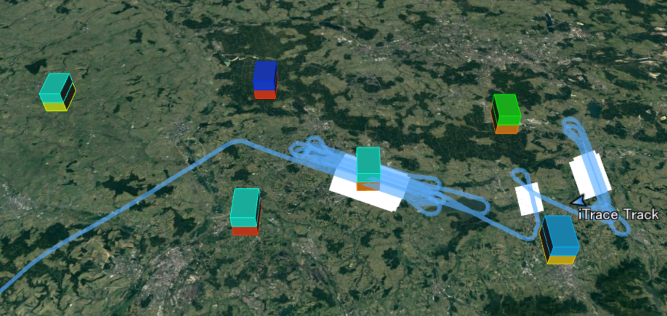
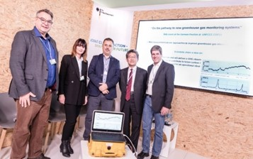
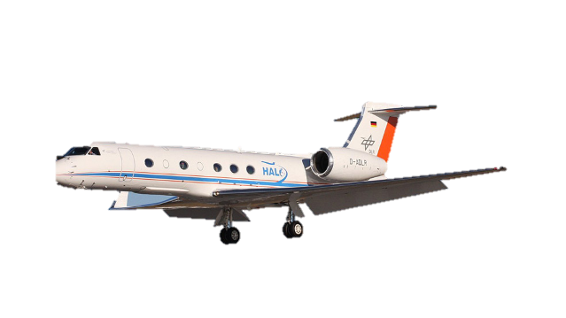
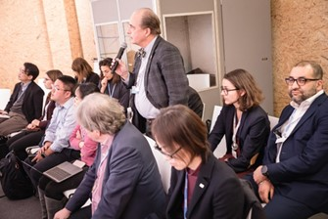
DLR-JAXA Joint CoMet 2018 Campaign
and Joint COP 24 Presentation
Comet coincident flight with GOSAT over Silesian Coal Mine on June 6, 2018 GOSAT targeted 6 points and captured whole emissions that spread horizontally and vertically from 666 km.
Joint presentation “On the pathway to new greenhouse gas monitoring systems” in the side event at the German Pavilion at UNFCCC COP24 on Dec. 6, Katowice, Poland
wind
Target-1
Target-2
KATOWICE
Target-3
1.93 ppm
Target-4
1.95 ppm
Target-6
1.98 ppm
Target-5
Joint team demonstrated direct CH₄ emission estimation from Silesian Coal Mine using GOSAT partial column density of lower Troposphere.
Courtesy of Friedemann Call, DLR
10

Slide 11
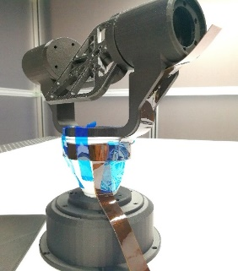
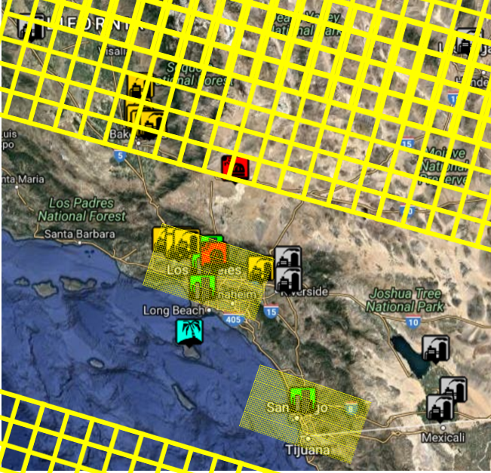
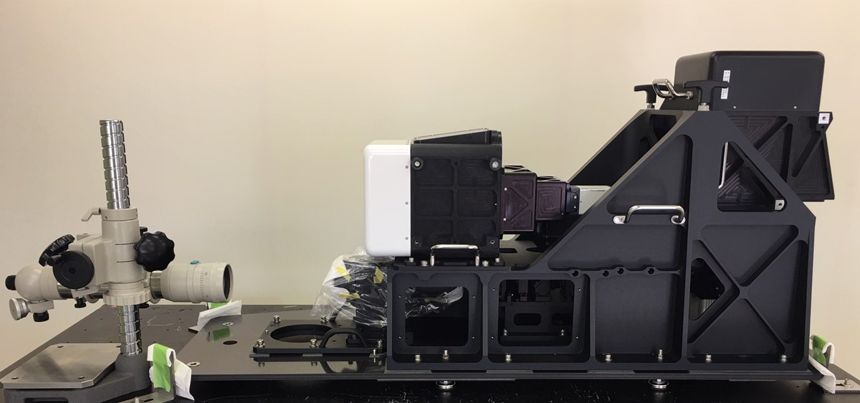
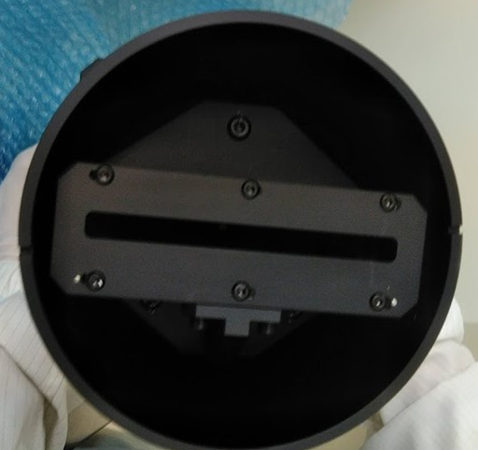
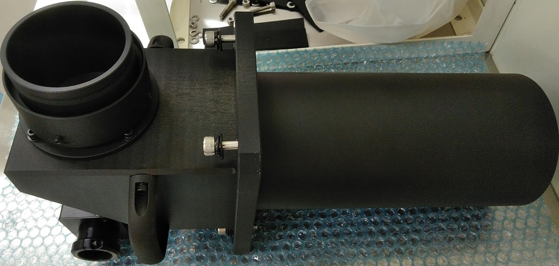
Air-bone demonstration model
Combination of staring and coverage
Survey entire earth’s surface
Selecting Proper reference
Staring
1 km resolution will enhance dCO₂ and dCH₄
Image can detect plume and has closer reference
Estimate plume direction
0.76 µm surface pressure, cloud height and solar induced chlorophyll fluorescence
1.6 µm for CO₂, CH₄
2-axis pointing system
survey mode
IFOV = 28 km
0.47 µm for
NO₂
staring mode
IFOV = 1 km
survey mode
IFOV = 28 km
Survey mode
Staring mode
11

Slide 12
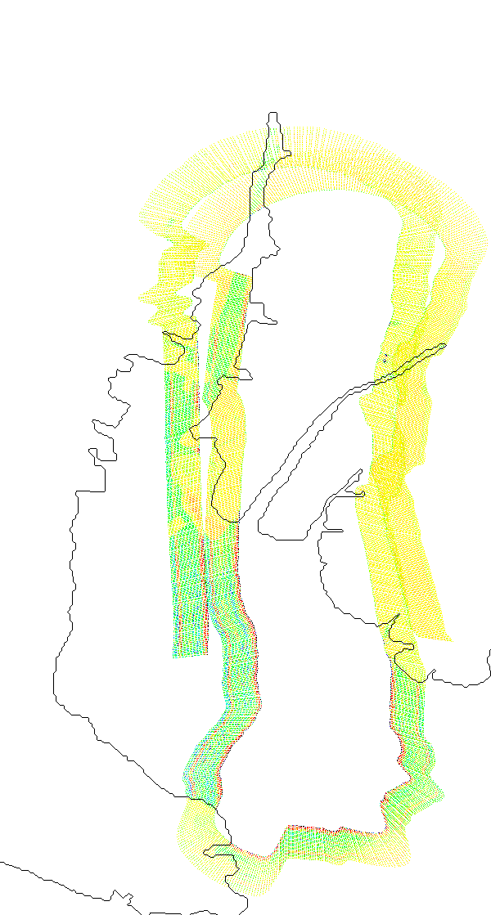
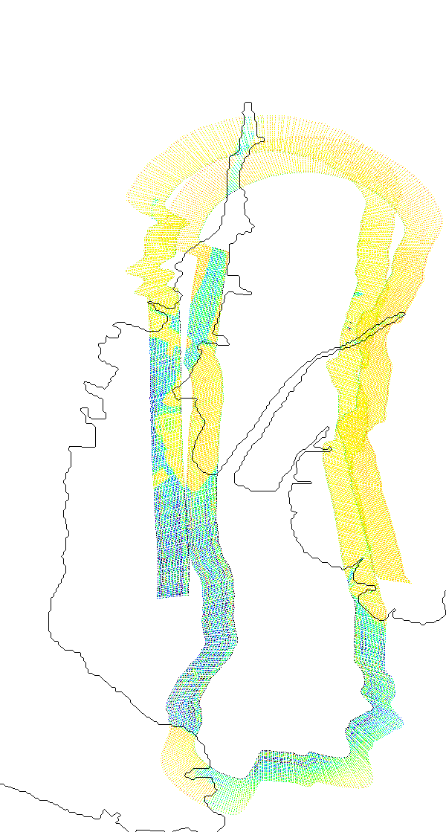
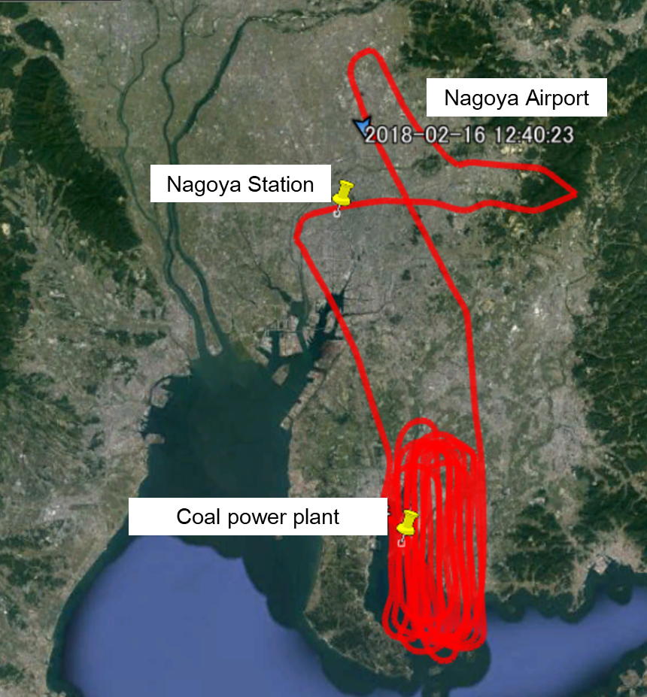


To demonstrate local flux estimation from different source sectors
Feb 2018 flight over greater Nagoya
CO₂
CH₄
Large CO₂ emission sources, including a coal power plant and the transportation sector, and possible CH₄ sources from agriculture, energy manufacturing, and waste that are geographically mixed.
12

Slide 13






CEOS AC-VC TOKYO 2019
Nakano Sun Plaza (conference and hotel)
CEOS AC-VC TOKYO 2019
June 10 (Mon) GHG June 11-12 (Tue-Wed) AQ
https://www.sunplaza.jp/en/

