Slide 1



FCDR / CDR / ICDR Introduction
Earth Observation and Space
Department of Meteorology
Christopher Merchant
Department of Meteorology
University of Reading

Slide 2
Context
Presented last year was a Proposed Definition and Guidance for Fundamental Climate Data Records (FCDR)
Need an agreed definition to help CEOS/CGMS agencies shape their programmes for archiving, reprocessing and disseminating Level 1 data in support of climate programmes
Decisions last year were
  Consult more widely and WG Climate to reflect
  Extend text to give option coherent on CDR and interim CDR definitions
  Return with updates for decision and recommendation at this meeting

Slide 3
UPDATE
Consultation on the FCDR definition and guidance
  Primarily through 1st FIDUCEO workshop in Lisbon (May 2018)
    Session on the definition/guidance with international participation
  Comments also solicited online (open invitation) and from WG climate
Workshop recommendations were implemented and definitions usefully refined
  Including distinction of FDR / FCDR idea
CDR and ICDR definitions have been proposed for this meeting, along similar lines to FCDR

Slide 4


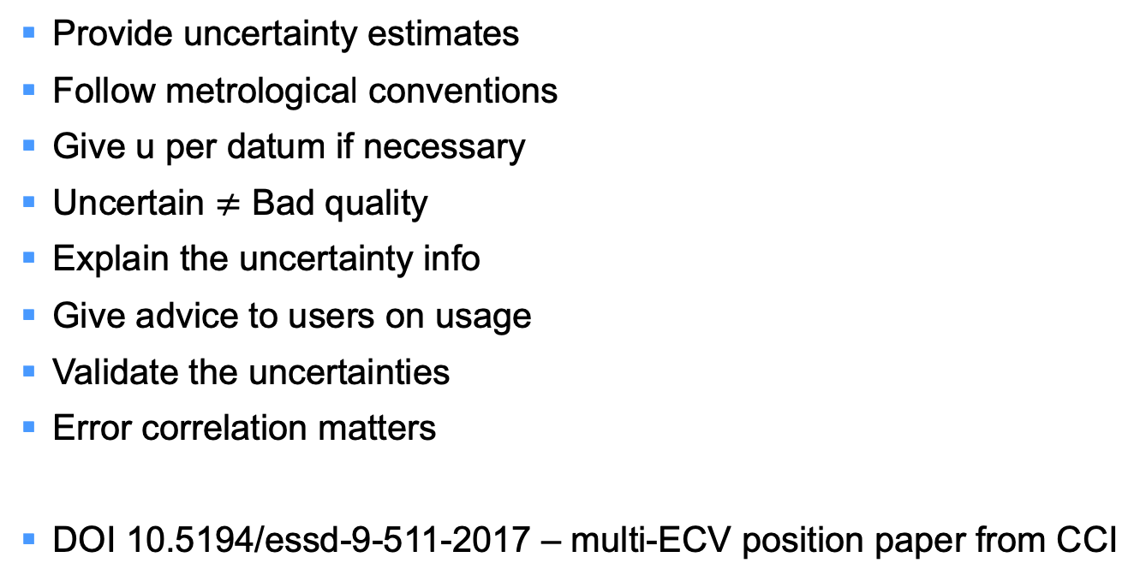
Uncertainty recommendations for CDRs
Provide uncertainty estimates
Follow metrological conventions
Give u per datum if necessary
Uncertain $≠$ Bad quality
Explain the uncertainty info
Give advice to users on usage
Validate the uncertainties
Error correlation matters
DOI 10.5194/essd-9-511-2017 – multi-ECV position paper from CCI
Notes:
As I mentioned, this talk won’t address uncertainty estimation for CDRs, but if you are interested please look at this paper which came out in. It emerged from looking at uncertainty issues across several different climate variables within the ESA climate change initative – covering aerosol, sea level, land cover classification, greenhouse gases, and several more including sea surface temperature, which is the CCI project Chris leads.
Reaching a common position on representing uncertainty in climate data records addressing these different types of climate variable involved a lot of debate, over quite a few years. But it turned out to be possible, and 8 Good Practice principles emerged, which are given in summary form on the left. Although framed in terms of climate data records, in fact, these principles are arguably relevant to all quantitative Earth observation.
The recommendations cover several obvious things such as “provide uncertainties” and “if the uncertainty in a product varies significantly, provide the uncertainty (or the means to derive it) for every datum in the product”. Some are a little less obvious and emerged after a lot of debate, such as the clarification of the distinction between uncertainty and quality – if you have a datum with relatively high uncertainty BUT you have been able to give a valid estimate of that uncertainty, then that pair of information – datum and its uncertainty – is still a “good” observation, in the sense that the observation is perfectly valid – high uncertainty is distinct from low bad quality IF you know what the uncertainty is. And this raises the other point that, if we are generating uncertainty estimates, then we also need to validate the uncertainty estimates as well as the data themselves.
If you are involved in creating EO-based products and haven’t got into providing the uncertainty information that should go with the data yet, we’d encourage you to take a look and see what is relevant to you in this paper.
However, for the purposes of the talk today, note that there is one very obvious thing missing from these 8 good practice recommendations – a principle we SHOULD have been able to list, but COULDN’T. It is this : to help you create the most realistic possible model for uncertainty in your product, you should propagate the uncertainty information in your input data through your processing chain. CDR producers couldn’t respond to such a principle at present, because usually the L1 data doesn’t provide adequate uncertainty information to work on. By creating uncertainty quantified FCDRs and then showing how that helps provide uncertainty information in the CDR, we hope the FIDUCEO project will advance the state of the art.
Ultimately, we want to see space agencies transform their thinking so that they see providing proper uncertainty information at L1 as a core part of their practice – and Chris will be giving a talk on the challenges of that idea tomorrow afternoon.

Slide 5
Raw satellite data (L0)
Calibrated radiances (L1, FCDR)
Climate index / information
Climate data record (L2, CDR)
Gridded CDR (L3, CDR)
Analysed / processed (L4+, CDR)
Liability
Insurance
Decision
Each transformation injects new uncertainty
Uncertainty from low-level data propagates
to high-level information

Slide 6
APPROACH TAKEN
Preamble – context (including the EO context of the definitions)
Short definition – quotable
Longer interpretation and guidance – necessary to explain the implications

Slide 7
SHORT DEFINITIONS
Fundamental Data Record : An FDR consists of a consistently reprocessed record of uncertainty-quantified sensor observations that are calibrated to physical units and located in time and space, together with all ancillary and lower-level instrument data used to calibrate and locate the observations and to estimate uncertainty.
Fundamental Climate Data Record : An FCDR consists of a long, stabilised record of uncertainty-quantified sensor observations that are calibrated to physical units and located in time and space, together with all ancillary and lower-level instrument data used to calibrate and locate the observations and to estimate uncertainty.
Climate Data Record : A climate data record consists of a long, stabilised record of uncertainty-quantified retrieved values of a geophysical variable relevant to Earth’s climate, together with all ancillary data used in retrieval and uncertainty estimation. The CDR is linked to (an) underlying fundamental climate data record(s).
Interim Climate Data Records : An interim climate data record is a seamless extension in time of a climate data record, in the processing of which a stated level of inconsistency [with the underlying CDR] is present as necessary to meet the required timeliness.

