Slide 1

Importance to Produce the Interim Climate Data Record (ICDR) for the Space-based Weather and Climate Extremes Monitoring (SWCEM) through Lessons Learned from its Demonstration Project (SEMDP)
WMO Initiative for Space-based Weather and Climate Extremes Monitoring
from Demonstration to Operation
Toshiyuki Kurino
WMO Space Programme

Slide 2
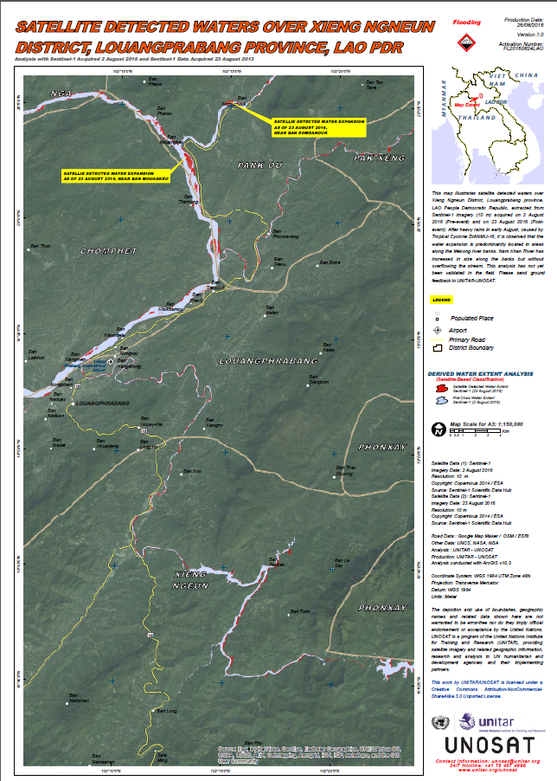
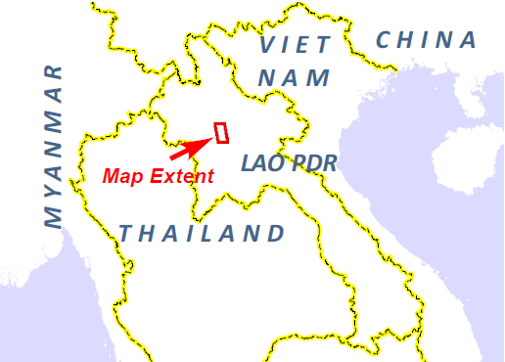

UNOSAT Report
Satellite Detected Waters over Xieng Ngneun District, Louangprabang Province, Lao PDR
This map illustrates satellite detected waters over Xieng Ngneun District, Louangprabang province, LAO People Democratic Republic, extracted from Sentinel-1 imagery (10 m) acquired on 2 August 2016 (Pre-event) and on 23 August 2016 (Post-event).
After heavy rains in early August, caused by Tropical Cyclone DIANMU-16, it is observed that the water expansion is predominantly located in areas along the Mekong river banks. Nam Khan River has increased in size along the banks but without overflowing the stream.
Satellite Data (1): Sentinel-1
Imagery Date: 2 August 2016
Imagery Date: 23 August 2016
Resolution: 10 m
Copyright: Copernicus 2014 / ESA
Source: Sentinel-1 Scientific Data Hub
http://www.unitar.org/unosat/node/44/2448?utm_source=unosat-unitar&utm_medium=rss&utm_campaign=maps

Slide 3
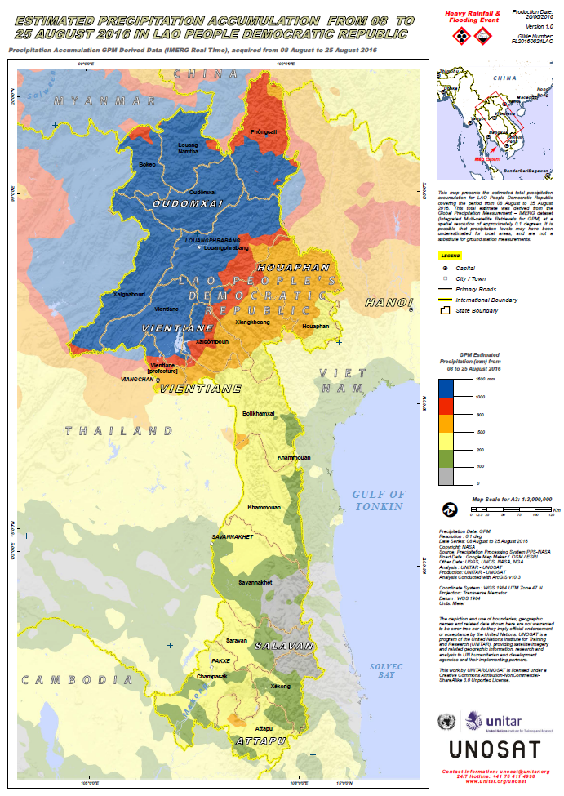
UNOSAT Report
Estimated Precipitation Accumulation from 08 to 25 August 2016 in Lao People Democratic Republic
This map presents the estimated total precipitation accumulation for LAO People Democratic Republic covering the period from 08 August to 25 August 2016. This total estimate was derived from the Global Precipitation Measurement – IMERG dataset (Integrated Multi-satellite Retrievals for GPM) at a spatial resolution of approximately 0.1 degrees. It is possible that precipitation levels may have been underestimated for local areas, and are not a substitute for ground station measurements.
http://www.unitar.org/unosat/node/44/2447?utm_source=unosat-unitar&utm_medium=rss&utm_campaign=maps

Slide 4
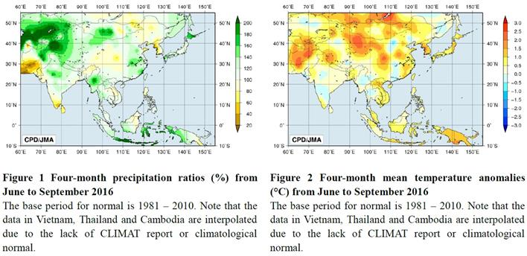

Slide 5
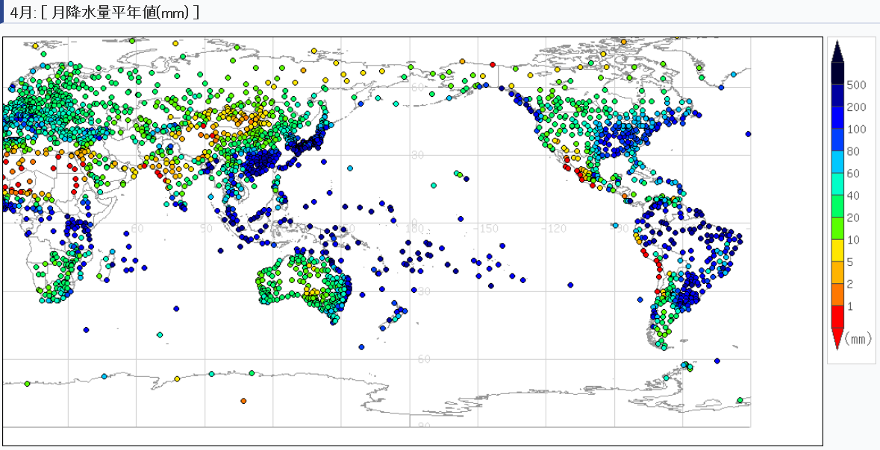
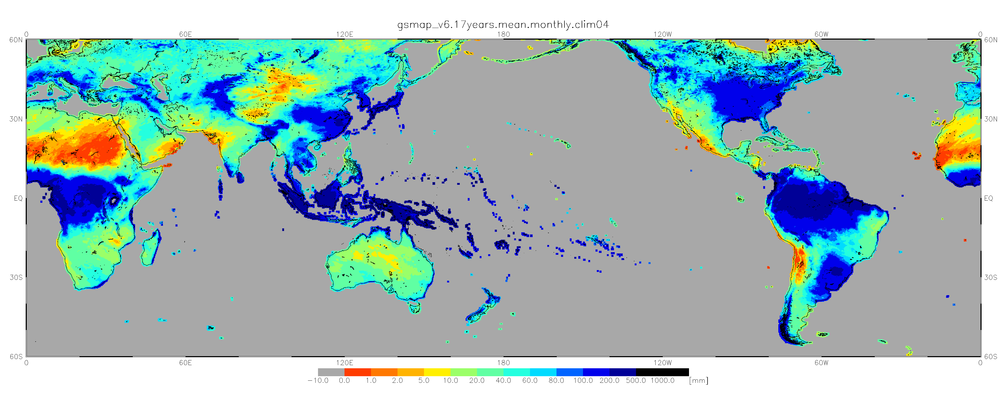
Monthly Mean Precipitation (mm) in April - CLIMAT (30-year mean) vs GSMaP (17-year mean)
JMA CLIMAT Viewer: http://www.data.jma.go.jp/gmd/cpd/monitor/climatview/frame.php?&s=1&r=0&y=2015&m=4&e=7&t=22&l=87&k=0&s=1
through the courtesy of JAXA/EORC

Slide 6
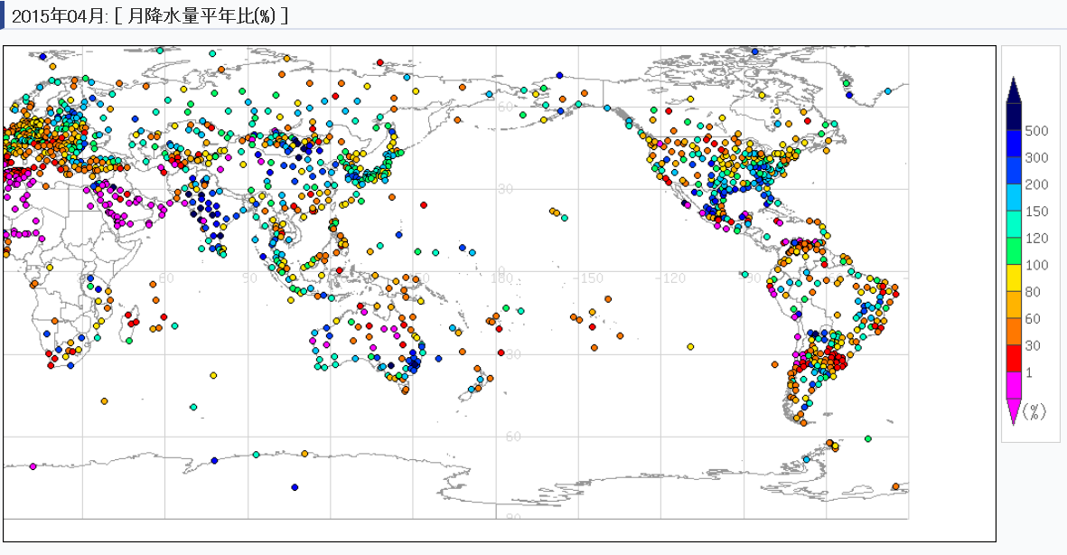
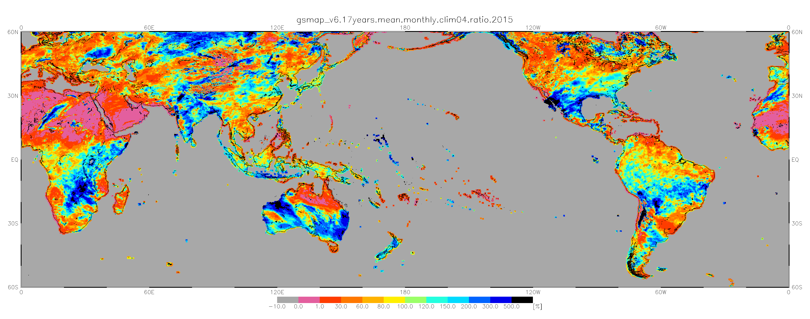
Monthly Mean Precipitation ratio (%) in April, 2015 - CLIMAT (30-year normal) vs GSMaP(17-year normal)
JMA CLIMAT Viewer: http://www.data.jma.go.jp/gmd/cpd/monitor/climatview/frame.php?&s=1&r=0&y=2015&m=4&e=5&t=22&l=87&k=0&s=1
through the courtesy of JAXA/EORC

Slide 7

Satellite Operators are contributing to Climate Extremes Monitoring by producing TCDRs and FCDRs
GAP !!
WMO Regional Climate Centres (RCCs) will not use satellite estimation of rainfall for extremes monitoring monthly basis in operation

Slide 8
It would be challenging for satellite operators to produce satellite-derived products for climate monitoring and diagnostics in operation, based on the deviation analysis with “climate normal” of 30years through re-processing!!!
Expectations for low latency (less than 1 day), long term (more than 20 years record), high spatial resolution (less than 0.1 degrees), low bias with rain gauge observation, gridded, and covered most global land regions makes it challenging, not only for satellite operators to produce, but also for RCCs to utilize satellite estimations in operation to place recent extremes in historic context.

Slide 9
Developments in WMO SWCEM

Slide 10
After the successful workshop in February 2017, the WMO Secretariat submitted the draft project on the Space-based Weather and Climate Extremes Monitoring (SWCEM) to the 69th WMO Executive Council (EC-69) in May 2017.
- EC-69 decides to support a demonstration project on space-based weather and climate extremes monitoring (SEMDP) in WMO Regions to the extent that resources are available;
- EC-69 requests:
(1) The presidents of the Commission for Climatology (CCl) and the Commission for Basic Systems (CBS), with the support of the other TCs and RAs, to:
(a) …..
(b) …..
(c) …..
(2) The Secretary-General to provide the necessary assistance and mobilize resources for the establishment of a pilot SEMDP in WMO Regions.
  (a) Establish a demonstration project on space-based weather and climate extremes monitoring (SWCEM) Demonstartion Project (SEMDP) and decide on priority WMO Region(s) starting in 2018 for a two year duration;
  (b) Identify the deliverables of the demonstration project, concentrating on products at national and regional levels:
    i. Monitoring persistent heavy precipitation and droughts;
    ii. Making best use of existing and newly developed satellite derived products and time series of measurements;
    iii. Making best use of products that combine satellite information with in situ data;
  (c) Assess the SEMDP products and other results, and recommend which should be transitioned from research to operations;

Slide 11




A Cross-cutting Scheme for Implementing Operational Space-based Weather and Climate Extremes Monitoring (SWCEM)
Meteorological Satellite Operators
R&D Space Agencies
CGMS to support SWCEM
Provision of Satellite derived Products
Evaluation/Validation of Products
Ground Station Measurements
Regional Climate Centres (RCCs)
Weather & Climate Extremes Data Base
Detection of Weather & Climate Extremes
sharing of experiences in the application of satellite products for monitoring weather & climate extremes initiation
Issuance of Guidance for Weather & Climate Extremes Monitoring
pre-disaster risk assessment to post-disaster emergency response mapping.
NMHSs
NMHSs
NMHSs
Utilization/Evaluation
of Guidance
Capacity Building

Slide 12
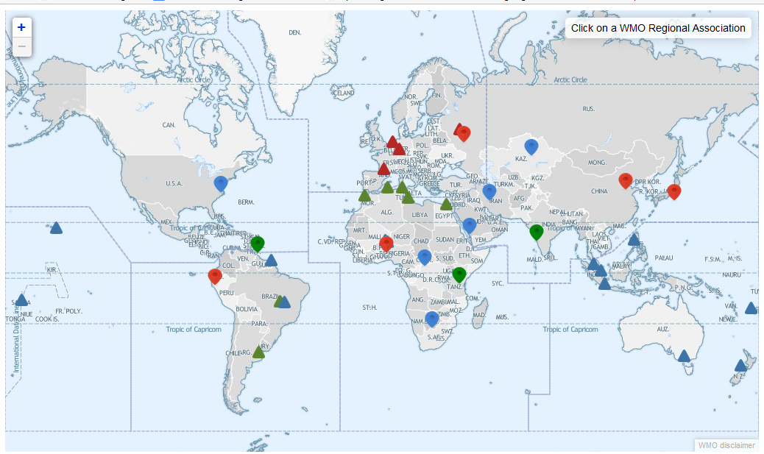

The GPCLRFs and the RCCs constitute integral components of WMO's Global Data Processing and Forecasting System (GDPFS) underpinning the generation of climate information products by the NMHSs.

Slide 13
- NOAA/NESDIS to support the Space-based Monitoring of Weather and Climate Extremes project by providing satellite observations of heavy precipitation events, and land surface parameters for monitoring droughts. The observations are required with a short latency of about one day. Furthermore the project requires the creation of climate reference data sets which will be used by the RCCs to classify observations as extreme event or not. (A45.05)
- JAXA to support the Space-based Monitoring of Weather and Climate
Extremes project by providing a short term (from 5-day up to monthly) climate normal from GSMaP data archives as a reference precipitation data set for the initial SEMDP areas, i.e. East Asia and Western Pacific regions. JAXA is also requested to set-up the on-line environment to provide GSMaP data with short latency to be utilized in the SEMDP. (A45.06)
- IPWG co-chairs and rapporteur to provide guidance on the estimation of
uncertainties and representativeness of the short-latency precipitation products
related to the Space-based Monitoring of Weather and Climate Extremes project. (A45.07)
- CEOS/CGMS Working Group on Climate to provide feedback on the proposed
definition for ICDR. (A45.08)
WMO Secretariat requested the Coordination Group for Meteorological Satellites (CGMS), in its 45th meeting in June 2017 to support the SEMDP implementation with placing actions on CGMS members, the IPWG and the joint CEOS-CGMS WG Climate. The following actions were agreed.

Slide 14
List of the Satellite-Derived Rainfall Estimation Products for SEMDP by NOAA and JAXA
Product | Provider | Geophysical Parameter
GSMaP | JAXA/EORC | - Satellite(s): GPM-Core, GCOM-W1, NOAA series, MetOp series, TRMM, Aqua, DMSP series, Geo-meteorological satellite - Spatial Coverage: 45ºS-40ºN/90ºE-160ºW - Spatial Resolution: 0.1 X 0.1 degree grid box - Temporal Resolution: 1 hour - Data Archiving Period: 1 March 2000 to the present - Data Latency: 2-3 hours - Data Format: plain binary format, NetCDF
CMORPH | NOAA/NWS/CPC | - Satellite(s): GPM-Core, GCOM-W1, NOAA series, MetOp series, TRMM, Aqua, DMSP series, Geo-meteorological satellites - Spatial Coverage: 45ºS-40ºN/90ºE-160ºW - Spatial Resolution: 0.1 X 0.1 degree grid box - Temporal Resolution: 30 minutes - Data Archiving Period: 1 January 1998 to the present - Data Latency: 1-2 hours - Data Format: plain binary format, NetCDF
NDVI (Normalized Difference Vegetation Index), VHI (Vegetation Health Index), and SMOPS (Soil Moisture Products) are provided by NOAA

Slide 15
“CEOS/CGMS Working Group on Climate” to provide feedback on the proposed definition for ICDR.
The 9th Session of CEOS-CGMS Working Group Climate was held in March 27-29, 2018 in Geneva, Switzerland. The definition was discussed and the proposed update is as follows:
Definition: An Interim Climate Data Record (ICDR) regularly extends in time a Fundamental or Thematic Climate Data Record using a system having optimum consistency with and lower latency than the system used to generate the FCDR or TCDR.
TCDR and FCDR are to be produced in the “sustained architecture of climate” whereas a common and accepted definition of an Interim Climate Data Record (ICDR) is still needed to provide best practices to RCCs in setting up operations on extreme monitoring in short latency, e.g. 1 day after observation.
ICDR as a CDR regularly updated with an algorithm / system having maximum consistency to TCDR generation algorithm / system. The update cycle depends on the user needs for climate extremes and might range from pentad to monthly.

Slide 16
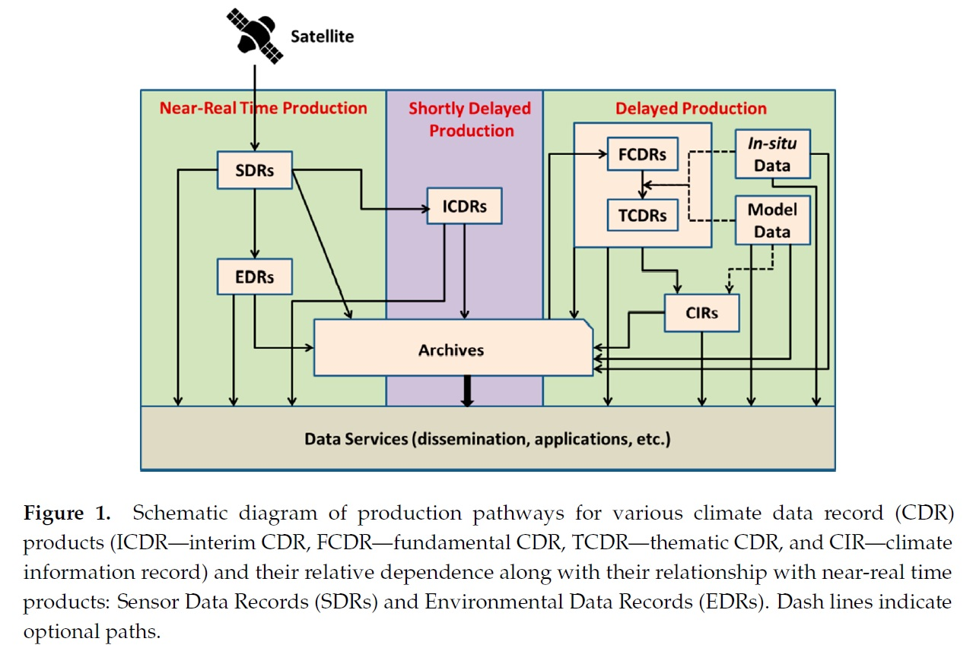
Schematic diagram of production pathway for various climate data record products

Slide 17
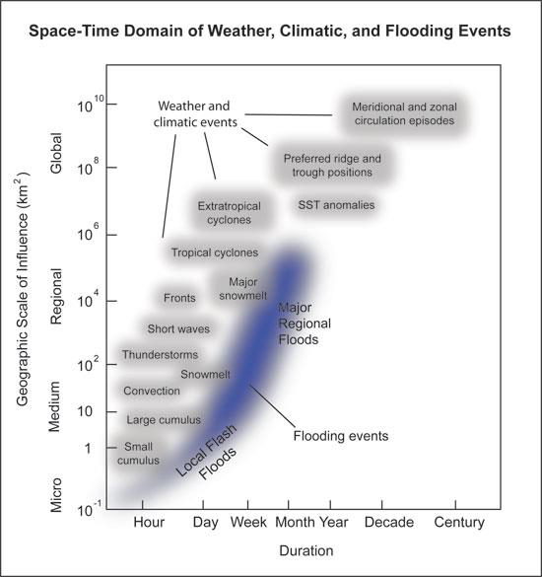
filling a gap between space-based “nowcasting” and “climate change monitoring”
with ICDR
monitoring weather and climate extremes in short duration on pentad or weekly basis up to monthly basis
Space-time domain of weather, climatic, and flooding events
(Katie Hirschboeck, The University of Arizona)
(http://www.southwestclimatechange.org/impacts/water/floods#references)

Slide 18
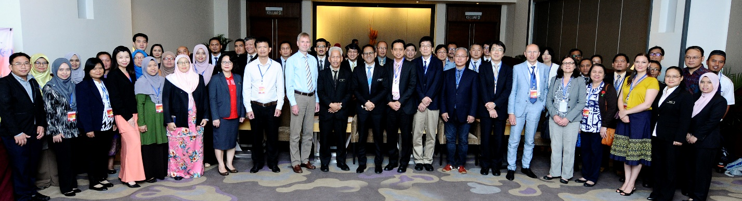
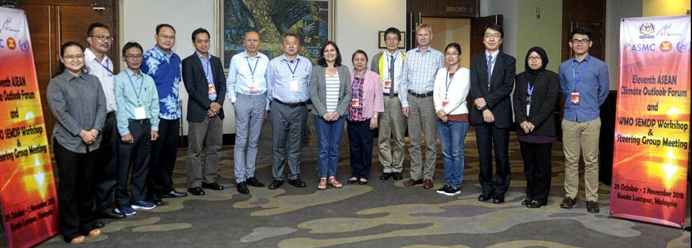
SEMDP Training and Capacity Building Workshop, back-to-back with the Eleventh ASEAN Climate Outlook Forum (ASEANCOF-11), 29-30 November 2018 in Kuala Lumpur, Malaysia
First session of the SEMDP Steering Group (SG-SEMDP-1), 1 November 2018 in Kuala Lumpur, Malaysia

Slide 19
Outcomes from Workshop (1/3)
For the workshop on training and capacity building, the satellite operator, JAXA and NOAA shared information on the latest development in the microwave-based satellite observation systems, and the capabilities for monitoring rainfall with other related variables (e.g. vegetation health and soil moisture).
JAXA and NOAA also reported three case studies on the validation of the satellite derived rainfall estimations and comparisons with in-situ rain gauge data demonstrating capabilities to monitor rainfall extremes.
  Persistent heavy rainfall event in Nov. – Dec. 2014 that affected Peninsular Malaysia, Southern Thailand, and occurred close to Singapore.
  Persistent heavy rainfall in Aug. 2016 which affected the Lao PDR, especially in the North.
  Extended dry period in January to March 2014 which affected Singapore, Malaysia and Indonesia.

Slide 20
Outcomes from Workshop (2/3)
The case studies demonstrated that the satellite estimates are generally able to represent rainfall well when compared to ground stations, especially spatial and temporal patterns.
However, intensities can be biased especially over orography, where few ground measurements are available to be able to establish ‘ground-truth’ properly.
Intensity-wise, the satellites are able to represent weekly and month averages better than daily averages in general. Rainfall-derived indices, such as number of rain days or dry days were also represented well in the relevant case studies and showed promising applications.

Slide 21
Outcomes from Workshop (3/3)
Overall the Workshop participants felt that the satellite products produced by JAXA and NOAA prepared for the Workshop can reasonably be used experimentally for monitoring the extreme events associated with the rainfall in a demonstration phase.
Furthermore, it was recommended that the workshop participants will be developing their own set of products to be semi-operationalised at the regional (RCCs) and national (NMHSs) levels in 2019.

Slide 22
Outcomes from SG-SEMDP
The outcomes from the workshop on training and capacity building were reviewed by SG-SEMDP.
It was confirmed that SEMDP has been successfully implemented and is in progress in the East Asia and western Pacific regions.
It is envisaged that upon successful completion of the SEMDP, lessons learned will be incorporated into SWCEM in operation involving broader activities across all of the WMO RCCs.

Slide 23
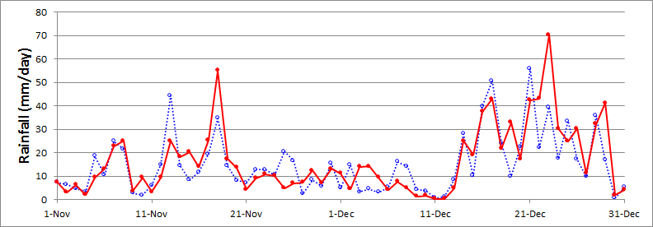
Figure 1 provides an example of a comparison of daily rain gauge data with satellite estimations from JAXA (Japan Aerospace Exploration Agency).
Figure 1 demonstrates two important aspects:
the agreement between the rain gauge analysis (CPCGAG) and the satellite-based GSMaP from JAXA is good.
both, the satellite-based method and the rain gauges, depict the heavy precipitation events well.
However, differences in the accumulated rainfall rates per day can be relatively high in specific instances which is presumably due to spatial and temporal (satellites) sampling problems.
Important is that the peak rainfall events are quite well observed will both methods.
Figure. 1: Time series of daily precipitation averaged over land in the following area: 100°E-105°E; Equator (EQ) -8°N); blue: CPCGAG (rain gauge data), red: GSMaP_GNRT6 (satellite data) (source: JAXA).

Slide 24
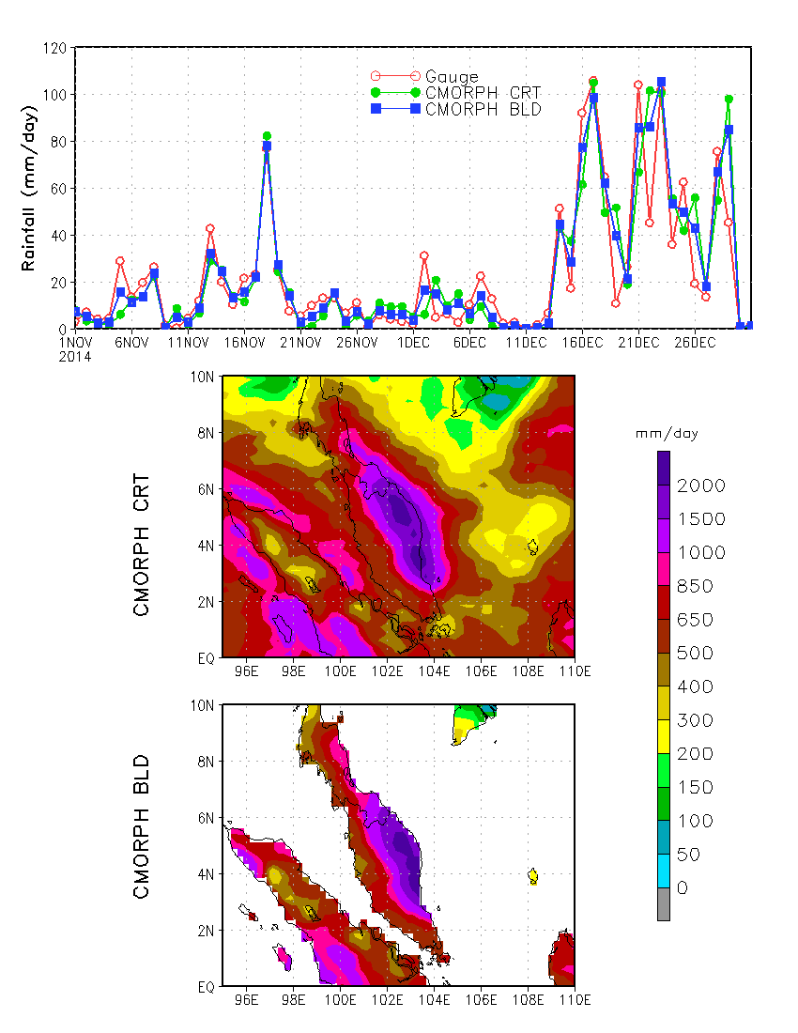
Figure 2: Several episodes of heavy precipitation occurred over November and December of 2014, accumulated over 1000 mm rainfall over the eastern shore of Malaysia, part of Thailand and Singapore (source: NOAA CPC);
Top: Time series of precipitation averaged over land are of (95ºE - 110ºE; 0° -10ºN) from CPC gauge analysis, CMORPH_CRT, and CMORPH_BLD;
Middle: Accumulated rainfall over November and December 2014 from CMORPH_CRT;
Bottom: Accumulated rainfall over Nov and Dec 2014 from CMORPH_BLD.
Figure 2 also shows heavy precipitation events as depicted by rain gauge data and from two satellite data sets by the NOAA/CPC.
The comparison illustrates again good consistency between the data sets.
This reassures that data used in this study are adequate and consistent for the monitoring of severe precipitation events.

Slide 25
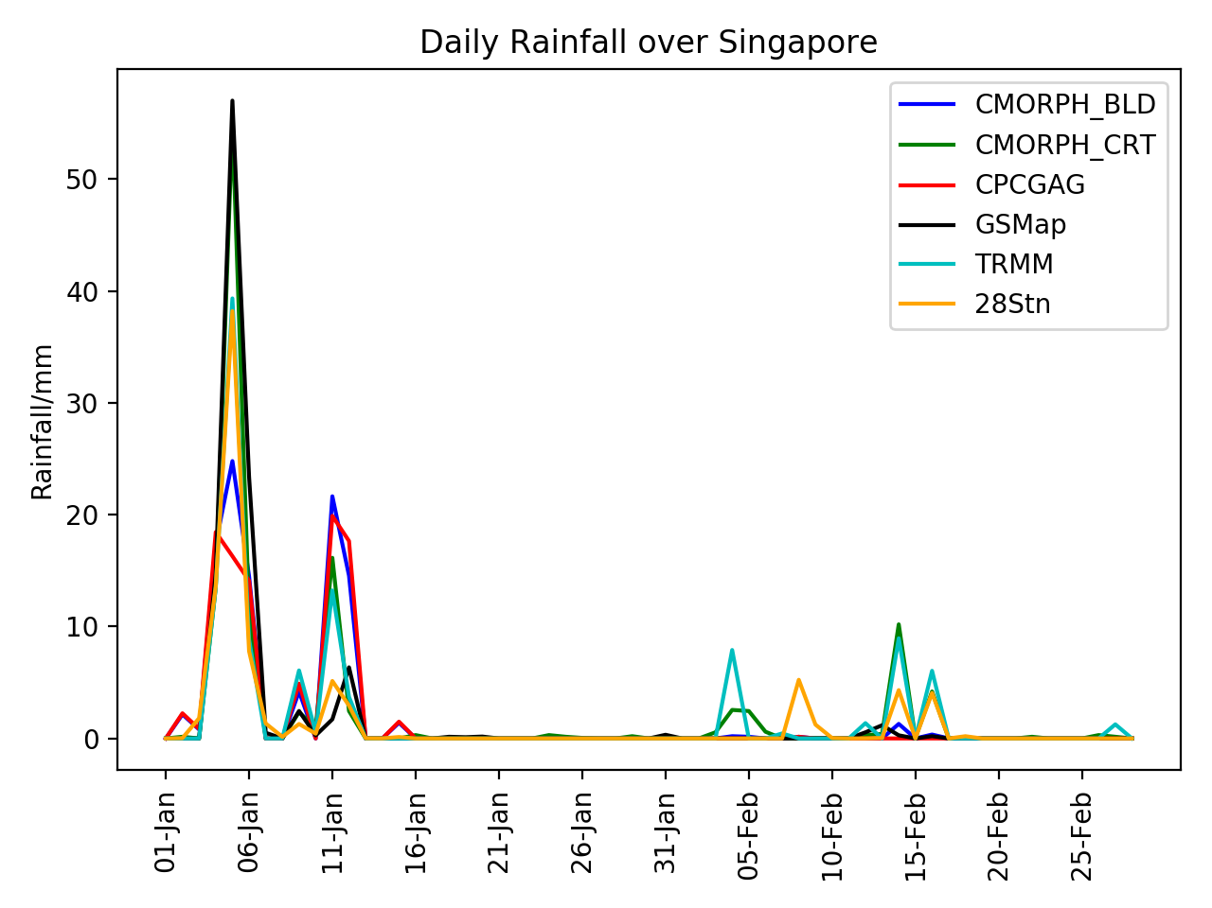
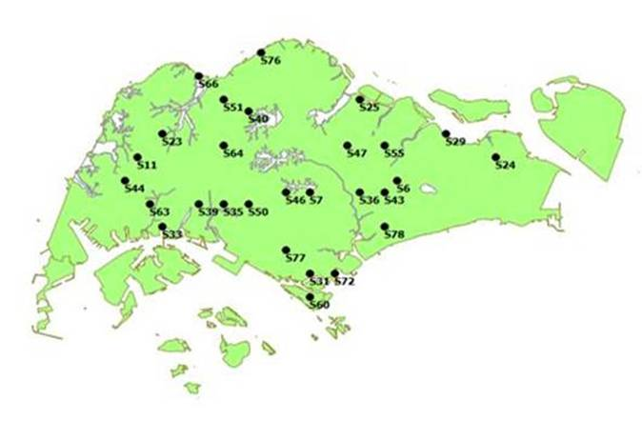
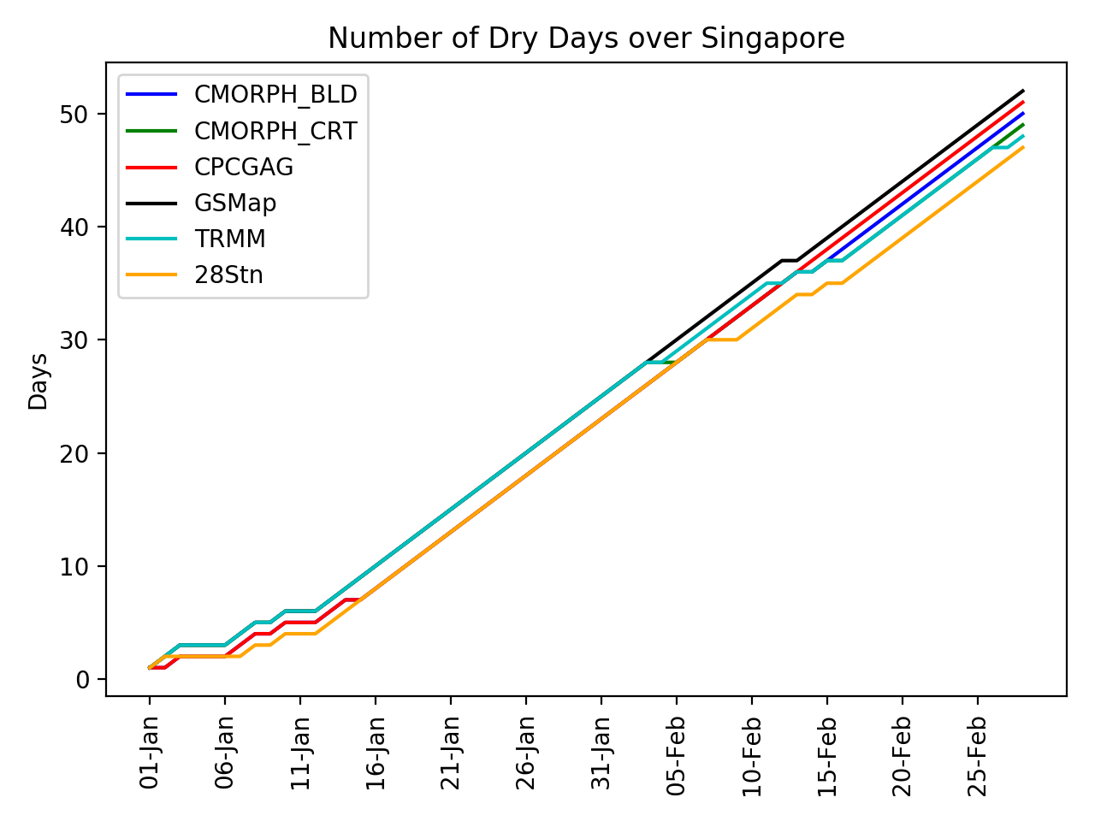
Figure 4.a: Daily Rainfall over Singapore in 2014 as retrieved with different satellite methods and from the 28 rain gauges shown in Figure 4.b.
Figures 4a - 4c show a monitoring of precipitation and drought over Singapore with satellite-based observations and ground-based observations based on 28 rain gauges, respectively. (Locations of the gauges are depicted in Figure 4b)
In Figure 4a we note again a good correspondence of satellite and ground-based precipitation observations.
Furthermore, there is good agreement in depicting days without precipitation thus demonstrating the space-based capabilities to monitor spells of dry days and droughts.
Figure 4c shows the accumulated number of dry days indicating good agreement between the observations based on rain gauges and satellites.
Figure 4.b: Locations of the 28 rain gauge stations in Singapore.
Figure 4.c: Number of accumulated dry days in Singapore since 1 January 2014 as observed with different satellite methods and from the 28 stations. A dry day is defined as daily rainfall is less than 1mm.

Slide 26
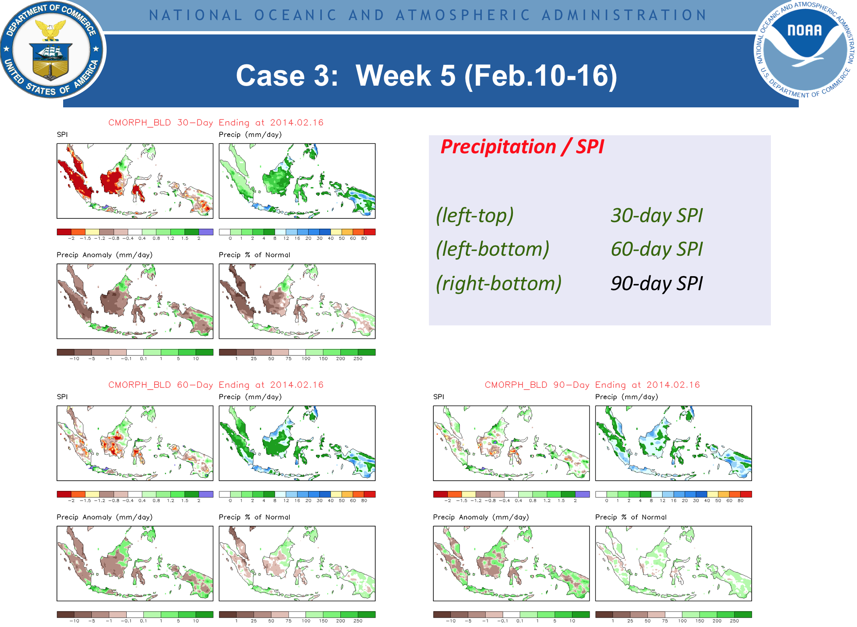
Examples of monitoring of precipitation and drought by NOAA are given in Figures 5 and 6, respectively.
Figure 5 shows a monitoring for a week with the Standardized Precipitation Index (SPI). It is demonstrated how the use of different averaging periods represents precipitation and precipitation deficits over different time scales.
The SPI is determined from precipitation observations alone. The SPI calculation requires at any location a long-term monthly precipitation database, ideally over a climatological period of 30 years.
SPIs are calculated as moving averages over the chosen time windows of averaging. Time series of such data would also show the start and ending of drought conditions in correspondence to the chosen time scales.
It also provides estimates of the magnitude of droughts and precipitation deficits.
Figure 5: Monitoring of precipitation with the NOAA Standardized Precipitation Index (SPI), precipitation (in mm/day), the precipitation anomaly (in mm/day) and percentage of normal precipitation. The calculations are for three different sets of averaging over 30, 60 and 90 days, respectively.

Slide 27
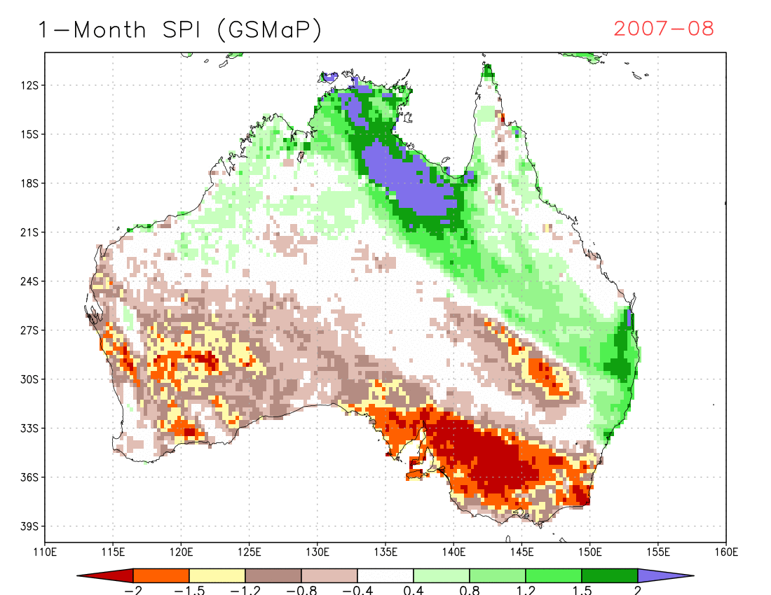
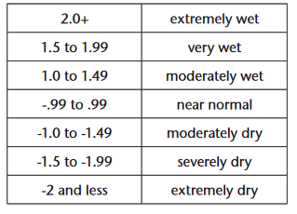

Definition of Drought
by Standardized Precipitation Index (SPI)
SPI methodology
Source: http://www.wamis.org/agm/pubs/SPI/WMO_1090_EN.pdf
Classification system shown in the SPI value table
e.g. 1-Month SPI
  1-Month SPI
It reflects short-term conditions, its application can be related
closely to meteorological drought.
  3-Month SPI
  It reflects short- and medium-term moisture conditions and
  provides a seasonal estimation of precipitation.

Slide 28
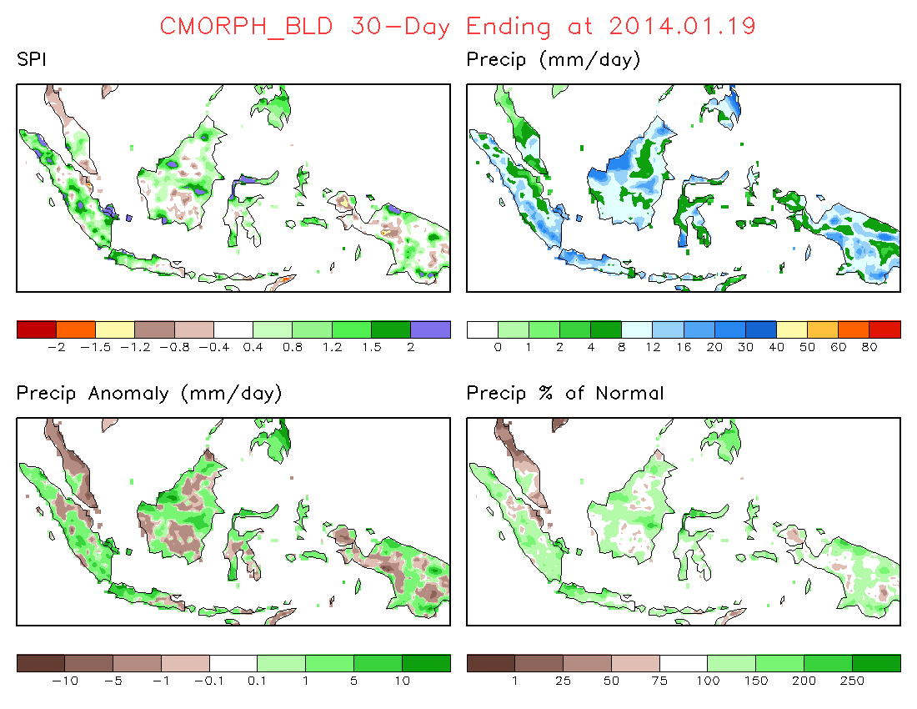
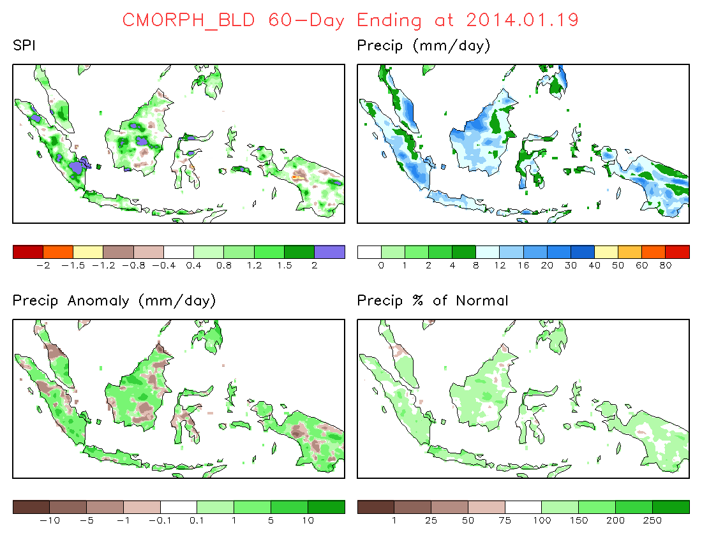
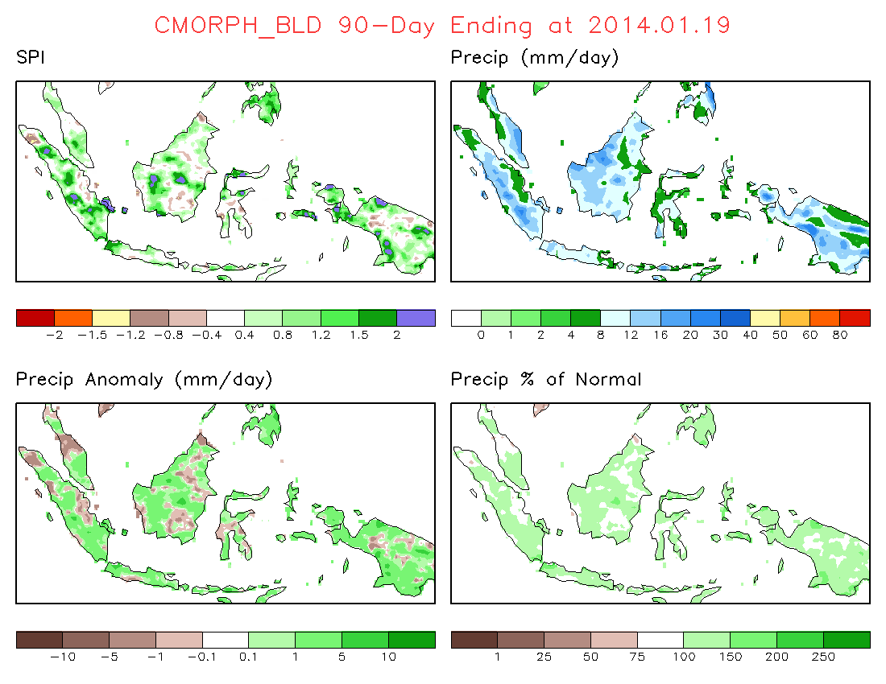
Case 3: Week 1 (Jan.13-19,2014)
Precipitation / SPI
(left-top) 30-day SPI
(left-bottom) 60-day SPI
(right-bottom) 90-day SPI

Slide 29
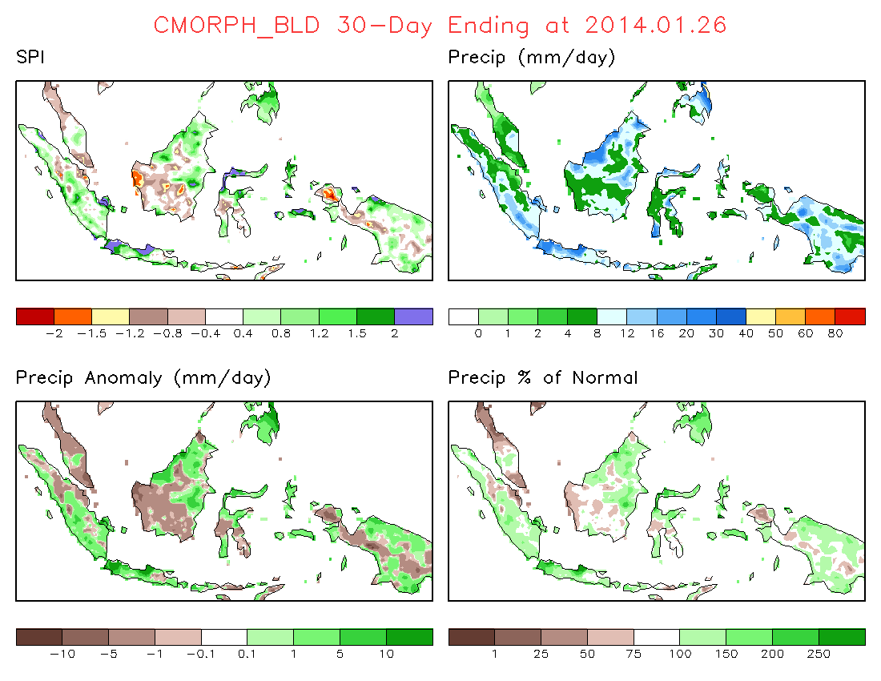
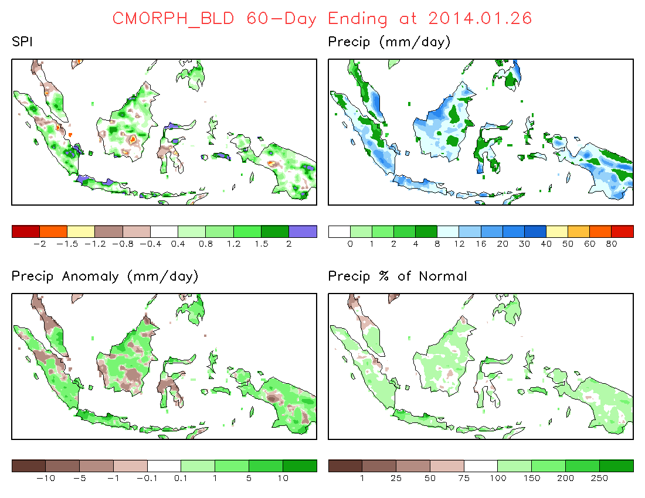
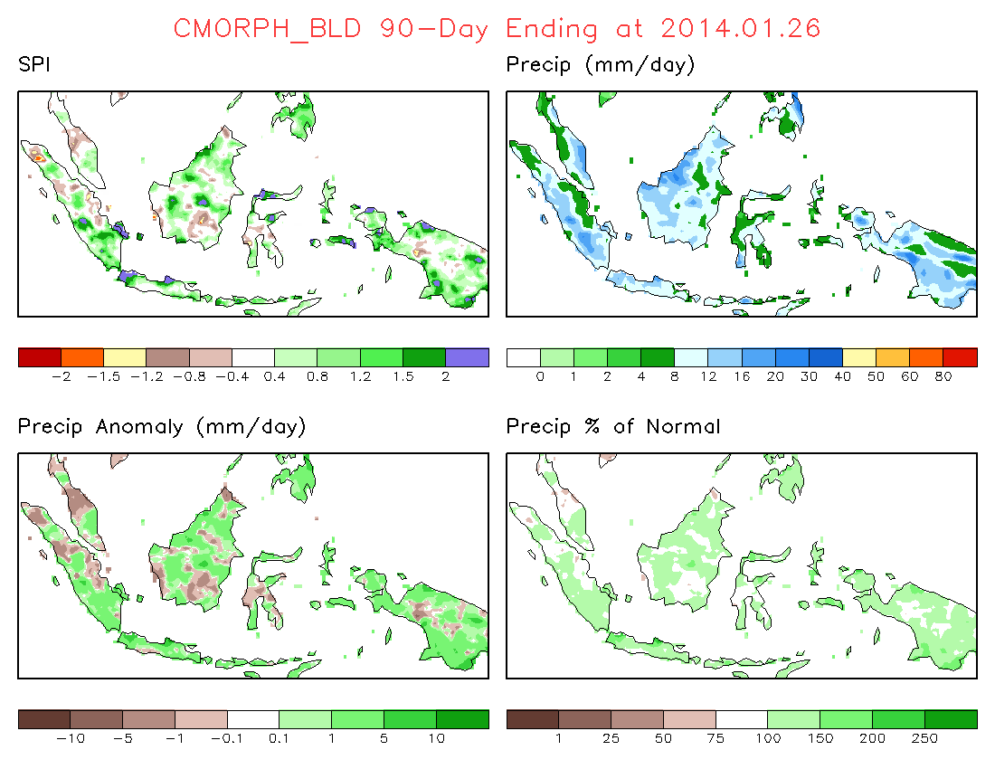
Case 3: Week 2 (Jan.20-26, 2014)
Precipitation / SPI
(left-top) 30-day SPI
(left-bottom) 60-day SPI
(right-bottom) 90-day SPI

Slide 30
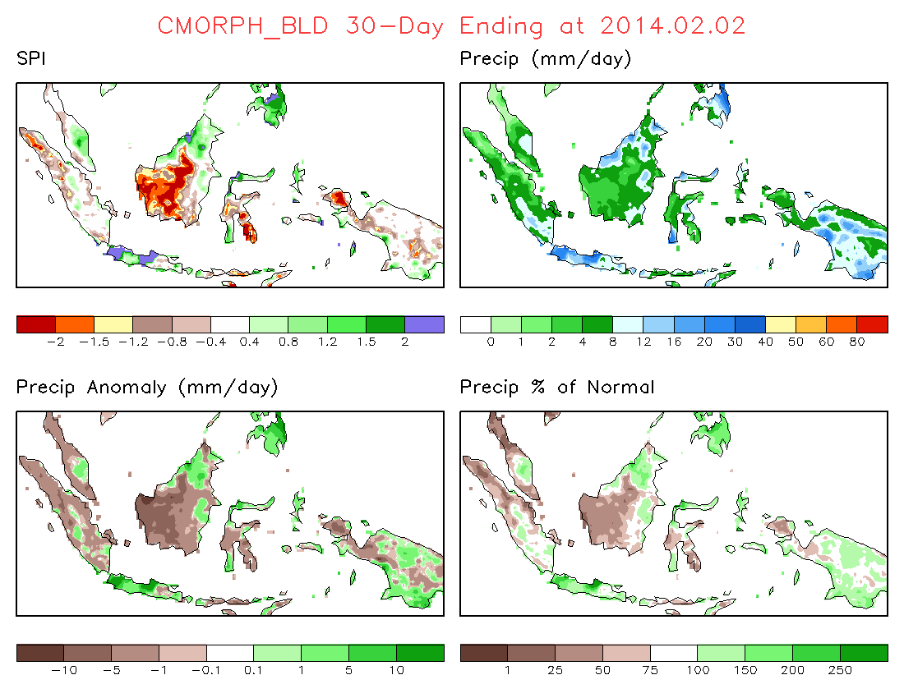
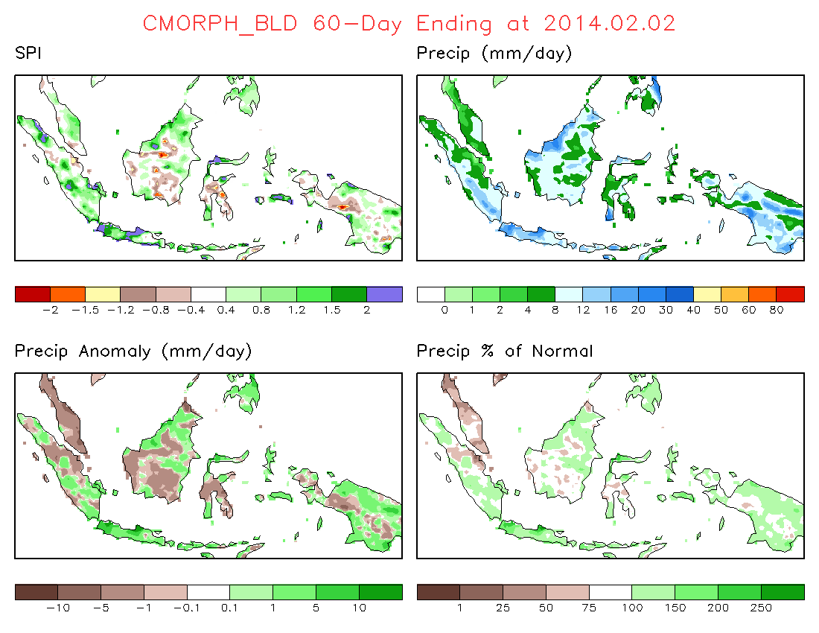
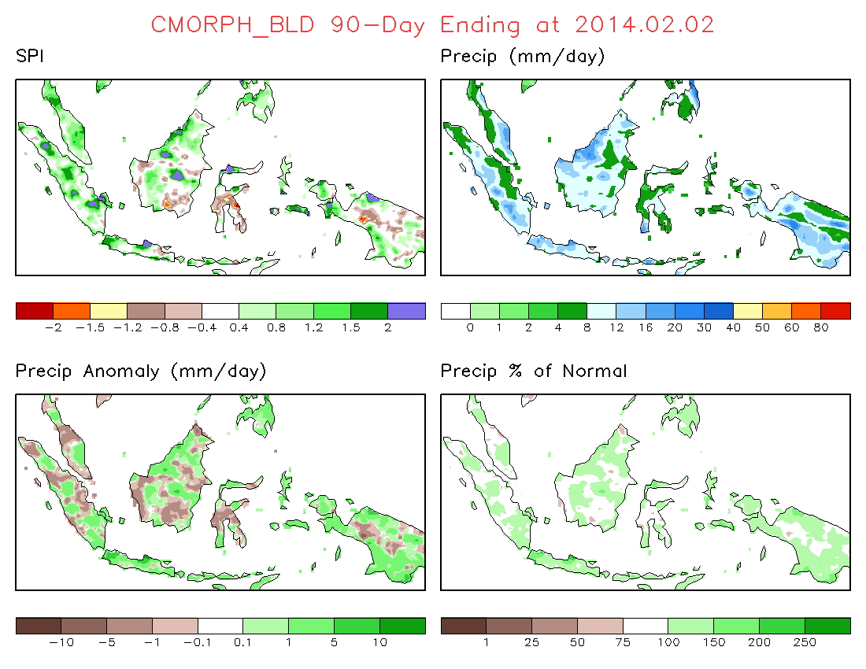
Case 3: Week 3 (Jan.27-Feb.2, 2014)
Precipitation / SPI
(left-top) 30-day SPI
(left-bottom) 60-day SPI
(right-bottom) 90-day SPI

Slide 31
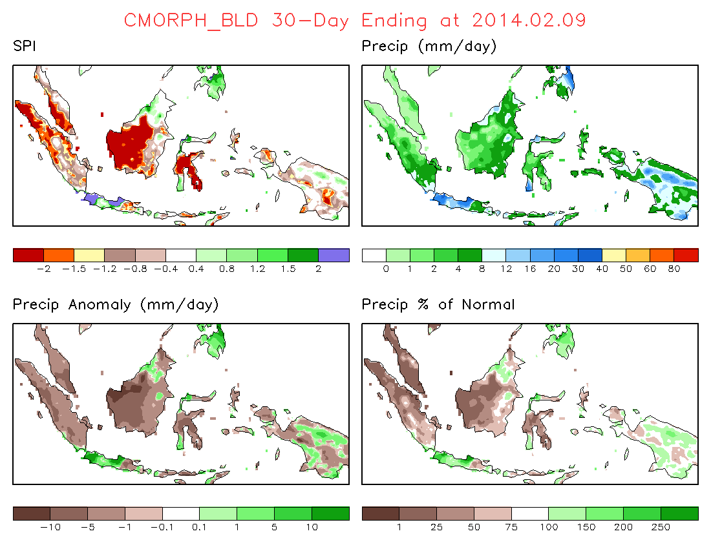
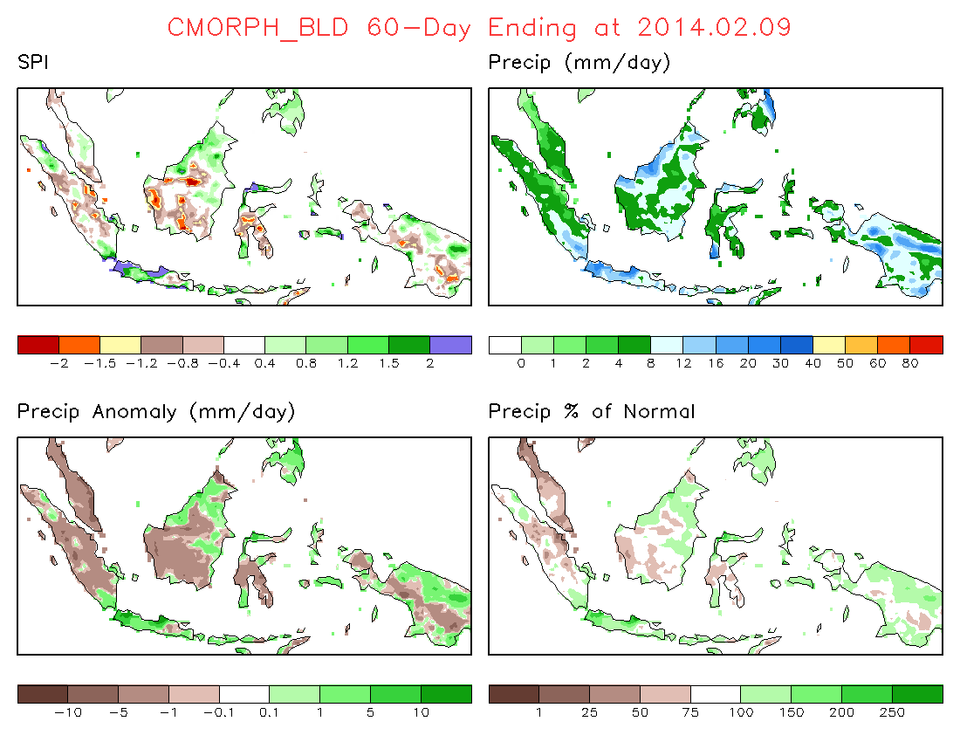

Case 3: Week 4 (Feb.3-9, 2014)
Precipitation / SPI
(left-top) 30-day SPI
(left-bottom) 60-day SPI
(right-bottom) 90-day SPI

Slide 32
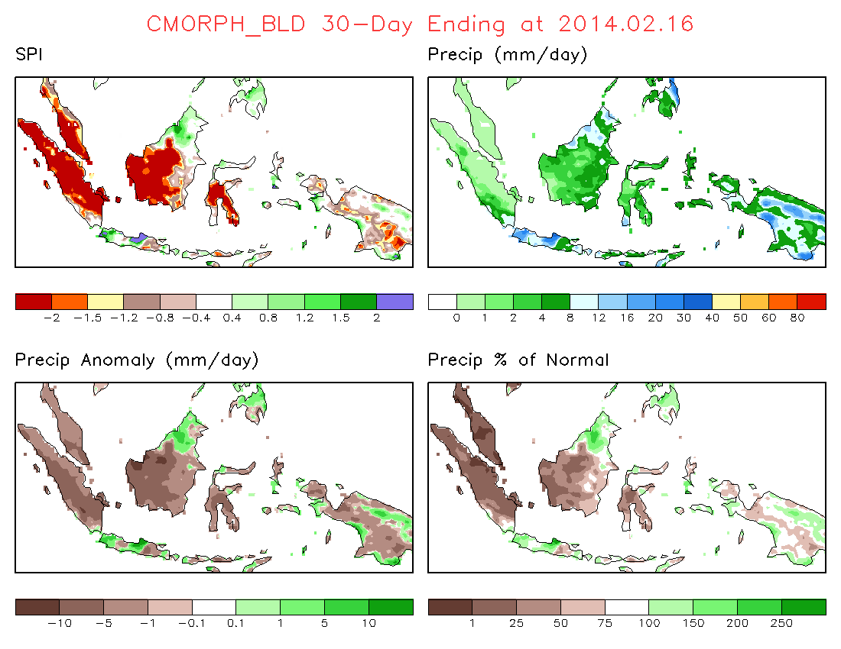
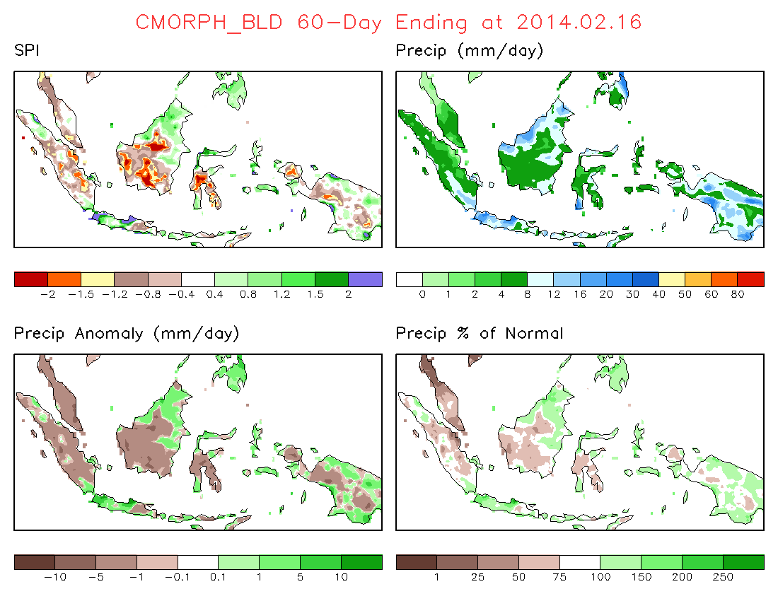
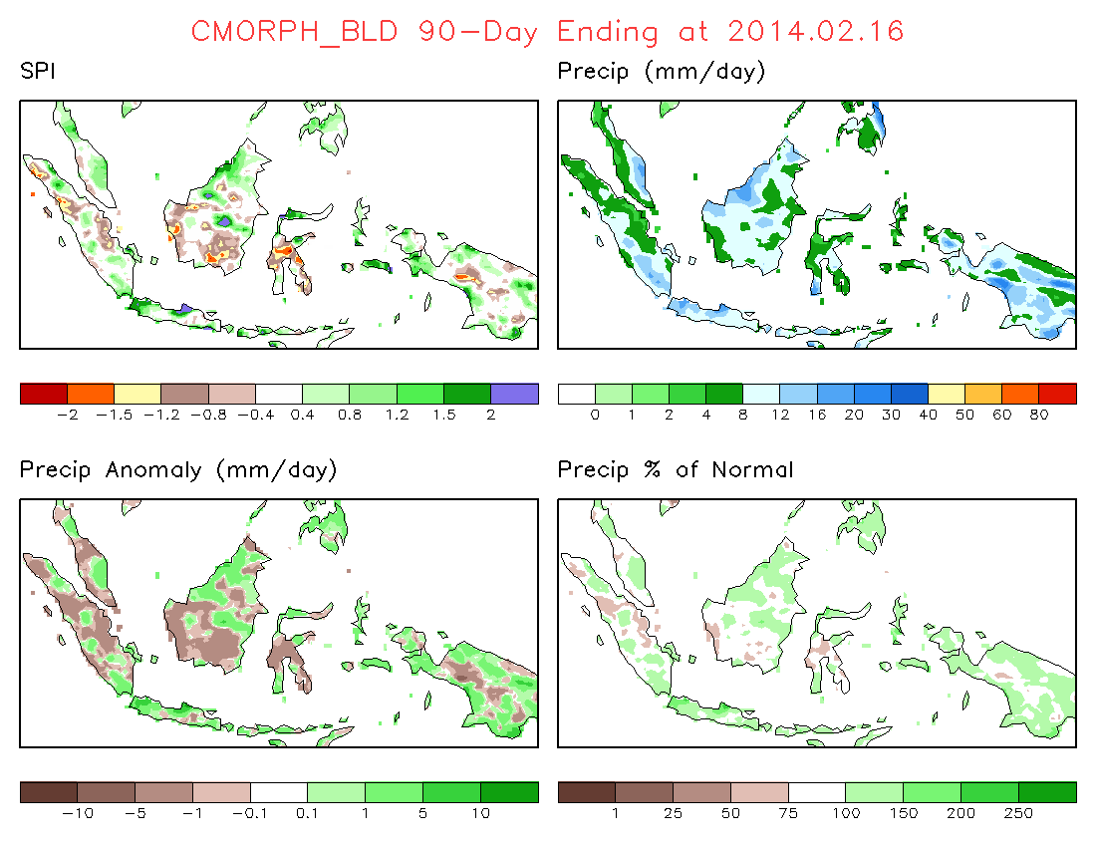
Case 3: Week 5 (Feb.10-16)
Precipitation / SPI
(left-top) 30-day SPI
(left-bottom) 60-day SPI
(right-bottom) 90-day SPI

Slide 33
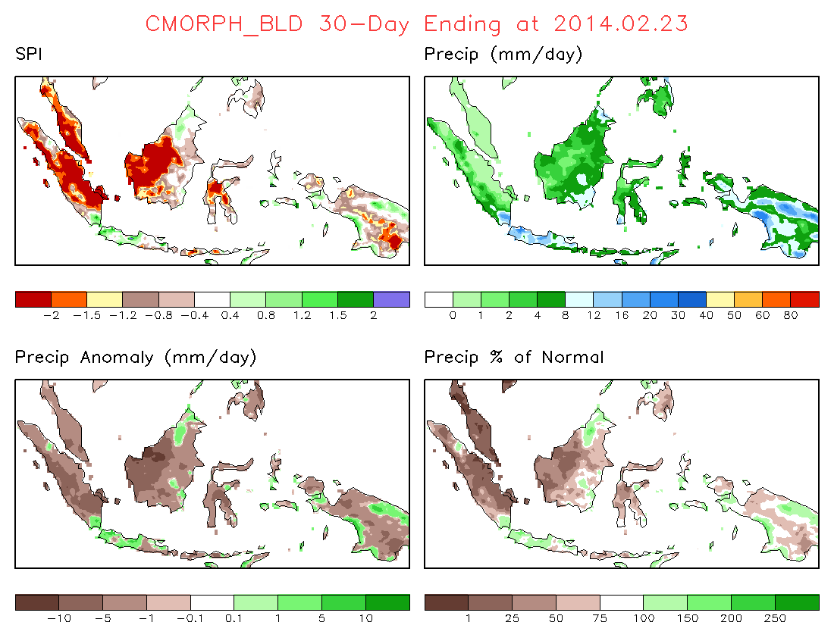
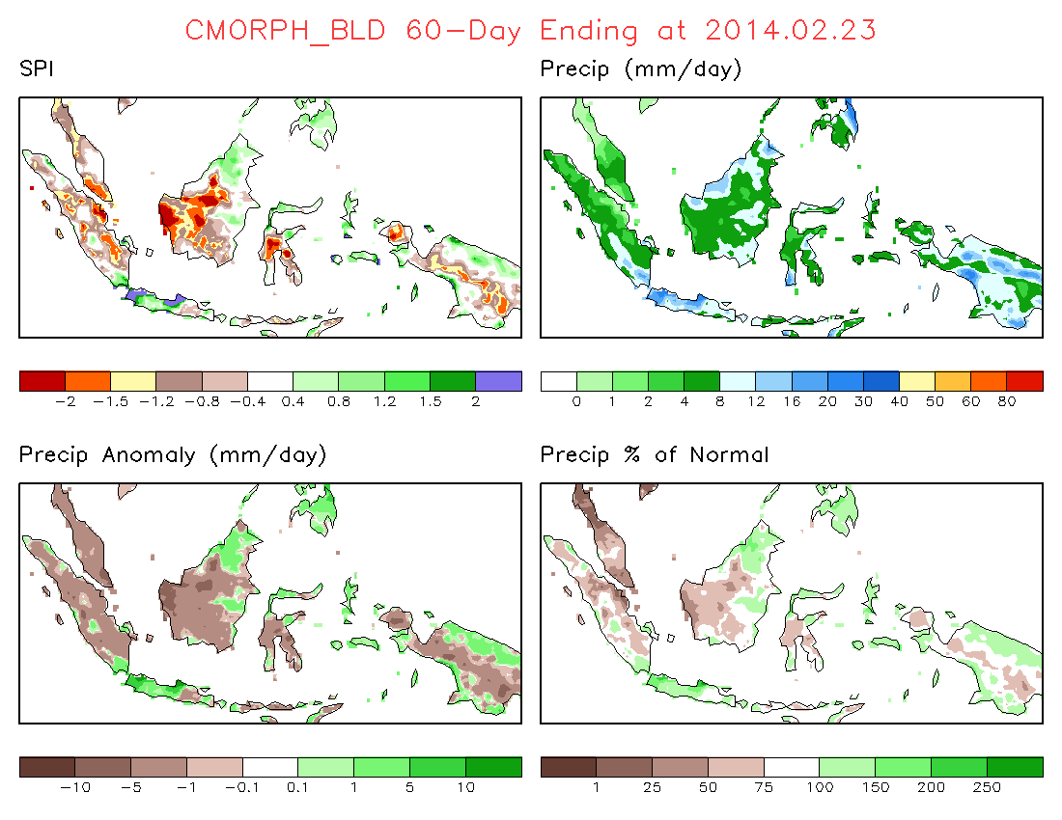
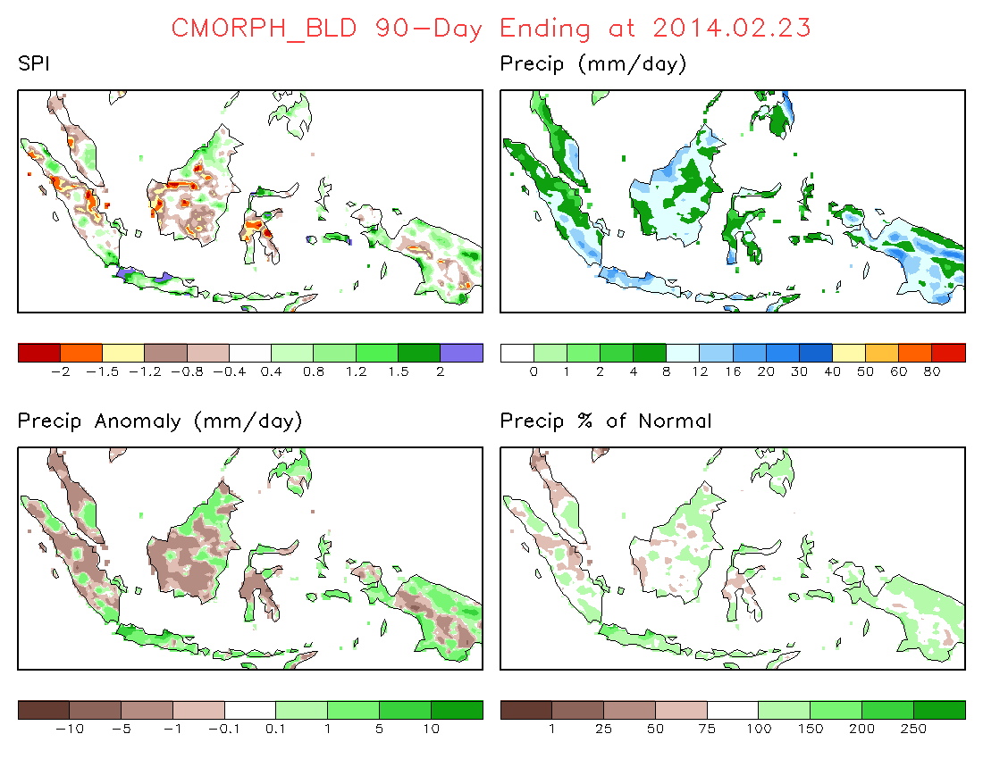
Case 3: Week 6 (Feb.17-23, 2014)
Precipitation / SPI
(left-top) 30-day SPI
(left-bottom) 60-day SPI
(right-bottom) 90-day SPI

Slide 34
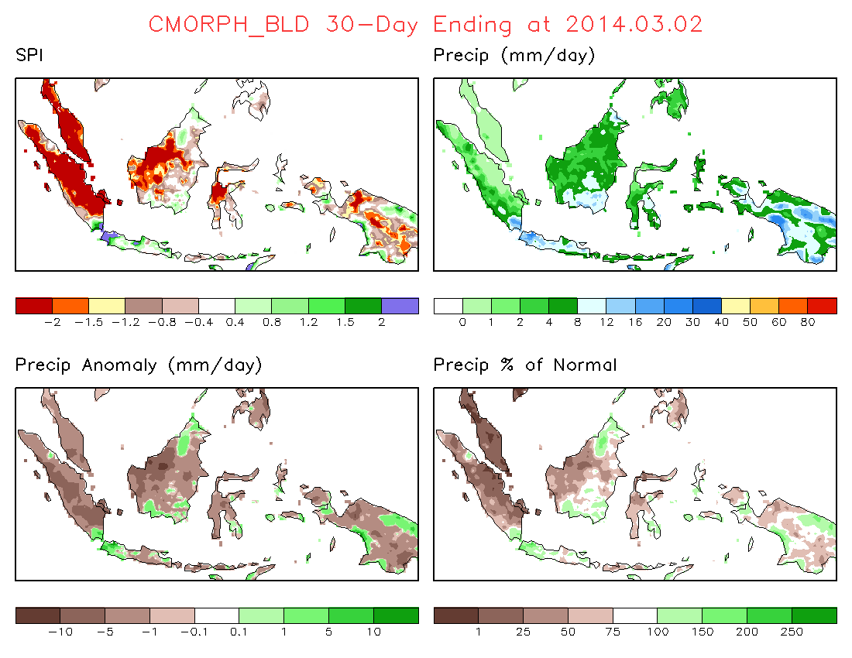
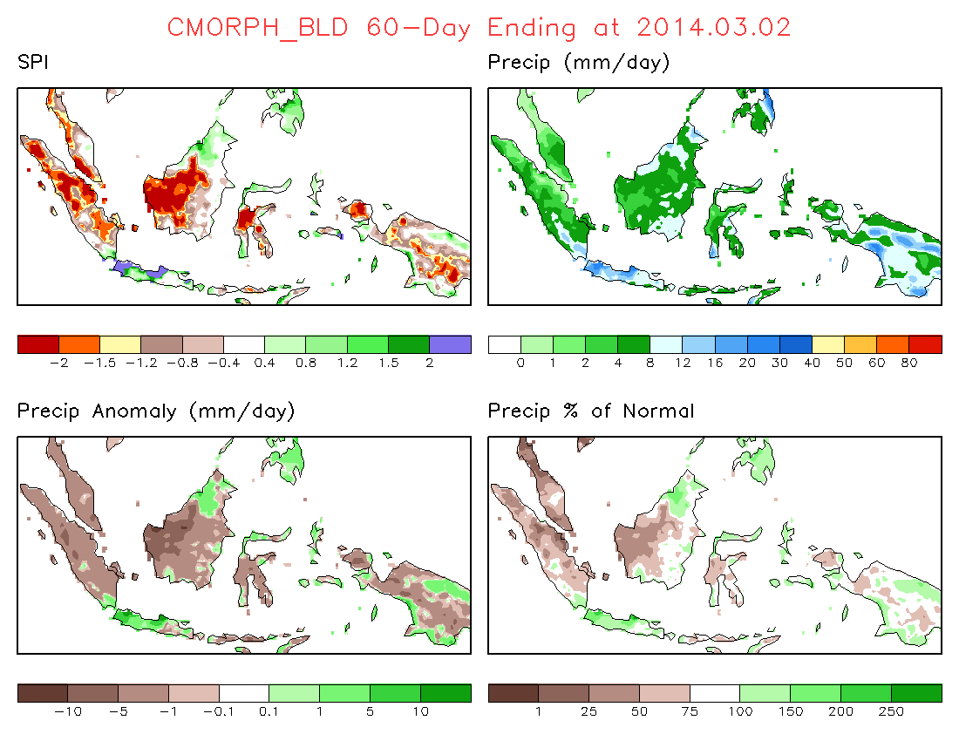
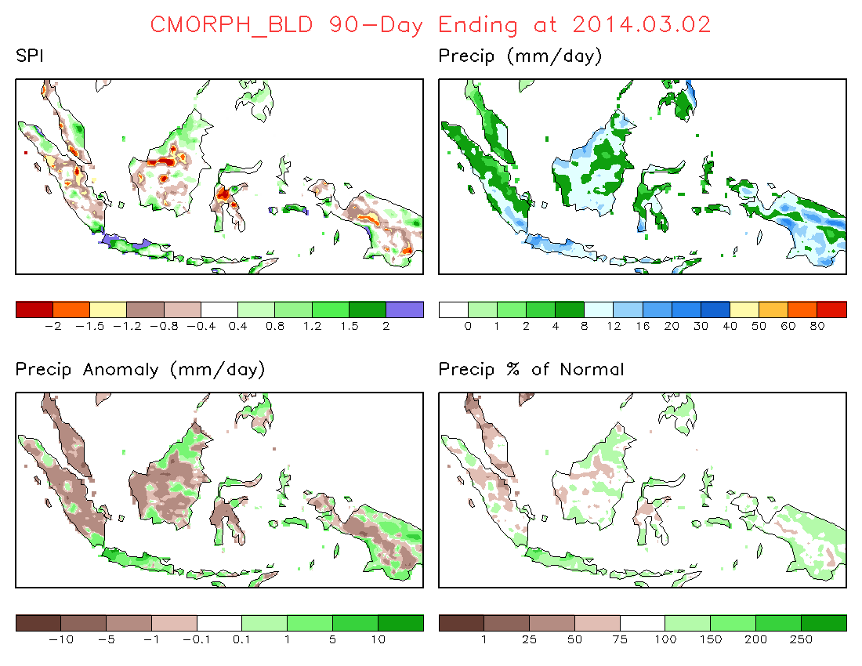
Case 3: Week 7 (Feb.24-Mar.2, 2014)
Precipitation / SPI
(left-top) 30-day SPI
(left-bottom) 60-day SPI
(right-bottom) 90-day SPI

Slide 35
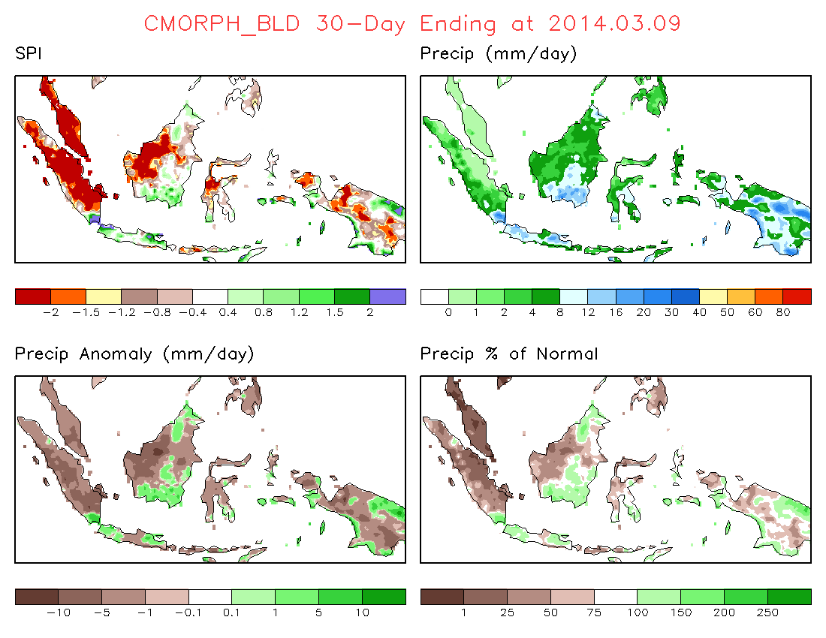
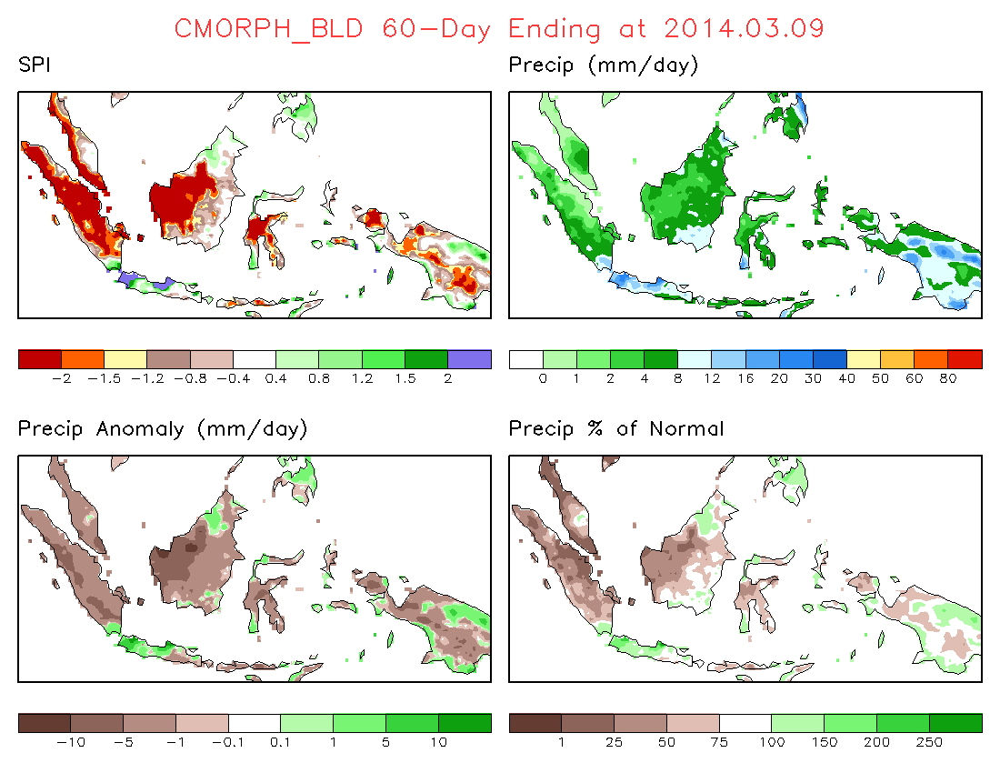
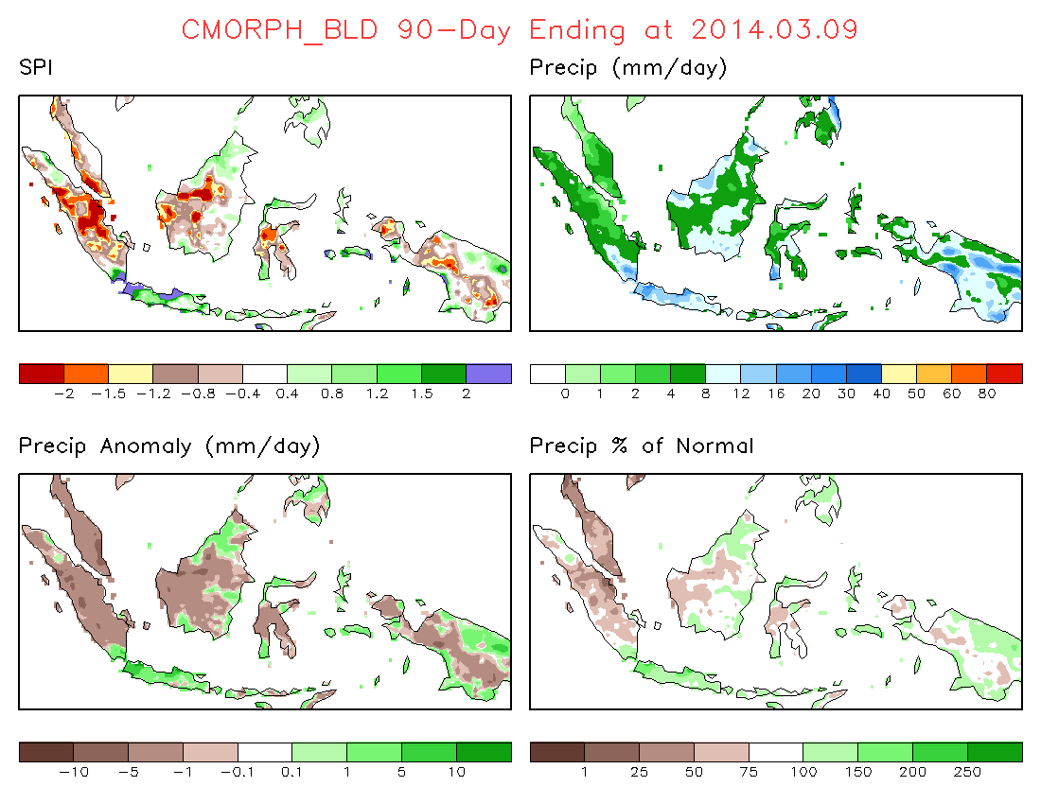
Case 3: Week 8 (Mar.3-9, 2014)
Precipitation / SPI
(left-top) 30-day SPI
(left-bottom) 60-day SPI
(right-bottom) 90-day SPI

Slide 36
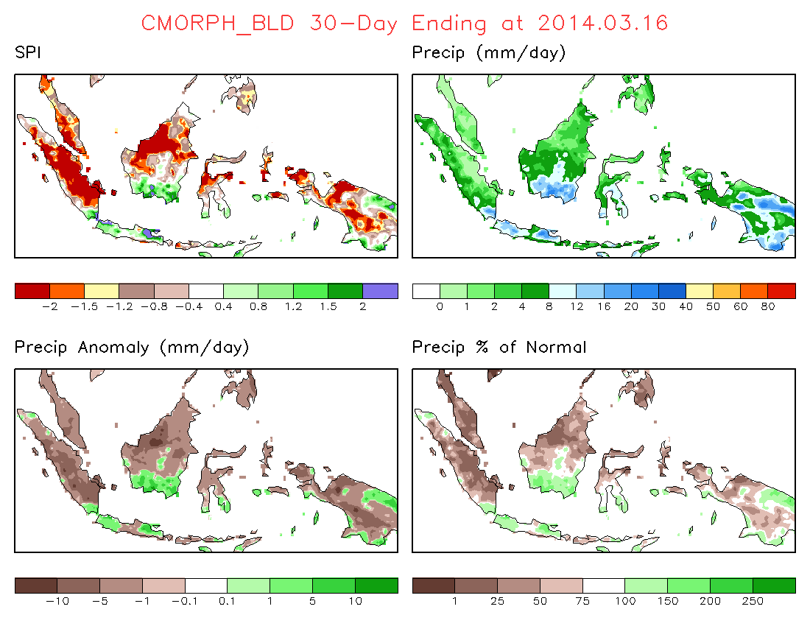
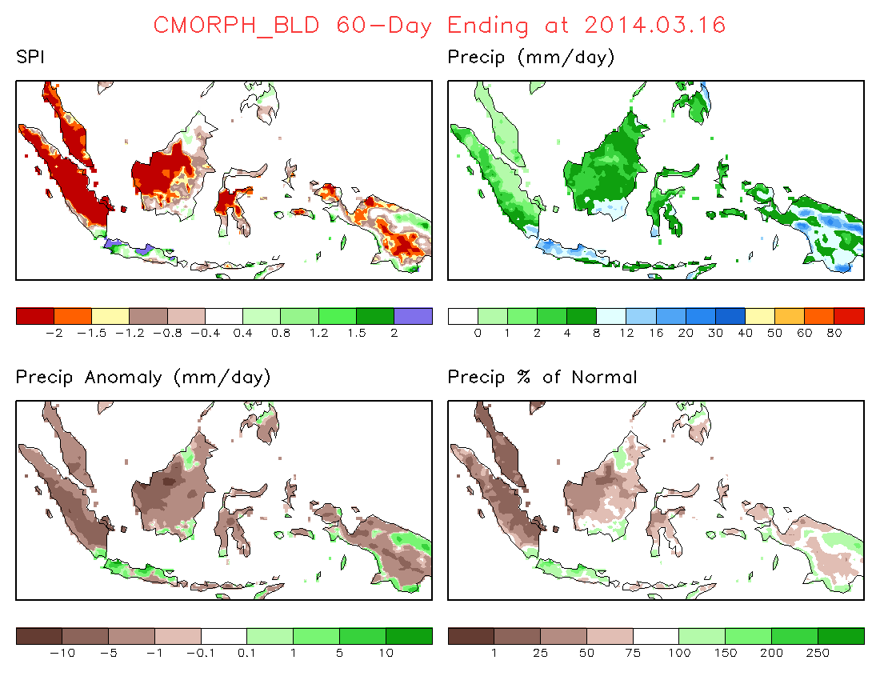
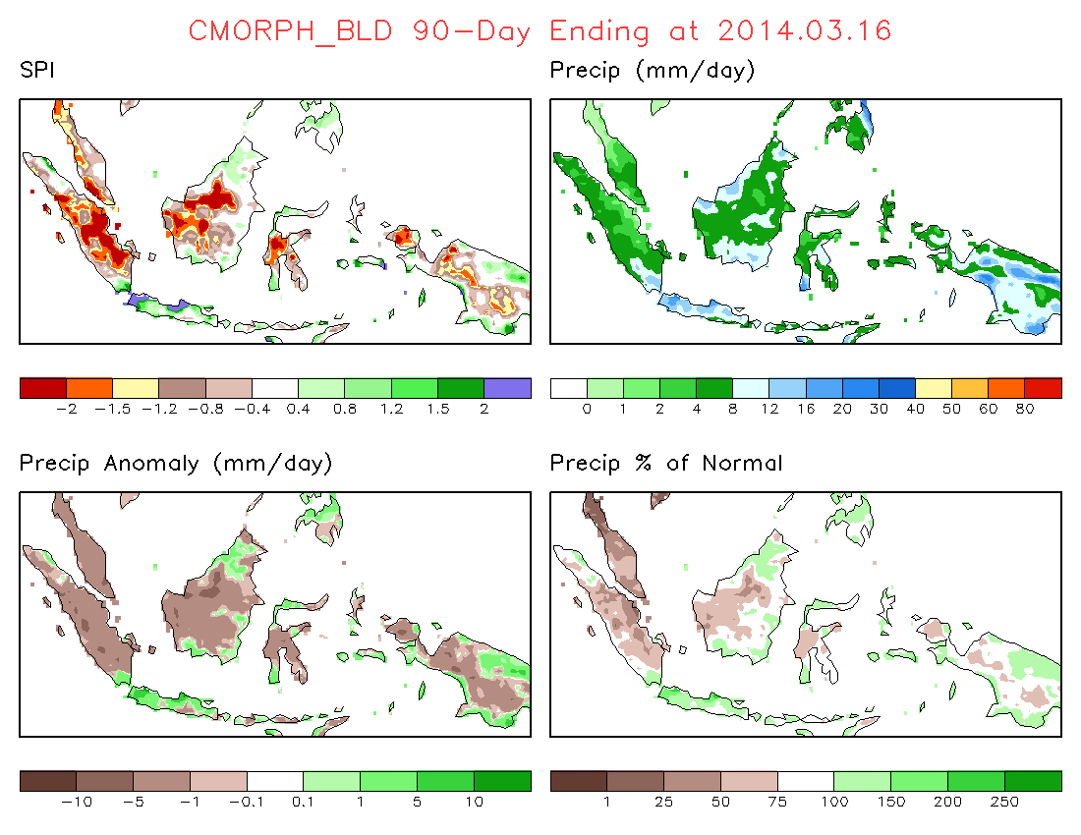
Case 3: Week 9 (Mar.10-16, 2014)I
Precipitation / SPI
(left-top) 30-day SPI
(left-bottom) 60-day SPI
(right-bottom) 90-day SPI

Slide 37
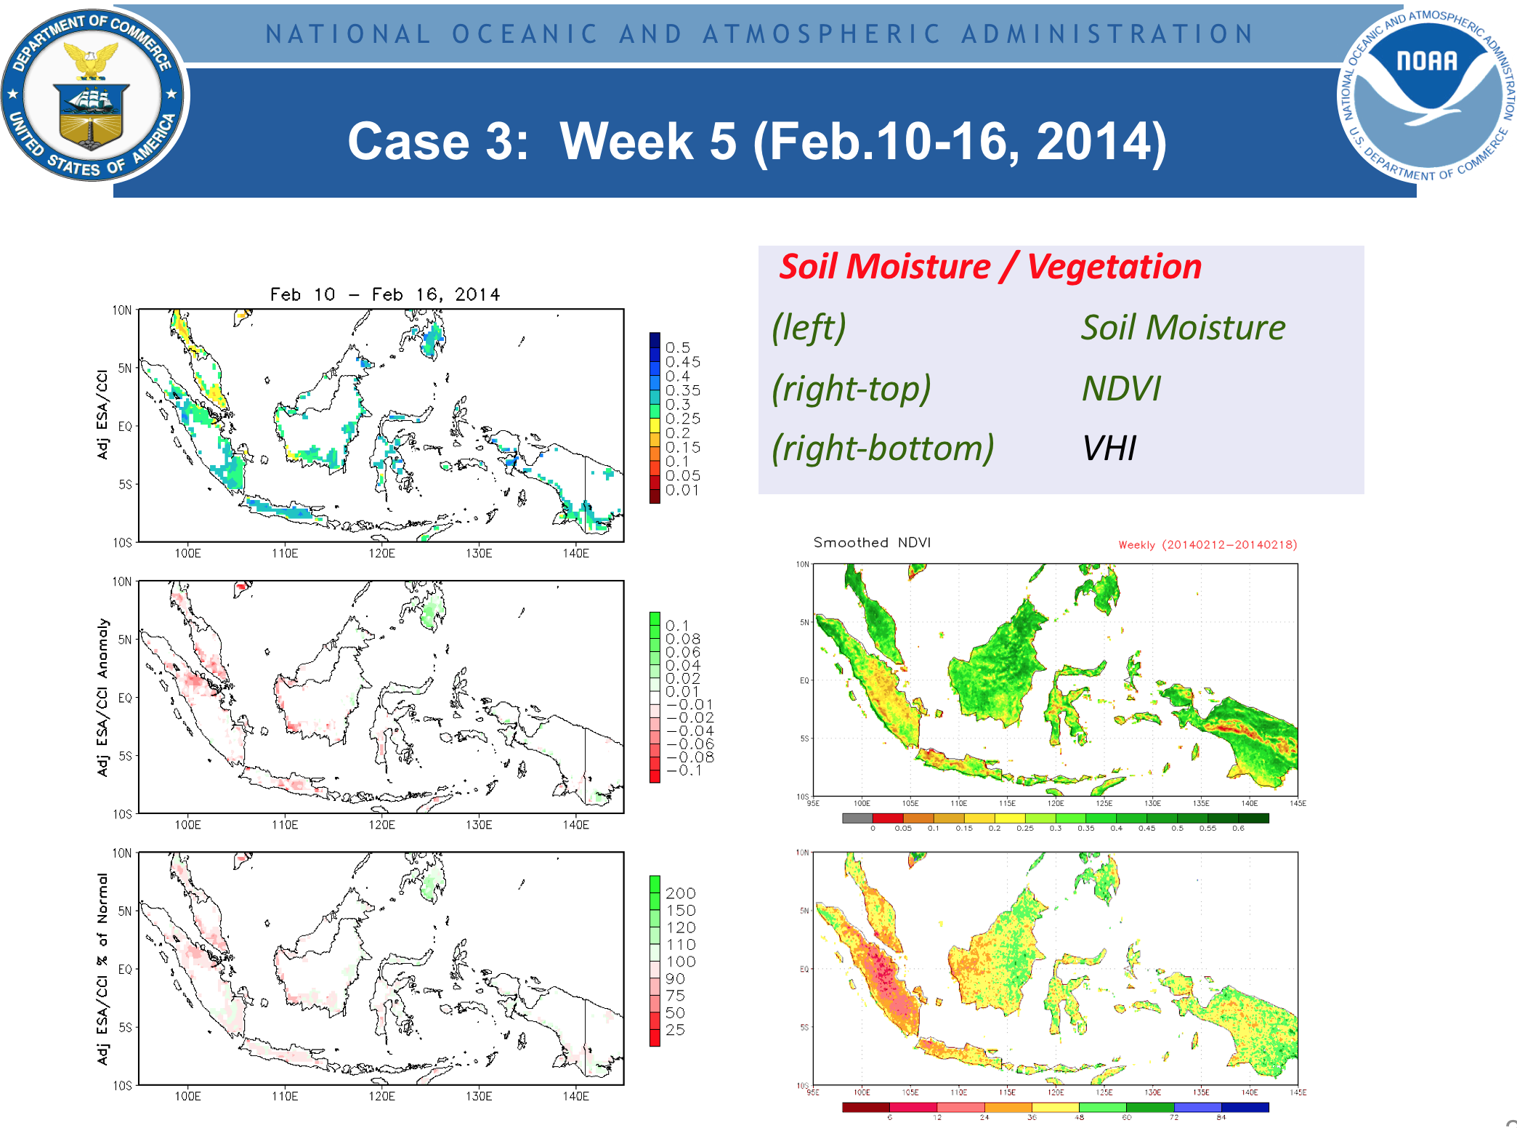
The joint interpretation of results in Figure 5 with soil moisture and vegetation parameters shown in Figure 6 will be instructive to provide a comprehensive picture of water availability and vegetation health.
Figure 6: Example of a monitoring of soil moisture and vegetation for the same period as in Figure 5. Soil moisture is from the ESA Climate Change Initiative (CCI). Vegetation is monitored with the Normalized Vegetation Difference Index (NDVI) and NOAA’s Vegetation Health Index (VHI), respectively.

Slide 38

Thank you

Slide 39
Backup Slides for Background

Slide 40
The 70th WMO Executive Council (EC-70) in June 2018 recognized the progress in SEMDP after EC-69, and endorsed the following developments;
The EC-70 decides:
(1) To request the Commission for Climatology (CCl) and Commission for Basic Systems (CBS) to review the SEMDP Implementation Plan in East Asia and Western Pacific Regions with the goal to have it updated in advance of the Eighteenth World Meteorological Congress (Cg-18) to reflect feedback from Members during its demonstration phase;
(2) To consider that the Cg-18 decides on matters concerning:
  (a) Implementation of the SEMDP in East Asia and Western Pacific Regions in operation phase;
  (b) Implementation of the SEMDP in other regions.

Slide 41
Q1: What is “Weather and Climate Extremes”?

Slide 42
WMO Meteoterm Definition: “Extreme Weather Event“
An extreme weather event is an event that is “rare” at a particular place and time of year. Definitions of “rare” vary, but an extreme weather event would normally be “as rare as or rarer than” the 10th or 90th percentile of a probability density function estimated from observations.
By definition, the characteristics of what is called extreme weather may vary from place to place in an absolute sense.
When a pattern of extreme weather persists for some time, such as a season, it may be classed as an extreme climate event, especially if it yields an average or total that is itself extreme (e.g., drought or heavy rainfall over a season).
(DEFINITION SOURCE: IPCC 5th Assessment Report, WG 1 Glossary)

Slide 43
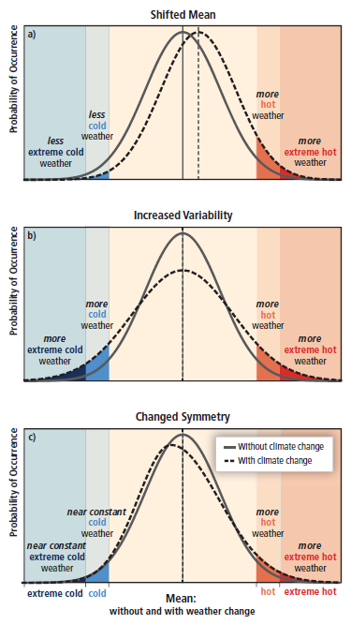
According to IPCC Report
Some types of extreme weather and climate events have increased in frequency or magnitude, but populations and assets at risk have also increased, with consequences for disaster risk.
Opportunities for managing risks of weather- and climate-related disasters exist or can be developed at any scale, local to international.
(IPCC report on “Managing the Risks of Extreme Events and Disasters to Advance Climate Change and Adaptation”, 2012)

Slide 44
Q2: How to Identify the Extreme Values or Percentiles from satellite derived products?

Slide 45
Our challenging is to “detect” the extreme values or percentiles from satellite derived products, such as precipitation, to be used for monitoring weather and climate extremes;
If the satellite products already covers a reasonably long period (i.e. > 15 years), we can perform a calibration against co-located in situ data, so that the percentiles for the satellite derived variables are equivalent to those for the in situ data.
If the satellite data is very short, like only two or three years, then it is needed to do a validation to demonstrate it can capture the extreme events, then use the product in a more or less qualitative manner. But still it is useful because satellite products have extensive spatial coverage that many in situ networks are often sparse.

