Slide 1
Joint CEOS/CGMS Working Group on Climate
10th Session
Agenda

Slide 2
Day 1 Afternoon
1. Introduction and Context
14:00 – 14:10 | Welcome (Jörg Schulz)
14:10 – 14:20 | Round table introduction (All)
14:20 – 14:30 | Acceptance of Agenda (Jörg Schulz)
14:30 – 15:00 | Status of Working Group (Jörg Schulz)
2. Nomination of New Vice Chair
15:00 – 15:15 | Candidate(s) introduction and decision on recommendation to CEOS and CGMS (Jörg Schulz)
3. Data Record Definitions
15:15 – 15:30 | Introduction on FCDR, CDR, ICDR (Chris Merchant)
15:30 – 15:45 | Importance to produce ICDR for climate extreme monitoring in operation (Toshiyuki Kurino)
15:45 – 16:15 | Discussion and eventual endorsement of proposals
16:15 | Coffee break and move to Plenary for GCOS Summary

Slide 3
Day 2 Morning
4. GHG Monitoring
08:30 – 10:00 | CEOS/CGMS status on GHG monitoring (Mark Dowell, David Crisp) Lessons learned from a-decade long GOSAT observations (Akihiko Kuze) Activities of the CEOS AC-VC (Ben Veihelmann, David Crisp) Activities of CEOS WG CV Atmospheric Composition Subgroup and CGMS GSICS (Bojan Bojkov) Towards an operational GHG monitoring system (Bojan Bojkov)
10:00 – 10:30 | Coffee Break
10:30 – 12:00 | Towards a roadmap for GHG monitoring (Mark Dowell) Organisation of GHG monitoring work in WGClimate (Jörg Schulz) Discussion and Decision for Plenary Action CEOS-32-05 for CEOS-SIT (Jörg Schulz)
12:00 - 14:00 | Lunch

Slide 4
Day 2 Afternoon
5. WMO Congress, Initiatives and Case Studies
14:00 – 14:45 | Resolution for 18th WMO Congress on Architecture for climate monitoring from Space (Werner Balogh) WMO Congress side event agenda, contributions, who is there (Jörg Schulz and Werner Balogh)
14:45 – 15:15 | Evolution of SCOPE-CM (Jeff Privette)
15:15 – 15:45 | Coffee Break
15:45 – 16:15 | Status of Space Climate Observatory (Selma Cherchali)
16:15 – 17:00 | Discussion on way forward for case studies for the architecture (Jörg Schulz)
Dinner: ?

Slide 5
Day 3 Morning
6. Joint Meeting with WCRP DAC
09:00 – 10:30 | Discussion on WCRP strategic priorities (Michel Rixen) CEOS/CGMS WG Climate Update (Jörg Schulz) Status of ECV Inventory (Alexandra Nunes) Gap analysis past and future (Jörg Schulz and Alexandra Nunes)
10:30 – 11:00 | Coffee Break
7. ECV Inventory Gap Analysis Organisation
11:00 – 11:30 | Registration of ECV Inventory CDRs in the CEOS International Directory Network (IDN) (Mirko Albani)
11:30 – 12:30 | Gap Analysis 2019 Organisation (Alexandra Nunes) Main targets (comparison to ECV 2.0, new ECVs, GCOS actions, …) Process and timeline Commitments
12:30 – 14:00 | Lunch

Slide 6
Day 3 Afternoon
Agency Presentations
14:00 – 15:30 | JAXA, NASA, ESA, WMO
15:30 – 16:00 | Coffee Break
16:00 – 17:00 | EUMETSAT

Slide 7
Day 4 Morning
Climatemonitoring. Info, Summary and Actions
09:00 – 10:00 | Evolution of climatemonitoring.info (Jörg Schulz)
10:00 – 11:00 | Review of Minutes and Actions, Concluding Remarks (Jörg Schulz)

Slide 8


Status of Joint CEOS/CGMS WGClimate
Jörg Schulz, EUMETSAT
Chair Joint CEOS/CGMS Working Group on Climate
John Dwyer, USGS
Vice Chair Joint CEOS/CGMS Working Group on Climate
Notes:
CEOS (the Committee on Earth Observation Satellites): September, 1984 is made up of 55 Agencies from all around the world committed to coordinating their satellite Earth observation programs and sharing data for a more sustainable and prosperous future. These satellite observations are critical for environmental monitoring, meteorology, disaster response, agriculture and many other applications (take a look at these case studies) that can improve life on Earth and save lives.
CEOS organizations currently operate 112 satellites. These satellites and their related systems operate simultaneously and serve both interdisciplinary and international activities; therefore, international discussion and cooperation are critical to their success.
CGMS: 19 September 1972, 16 members + 6 observers, coordinates the meteorological observing system. The main goals of the coordination activities of the Coordination Group for Meteorological Satellites are to support operational weather monitoring and forecasting as well as climate monitoring, in response to requirements formulated by WMO, its programmes and other programmes jointly supported by WMO and other international agencies.

Slide 9
WG Climate Leadership Proposal at 2018 CEOS Plenary
USGS informed CEOS that current Vice-Chair John Dwyer, unfortunately cannot fulfil Chair term Nov. 2019-Nov. 2021;
WGClimate is in need for a new Chair and Vice-Chair in Nov 2019;
Deviating from the ToR WGClimate proposed:
  Ask agencies for nominations for a new Vice-Chair with reduced term Nov. 2019-Nov. 2020 becoming Chair for Nov. 2020-Nov. 2022;
  WGClimate plan to decide on nominations at next WGClimate meeting with endorsement at 33rd Plenary 2019;
  Extend term of current chair, Jörg Schulz (EUMETSAT) by one year to Nov. 2020 with endorsement at 33rd Plenary 2019.
Rational:
  Replacement of complete leadership in Nov. 2019 is difficult to achieve;
  Proposed deviation from the ToR is because of exceptional circumstances;
  WGClimate activities need stability in leadership of the WG.
Plenary endorsed proposal – this makes Item 2 of our Agenda.

Slide 10


Leadership
November 2017 – November 2020
Chair: Jörg Schulz (EUMETSAT)
Vice Chair: John Dwyer (USGS) until 2019
incoming Vice Chair 2019
November 2020 – November 2021
Chair: incoming Vice Chair 2019
Vice Chair: asking for proposals by Agencies

Slide 11
Achievements since last meeting
Finalised first gap analysis and coordinated action plan and got both endorsed by 2018 CEOS and CGMS Plenaries;
Opened climatemonitoring.info that provides access to the ECV Inventory and analysis results;
Provided analysis report on space agency contribution to the implementation of the Paris Agreement;
Received go ahead for inclusion of coordination task for GHG monitoring in WGClimate including endorsed change of WGClimate TOR;
Finalised the statement to SBSTA-49, an extra report, and contributions to the SBSTA Chair report. Provided a presentation by EUMETSAT to SBSTA-49 Systematic Observations Delegates;
Launched population of ECV Inventory 3.0.

Slide 12
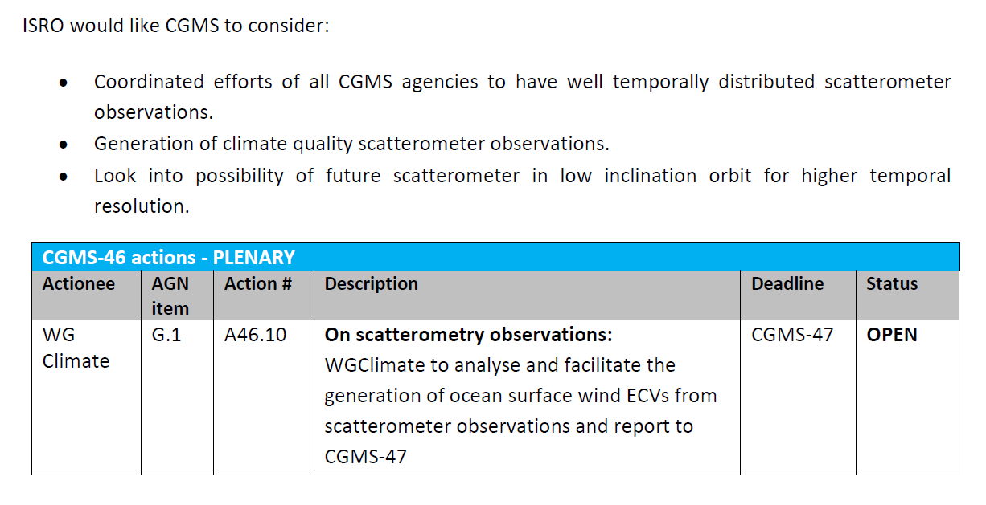
CGMS-46
Gap Analysis

Slide 13
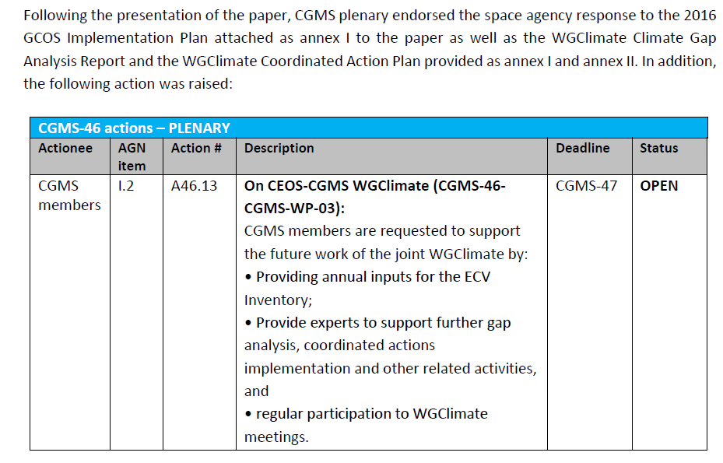
CGMS-46

Slide 14
Space Agency contribution to the
Paris Agreement
CEOS-31-01 | WGClimate to explore development of a brief, consolidated statement of space agency contributions in support of each Article of the Paris Agreement. | 32nd CEOS Plenary
✓
Consulted GCOS and GEO that performed similar analysis in their areas;
Applied categorisation of Paris Agreement articles as depicted by GCOS (see next slide);
Document provides an assessment in support of individual articles of the Agreement;
Addressed in particular CEOS cross cutting Working Groups contributions;
Plan to publish the short note of 9 pages on CEOS and climatemonitoring.info web sites;
Plenary closed the action.

Slide 15
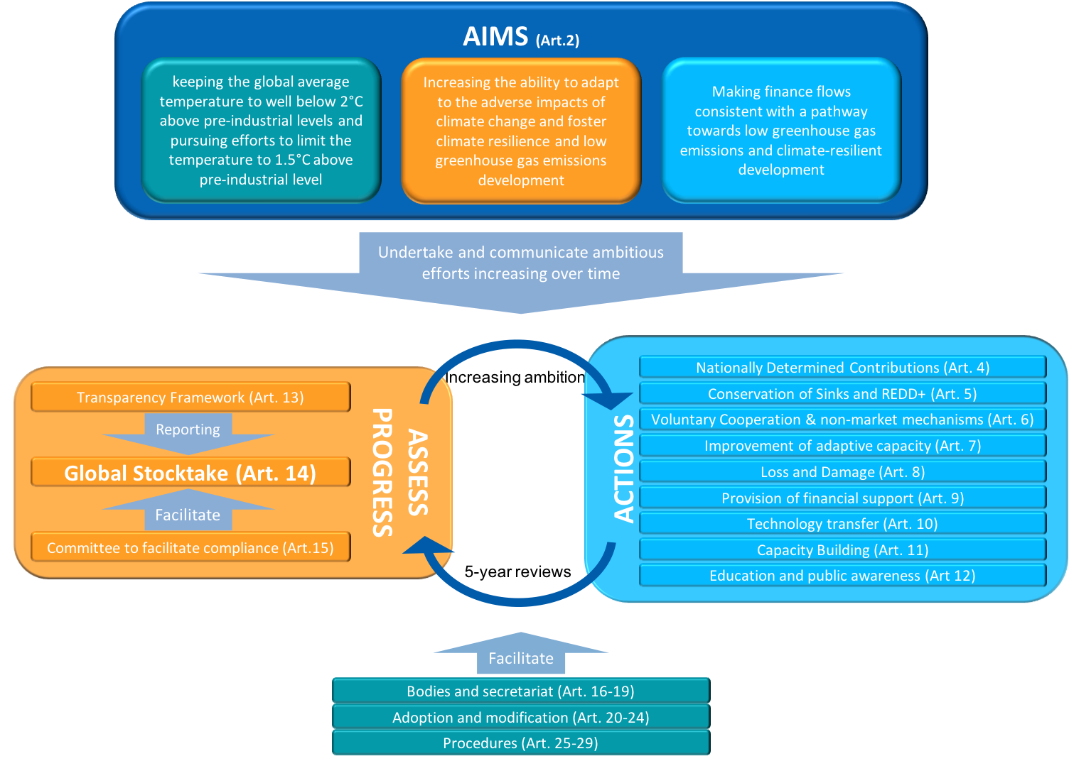
Statement on the Paris Agreement

Slide 16
CEOS-32 Plenary
Paris Agreement Report
UNFCCC/SBSTA-49
WGClimate Leadership
Space Climate Observatory

Slide 17
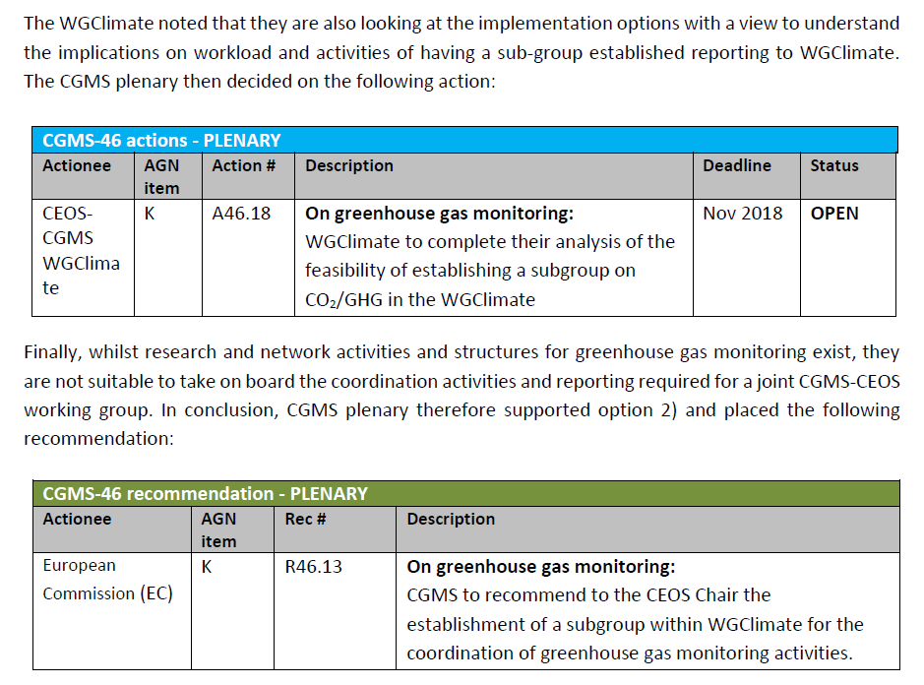
CGMS-46
GHG Monitoring

Slide 18
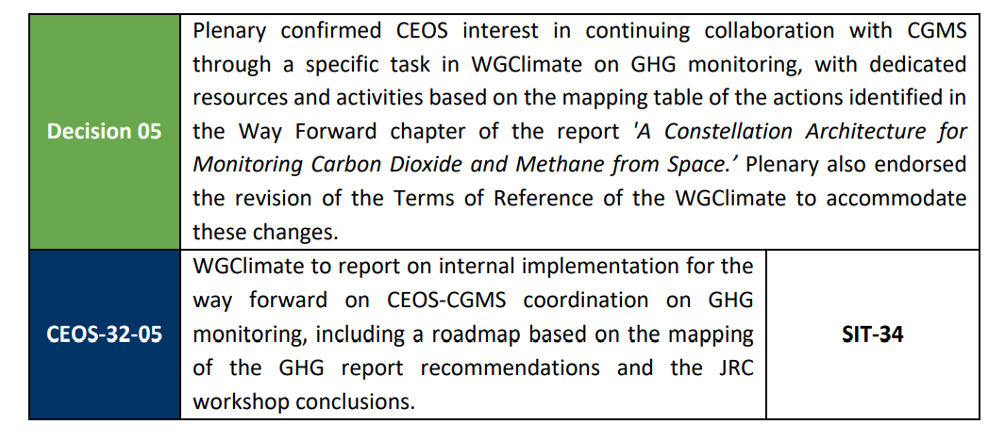
CEOS-32 Plenary
GHG Monitoring

Slide 19
Implementation of Coordinated Actions
Implementation of Coordinated Actions will be distributed in CEOS and CGMS;
Implementation has started:
  Presentation and first discussion with WGCV on CDR validation;
  First activities and discussion with MIM and OSCAR on addressing issues in those data bases relevant for gap analysis;
  First discussion with VC-SST on how to address analysis of usefulness of not used historical sensors for SST data records;
  VC-PV is taking up recommendation and action on precipitation to stimulate the production of an improved precipitation climatology;
Telecons were planned with all impacted VCs to address Actions and understand VC/WG capabilities with the target to make arrangements for the update of the CEOS Workplan 2019-21. However, I was not very successful.

Slide 20
CEOS 2019-2021 Workplan
Climate Monitoring, Research, and Services Objectives/Deliverables: 2019-2021
Objective/Deliverable | Projected Completion Date | Background Information | Responsible CEOS Entity
Information dissemination and communication
CMRS-13: Development and Promotion of Case Studies | Q3 2019 | Previous work, supervised by the EC JRC and WMO, has already produced WMO 1192 Case Studies for Establishing an Architecture for Climate Monitoring from Space. WGClimate #10 will discuss how additional case studies may be realized. The results and potentially an updated plan for case studies is targeted for 2019. | WGClimate

Slide 21
CEOS 2019 – 2021 Workplan
Annual delivery of the Essential Climate Variable inventory
CMRS-17: Collection, incorporation, and quality control of new & updated information from data providers | Q4 every year | Based on a stable questionnaire, with potential updates of the inventory structure, to accommodate, for example, requirements stemming from C3S and WCRP; and experiences from applicable projects. | WGClimate
CMRS-20: Gap analysis | Q4 every year | WG chairs will initiate gap analysis work that always provides incremental updates to the year before in terms of improvements on the compliance to GCOS requirements and a report in focus areas addressing needs of CEOS and CGMS. The gap analysis is coordinated by the WG Chair team and support by several expert teams that will perform the gap analysis in parallel. | WGClimate
CMRS-21: Action plan | Q4 every year | The action plan identifying agreed actions that CEOS and CGMS Members and Associates intend to take to address priority gaps will be updated once a year. The actual action plan will be endorsed and released to the CEOS community at a suitable meeting. | WGClimate

Slide 22
CEOS 2019 – 2021 Workplan
Engagement with UNFCCC and GCOS
CMRS-22: CEOS contribution to COP meetings | Q4 every year | WG Chair drafts the "Space Agencies Statement" and other contributions as agreed with the UNFCCC Secretariat and presents this for endorsement to CEOS Plenary. | WGClimate
CMRS-23: Intermediate report on the status of the Space Agency Response to the 2016 GCOS Implementation Plan | Q3 2020 | This report assesses the status of activities from the "Space Agencies response to the 2016 GCOS IP" and provides an updated of the report to GCOS. Report is assumed to need endorsement by CEOS and CGMS Plenaries. This should consider the Coordinated Action 12 on monitoring progress on GOCS Action T71 (results for this should come from action CMRS-30-2018-1). | WGClimate
CMRS-24: Support to the GCOS Status report on observing systems for climate monitoring | Q3 2021 | WGClimate shall support to the assessment of the fulfilment of the 2016 GCOS IP. Outputs from Actions CMRS-23, 24, and 28 shall provide a solid picture of space agencies contributions. | WGClimate

Slide 23
CEOS 2019 – 2021 Workplan
Implementation of the international greenhouse gas monitoring system
CMRS-25: Provide oversight to the implementation of the international greenhouse gas monitoring system (Coordinated Actions 11, 13, and 14). | Q3 2019 Q3 2021 Q3 2026 | Three sub deliverables are defined: Establish a roadmap for the development of a GHG monitoring system Develop of a prototype GHG monitoring system Develop the initial operational GHG monitoring system | WGClimate
Climate Data Records
CMRS-26: Update definitions for FCDR, CDR, ICDR (Coordinated Action 1) | Q3 2019 | Update definitions for Fundamental Climate Data Records, Climate Data Records for GCOS ECVs and Interim Climate Data Records for both types of data records. It is planned to agree on definitions at 10th and 11th WGClimate meetings during 2019. | WGClimate
CMRS-27: Implement Coordinated Actions 5 on FCDR Inventory, 6 on nomenclature document for CDRs, 10 on meta data standards | Q3 2020 | Upgrade the ECV Inventory technically that it can provide information on Level 1 base data records (FCDRs) used for CDRs of GCOS ECVs. Provide to CEOS agencies documentation on CDR related nomenclature and meta data standards. | WGClimate

Slide 24
Goals for this meeting
Nominate a new Vice Chair;
Discuss and potentially agree on definitions for data records;
Devise way forward for inclusion of coordination of GHG monitoring;
Discuss and agree WMO report to 18th Congress;
Discuss future of SCOPE-CM and SCO;
Discuss future case studies for the architecture;
Organise next gap analysis;
Meet with the WCRP DAC and discuss WCRP strategic priorities;
See and admire some agency presentations;
Discuss future evolution of climatemonitoring.info.

Slide 25
Next Meeting
We will need another meeting prior the CEOS Plenary (14-17 October 2019 in Hanoi):
  To close out the SBSTA-51 statement and other needed constributions;
  To close out the 2019 gap analysis report and the updated coordinated action plan;
  To monitor progress on GHG roadmap
  Maybe to finish ICDR story
Propose to have this before or after the CEOS Technical Workshop which is scheduled for 9-13 September in Fairbanks, Alaska, USA. We could do a meeting the week before (4-6 Sep) in Fairbanks or Anchorage.

