Slide 1
WGCV-53 summary
For GHG task team meeting
Jaen-Christopher Lambert
WGCV ACSG chair
John Worden, Akihiko KUZE,
GHG task team
11th March 2024

Slide 2
Topics
A. Joint Cal/Val Campaign meeting for OCO-TROPOMI-TEMPO-GOSAT
B. GHG match-up database: GOSAT, GOSAT-2 AIRS, IASI, CrIS
C. GHG Cal/Val Networks, Resources and IMEO WG
D. Updates to Annex-C

Slide 3
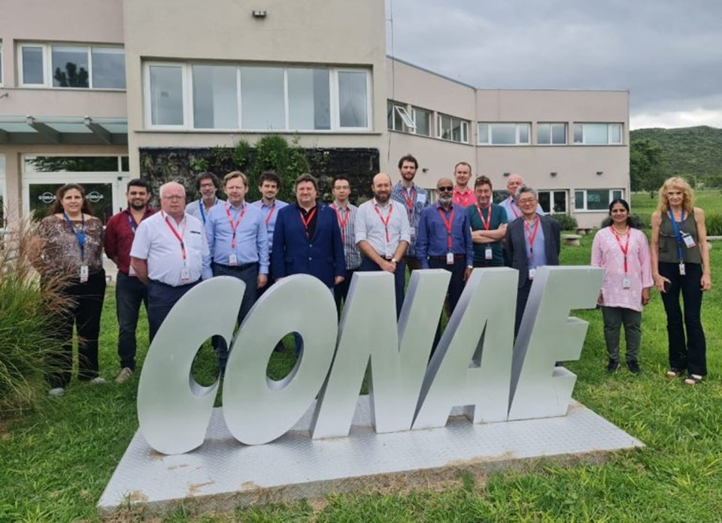
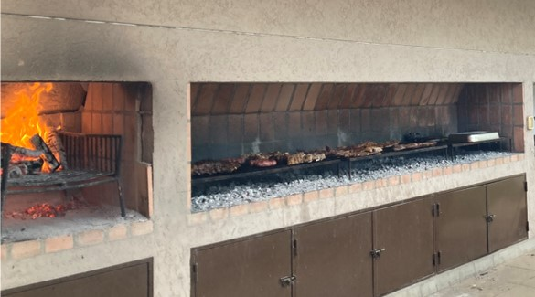
WGCV-53
Event Dates: 5-8 March, 2024
Location: Córdoba, Argentina
Hosted by: CONAE
CONAE Cafeteria

Slide 4
Actions
WGCV-53-ACT-01
In support of the SITSat Task Team’s communication strategy, WGCV members are asked to help gather examples/case studies regarding ‘real world’ impacts of the reduction in uncertainties that are facilitated by SITSats.
We seek to show the unique value of these types of missions and highlight differences between usual calibration practices and those provided by SITSats. Examples should be accompanied by clear, transparent metrics (financial, improved decision-making, etc.).
Notes:
The paper from Bruce Wielicki of NASA was cited as a good example.
LPV Chair noted ongoing assessments related to soil moisture, cost-value estimates that might be applicable.
ACSG Chair noted two potential examples: (i) improving the accuracy of XCO2 and XCH4, e.g., to be able to resolve natural CO2 fluxes varying by about 0.2 ppm/100 km and ocean fluxes varying by less than 0.1 ppm/100 km while the current XCO2 accuracy remains 0.8 ppm (John Worden), and (ii) reach the aerosols/PM2.5 accuracy needed to monitor environmental policies (Shobha Kondragunta). Ref.: discussions in AC-VC-19/ACSG Joint Meeting 2023.

Slide 5
Actions
B. WGCV-53-ACT-14
Paolo, Nigel and Kuze-san, to work with Jean-Christopher Lambert on the issues with the Fiducial Reference Measurements (FRM) Assessment Framework specifically for the atmospheric domain.
Notes: May need some clarifications in the accompanying documentation regarding the situation / approach for Level 2 atmospheric data.

Slide 6
A. RRV Vicarious calibration
Summary of TROPOMI-OCO-GOSAT calibration meeting (Jan. 19)
Long term L1B using prelaunch vs forward calculation with a common RT model with RRV campaign data using 5 different footprints of GOSAT, GOSAT-2,OCO-2, OCO-3 and TROPOMI with viewing geometry and IFOV correction
Uncertainties Estimation toward seamless multi-sensor and long-term data set
Investigate the difference of 5% in OCO-2 between JPL and GOSAT team analysis
BRDF correction error
Long term stability (RRV2023 shows large change in forward viewing geometry)
Geometry correction error (forward and backward reflection)
Large off-nadir angle correction (especially for OCO-3, TROPOMI)
Polarization (sensitivity 2—5% estimated from RRV2023, should be updated in RRV2024 campaign)
3. Recommendation of geometry and data selection for vicarious calibration

Slide 7
A. Solar and Lunar Calibration products
1. Request by the TSIS team
The TSIS team is interested in long term and high spectral resolution data from solar calibration by GHG spectrometers
2. Lunar Calibration WS at EUMETSAT in Dec. 2023
GOSAT-2 lunar calibration presentation
Deviation of the absolute radiometric calibration from the lunar model it too large.
Request for Hight spectral resolution data and TIR data by GOSAT and GOSAT-2 (no TIR data were acquired yet to avoid operation risk)
3. Long term and analysis ready GOSAT solar calibration data

Slide 8

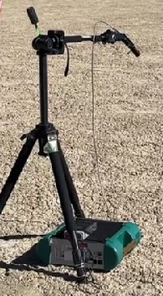


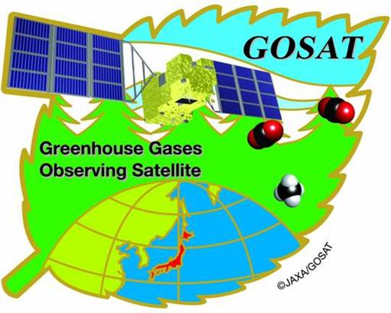


A. Plan for 2024 joint
Vicarious Calibration Campaign
16th Joint Vicarious Calibration Campaign June 12-17, 2024
June 14 (TROPOMI nadir (8.1 deg) , OCO-2, GOSAT)
June 16 (TROPOMI off nadir (46.3 deg), OCO-2, GOSAT, GOSAT-2)
2. OCO-3 becomes ready from the storage and after initial check
3. Estimate uncertainties
Update polarization sensitivity of the playa surface
4. Add TEMPO near O₂-A (POC: Xiong Liu, Harvard Smithsonian)
Spectral range: 290–740 nm (UV, VIS); spectral sampling: 0.2 nm; spectral resolution: 0.6 nm

Slide 9
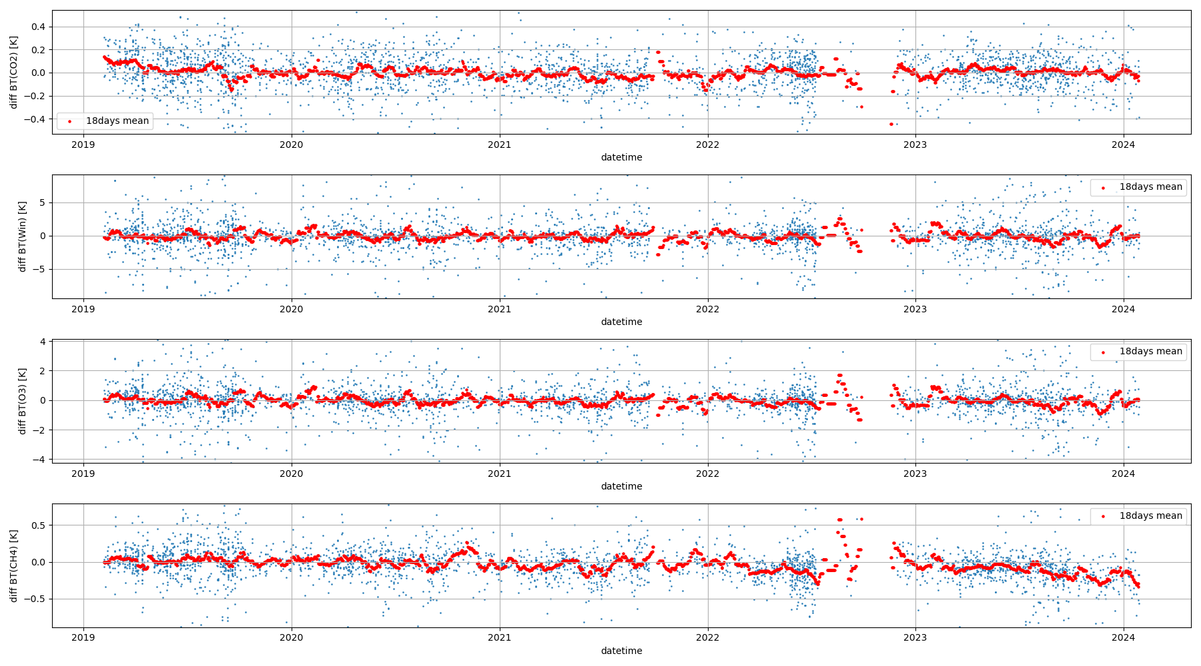
B. GHG match-up database (nadir)
SNO match up data set
SNO match ups dataset collaborating with SSEC, U of Wisconsin
GOSAT GOSAT-2
AIRS
(to be replaced by NOAA-20, 21 CrIS)
IASI
Long term (5 year)
GOSAT-2 IASI SNO
CO₂: 681.99-691.66 cm⁻¹
Window: 900.31-903.78 cm⁻¹
O₃ : 1030.08-1039.69 cm⁻¹
CH₄: 1304-1306 cm⁻¹
GOSAT2 - IASI (2019～2023) distance <100km, |lat| < 2deg, |SAT zenith| < 2deg, |GOSAT-2 AT| < 2deg

Slide 10
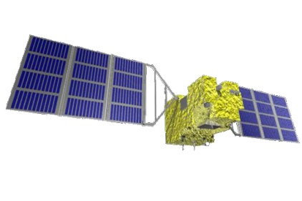

B. GHG match-up database (off-nadir)
Needs for 2O-SONOs
2-orthogonal simultaneous off-nadir overpass (2O-SONO)
GOSAT and GOSAT-2 have 2-axis pointing capability improve targeting GHG emission points such as mega cities.
TIR needs frequent calibration but only 1-axis rotation for calibration
Demonstrates AT vs CT Cross-Calibration
GOSAT
AT angle
Ascending
AIRS
Scan angle
(+)
Descending
Suto et al., Atmos. Meas. Tech 2022

Slide 11
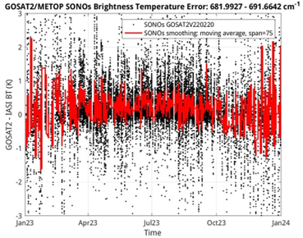
B. GHG match-up database (off-nadir)
SONO match up data set
Long term (5 year) GOSAT-2 IASI SONO
CO₂ 682-692 cm⁻¹
+Y(pitch)
North
G2 swath
IASI swath
G2 AT>0
SNO
IASI=0deg
G2=0deg
NH
Lat=81deg
G2 AT<0
Lat=74deg
SONO
IASI= -38degCT
G2= -38degAT
09:30
13:00

Slide 12
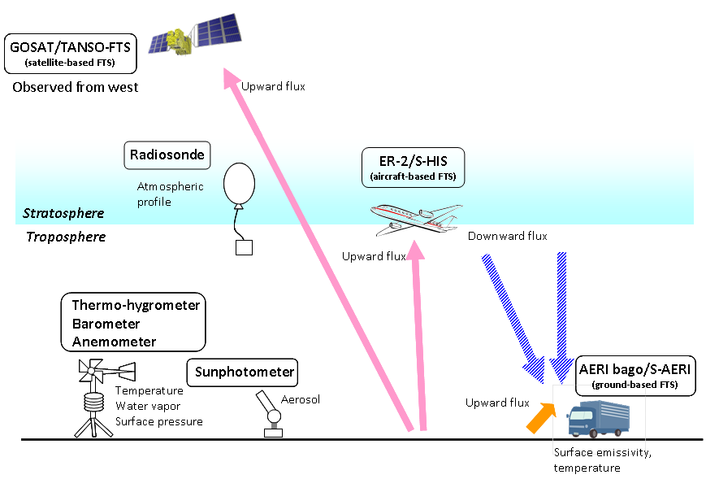

B. GHG match-up database (off-nadir)
Double Difference X-CAL
Double Difference =
((Measured by A) – (Simulation for A)) - ((Measured by B) – (Simulation for B)) -
To minimize the caused by due to geometry difference, radiative Double
Ground data can reduce uncertainties
Kataoka et al., TGRS 2014

Slide 13
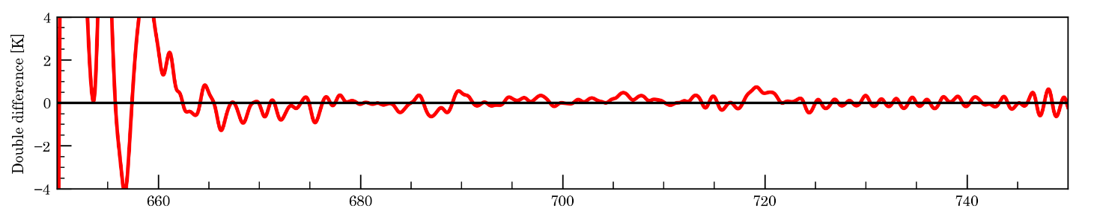
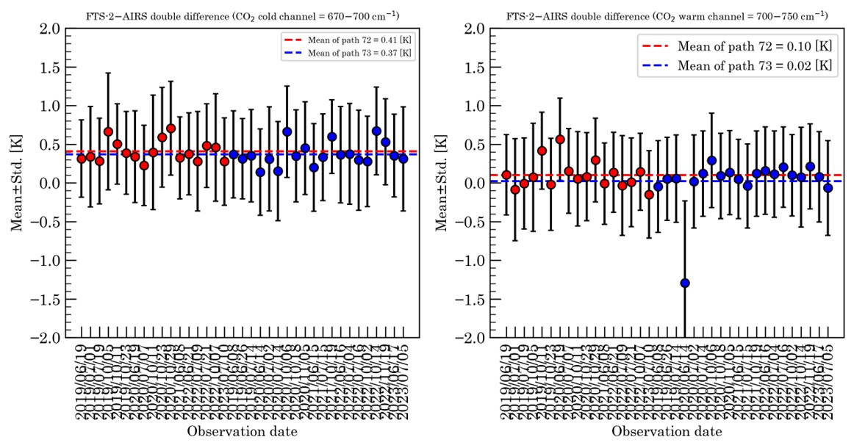
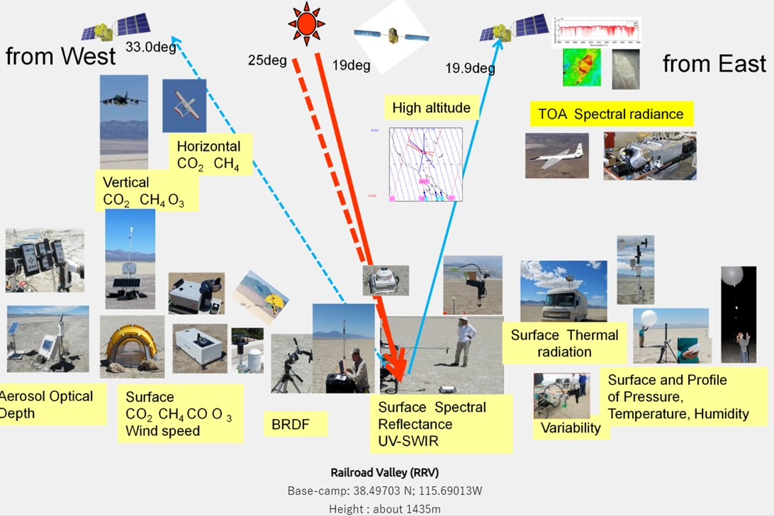
B. GHG match-up database (off-nadir)
Double Difference X-CAL over RRV site
Multiple sensors observe RRV calibration site from different geometries.
Surface reflectance, BRDF, Emissivity are available.
Double difference approach will minimize the bias due to different geometry

Slide 14
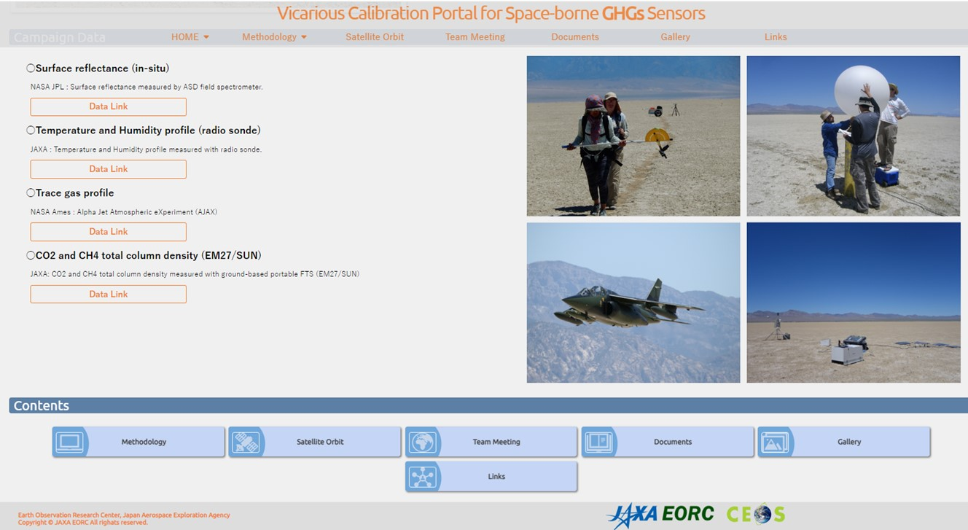
B. GHG match-up database Double
Long term & high spectral resolution data will be available from GHG Cal site

Slide 15
GHG Cal/Val Networks, Resources and IMEO WG
GHG Cal/Val Networks Sustainability and Tailoring
Development of GHG Cal/Val Resources Catalogue
UNEP/IMEO Cal/Val Testing WG

Slide 16
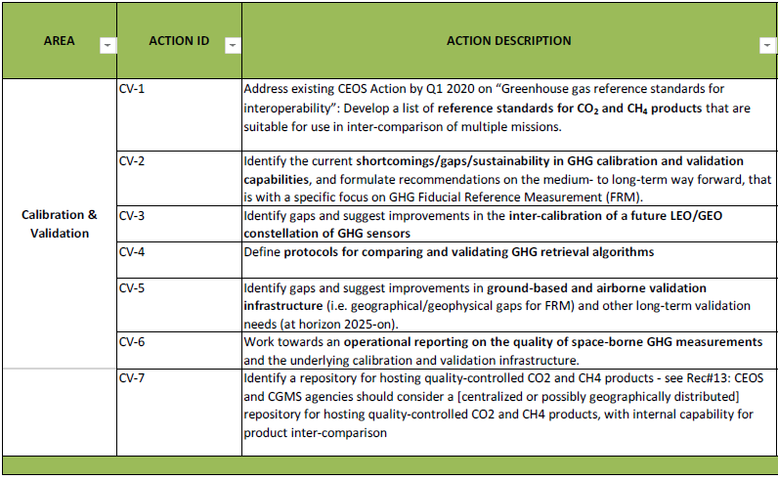

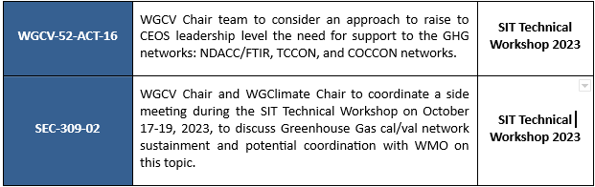
CV-2/5/6: Networks Sustainability and Tailoring
GHG constellation roadmap – Annex C: Implementations actions – Calibration & Validation
https://ceos.org/meetings/wgcv-52/

Slide 17

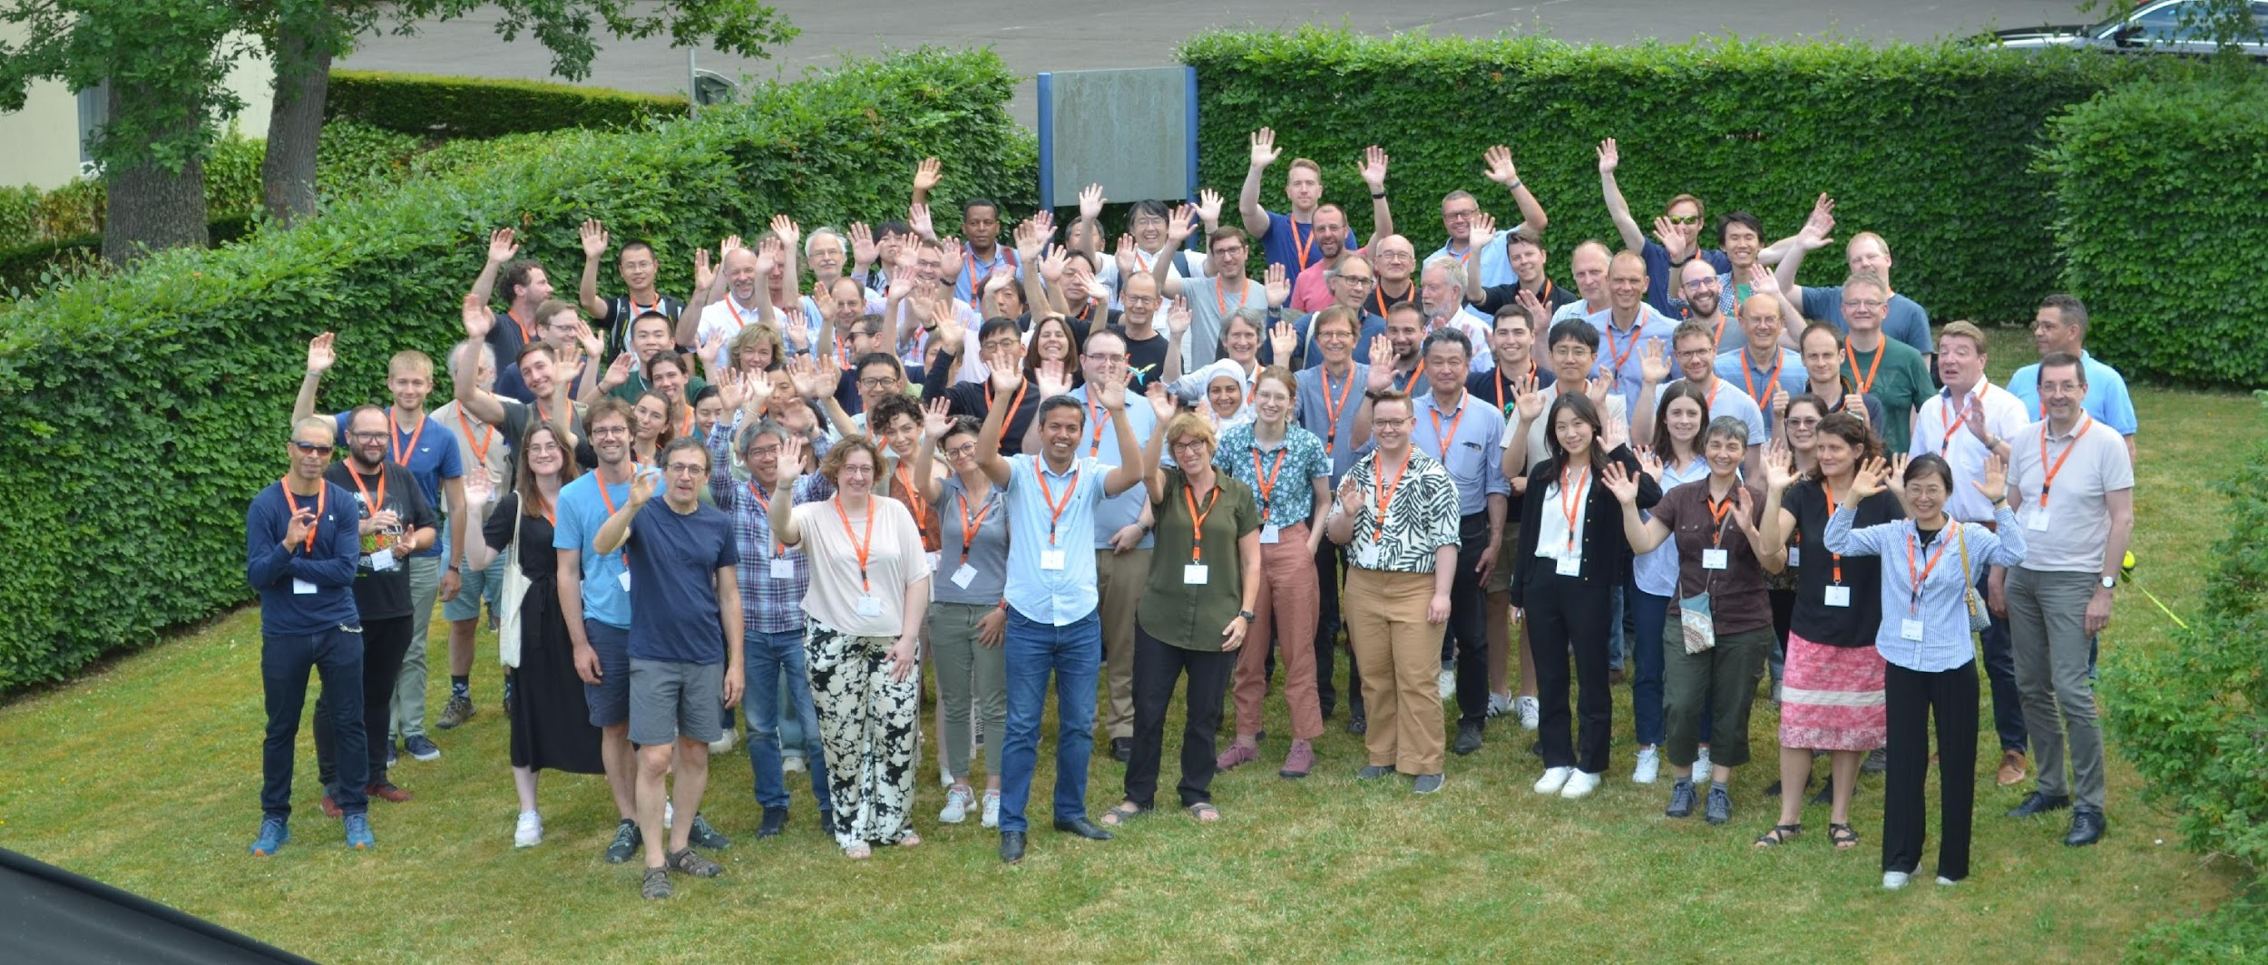
CV-2/5/6: Networks Sustainability and Tailoring
GHG Constellation Roadmap v2.3 – Annex C: Implementations actions – Calibration & Validation
CV-2 Identify the current shortcomings/gaps/sustainability in GHG calibration and validation capabilities, and formulate recommendations on the medium- to long-term way forward, that is with a specific focus on GHG Fiducial Reference Measurement (FRM).
CV-5 Identify gaps and suggest improvements in ground-based and airborne validation infrastructure (i.e. geographical / geophysical gaps for FRM) and other long-term validation needs (at horizon 2025-on)
https://events.spacepole.be/event/160/

Slide 18

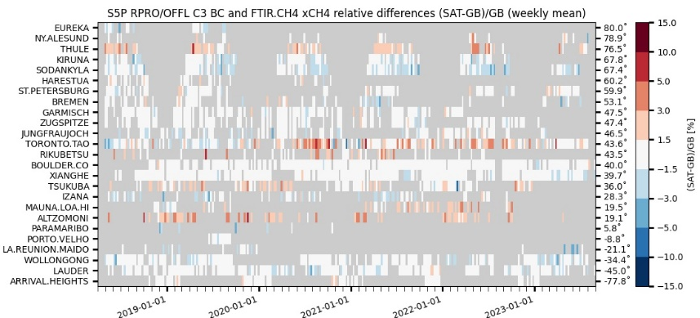


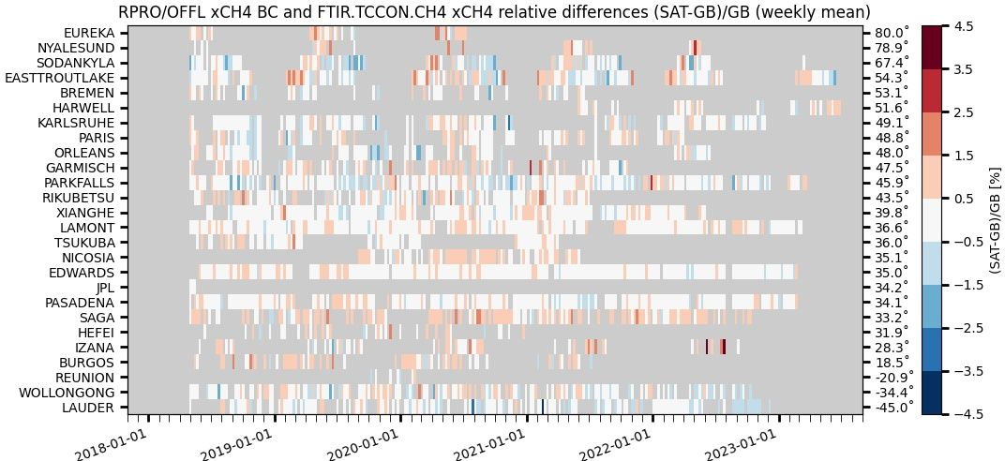

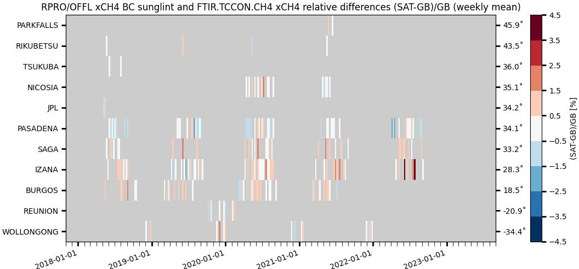





CV-2/5/6: Networks Sustainability and Tailoring
GHG Constellation Roadmap v2.3 – Annex C: Calibration & Validation
CV-6 Pathfinder: ESA/Copernicus ATM-MPC Sentinel-5P CH₄ and CO operational validation relying on the three GHG column/profile monitoring networks
    NDACC FTIR : automated validation channel in ATM-MPC Automated Validation Server (https://mpc-vdaf-server.tropomi.eu).
      Validation protocols based on published experience with HALOE, MOPITT, SCIAMACHY, MIPAS, ACE-FTS, IASI, GOSAT…
    TCCON FTIR : manual validation channel in ATM-MPC, ESA contract for operations support to be placed; EUMETSAT FRM Roadmap and CO2M Cal/Val Studies in progress
    COCCON FTIR : manual validation channel in ATM-MPC, EVDC data collection and automation in progress (ESA FRM4GHG 2023-2027)
S5P TROPOMI CH4 & CO validation updated permanently vs. NDACC FTIRs
and monthly – when and where data available – vs. TCCON & COCCON FTIRs.
Quarterly validation reports available on http://mpc-vdaf.tropomi.eu
CH₄ images courtesy M.K. Sha
ATM-MPC review October 2023
Automated collection of observations from 17
NDACC FTIR stations
through EVDC =>
automated production of S5P Quality Indicators
TCCON GGG2020 data
released 26 April 2022
No/limited data submitted
between early 2021 and the
release of new data version
GGG2020
Collection of permanent
and campaign based
observations
~17 COCCON stations
to contribute in the
future

Slide 19
CV-2/5/6: Networks Sustainability and Tailoring
Recommendations presented at CEOS SIT/GHG-TT TW 2023 for Cal/Val networks capabilities, infrastructure and operational capacity
To be incorporated in CEOS GHG Constellation Roadmap v2.3 – Annex C: Implementation Actions – Calibration & Validation
NETWORKS DESIGN AND EVOLUTION: to support gap analysis studies with a view to tailoring CO₂,CH₄ and N₂O networks deployments to Cal/Val needs of the GHG satellite constellation: background/hot spots, land/ocean, low/high albedo, full range of atmospheric temperature…
INSTRUMENT DEPLOYMENT: (i) to further develop (low-cost, light-weight, mobile) low-resolution infrared instruments; (ii) to support standardized production of enclosures for their deployment in the field; (iii) to maintain a supply of spare parts.
CALIBRATION: to support the development of and maintain mutually consistent calibration and QA/QC of the GHG Cal/Val networks – within and across networks. Key actions: (i) traceability towards internationally agreed standards; (ii) more regular and network-wide deployment of traveling standard; (iii) more regular intercomparisons within and across networks, and between in situ (AirCore…) and remote sensing (networks); (iv) facilitate AirCore deployment; (v) establish a central AirCore data archive.
DATA PROCESSING: to support GHG Cal/Val network data processing improvements needed to maintain FTIR data precision/accuracy and meet future goals: formal intercomparison exercise of the GGG and PROFFAST retrieval algorithms, development and standardization of profile retrievals, spectroscopy studies.
Notes:
- Stratospheric gliders available and demonstrated. E. g., at NOAA with AirCore onboard; by Stratodynamics company (Canada) but not yet with AirCore onboard. Proposals for embedding AirCore as payload exist but have not been funded…

Slide 20
CV-2/5/6: Networks Sustainability and Tailoring
Recommendations presented at CEOS SIT/GHG-TT TW 2023 for Cal/Val networks capabilities, infrastructure and operational capacity
To be incorporated in CEOS GHG Constellation Roadmap v2.3 – Annex C: Implementation Actions – Calibration & Validation
DATA ACCESS: to establish interoperable GHG Constellation Cal/Val Data archives and tools for tailored network data (traceable, open, metadata, co-located…) and ‘hidden’ data (e.g. campaigns), ideally coupled to New Space related matchup database(s).
TIMELINESS: to organize concertation between stakeholders and with networks data providers to support rapid and continuous availability and improved access to networks-wide GHG data.
CENTRAL PROCESSING FACILITIES (CPF): to establish central processing facilities for every network product, which will directly support harmonized calibration (3), data processing, QA/QC and tailoring (4-5) and timeliness (6).
GHG EMISSIONS AND ATTRIBUTION: to support the development of new Cal/Val protocols for satellite derived GHG emissions and fluxes, in collaboration with relevant bodies and initiatives (global stocktakes, WMO GGGW, UNEP IMEO, New Space…) Consider co-located measurements of GHG and tracers of anthropogenic/biogenic contributions for better attribution of emissions.

Slide 21
Cal/Val Resources Status and Catalogue
GHG Cal/Val in AC-VC-19 / ACSG joint meeting (2023/10, Brussels)
https://ceos.org/meetings/ac-vc-19-acsg-joint-meeting-2023/
In Greenhouse Gases session (Chairs J. Worden and Y. Meijer)
  Talks on GHG Cal/Val networks, calibration, campaigns, other initiatives
  Engagement with WGCV on sustainability of GHG Cal/Val networks in GHG-TT report by Y. Meijer
  5 talks and general discussion on Cal/Val Status/Needs/Synergies
  Agreement to elaborate on super-sites concepts and make relevant recommendations.
In Cal/Val for the Constellations session (Chairs J.-C. Lambert and H. Tanimoto)
General talk on Cal/Val needs for the Constellations (incl. GHG constellation) by J.-C. Lambert
WGCV engagement in GHG Cal/Val by A. Kuze
GHG Cal/Val talk with outlook to Copernicus Contributing Missions (NewSpace)
Panel review of the Cal/Val needs for the AC-VC constellations (incl. GHG), general discussions on way forward

Slide 22
Cal/Val Resources Status and Catalogue
Development of a guidance document on Cal/Val resources for Greenhouse Gases similar to the hyperspectral guidance document ?
Relevant discussions at AC-VC-19/ACSG joint meeting (2023/10)
  Validation resources in CEOS whitepapers on GHG constellation Architecture (2018) and Roadmap (2020) succinct (not the main target), need an update.
  Agreement on the principle to compile a useful catalogue of Cal/Val resources.
  Key point: Scope and objectives of this document to be clarified.
  Global GHG mappers first; validation of point-source emissions data not mature yet (e.g., needs identified in IMEO Cal/Val Testing WG TN).
  Coordinate Cal/Val resources catalogue with update of GHG Constellation Roadmap Annex C (see next 3.7 report by J. Worden).
  Coordinate with elaboration of super-sites concepts (cf. 1.7 ACSG report).

Slide 23


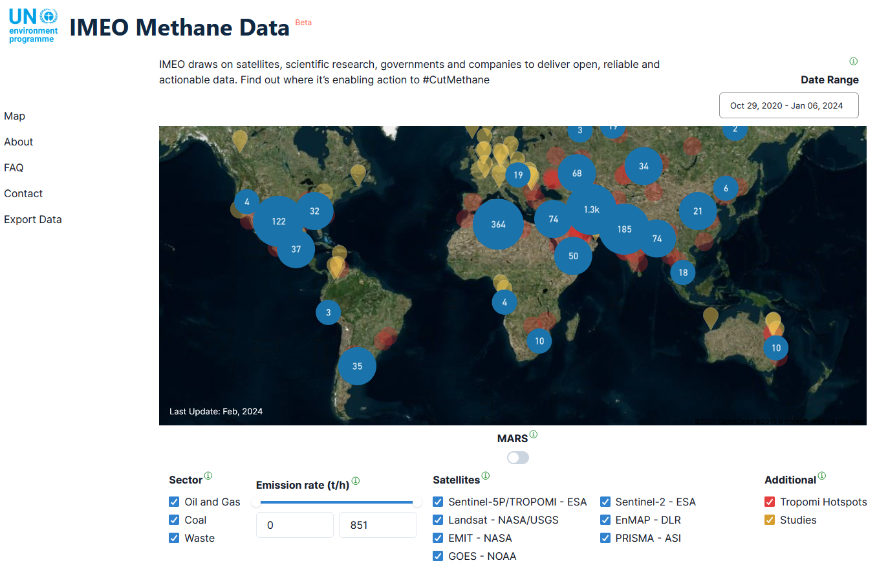
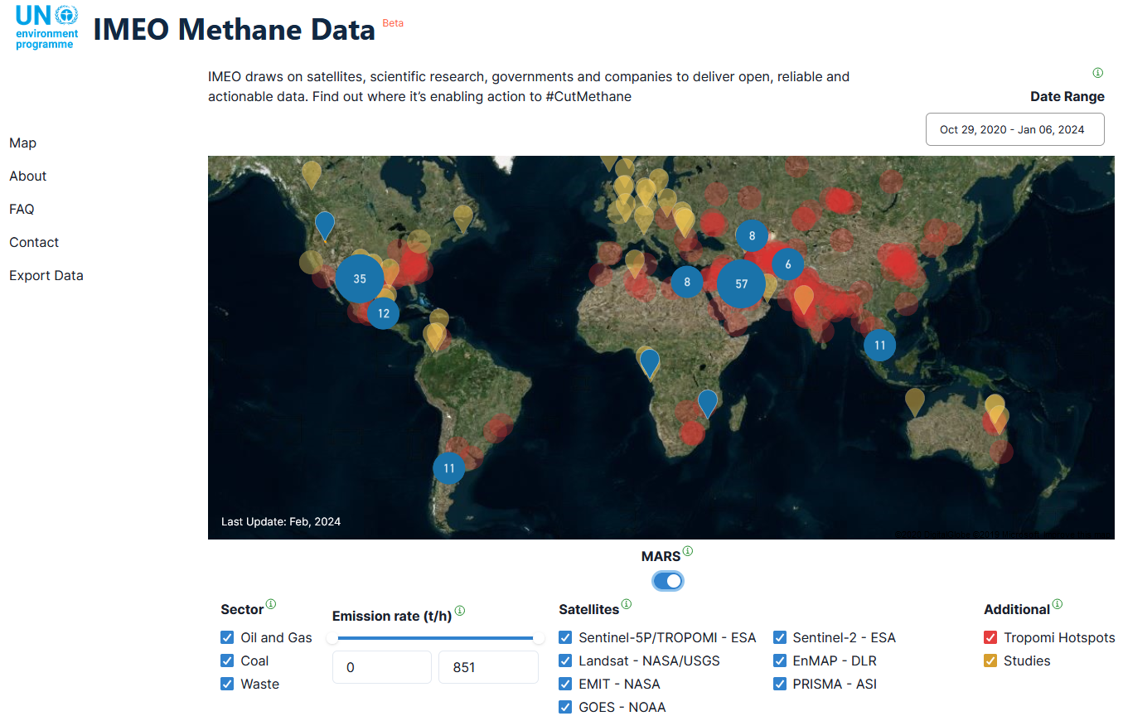
UNEP/IMEO Cal/Val Testing WG
UNEP IMEO Methane Alert and Response System (MARS): first global satellite detection and notification system providing actionable data on very large methane emissions around the world.
All UNEP IMEO’s Methane Data
MARS Satellite Data
https://methanedata.azurewebsites.net/plumemap?mars=true

Slide 24
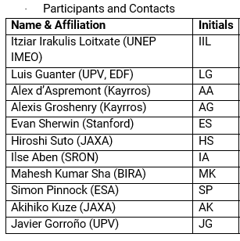
UNEP/IMEO Cal/Val Testing WG
5 thematic WGs: Observability, Use Case, Data Integration, Cal/Val/Testing, Roadmap.
Cal/Val/Testing WG – Defining testing methodologies and metrics for different patterns of emissions and scales with the intent of providing understanding of data product quality and uncertainties.
Two meetings (27 July and 11 September 2023) organized by UNEP IMEO, where a group of 11 experts gave input for the WG document.
First WG deliverable: ‘Validation of point-source methane emissions observed from space’ high-level document led by C. Randles (UNEP/IMEO) with WG contributions, to serve as input to next convening and other groups interested in same topics (e.g., CEOS)

Slide 25
UNEP/IMEO Cal/Val Testing WG
IMEO TN ‘Validation of point-source methane emissions observed from space’
  (1) Need to identify specific needs for Cal/Val of detection, localization and emission quantification from point-source methane imagers.
  (2) Data conventions
    - Need to define critical validation components. Not only validation of CH₄ emissions, but also validation of column-mixing ratio (XCH4), localization, Probability of Detection (POD) and all associated uncertainties under various conditions.
    - Need to define conventions and definitions for understanding the applicability of a given validation method: e.g., Location-blind Detection Limit, Controlled Detection Limit, Uncertainty.
  (3) Validation methodologies specific for point-source methane emissions
    - Controlled release experiments.
    - Other methods: cross-comparisons, non-satellite observations, modeling support.
  (4) Conclusions and recommendations
    - To establish common definitions for key quantities needed to define how point-source methane emissions are validated.
    - To define common standard conditions under which satellite data providers agree to assess their satellite’s performance.
    - Multiple approaches should be taken for validation to cover as many conditions as possible.
⇨ Many links with GHG Roadmap Annex C: Prod-9, Inv-1/2/6/8/9, CV-7…

Slide 26
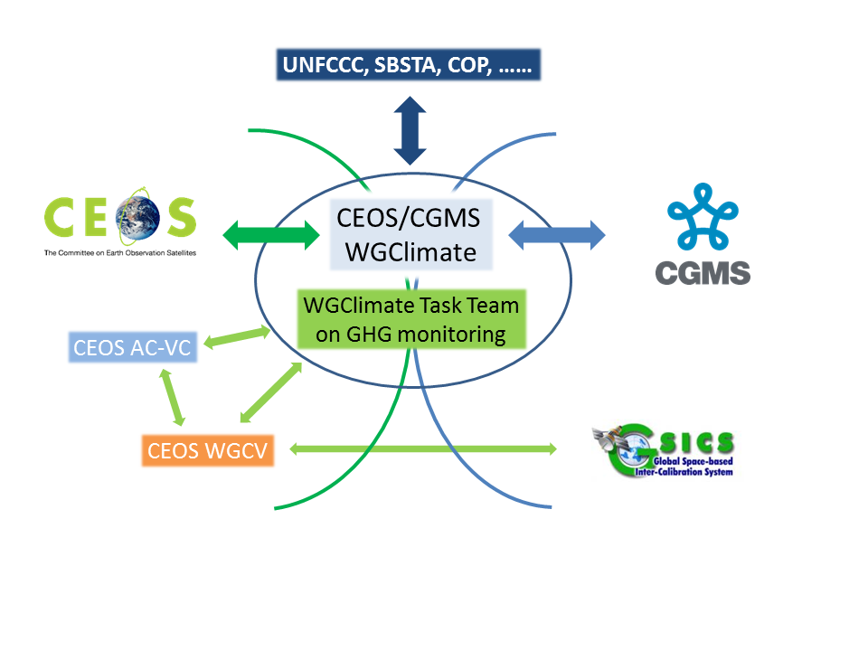
GHG Task Team – its Role
Responsible for maintaining and implementation of the GHG Roadmap and its identified Actions
Interfaces with, stimulates and monitors
GHG related activities across various
(CGMS &) CEOS WGs: WG-Climate, WG-CalVal,
AC-VC, WG-CapD, NewSpace Task Team, etc
Actively ensure representation of CEOS and CGMS bodies by identifying Points of Contact (PoCs) for tasks to be executed by these bodies
http://ceos.org/ghg-tt

Slide 27
GHG TT – organisation
Area leads (plus deputies) have been appointed using the thematic areas of Annex C (actions) in the GHG Roadmap:
Stakeholder Engagement - Mark (John, Wenying) supports data use, requirements definition, and coordination of satellite measurements for (for example) International Methane Emissions Observatory and WMO Global Greenhouse Gas Watch; participation
System Development Facilitation – Richard (John, Kevin) Enables quantification of country-level emissions using satellite data (see ceos.org/gst to support the global Stock-Take
Sensor Development – John (AC-VC) (Yasjka) Supports coordination and evaluation of instrumentation and algorithms needed to improve accuracy of greenhouse gas measurements

Slide 28
GHG TT – organisation
Area leads (plus deputies) have been appointed using the thematic areas of Annex C (actions) in the GHG Roadmap:
Operational Preparation and Training – TT discuss Supports Supports use of operational system
L1 & L2 GHG Product Development – Ruediger & Dave Supports evaluation and development of measurements needed to support science requirements (subsequent slide)
Flux Inv. Model Development – Kevin (Frederic) Coordinates research between agencies to define requirements for estimating and
Calibration & Validation – Hiroshi (Kuze) Coordinates calibration and validation activities

Slide 29
Meetings in 2023–2024
General Meetings
02 FEB ‘23: GHG Task Team meeting #2, at WMO, Geneva
12 SEP ‘23: Leads discussion (telecon)
17 OCT ‘23: GHG Task Team meeting #3, at ESRIN
11 MAR ‘24: GHG Task Team meeting #4, virtual
09 APR ‘24: Side meeting at CEOS SIT, Tokyo
Contributions to various CEOS and CGMS (WG) meetings
Topical meetings
7-8 JUN ’23: (Joint CEOS/IMEO) International Coordination Workshop on Detection of Anthropogenic
Methane Emissions from High-Resolution Satellites, Harvard Uni., USA
03 JUL ‘23: Emission Uncertainties Workshop, Paris, France

Slide 30
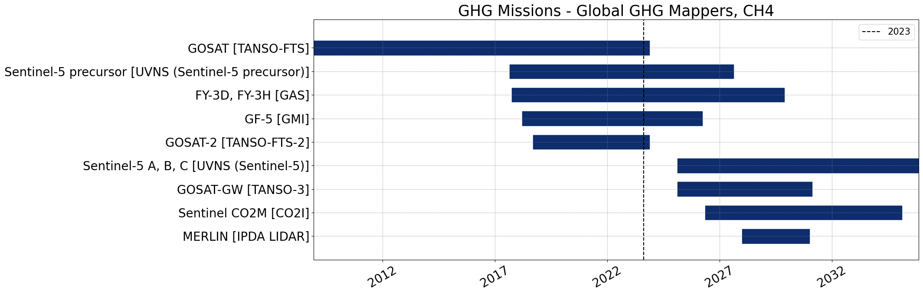
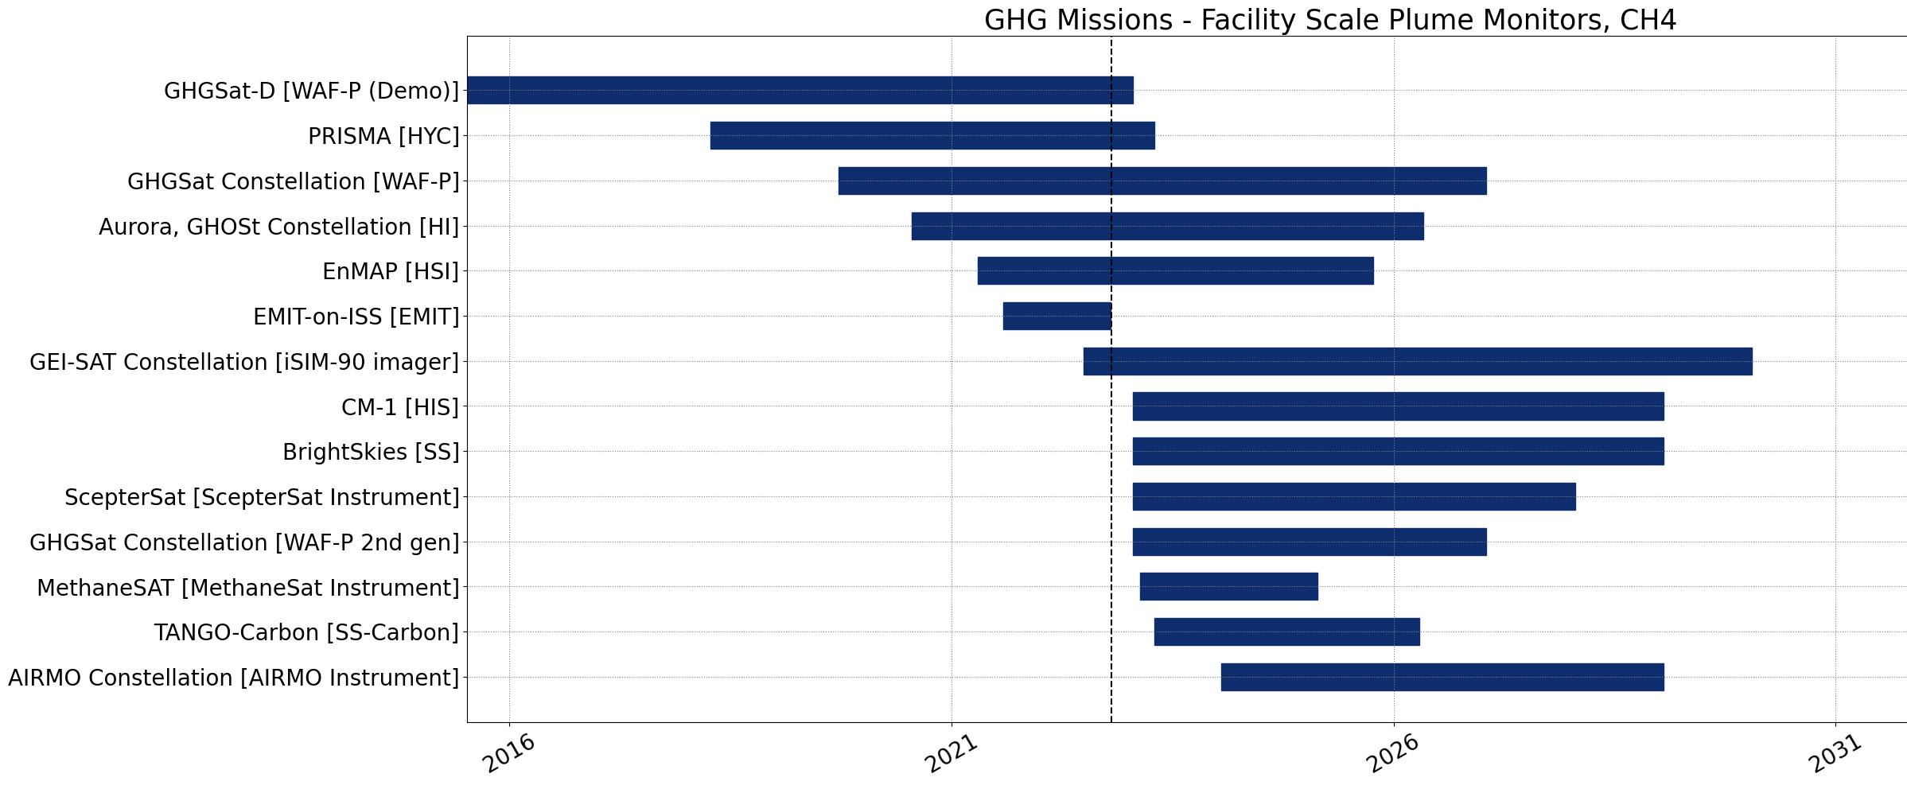
Recent Activities
International Engagement with WMO’s plans on a Global GHG Watch (G3W)
and UNEP’s IMEO (with GHG TT members participating in WGs)
CEOS GHG Missions Portal; centralized overview of GHG Missions in one Portal at ceos.org/ghg
New Space
CEOS is engaged with activities to develop best practices and standards for developing/reporting emissions from “high emitters”
IMEO seeks expertise to coordinate facility scale observations , especially for ‘tip-and-cue’ and validation
This is across various operators (commercial, NGOs, philanthropic, public and mixtures) → ROLE for CEOS?

Slide 31
Topic Discussions at Next GHG-TT meeting
(Cal-Val) How to support cal/val of facility scale to global CO2 and CH4 fluxes → Currently cal/val of facility scale performed on ad-hoc basis (e.g. individual projects + IMEO supporting). Need to understand project and user needs for cal-val
(Cal-Val) Support implementation of “super sites” to include ancillary measurements that can help test processes (e.g. aerosols) that affect XCO2 and XCH4 accuracy
(Sensor) CO2M plus other missions likely need joint aerosol measurements to reduce uncertainty in their XCO2 and XCH4
(System Dev, Stakeholder, Flux Inv., Operational Prep/training) Need to discuss next steps for CEOS support of global stock take
Update to GHG Roadmap in discussion to support New Space cal-val / evaluation

