Slide 1
Updates on Inverse Modeling Task
Kevin W. Bowman and Frederic Chevallier

Slide 2
Inverse Modeling in support CEOS GHG Task Force
Inv-1 | Identify accuracy and precision requirements sufficient for policy applications | X | X | AC-VC | 1.ACTION
Inv-2 | Coordinate research on flux estimation (local to national scale; Level-4 products) (Rec#3) | X | X | AC-VC | 1.ACTION
Inv-3 | Coordinate between CAMS/C3S and NASA OCO-2/CMS/GMAO efforts - see extract from Rec#12: CGMS and CEOS should work with their member agencies to identify and promote standards in product specification, formats, pre-processing etc. and product inter- comparisons should be routinely undertaken and supported on a sustained basis to produce seamless, interoperable datasets for use in the broader system implementation | X | X | AC-VC | 1.ACTION
Inv-4 | Coordinate OSSE studies dedicated to flux estimation - see text from Rec#8: CEOS, CGMS and their partners should continue to support the necessary OSSE experiments, which remain of critical importance in further refining the detailed requirements of the space-based elements of the constellation (sensor precision, accuracy, and resolution, orbit and mission coordination). The near-term objective is to develop a prioritized list of the required OSSE experiments and end-to-end system simulations to optimize the overall system design, resolve system-level uncertainties, and facilitate the coordination of activities among the CEOS and CGMS agencies. The output from these experiments should be made available to the CEOS and CGMS Principals periodically, in a format conducive to discussions with their mission and orbit planning organizations | X | X | AC-VC | 1.ACTION
Inv-5 | Identify synergies between observation strategies for GHGs and air quality gases and aerosols | X | X | AC-VC | 1.ACTION
Inv-6 | Consolidate mission requirements for auxiliary observations(e.g. plume tracers like NO2) (Rec#14) | X | X | AC-VC | 1.ACTION
Inv-7 | Pursue consistency in the product content (Rec#12) | X | X | AC-VC | 1.ACTION
Inv-8 | Ensure traceability of data quality (Rec#12, 13) | X | X | AC-VC | 1.ACTION
Inv-9 | Define types of data that must be exchanged to derive and validate fluxes from a constellation of space-based sensors to facilitate open data access - see text from Rec#11: TCCON has provided the primary transfer standard to relate space-based XCO2 and XCH4 estimates to the ground-based in situ standards maintained by the WMO GAW network. This network must be maintained and augmented using portable, ground-based remote sensing instruments (e.g. EM27/SUN), in situ sensors on fixed-wing aircraft (commercial aircraft, such as CONTRAIL, IAGOS) and balloons (AirCore), and airborne remote sensing instruments (MAMAP, CHARM-F etc.) to provide a more robust and accurate operational validation approach | X | X | AC-VC | 1.ACTION

Slide 3
Inv-1: Identify accuracy and precision requirements for Policy applications
Inverse modeling activities are primarily capabilities driven rather requirements driven, but is evolving
  CoCO2
  GHG Center
  GGGW
MIP activities have established that satellites can inform large country or regions for carbon stock, their interannual activities, and sensitivity to climate variations
  CO2: Byrne et al, 2023, Chevallier 2021; Deng et al 2022
  CH4: Deng et al, 2022
Single model sectoral attribution based on analytic frameworks, e.g., Worden et al, 2023 for CH4.
  Concept of inversion operators, analogous to observation operators, is an important step
  This approach has not been applied for CO2
Threshold for smaller countries is a challenge, but achievable (Liu et al, 2023)
Resolution of inversions and their limit given increased observational coverage still requires development

Slide 4
Inv-2 Coordinate Research on Flux Estimation
Research community using CEOS assets is active
IWGGMS, OCO-2 STM, etc. are primary venues
Explicit research coordination is possible with new frameworks, e.g., Community Inversion Framework (Berchet et al 2020) or potentially JCSDA JEDI
Current challenge of a hierarchy of scales, e.g., global, regional, local, and how they might be integrated.
There is no good mechanism for international flux estimation research in the absence of a funding mechanism
  For NASA, that could be opening up USPI to participate in groups like CoCO2, and vice-versa.
Expect that ML/AI techniques will become important (Bauer et al, Nature Rev. 2023

Slide 5
Inv-3 Coordinate between CAMS/C3S and NASA OCO2/CMS/GMAO
GGGW implementation plan has been submitted.
CAMS/C3S has a 4-month latency based upon OCO-2 data.
NASA is pushing towards low latency (~1-2 month for climatology-driven fluxes and sub-annual for inverse models)
Bilateral coordination is possible when both systems are operating.

Slide 6
Inv-4 Coordination on OSSEs
Recent contributions:
CO2M:
Santaren, D., Hakkarainen, J., Kuhlmann, G., Koene, E., Chevallier, F., Ialongo, I., Lindqvist, H., Nurmela, J., Tamminen, J., Amoros, L., Brunner, D., and Broquet, G.: Benchmarking data-driven inversion methods for the estimation of local CO2 emissions from XCO2 and NO2 satellite images, Atmos. Meas. Tech. Discuss. [preprint], https://doi.org/10.5194/amt-2023-241, in review, 2024.
Climate Extremes:
Brendan Byrne, Junjie Liu, Kevin W. Bowman, et al. Regional inversion shows promise in capturing extreme-event-driven CO2 flux anomalies but is limited by atmospheric CO2 observational coverage. ESS Open Archive . September 30, 2023.
DOI: 10.22541/essoar.169603599.91008398/v1
Integration of imagers and sounders is still open.
OSSEs could facilitate this analysis.

Slide 7
Inv 5: Identify synergies between observation strategies for GHGs and air quality gases and aerosols
Inv-6 Consolidate mission requirements for auxiliary observations(e.g. plume tracers like NO2) (Rec#14)
The AC-VC constellation is coming to fruition (GEMS, TEMPO, S4)
AQ measurements, e.g., NO2, SO2, could be valuable, but unexplored.
CO from TIR and NIR will be critical to assess fire (S5/IASI-NG synergies)
Ammonia could be valuable for CH4, can be harnessed from TIR, e.g, CrIS and IASI
GEO imagers are being used for CH4
CH4 is being used as proxy for AQ, e.g., landfills.
Isotopes have promise for attribution.
Not clear that accuracy/precision of auxiliary variables pace CO2/CH4 (except for isotopes)

Slide 8
Inv 7 and 8
No major updates. Could be pursued more practically under GGGW.

Slide 9
Inv 9 Define types of data that must be exchanged to derive and validate fluxes
In-situ and remote sensing measurements, e.g., NOAA network, TCCON
New activities such as coordinated GHG releases are emerging for imagers, but not directly supported in CEOS.

Slide 12
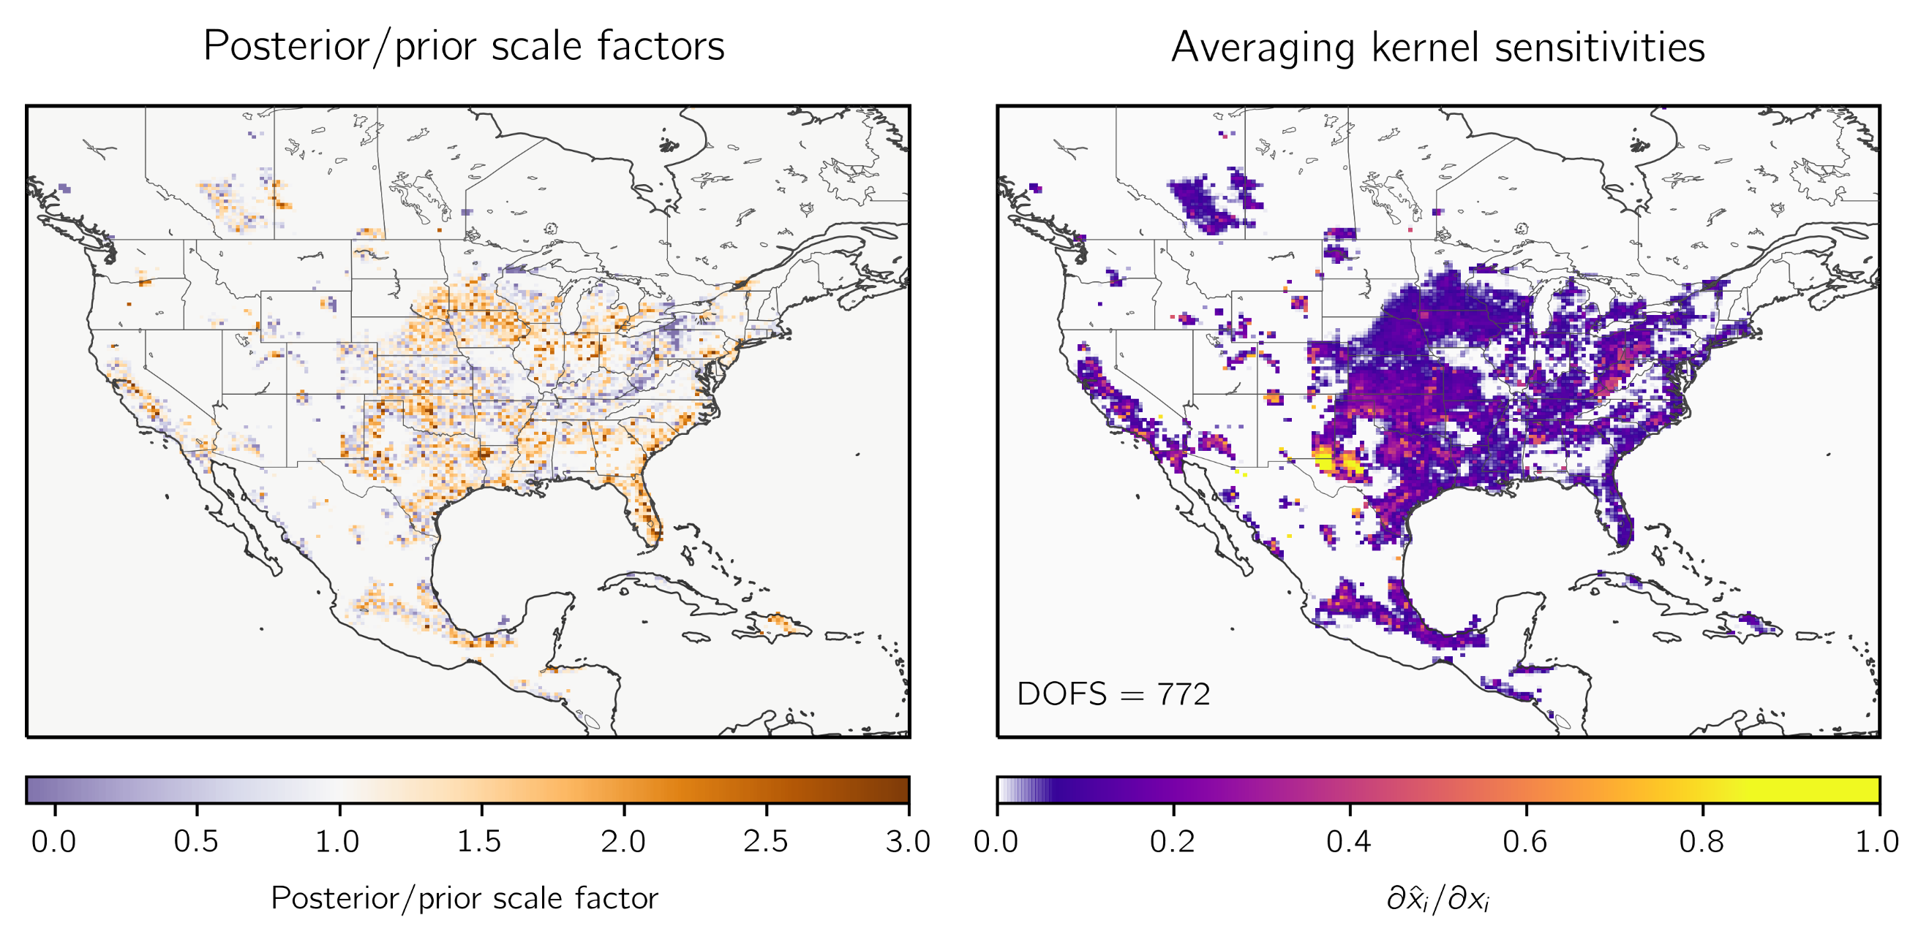
Information content
The resolution of GHG flux estimates is an essential diagnostic for policy and science
  Can we distinguish between Germany and France?
  Averaging kernels and dofs are important diagnostics
Information content is a key metric of uncertainty reduction given prior knowledge conditioned on new observations.
  What value do additional observations provide?
Challenging to compute for large state vectors
  Monte Carlo
  Analytic
Nesser et al, in review
Resolution (or equivalently covariance) between regions needs to be computed, especially for policy-critical regions.
Combinations of 4D-var and analytic systems could be combined to practically generate metrics.
OSSE experiments should be used to characterize impact of increases in observations.

Slide 13
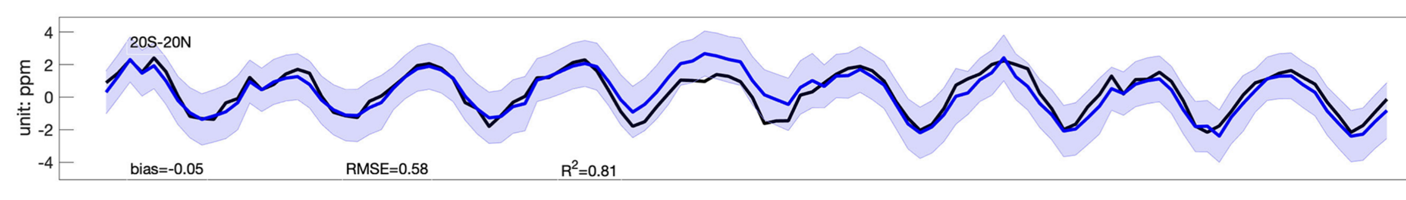
Validation
NWP solves an initial condition whereas GHG Inversions solves a boundary condition
The latter can not be directly verified.
Independent concentration measurements can be evaluated against prior and posterior concentrations.
Adjoint techniques can attribute differences to fluxes.
Ensemble and analytic techniques can project flux uncertainty to concentrations.
Must be used in conjunction with independent measurements.
Following Liu and Bowman, GRL, 2016
Comparison of CMS-Flux posterior concentrations to tropical NOAA MBL.
Differences consistent with concentration uncertainty (projected from ensemble).
2010
Liu et al, ESSD 2021
2018

Slide 14
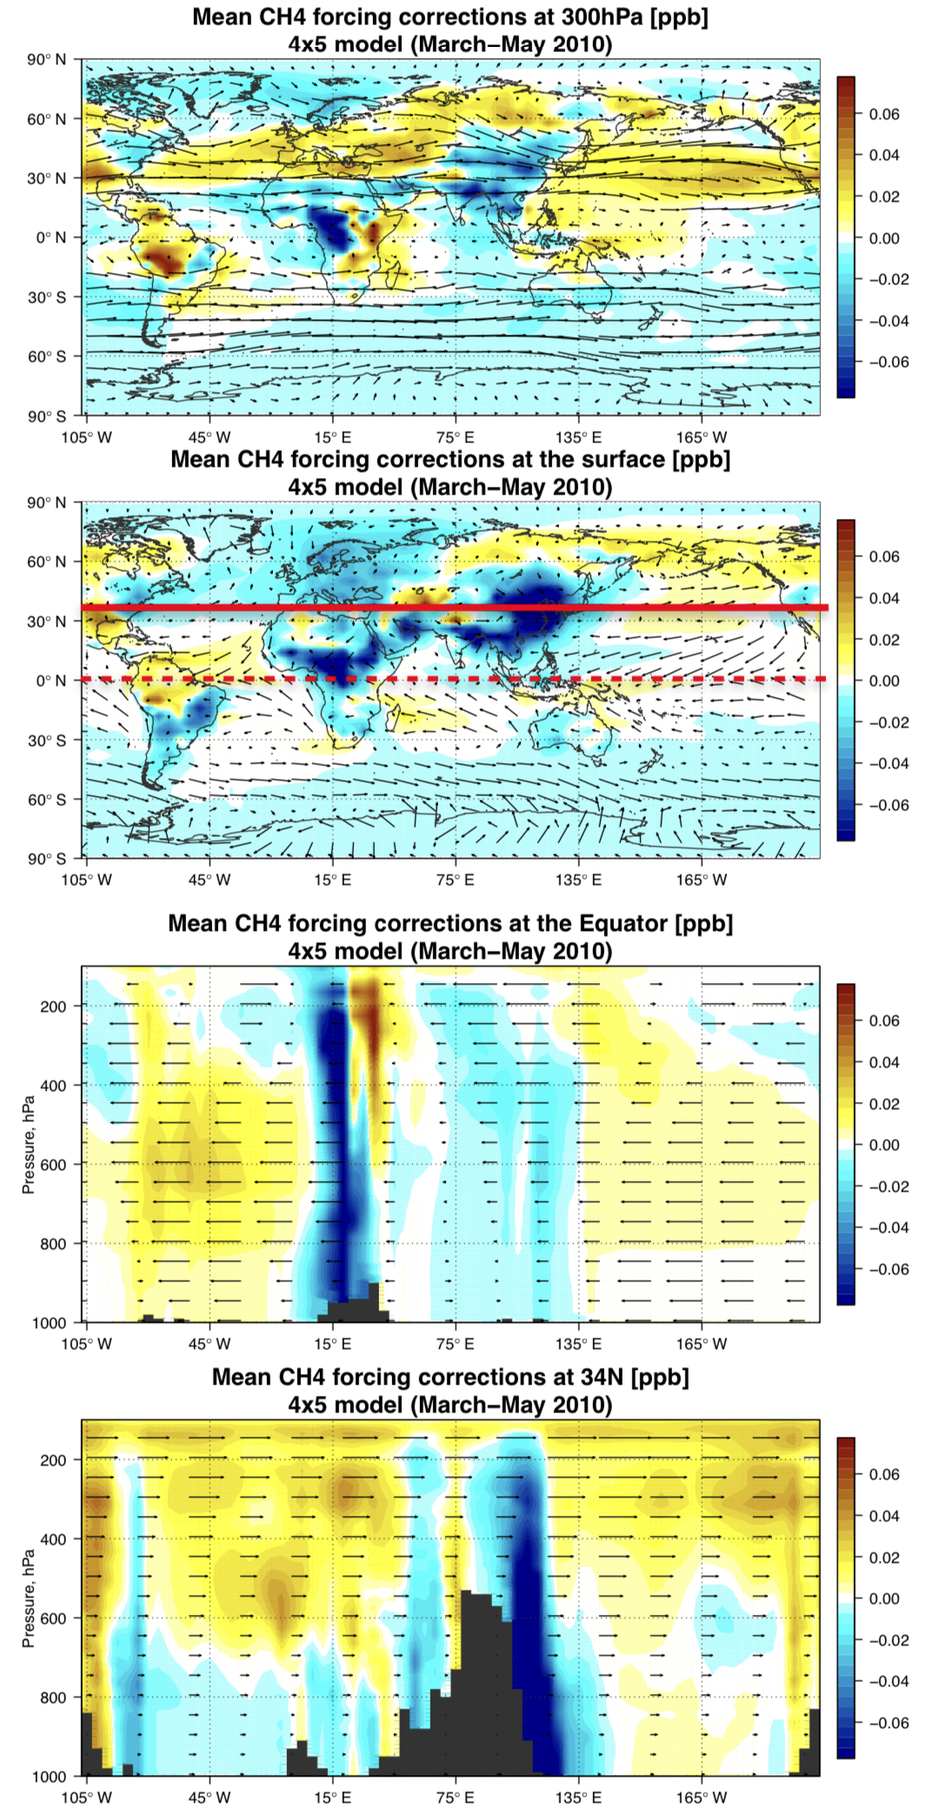
The many ways of J
Basic approaches to minimize J and characterize x are based upon
  4D-var
  EnKF
  Analytic Bayesian/Optimal Estimation
Each have their own strengths and weaknesses.
New techniques such as weakly-constrained 4D-var could be a powerful tool for mitigating transport uncertainty.
Synthesis of classical techniques, e.g, Ens. 4D-var, could provide benefits to both.
Novel methods such as AI/ML should be investigated
Stanevich et al, ACP, 2021

Slide 15
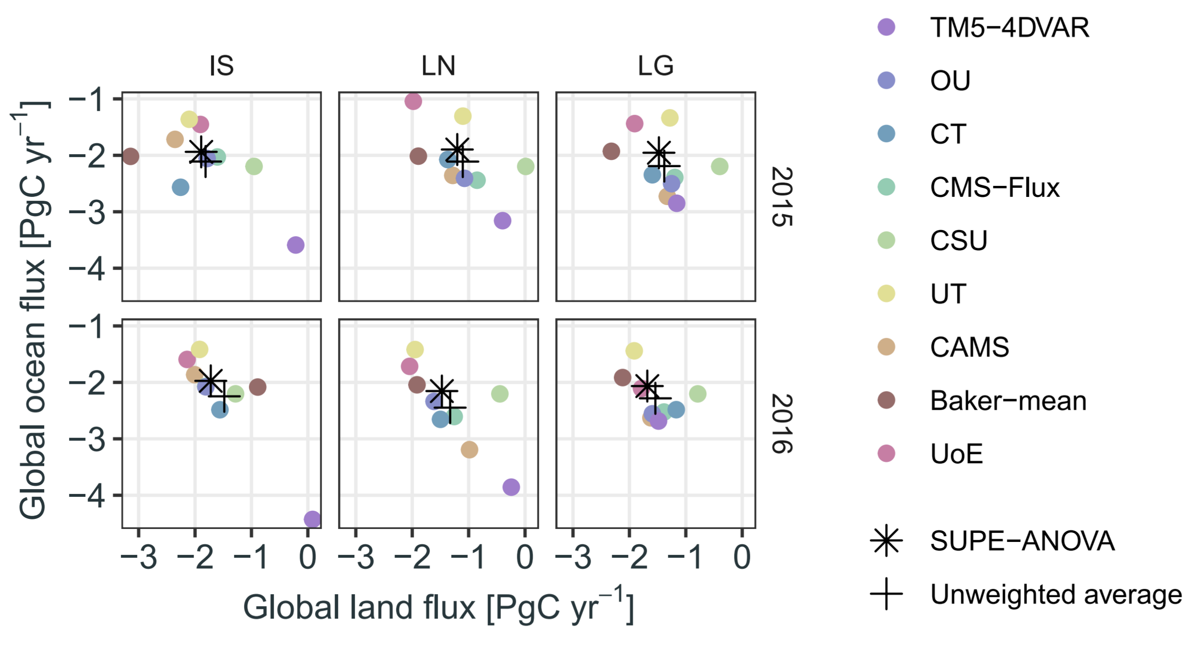
Ensembles and consensus estimates of
GGGW will receive multiple estimates of the same regions from different institutions.
How these estimates will be combined is a critical challenge for GGGW.
“Model democracy” may not provide the best “consensus estimate.”
The CMIP community has researched ways beyond “model democracy”
Cressie et al, GRL, 2022
Theoretical and applied research into multiple methods for ensemble averaging should be advanced.
Ensemble design instead of “ensemble-of-opportunity” should be built into the protocols.
Model performance against independent observations may lead to regional weighting.
Utilization of both point estimates and their uncertainties should be considered.

