Slide 1
Greenhouse Gas (GHG) Task Team
Meeting #4
Y.Meijer, ESA
GHG Task Team Lead
GHG TT Meeting #4
11th March 2024, ESA/ESRIN

Slide 2
1. Objectives of Meeting #4
Consolidate Action list of GHG Roadmap
Discuss Cal/Val continuity in support of GHG observations
Discuss role and engagement of CEOS with IMEO (& G3W)
Prepare for SIT-39

Slide 3
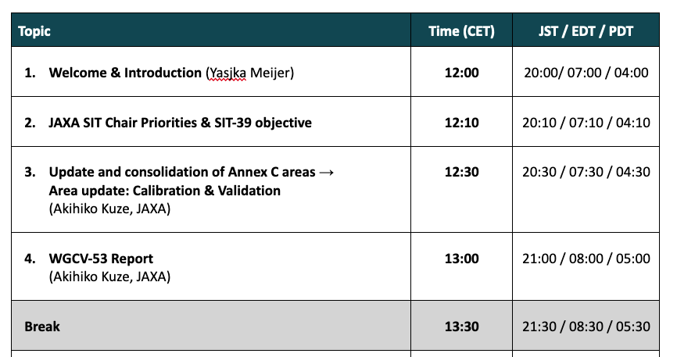
Agenda - 1

Slide 4
1. Review of Meeting Actions
Action Status of Meeting #4:
Organise a dedicated meeting on definitions and to reformulate actions under System Development Facilitation, R. Engelen
Add action under Stakeholder engagement to coordinate with AFOLU
Roadmap, M. Dowell
Finalise update of each area in Annex C, area leads
Add new actions covering importance of airborne sensors and need for validation over ocean, A. Kuze
Move actions Sens-3 & -4 under “Calibration & Validation” in Annex C, W. Su

Slide 5
1. GHG Task organisation
Area leads (plus deputies) have been appointed using the thematic areas of Annex C (actions) in the GHG Roadmap:
Stakeholder Engagement - Mark (John, Wenying)
System Development Facilitation – Richard (John, Kevin)
Operational Preparation and Training – TT discuss
Sensor Development – John (AC-VC) (Yasjka)
L1 & L2 GHG Product Development – Ruediger & Dave
Flux Inv. Model Development – Kevin (Frederic)
Calibration & Validation – Hiroshi (Kuze)
Leads mailing list has been set-up ghg-tt-leads@googlegroups.com
GHG TT mailing list has been set-up ghg-tt@googlegroups.com
Work continues to be supported by Symbios!
Points of Contact still missing toward CapD and CGMS WGs

Slide 6




SHORT BREAK - restart at 13:30 hrs (CET)

Slide 7
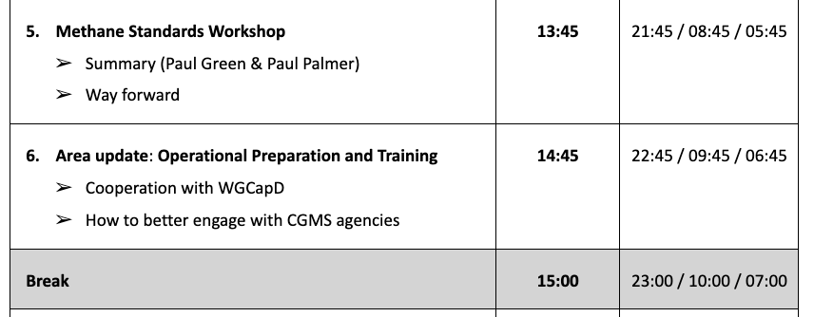
Agenda - 2

Slide 8
SHORT BREAK - restart at 15:00 hrs (CET)

Slide 9
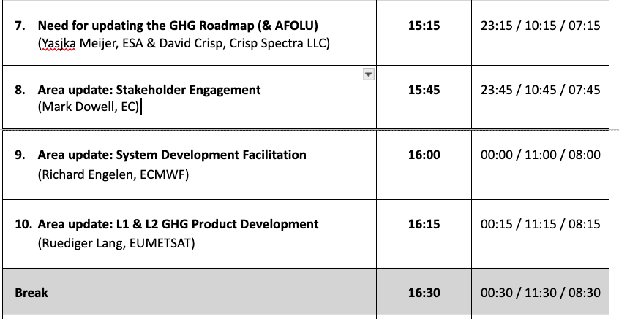
Agenda - 3

Slide 10
SHORT BREAK - restart at 16:30 hrs (CET)

Slide 11
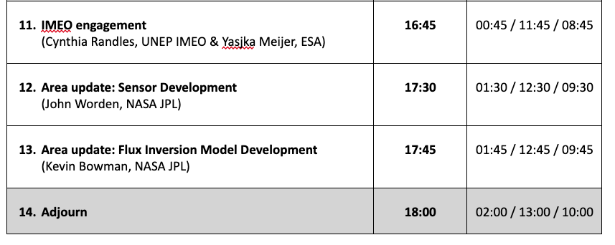
Agenda - 4

Slide 12
1. Challenges
        Setting up interfaces with IMEO and G3W
        User engagement:
        UNFCCC (GST)
        CO₂: policymakers at smaller spatial & temporal scales (covenant of mayors, finance)
        CH₄: (policymakers) on non-O&G related emissions, e.g. landfills, wetlands
        Mission delays, Space Agencies false notion that New Space could do it all
        Tackle the aquatic (mainly coastal & open ocean) aspect of the carbon cycle
        Timely switch to missions capable to monitor the carbon cycle in a changing climate

Slide 13
GHG Roadmap update 1/2
In view of recent developments like the emerging G3W of WMO and our engagement with UNEP’s IMEO, an update is required
Role of CEOS is to provide required space-based observations including all needed product information up to L2.
On top, we can facilitate user uptake and stimulate science by going from L2 to L4/fluxes and reaching out to users/policymakers.
Once users start to pick this up and processes work beyond L2, then we need to hand it off and step back on the L2+ aspects.
With the emerging G3W and IMEO, we need to agree/establish the interfaces.

Slide 14
2. GHG Roadmap Update 2/2
More is needed than a soft update through Annex C
Update of action list by a thorough review per Area coordinated by Area Leads (add more milestones & specific (SMART) actions)
Split along various scales (point/area vs national/regional)
Split between CO₂ & CH₄

Slide 15
10. Way forward & AOB
        Next steps of GHG Task Team
        Presentation to SIT-39; which points for attention
        Engage with and ensure CEOS expertise is used in WMO’s G3W and UNEP’s IMEO
        Coordinate GHG TT activities with the AFOLU Roadmap
        Ensure continuity to earlier/existing missions
        AOB
        Anything, anybody?
        Date of next GHG Task Team meeting

Slide 16
Update of Action List (annex C) – 1/2
Stakeholder Engagement - Mark Dowell
System Development Facilitation – Richard Engelen
Calibration & Validation – Akihiko Kuze
Mark
Richard
Akihiko

Slide 17
3. GHG Cal/Val Networks
GHG Cal/Val Networks Sustainment
by WG-CalVal – Atmospheric Composition Sub-Group
* Jean-Christopher Lambert, BIRA-IASB
* Philippe Goryl
EUMETSAT’s Cal/Val Support Strategy – Thierry Marbach
Reflection on Action List in this Area?
WGCV
Thierry

Slide 18
Update of Action List (annex C) – 2/2
Operational Preparation and Training – TT discuss
Sensor Development – John Worden
L1 & L2 GHG Product Development – Ruediger Lang
Flux Inv. Model Development – Kevin Bowman
 |  | Action Description | Lead | Status | Revisit
Operational Preparation and Training Lead: GHG TT | Ops-1 | Establish and maintain an overview of the process followed for achieving operational readiness of the PS and IOS (including system commissioning and beta testing prior to the declaration of operational readiness) and provide feedback as appropriate | WGC-TT | 2. ON GOING | Annual | (jw) seems like these next 3 require determination of outcomes from the previous set of components (system development facilitation)
 | Ops-2 | Establish and maintain an overview of the governance arrangements for the operation of the PS and IOS and provide feedback as appropriate | WGC-TT | 2. ON GOING | Annual | (jw) again, this needs revisiting based on upcoming EIS
 | Ops-3 | Establish and maintain an overview of the arrangements and documentation for preparing end-users to exploit the outputs of the system, including training, and provide feedback as appropriate | WGC-TT | 2. ON GOING | Annual | (jw) again, this needs revisiting based on upcoming EIS | [DC]: It would seem that capacity building is a critical element of this task. Should WGCapD be involved?
Lead
John
Ruediger
Kevin

Slide 19
5. New Space Coordination
Topic led by John Worden
Development of evaluation criteria
Supporting validation activities
Climate finance
John
6. GCOS IP Response
Topic led by Yasjka Meijer
Response to GCOS IP 2022
Related activities in B3.1, F2.2, F5.2 & F5.4
Yasjka

