Slide 1
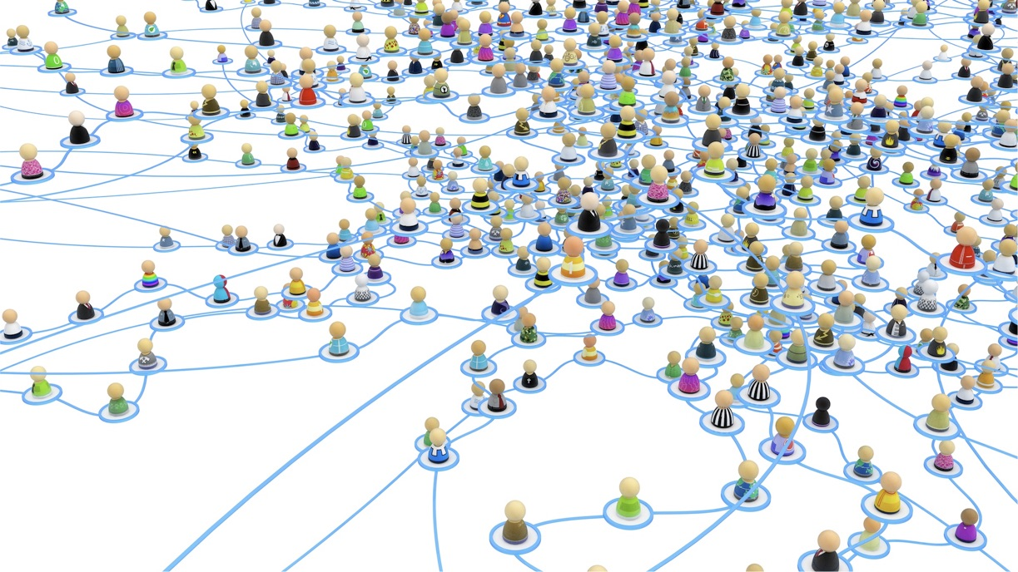
Our stakeholders and network
why?
CO2 MVS
who?
how?

Slide 2
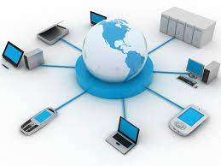
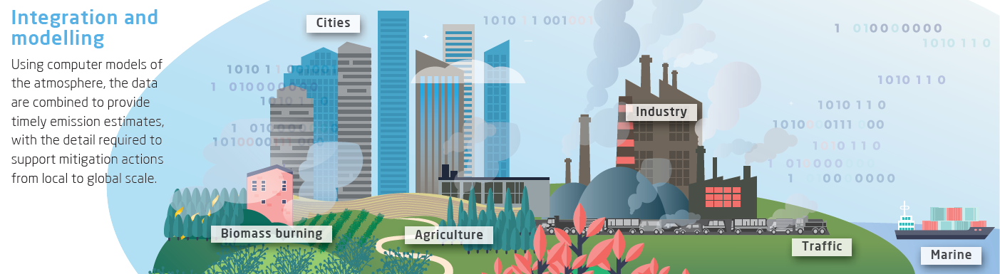
Networking to:
implement CO2MVS blueprint
CO2 and GHG monitoring and verification are
complex activities and require integration of competencies, teamwork and critical mass. No institution has all the resources to address these activities in isolation
networking is key for building reputation and capacity
Excellent use cases are needed to become a trustable and authoritative provider of observation-based evidence of CO2 and GHG emissions
why?
Notes:
1. “If you want to go fast, you go alone. If you want to go far, you go together”
Understanding the Earth system, understanding human activities and their interaction via GHGs in the atmosphere, feedback loops in the climate is challenging.
More and more, we get requests from industry to provide them a comprehensive, multisectoral view. (Fast changing market, fast changing policies, trade-offs, …)
Observations embedded in an integrated system is wanted
Building capacity
Building trust

Slide 3
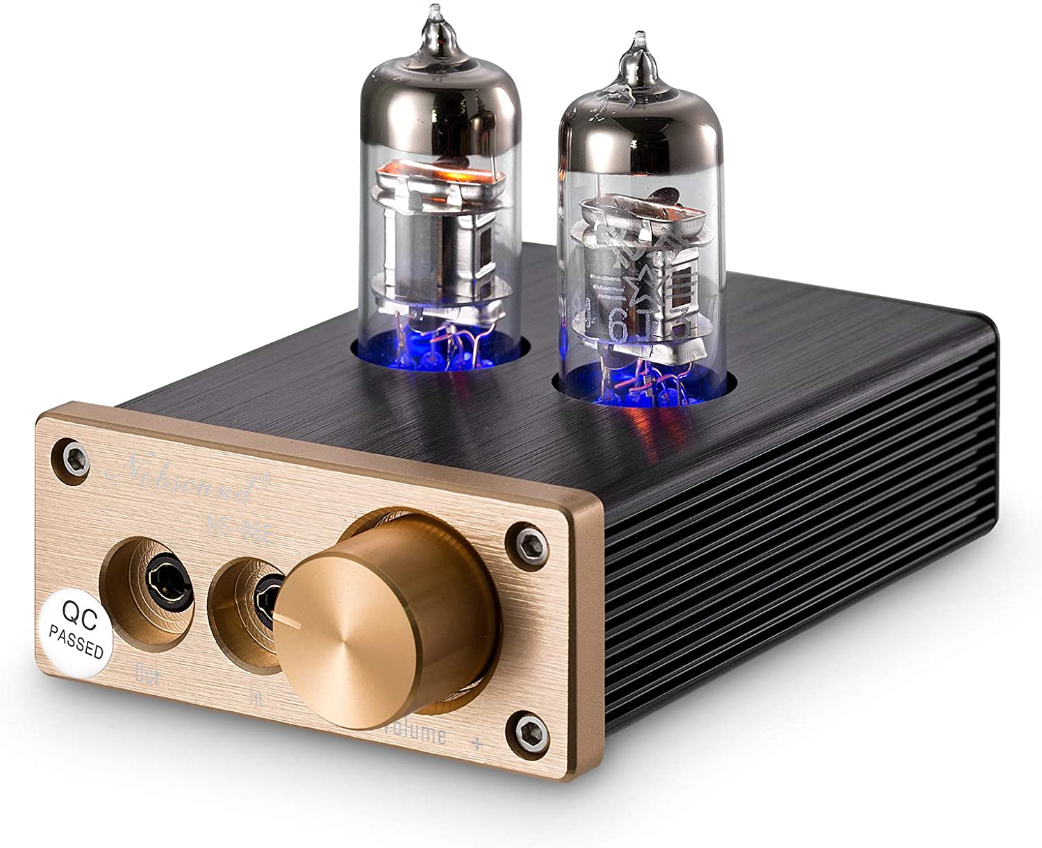
Stakeholder engagement to:
empower CO2 MVS
stakeholders as key amplifier of CO2 MVS capabilities and impacts
leverage on large resources in the data service sector and catalyze the knowledge transfer from science to society
Building societal acceptance and trust in science and technology by disseminating coherent narratives and reducing conflicting messages
why?
Notes:
“Errors using inadequate data are much less than those using no data at all.” (Charles Babbage)
If a new policy is coming up, stakeholders want to know: which data, which data provider is the source of information steering the political dialogue and ultimately the decisions
NGOs, citizen science

Slide 4
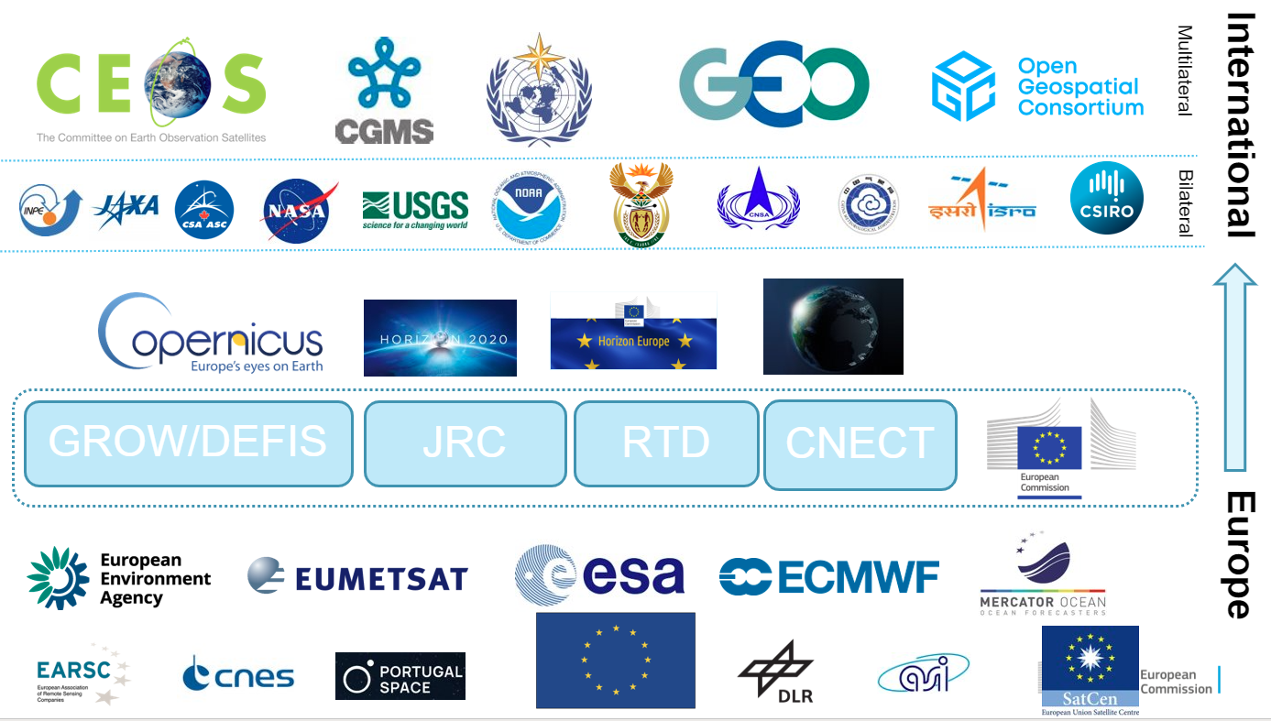
Stakeholders
who?

Slide 5
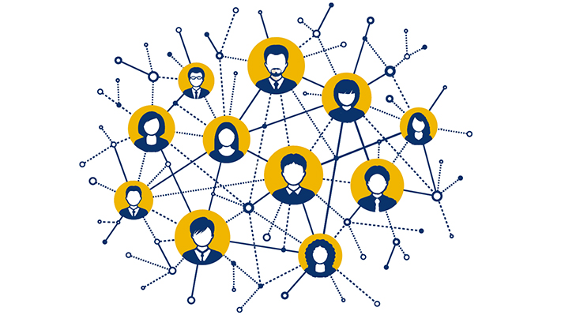



Network
academic/
research institution
National/ EU
institutions
In EU and outside EU
Networks of universities
International research programmes
Horizon Europe,
GCOS, …
TRACE, …
European Commission
DG CLIMA CCC WG1
EU MS, UNFCCC parties, national inventory
agencies, EEA
who?
CO2MVS
Industry/NGOs
international
organizations
Planet, …
ICLEI, C40 Cities …
CoM, Bloomberg …
UNFCCC
IPCC (TFI/AR)
WMO
FAO
WB
Citizens
Notes:
Starting off from the stakeholder perspective.
Building things differently
Long-term we have a changing landscape of stakeholders,
the younger generation will have new jobs.
Students re-entering after Covid a university lecture room see a CO2 Instrument. Other perception about measuring, about connecting via apps on their phones.

Slide 6

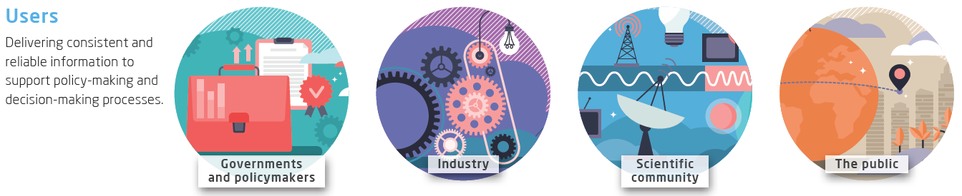
Setting up successful business
Funding:
Continuity of providers
Creation of value, increasing group of users
how?
Notes:
Fortunately, some institutional organisations are remaining,
Proud on Copernicus
Proud on collaboration
Finding the flexibility for others to kick
but others kicking in.

Slide 7
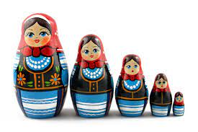
Constellation of systems
Frontrunners/ countries build alternative GHG MVS systems
To increase buy-in, reserving a visible place for all, assessing quality and fitness for purpose, and so the appropriate size
Linking to not lose sight of a comprehensive view
how?

Slide 8
Our network & stakeholders – worldwide
why?
CO2 MVS
who?
how?

