Slide 1
Introduction of Yasjka Meijer
Yasjka Meijer - Copernicus CO2M Mission Scientist
13/10/2022

Slide 2
Short bio
1991–1997 Studied “Physics and Astronomy” at Vrije Universiteit in Amsterdam
1995 – 1998 Master stage and 2 work periods in Lauder, New Zealand working on RIVM ozone lidar
1999 – 2005 PhD at RIVM connected to TU Eindhoven. Thesis “Characterization of ozone profiles retrieved from satellite measurements”
2004 – 2007 Project leader at RIVM on contracts with ESA and the ozone lidar in New Zealand
2007 – 2009 Mission Scientist at ESA-ESTEC
2008 – 2011 Validation Scientist at ESA-ESRIN
2011 – present Mission Scientist at ESA-ESTEC working on various Copernicus atmospheric missions. Since 2015 as Mission Scientist of the Copernicus Anthropogenic CO2 Monitoring (CO2M) mission.
Personal background: born in The Netherlands close to Amsterdam, now married with my Italian wife Isabella and we have two (teenage) daughters. We live in Amstelveen.

Slide 3

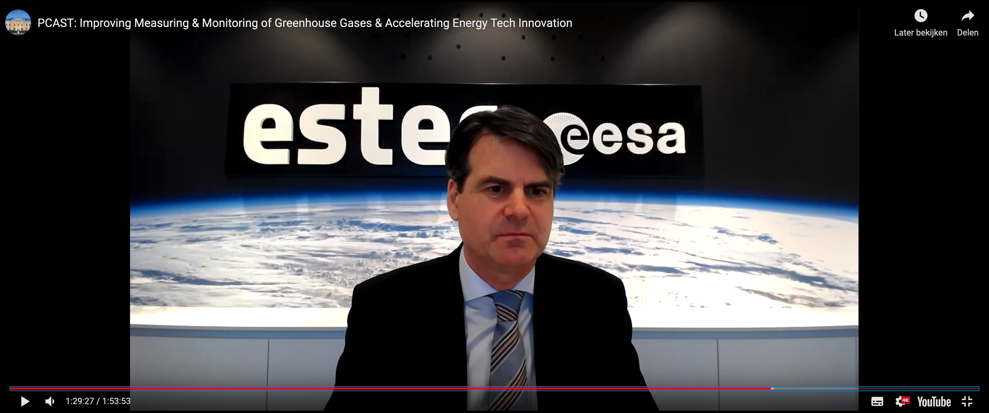
Recent groups & highlights
Groups:
Co-chairing the CO2M Mission Advisory Group (MAG) with EUM
CO2 Monitoring Task Force of the EC
CEOS AC-VC and specifically on the Greenhouse Gas part
WMO Study Group on GHG Infrastructure
Scientific committee of IWGGMS since 2014
Participation:
CEOS White Paper on GHG
White House PCAST meeting on GHG monitoring
US NAS meeting on GHG monitoring
Various national activities on CO2 monitoring
Upcoming COP27 side event on CO2 MVS

Slide 4
Focus and Proposed Next Steps
Ensure the GHG TT stays focussed on specific tasks/actions
Jointly review and make a soft update of the Roadmap
Jointly address the identified Roadmap Actions looking for GST2 and beyond
Coordinate outreach & a common message

