Slide 1

Space for Climate Observatory
Plans and updates – CEOS WG Climate
Frederic.bretar@cnes.Fr

Slide 2



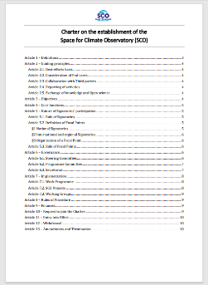
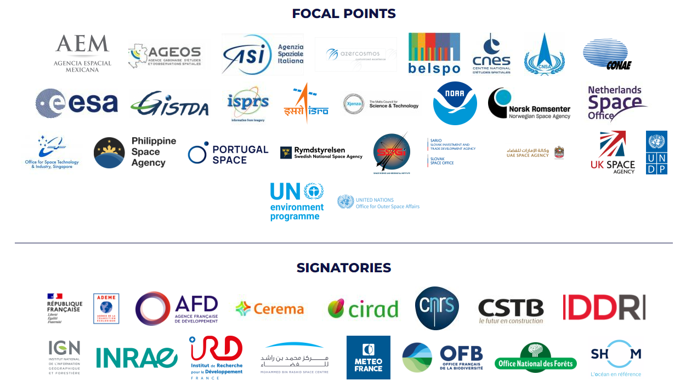


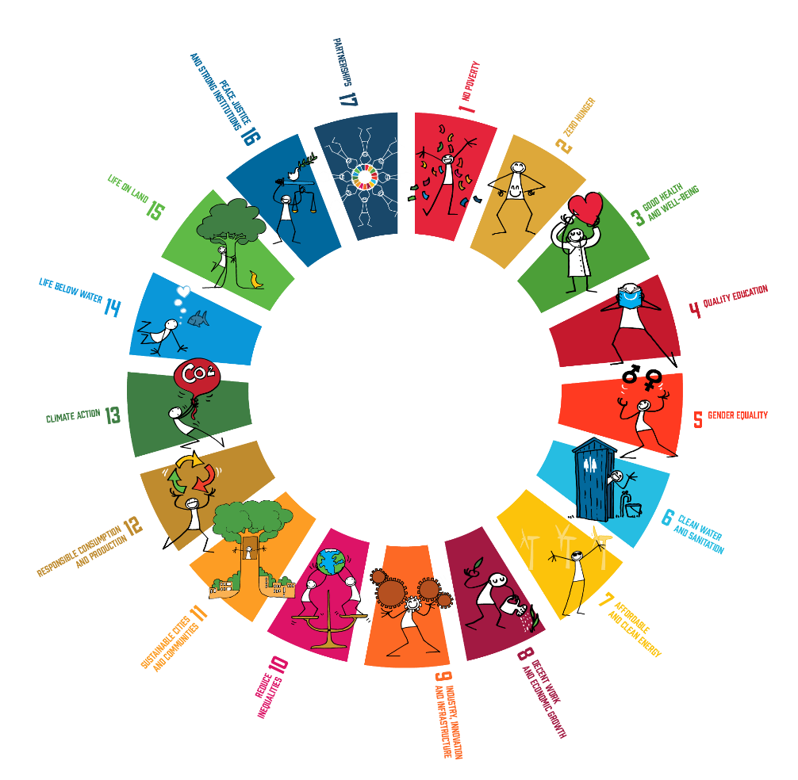






THE SCO INTERNATIONAL ALLIANCE
43 SIGNATORIES
Charter on the establishment of the SCO
entry into force on 1st Sept. 2022
SCO international network
SCO INTERNATIONAL OBJECTIVES
Provide operational tools (SCO projects) and studies to help decision-makers to adapt to climate change.
Foster cooperation around these applications to favour their reuse and communicate on them
Build a network for space agencies and public and private entities involved in the use of EO data for operational climate action
Notes:
The creation of the SCO international initiative on best effort-basis dates back to 2017 within the framework of the One Planet Summit by the French Republic President, Emmanuel MACRON, but it was not officially launched until June 2019 when thirty-six space agencies and international organisations signed a declaration of interest. In the continuity, SCO members worked together under the coordination of UNOOSA to clearly define the nature of SCO and formalize its governance through the Charter on the establishment of the Space for Climate Observatory, which entered into force on 1st September 2022.
During its first three years of existence, the SCO progressively expanded: new space agencies joined the initiative, currently 34 members and the organisation of multiple annual calls for projects resulted in the emergence of about sixty SCO Projects.
In order to make the best use of satellite data and digital technologies for climate action, the SCO aims at coordinating international efforts, while gathering public and private entities involved in Earth Observation (EO) sector, to support the emergence of operational tools for climate monitoring, mitigation and adaptation addressed to decision-makers and the wide public.
SCO members are the Signatories of the Charter on the establishment of the Space for Climate Observatory. Furthermore, in every country, a single public entity assumes the role of Focal Point, responsible for the organisation of SCO activities at the national level. Therefore, the space agencies that have signed the SCO Charter are responsible for coordinating with national institutions whose missions are related to climate issues, promoting cooperation between partners to establish national SCOs, and structuring the link with public authorities managing local territories. Consequently, SCO members work toward the creation of several national SCO implementations: such as SCO Sweden, SCO Gabon, SCO China or SCO France.
SCO France for instance : As the SCO initiative was born in June 2019 at the instigation of France, the French Space Agency CNES (Centre National d’Études spatiales) was immediately entrusted with the implementation of the SCO in France. This national implementation aims at rallying the creation of other SCOs in other countries, and has therefore created a general model – in terms of global structuring, organization and animation – to be shared with other Signatories.

Slide 3
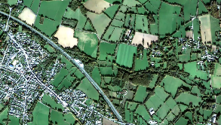
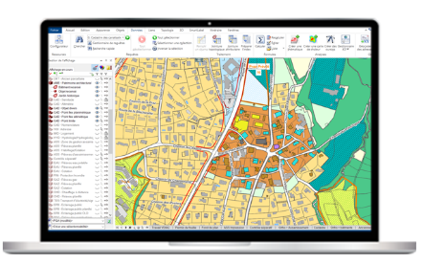
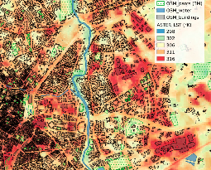
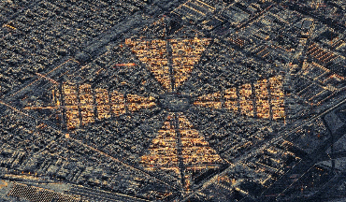


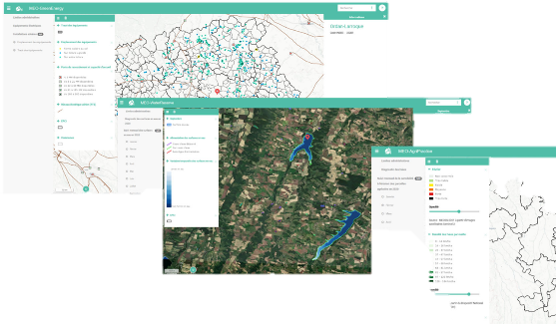
SCO use case approach AND Overview of major stakeholders INVOLVED
SCO PROJECTS CRITERIA
Addressing the needs of end users within a specific geographic area;
Proposing operational and practical software(s);
Making the best use of available satellite, environmental, climate, in situ and socio-economic data, at a resolution adapted to the problem;
Building on (pre-)operational and research infrastructures, services and local data provision;
Having a built-in potential for extending to several geographic areas.
Satellite data
In Situ data
Service Provider / Company
Users
Labs
SCO PROJECT.
Operational Climate Service in 2 years
Prototype
State-of-the-art technology
Scientific content
Private and public consortia
Notes:
The SCO supports the development of operational tools addressed to decision-makers and the wider audience, to fully leverage the potential of satellite data together with socio-economic data in helping towards climate monitoring, mitigation and adaptation at the local scale. These tools must be co-designed with their end-users to answer specific needs, and should be easily modified to be adapted to other geographic areas facing similar climate stakes.
In addition to these projects, the SCO also aims at enhancing international coordination around operational applications based on space technologies for climate, highlighting such tools and acting as an international forum to discuss and advocate for these solutions.
SCO Projects designate satellite-based applications for climate change monitoring, mitigation and adaptation supported by SCO Signatories and meeting the following criteria:
C1. Addressing the needs of end users within a specific geographic area;
C2. Proposing operational and practical software(s);
C3. Making the best use of available satellite, environmental, climate, in situ and socio-economic data, at a resolution adapted to the problem;
C4. Building on (pre-)operational and research infrastructures, services and local data provision;
C5. Having a built-in potential for extending to several geographic areas.
Following annual calls for projects in the downstream space segment, the SCO delivers and operates operational tools in accordance with minimum set of criteria (cf. infra) to make the best possible use of available satellite, environmental and socio-economic data. In particular, the goal is to target specific issues at the local level, and to involve the end-users – be it decision makers or citizens – in the design process to make sure that the final tool suits their needs.
The ambition is also to be able to easily adapt and replicate the resulting tool in similar geographic areas, so as to avoid duplication and favour collaboration – which also entails the use and the creation of open-source components as much as possible.

Slide 4
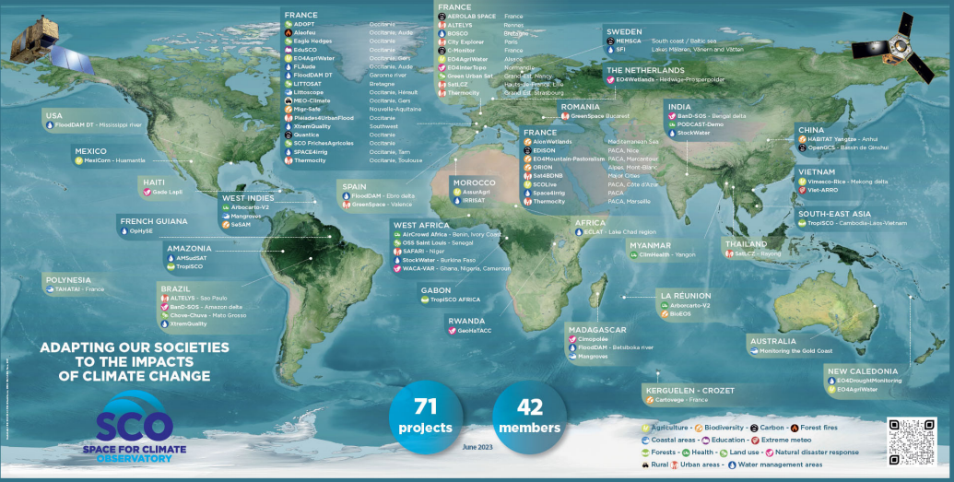
Notes:
Illustration of SCO international operational tools around the world to help decision-makers to adapt to climate change.

Slide 5

Timeline since last CEOs WG meeting
3 jours
UN/Austria Symposium 2023. Space for climate action
9/12/2023 - 9/14/2023
3 jours
UNEP High Level Expert Group Meeting
9/11/2023 - 9/13/2023
5 jours
IGARSS 2023 - special session
7/17/2023 - 7/21/2023
1 jour
GeoWeek Ministerial - special session Impact Stories
11/10/2023 - 11/11/2023
7 jours
COP28
12/4/2023 - 12/10/2023
80 jours
SCO International call
9/1/2023 - 11/19/2023
5 jours
IGARSS 2024 - special session
7/15/2024 - 7/19/2024
CEOS WG Climate meeting
3/1/2023
10 new SCO accredited projects
12th StC IAC Bakou
3/6/2023
10/3/2023
14th StC IAC Milan
11th StC IAF/GLOC
CEOS WG Climate meeting
5/31/2023
10/16/2023
10/18/2024
2023
mars
mai
juil.
sept.
nov.
2024
mars
mai
juil.
sept.
2024
Aujourd'hui

Slide 6






membership applications approval
Brazilian Space Agency
Egyptian Space Agency
European operational satellite agency for monitoring weather, climate and the environnement from space
French Development Agency’s subsidiary
Public agency for the design and implementation of internation technical cooperation projects
South African National Space Agency
Saudi Space Agency

Slide 7

Due diligence process for private entities
Deep work on how managing the approval for private entities to join the SCO: A due diligence process managed by UNDP
Membership Form
Risk Assessment Tool
Eligibility Checklist

Slide 8


Work programme approval (2023-2025)
Governance and Secretariat Activities
Actions steered by the Secretariat, the Programme Committee with the support of Working Group(s) Chair(s)
Working groups activities related to the development of the SCO community
Actions steered by the Secretariat and the Global Awareness Working Group
In-house activities of the Signatories addressing SCO objjctives and implementing SCO core functions
Actions steered by the Secretariat and the Steering Committe
Implementing the rules of procedure.
Ensuring the operational functioning of the Programme Committee.
Building and Implementing a due diligence framework to review private entities membership applications.
Structuring Working Group(s).
Governance meetings preparation.
Assisting new signatories toward implementation of national and regional SCOs
Focal Points are invited to implement national and regional SCOs with support from the Secretariat. Upon the request of Focal Points, the Secretariat can accompany them to:
create a community of stakeholders;
Participate to international calls;
arrange discussion forums;
use appropriate communication resources.
Ensure SCO representation and participation within global groups and communities involved in EO and Climate sectors (notably CEOS, GEO, ECMWF, EUMETSAT, UNDP, UNEP, S4C).
Draft and implement an outreach, awareness raising and communication strategy.
Develop SCO awareness raising material (unified material).
SCO website (maintain and update, develop nationals SCO pages).
Reporting and Evaluation
Actions steered by the Programme Committee, the Working Groups with the support of the Secretariat
Annual activity report for Signatories
The Programme Committee tracks progress of SCO Project and Working Group activities to be presented to the Steering Committee.
Notes:
38 Signatories
27 Focal Points
23 Etats Membres
+ ajouter les signataires Français du congrès (Météo France, ADEME, IDDRI, Loft Orbital).

Slide 9
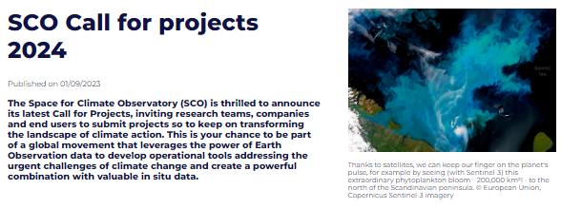
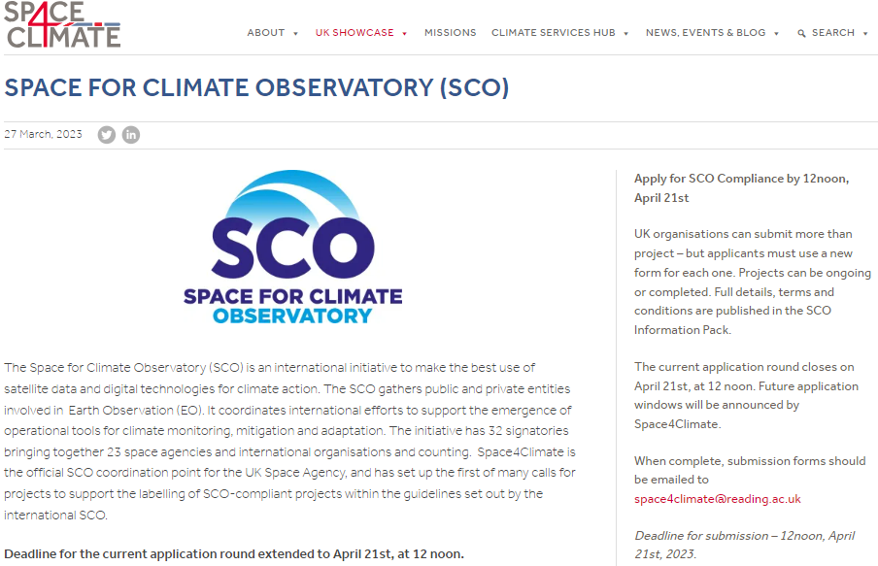
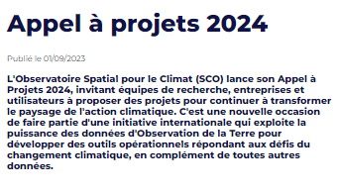
Work programme approval (2023-2025) Focus on the content : SCO projects-related activities
Set up and manage the international accreditation process
Actions steered by the Programme Committee with the support of the Secretariat
First international call open from Sept.1st to Nov.17th 2023 : https://www.spaceclimateobservatory.org/sco-call-projects-2024
Further annual international calls are expected in 2024 and 2025.
Creation of an international panel of reviewers (registration form to be filled by nominated experts).
Joint forced to stimulate national and regional calls for proposals (only two independents national SCO calls exist today : CNES & UKSA).
International Call SCO UK call SCO France call
Leveraging SCO solutions
Actions steered by the Secretariat and Focal Points
Disseminate projects content/ results and facilitate their transfer/replication to additional use cases.
Arrange the access to the SCO portfolio from a user perspective, and support and guide the interested users towards the most suited solution to their problem.
Development of specific material on how to consult the SCO portfolio (to get essential information) and on which steps would be needed to implement projects in new use cases.
Notes:
al).

Slide 10
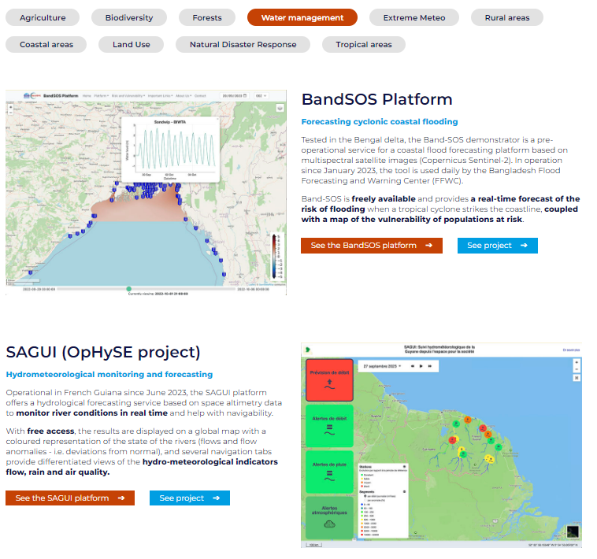

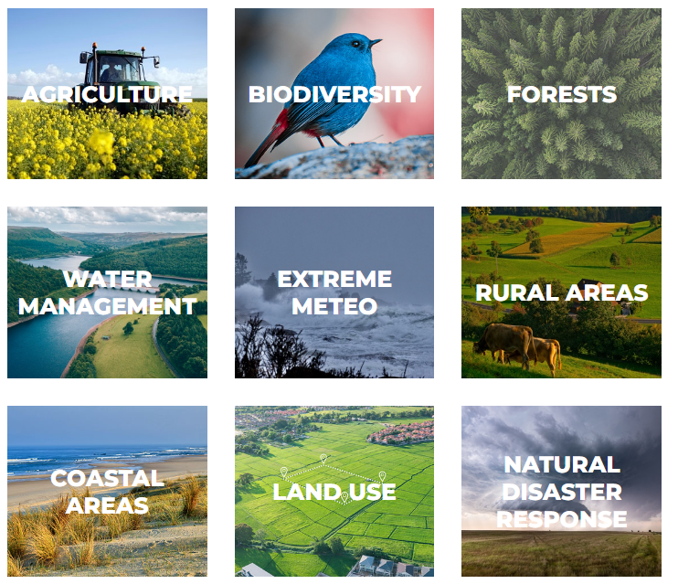
The Digital ToolBox of the SCO

Slide 11
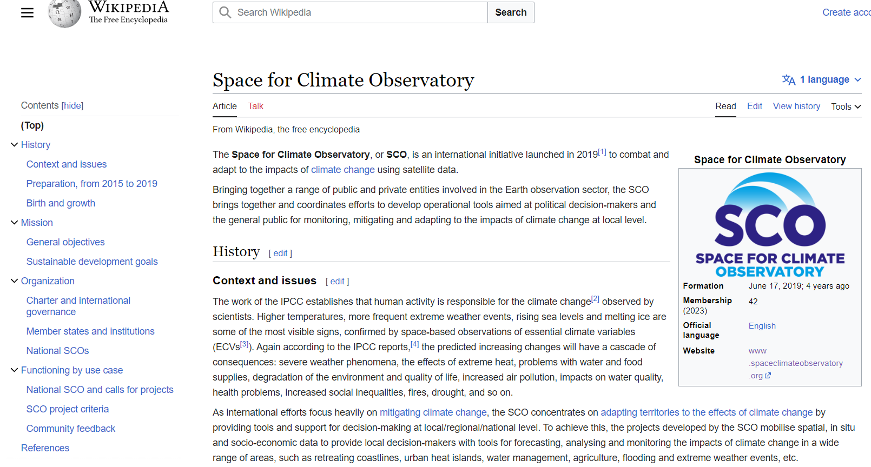
SCO on Wikipedia
SCO on wikipedia
Space for Climate Observatory - Wikipedia

Slide 12

Next steps
3 jours
UN/Austria Symposium 2023. Space for climate action
9/12/2023 - 9/14/2023
3 jours
UNEP High Level Expert Group Meeting
9/11/2023 - 9/13/2023
5 jours
IGARSS 2023 - special session
7/17/2023 - 7/21/2023
1 jour
GeoWeek Ministerial - special session Impact Stories
11/10/2023 - 11/11/2023
7 jours
COP28
12/4/2023 - 12/10/2023
80 jours
SCO International call
9/1/2023 - 11/19/2023
5 jours
IGARSS 2024 - special session
7/15/2024 - 7/19/2024
CEOS WG Climate meeting
3/1/2023
10 new SCO accredited projects
12th StC IAC Bakou
3/6/2023
10/3/2023
14th StC IAC Milan
11th StC IAF/GLOC
CEOS WG Climate meeting
13th StC ???
5/31/2023
10/16/2023
5/13/2024
10/18/2024
2023
mars
mai
juil.
sept.
nov.
2024
mars
mai
juil.
sept.
2024
Aujourd'hui

