Slide 1
Celebrating 10 years of…
WGCapD
WGCapD History Charts

Slide 2
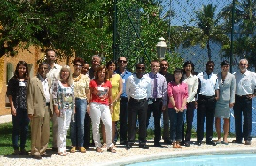
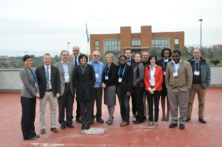
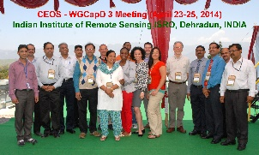
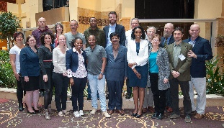
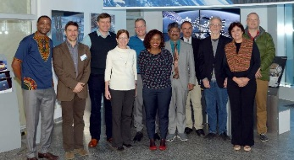
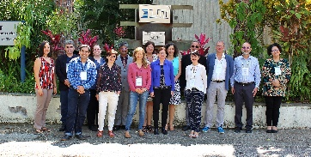
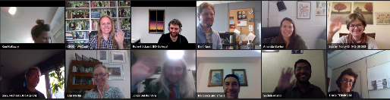
WGCapD Chair & Meeting History
Chair / Vice-Chair
Year
Annual Meeting
Hilcea Ferreira, INPE / Jacob Sutherlun, NOAA
Hilcea Ferreira, INPE / Jacob Sutherlun, NOAA
Jacob Sutherlun, NOAA > Eric Wood, USGS / Jane Olwoch, SANSA
Eric Wood, USGS / Jane Olwoch, SANSA
Jane Olwoch, SANSA / Senthil Kumar, ISRO
Jane Olwoch, SANSA > Phila Sibanze, SANSA / Senthil Kumar, ISRO
Senthil Kumar, ISRO / Nancy Searby, NASA
Prakash Chauhan, ISRO / Nancy Searby, NASA
Nancy Searby, NASA / Pham Thy, VNSC
Nancy Searby, NASA / Pham Thy, VNSC
2012
2013
2014
2015
2016
2017
2018
2019
2020
2021
WGCapD-1: Ilhabela, Brazil
WGCapD-2: Frascati, Italy
WGCapD-3: Dehradun, India
WGCapD-4: Pretoria, South Africa
WGCapD-5: Hampton, USA
WGCapD-6: Oberpfaffenhofen, Germany
WGCapD-7: Sao Jose dos Campos, Brazil
WGCapD-8: Dehradun, India
WGCapD-9: San Francisco, USA Virtual
WGCapD-10: Virtual

Slide 3
WGCapD Chair & Meeting History
Chair / Vice-Chair
Year
Annual Meeting
Jorge del Rio Vera, UNOOSA / Dan Matsapola, SANSA
Jorge del Rio Vera, UNOOSA / Dan Matsapola, SANSA
Dan Matsapola, SANSA / Julio Castillo, AEM
Dan Matsapola, SANSA / Julio Castillo, AEM
2022
2023
2024
2025
WGCapD-11: virtual
WGCapD-12: Vienna, Austria
WGCapD-13: virtual
WGCapD-14: Vienna, Austria

Slide 4
WGEdu & WGCapD History
Focus: GeoCab Portal support, KenyaCube, SAR trainings
COVID-19 drives first all-virtual annual meeting; virtualization of many deliverables
WGEdu Formed
WGEdu 🡪 WGCapD
Focus: Growing training, workshops, and data collections
Focus: Support of Data Cubes, AmeriGEOSS & AfriGEOSS
2003
2013
2015
2017
2019
2021
1999
2012
2014
2016
2018
2020
WGEdu formally adds capacity building to mandate
Focus: DEM Workshops
Focus: Increased number of trainings, workshops, and online courses
EOTEC DevNet established, Resource Portal & CEOS Webinar Toolkit launched
Focus: Awareness building
Focus: Deeper engagement of GEO

Slide 5
WGEdu & WGCapD History
update
update
2023
2025
2027
2029
2031
2033
2022
2024
2026
2028
2030
2032
update
update

