Slide 1
SRTM 30-m Data Access (DRAFT)

Slide 2
NGA SRTM 2 - 1 arc second (30m)
Earth Explorer Data Portal
https://earthexplorer.usgs.gov

Slide 3
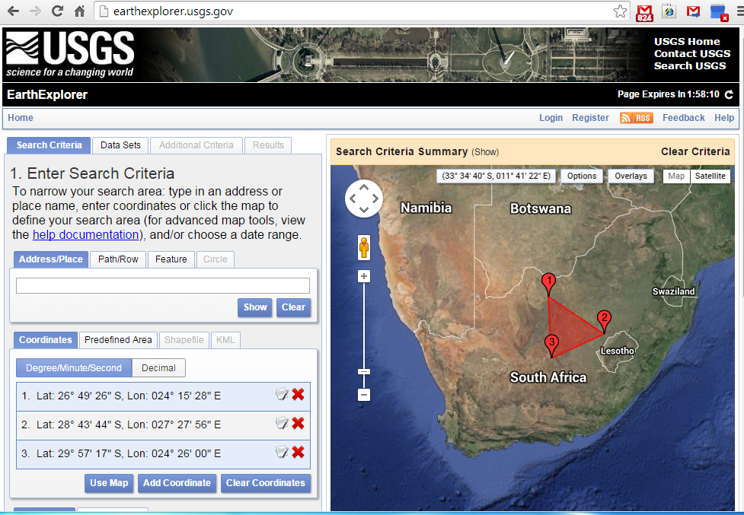

Slide 4
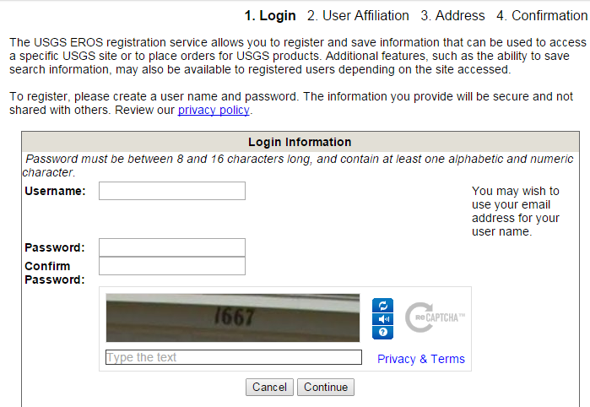
Registering (Creating a New Account)

Slide 5
Logging In (Accessing an Existing Account)

Slide 6
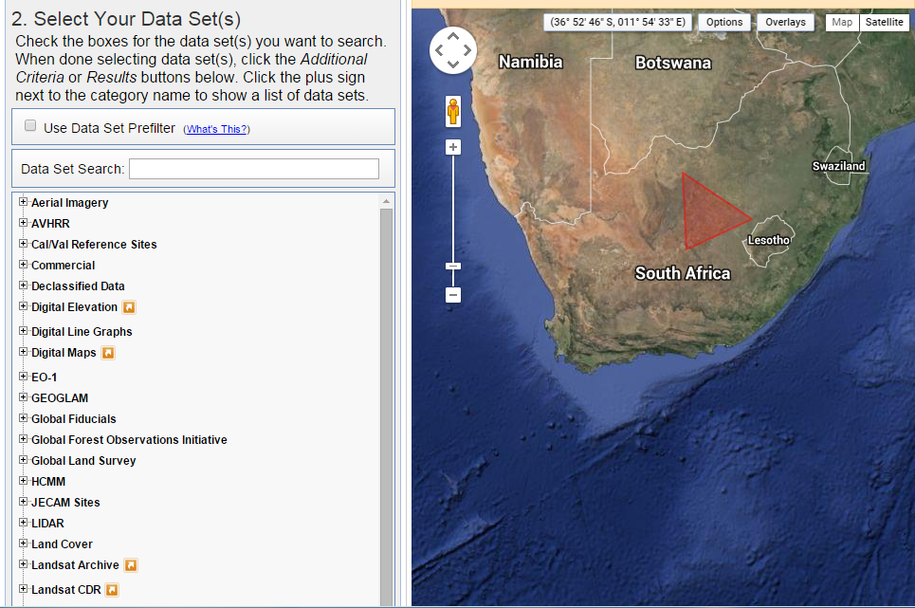

Slide 7
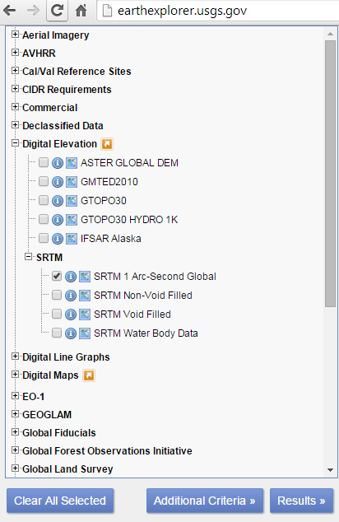
Results
NGA SRTM 2

Slide 8
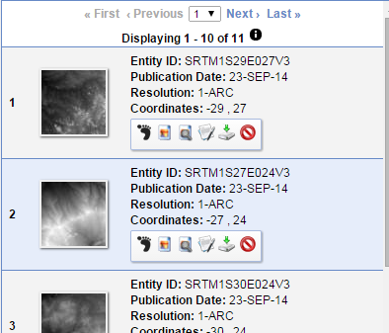
Downloading

Slide 9
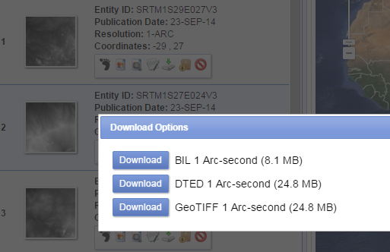
Downloading

Slide 10
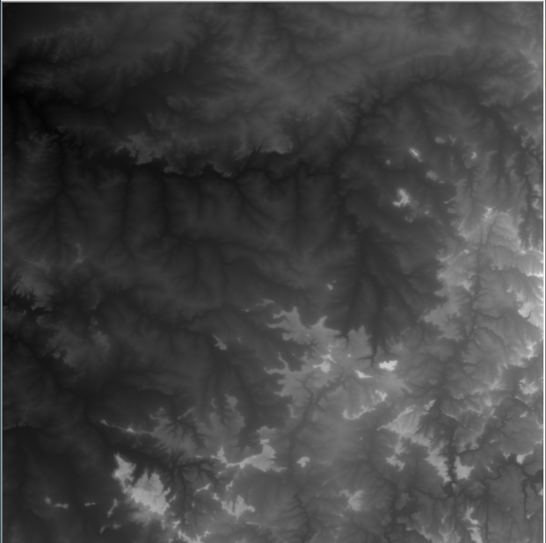
Downloaded NGA SRTM 2 Tile

Slide 11
NASA SRTM 3 - 1 arc second (30m)
LPDAAC Data Portal
https://lpdaac.usgs.gov/products/measures_products_table

Slide 12
https://lpdaac.usgs.gov/products/measures_products_table

Slide 13
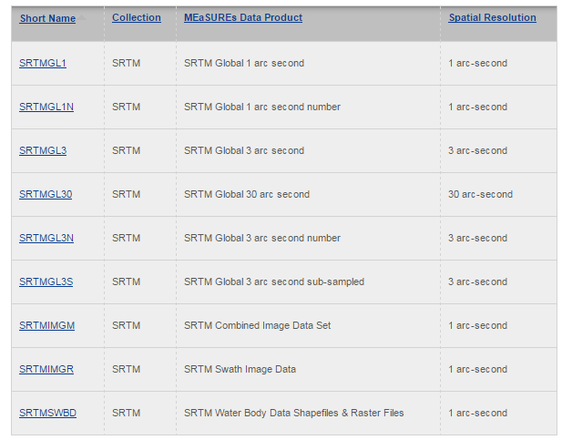

Slide 14
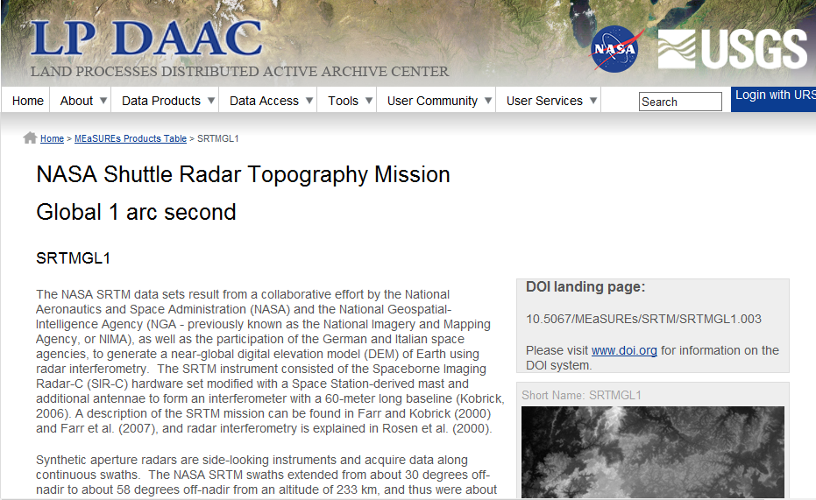

Slide 15
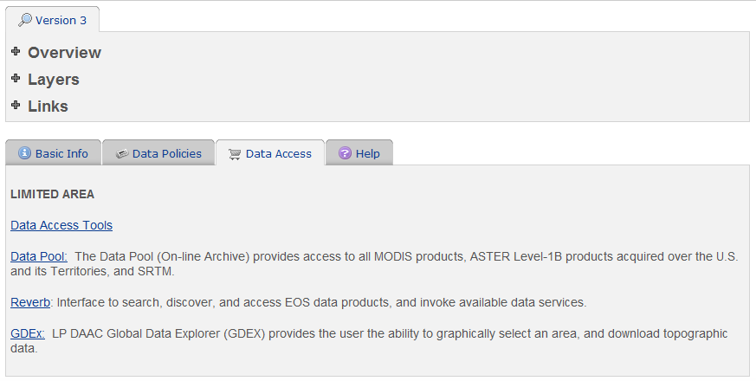
Global Data Explorerer - GDEX

Slide 16
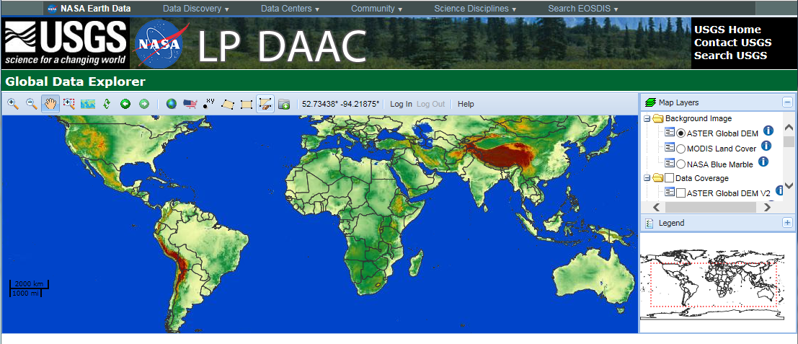
Global Data Explorerer - GDEX
http://gdex.cr.usgs.gov/gdex/

Slide 17
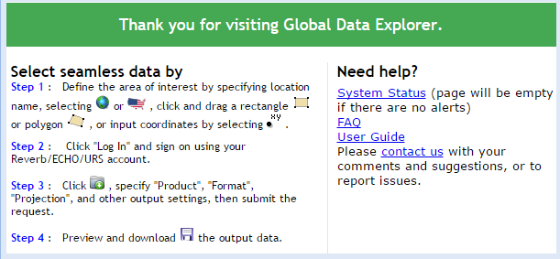

Slide 18
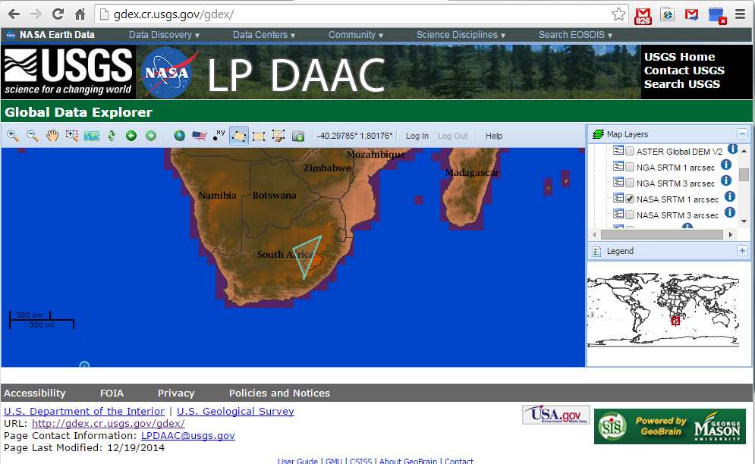
Selecting and Download SRTM Tiles

Slide 19
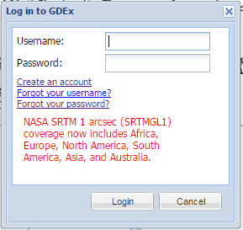
Logging In (accessing an existing account)

Slide 20
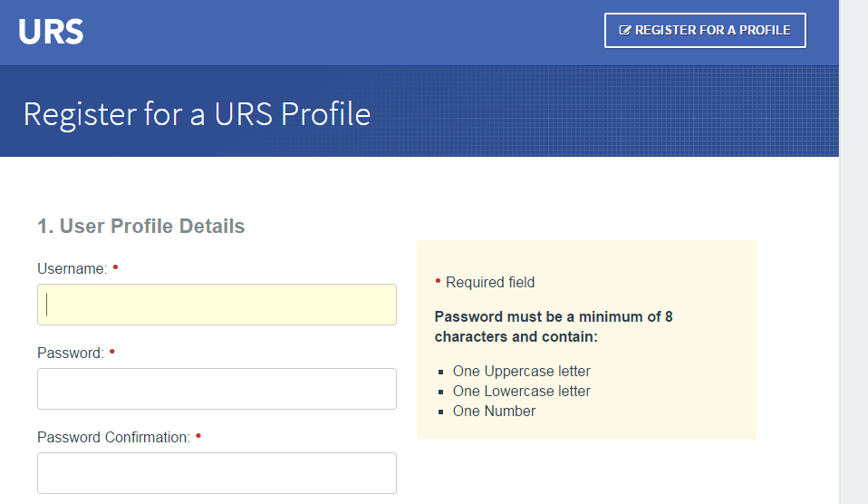
Creating a New Account

Slide 21
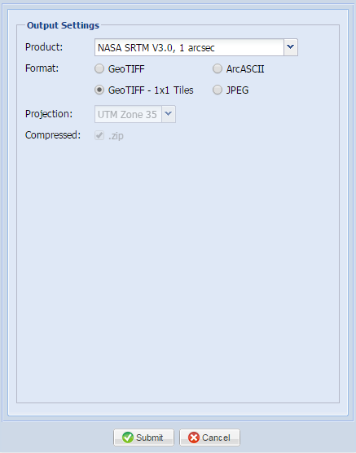
Downloading

Slide 22
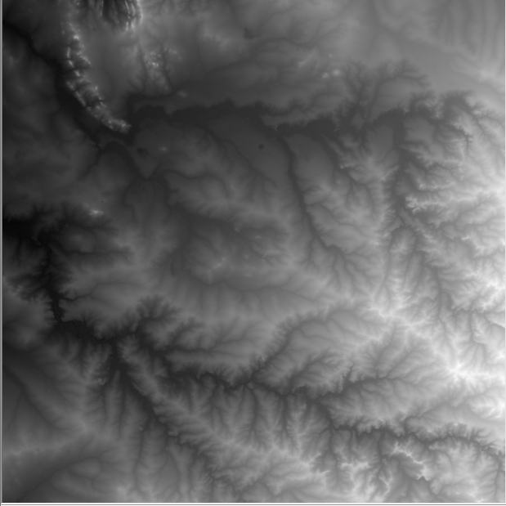
Downloaded NASA/JPL SRTM 3 Tile

