Slide 1
SRTM 30-m
Wm Matthew Cushing (USGS)
16 May 2013
Notes:
Committee on Earth Observation Satellites (CEOS)
Regional Centre for Mapping of Resources for Development (RCMRD)

Slide 2
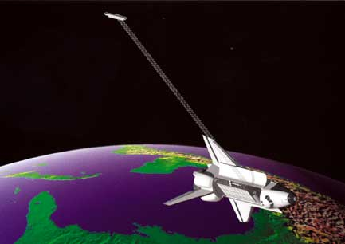
SRTM Mission
Shuttle Radar Topography Mission (SRTM)
Space Shuttle Endeavour during the 11-day STS-99 mission in February 2000
Used a technique known as Interferometric Synthetic Aperture Radar to generate a DEM at a near global extent of 56° S to 60° N
Notes:
11 Day mission
February 2000
Interferometric Synthetic Aperture Radar (InSAR)

Slide 3
STS-99 acquired topographic (elevation) data using single-pass interferometry to capture two radar datasets simultaneously via two antennas with slightly different angles.
The main antenna was located in the shuttle’s cargo bay, while the other was located at the end of a 60-meter (200-foot) mast extended from the cargo bay once the shuttle was in space.
National Aeronautics and Space Administration (NASA) and the National Geospatial-Intelligence Agency (NGA) participated in an international project to acquire radar data, which were used to create the first near-global set of land elevations.

Slide 4
SRTM surface elevation above, at, or below sea level (in meters) was then calculated from the difference between the two signals.
These data were used to construct a global digital elevation model having elevation postings every 1 arc-second (approximately 30 meters)1.
Until a recent policy change, SRTM elevation data outside of the United States were distributed at 3 arc-second postings (approximately 90 meters). The recent policy change permits the unrestricted distribution of 1 arc-second elevation data outside of the US, which are being released on a region-by-region basis.

Slide 5
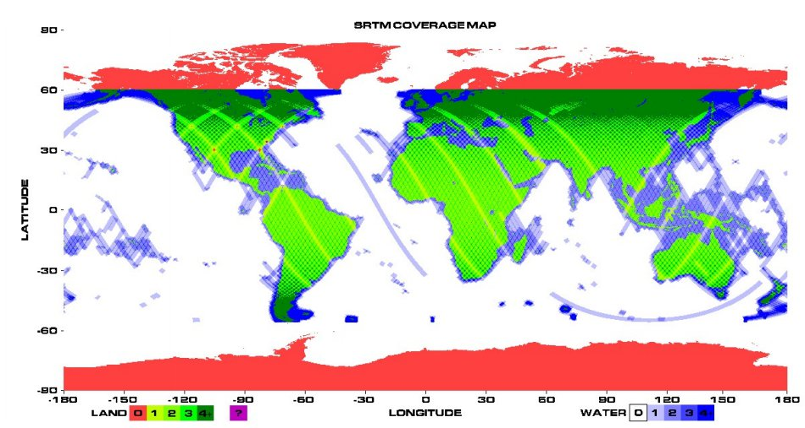
SRTM Mission
SRTM near global coverage
60º
56º
Source: JPL
Notes:
Visual Graphic of coverage
60n to 56s (All of Africa is covered)

Slide 6
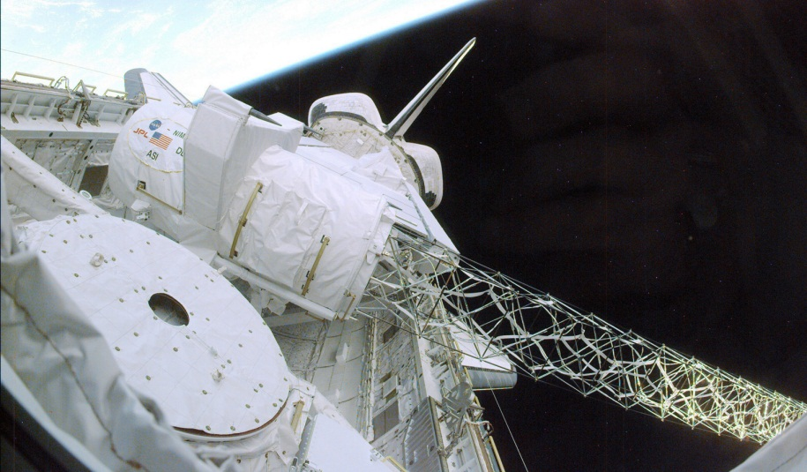
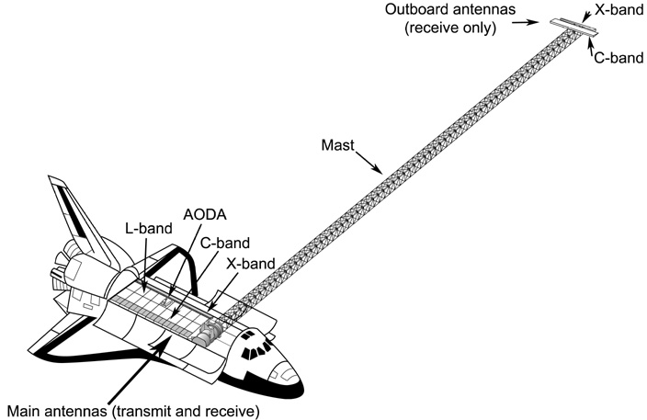
SRTM Mission
SRTM main antennas and mast
Source: JPL
83 m
Source: JPL
Notes:
Visual Graphic of coverage
Mast is 83 meters in length
Took advantage of zero gravity environment

Slide 7
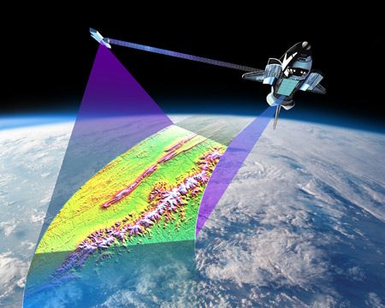
SRTM – side-looking radar technique
Source: JPL
Notes:
side-looking radar technique
Mast provided a ability to record stereo pair images in a single pass

Slide 8
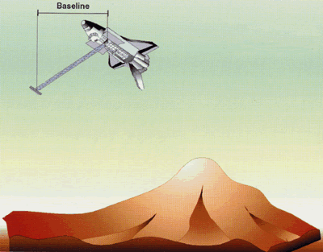

SRTM – side-looking radar technique
Notes:
side-looking radar technique

Slide 9
SRTM Data Characteristics
SRTM data characteristics to consider prior to including the DEM in data analysis.
  Data voids
  Phase noise
  Canopy bias
  Horizontal resolution

Slide 10
Data Voids
Shaded Relief of DTED 1
SRTM with gaps (Voids)
(Grohman, 2006)
Notes:
Data voids are areas in the dataset that were found to have either extreme error during processing or no radar signal returned. After a preliminary analysis of the SRTM for South America it is estimated that there are about 500 1 degree tiles with data voids

Slide 11
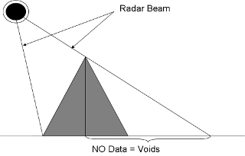
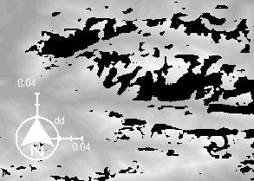
Data Voids
Side looking radar technique results in void pixels in high relief areas
Source; http://www.opendem.info/srtm_processing.html
Notes:
Due to the side-looking radar technique used by SRTM voids occur in mountainous regions

Slide 12
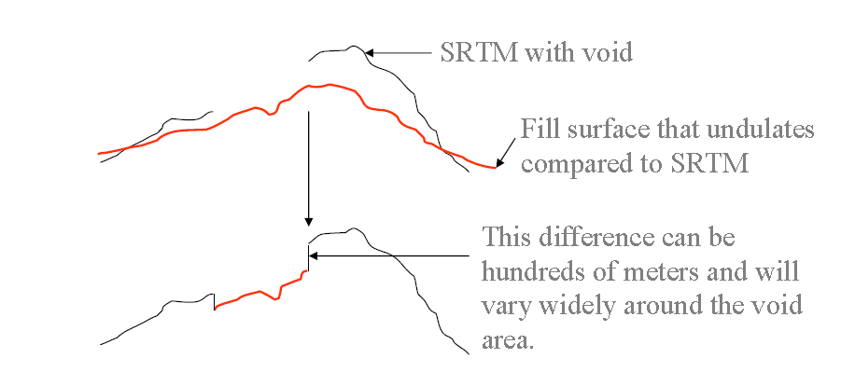
Feathering Method
(Grohman, 2006)
The feather method uses a fill source pixel at the same geographic area without adjusting for the difference in elevation (delta) and then “feathers” the edges between the different data sources to mitigate the difference in elevation.

Slide 13
Delta Surface Fill
(Grohman, 2006)

Slide 14
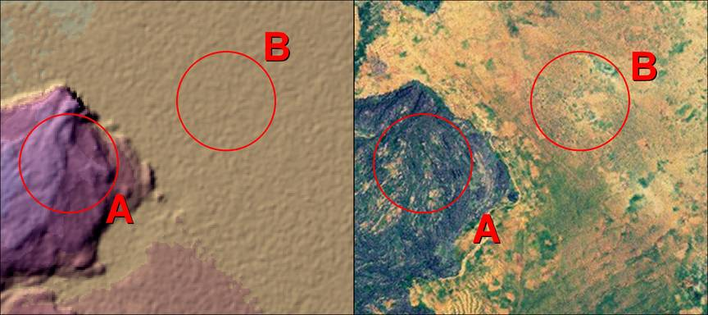
Phase Noise
An example of phase noise from two different surface types. A is from a rock outcropping, and B is bare soil with sparse vegetation
Notes:
Simple stated, phase noise is a minimal neighboring pixel by pixel height variation, and this variation was influenced by the type of surface the radar transmission was reflecting off. For example, an area with forest cover will have less noise than agricultural lands due to how the radar signal is bounced off the surface (Walker, 2006).
Walker, W. S., Kellndorfer, J. M. and Pierce, L. E. 2007: Quality assessment of SRTM C- and X-band interferometric data: Implications for the retrieval of vegetation canopy height: Remote Sensing of Environment, v 106, p. 428 - 448

Slide 15
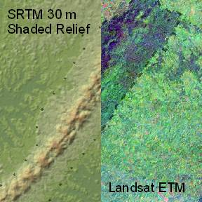
Canopy Bias
Shaded Relief / Landsat image mosaic illustrating canopy bias along the borders of a protected forest in Ghana, West Africa.
Notes:
Digital SURFACE Model, not Digital Terrain Model
A highly disputed characteristic of the SRTM DEM is the canopy bias. Because of the short wavelength (5.6 cm) of the C-Band, the majority of the received radar waves over heavy vegetative areas (Figure 7) are reflected back within the canopy, well above the bare Earth surface (Kellndorfer, 2004). For this reason many geologist and hydrology find the SRTM DEM a less than desirable dataset for large scale use, were as ecologists are finding it an invaluable tool to aid in estimating canopy height and biomass (Kellndorfer, 2004; Simard, 2006). One reason this is problematic for hydrologists is when modeling, for example, a drainage network in an area of dense forest were deforestation is occurring. Sometimes false channel networks are created because of the contrasting elevation values between the forest and the cleared areas (Figure 8) (Valeriano, 2005). For that same reason ecologists find it very useful because it can estimate a forest height and potentially extrapolate biomass (Kellndorfer, 2004).

Slide 16
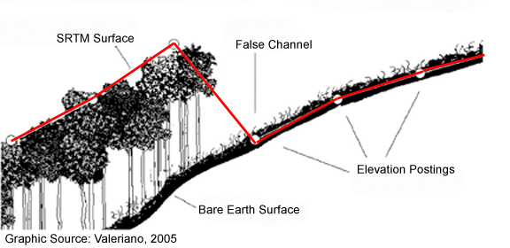
Canopy Bias
Example of potential false channel extraction using SRTM data.
Notes:
A highly disputed characteristic of the SRTM DEM is the canopy bias. Because of the short wavelength (5.6 cm) of the C-Band, the majority of the received radar waves over heavy vegetative areas (Figure 7) are reflected back within the canopy, well above the bare Earth surface (Kellndorfer, 2004). For this reason many geologist and hydrology find the SRTM DEM a less than desirable dataset for large scale use, were as ecologists are finding it an invaluable tool to aid in estimating canopy height and biomass (Kellndorfer, 2004; Simard, 2006). One reason this is problematic for hydrologists is when modeling, for example, a drainage network in an area of dense forest were deforestation is occurring. Sometimes false channel networks are created because of the contrasting elevation values between the forest and the cleared areas (Figure 8) (Valeriano, 2005). For that same reason ecologists find it very useful because it can estimate a forest height and potentially extrapolate biomass (Kellndorfer, 2004).
One reason this is problematic for hydrologists is when modeling, for example, a drainage network in an area of dense forest were deforestation is occurring. Sometimes false channel networks are created because of the contrasting elevation values between the forest and the cleared areas (Figure 8) (Valeriano, 2005).
On the other hand, ecologists are finding it an invaluable tool to aid in estimating canopy height and biomass (Kellndorfer, 2004; Simard, 2006). For that same reason ecologists find it very useful because it can estimate a forest height and potentially extrapolate biomass (Kellndorfer, 2004).

Slide 17
Horizontal Resolution
Original data collection was near 30 m.
Increased usability and smoothing algorithm was applied reducing resolution to 45 and 60 meters (Farr, 2006).
Other studies show the resolution may be between 30 and 48 meters (Pierce, 2006).
Notes:
Another area of contention with the SRTM 30 m DEM is its true horizontal resolution. The intrinsic resolution of SRTM interferometric product was very close to 30 m, but because of the point-to-point sampling there would be considerable height error variability (noise) between pixels (Farr, 2006). While still falling within the requirements, the product would not have been very useful to the end user (Farr, 2006). In order to increase the usability of the product a smoothing algorithm was applied to reduce the noise, and as a result the final product had a sampling resolution of between 45 and 60 meters, depending on whether the data was collected in high terrain or in relatively flat terrain respectively (Smith, 2003, Farr, 2006). These figures are not final, however, and a more recent study (Pierce, 2006) suggests that the horizontal resolution is closer to 30 m. The results indicate that the resolution is 30 to 48 m pixels, depending on the local variability or the elevation data; with a higher resolution near sharp edges and corners (e.g., mountainous areas) and a lower resolution in smoother areas (e.g., flood plains) (Pierce, 2006).

Slide 18
Slope
Overestimates in areas of steep topography
Overestimates in areas of little relief (Guth, 2006; Jarvis, 2004; Farr, 2006)
There is a combined influence of the smoothing algorithm and the phase noise error (Farr, 2006)
Notes:
Slope is a valuable derivative product of any DEM and is involved in many of the earth surface process models, such as in modeling for landslides. It has been documented in several studies that slope is underestimated in areas of steep topography and overestimated in areas of little relief (Guth, 2006; Jarvis 2004; Farr 2006). Both the underestimation of slope on steep areas and its overestimation on smoother location is a combined influence of the smoothing algorithm and phase noise error (Farr, 2006).

Slide 19
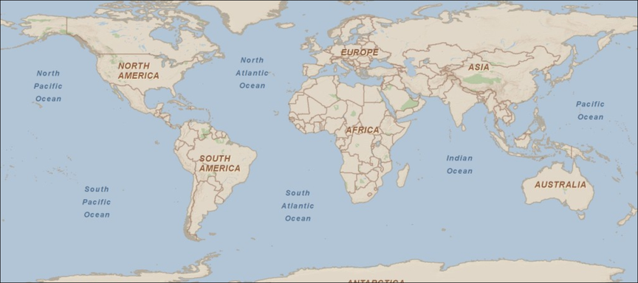
Overall SRTM Data Quality
The SRTM is an unprecedented collection of the world's topography and currently there is no global dataset that can match its versatility and quality (Guth, 2006).

Slide 20
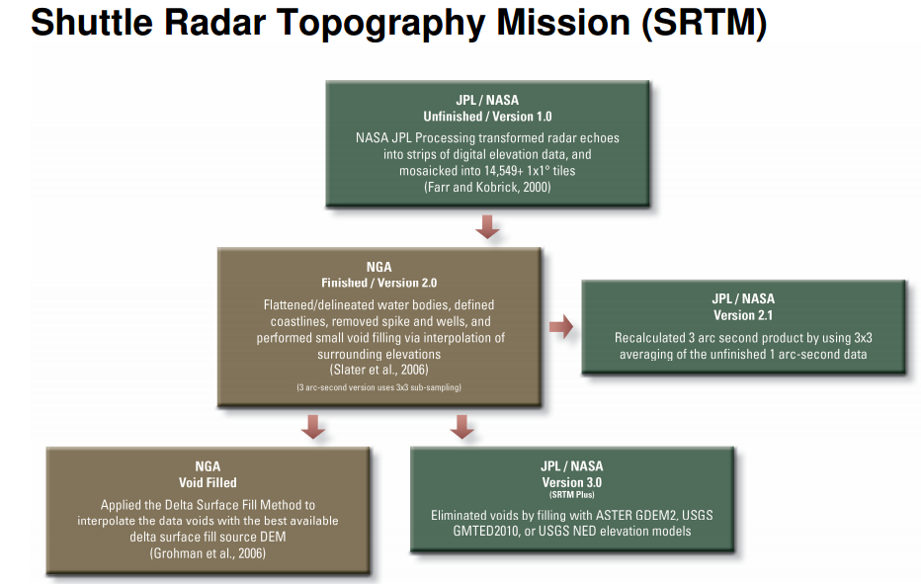
Notes:
NASA v.3.0
ASTER GDEM2 – 30m, but has some issues
USGS GM”Ted”2010 – where ASTER not available, probably used 50m
USGS NED – clean, high resolution, but only US

Slide 21
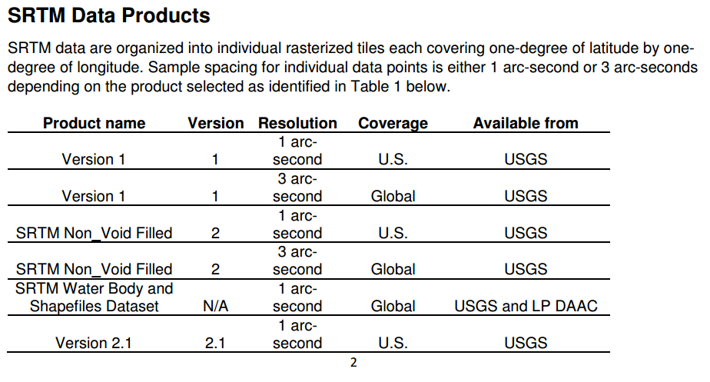

Slide 22
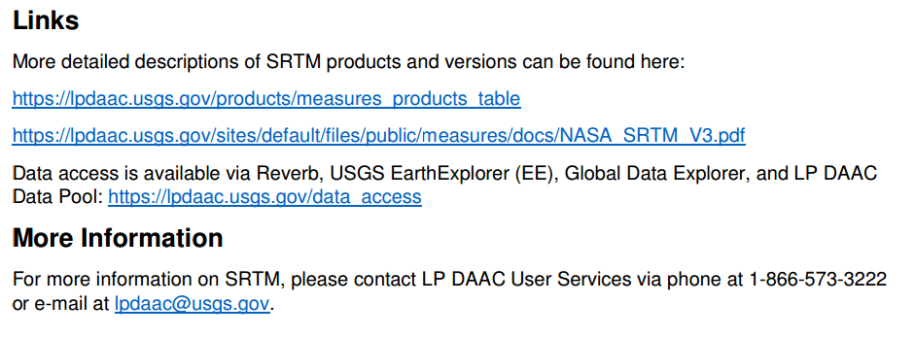

Slide 23
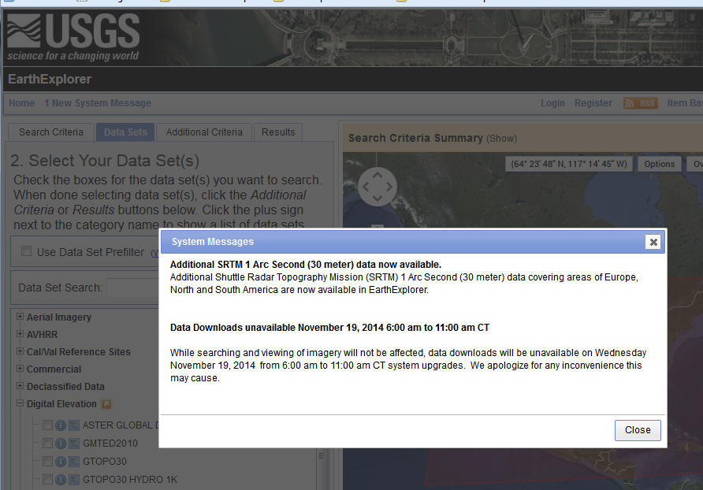

Slide 24
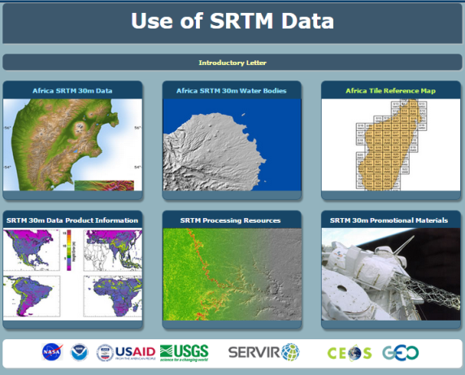

Slide 25
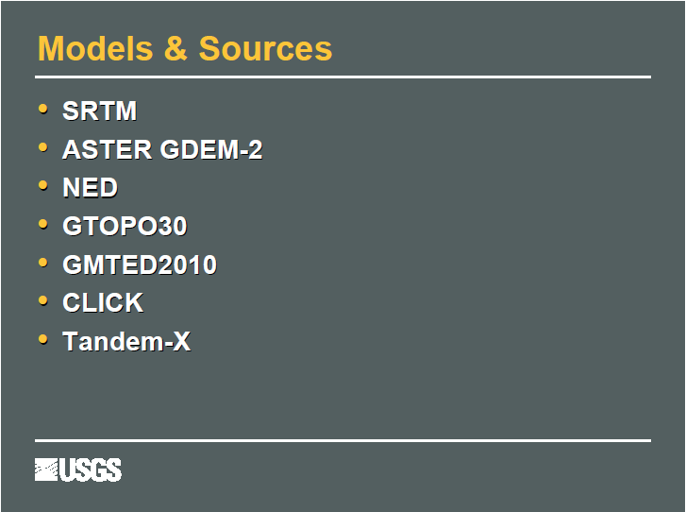

Slide 26
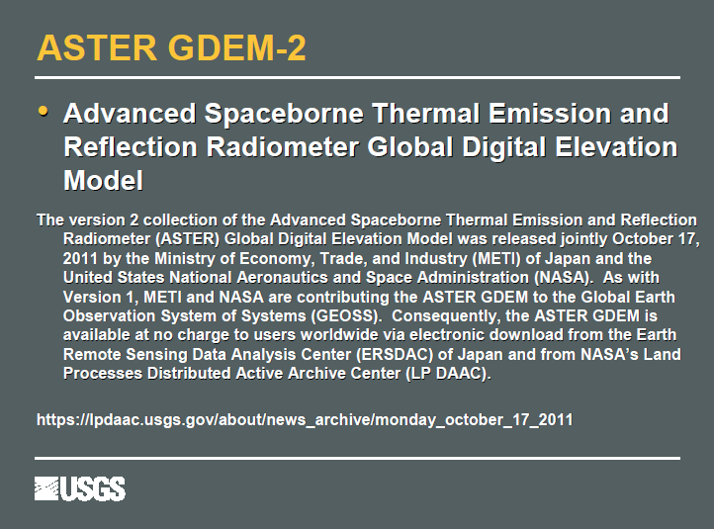

Slide 27
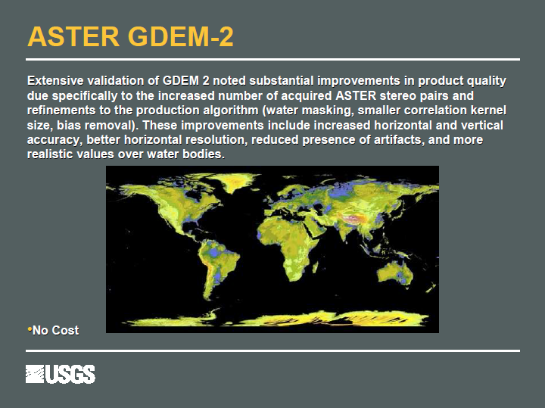

Slide 28
ASTER GDEM
30m ASTER GDEM version 2
  V2 used 1,500,000 stereo pairs – released
30m ASTER GDEM version 3
  V3 uses additional 500,000 stereo pairs – release pending 2015
PlanetDEM 30 (GDEM v2 source)

Slide 29
ASTER Global DEM
Coverage/cell size/Availability
  83 degrees south to 83 degrees north/1-arcseconds (30 meters)/ V2.0 released (V3.0 release 2015)
Accuracy
  Vertical error (LE95): absolute 17m
  Horizontal error: absolute 0.6 pixel;
Source data
  SRTM V1.0 Digital Elevation Model Data
  ASTER GDEM2 (Global Digital Elevation Model Version 2)
  National Elevation Dataset (NED)
  USGS GMTED2010
Costs
  none
Use/distribution restrictions
  users must agree to redistribute data products only to individuals within their organizations or projects of intended use, or in response to disasters in support of the GEO Disaster Theme. When presenting or publishing ASTER GDEM data, users are required to include a citation stating, "ASTER GDEM is a product of METI and NASA.”
Citations
  Tetsushi, Manabu Kaku, Akira Iwasaki, Dean Gesch, Michael Oimoen, Zheng Zhang, Jeffrey Danielson, Tabatha Krieger, Bill Curtis, Jeff Haase, Michael Abrams, Robert Crippen, and Claudia Carabajal, 2011, ASTER Gobal Digital Elevation Model Version 2 – Summary of Validation Results, available at https://www.jspacesystems.or.jp/ersdac/GDEM/ver2Validation/Summary_GDEM2_validation_report_final.pdf

Slide 30
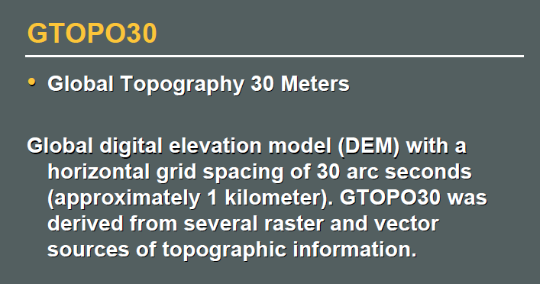

Slide 31
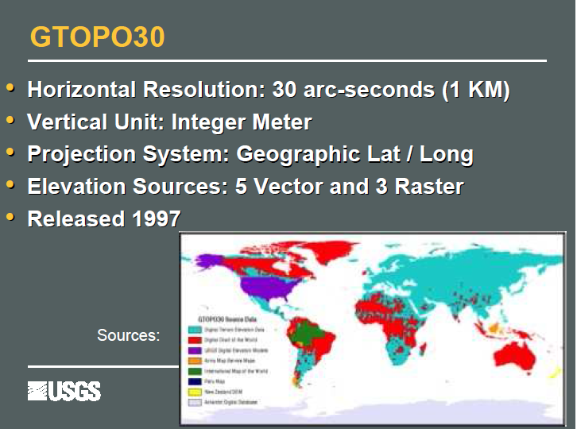

Slide 32
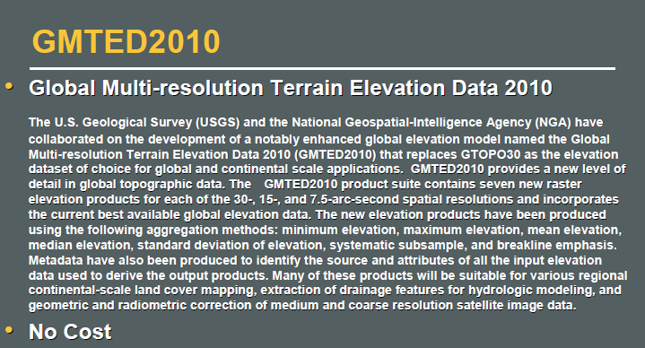

Slide 33
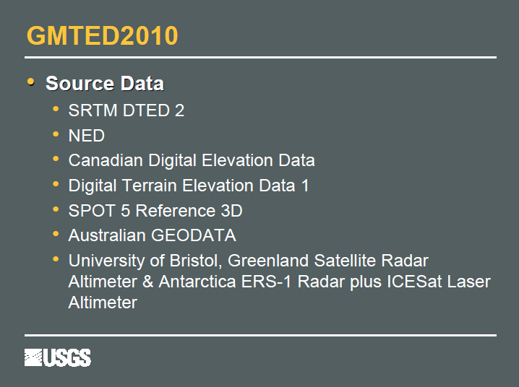

Slide 34
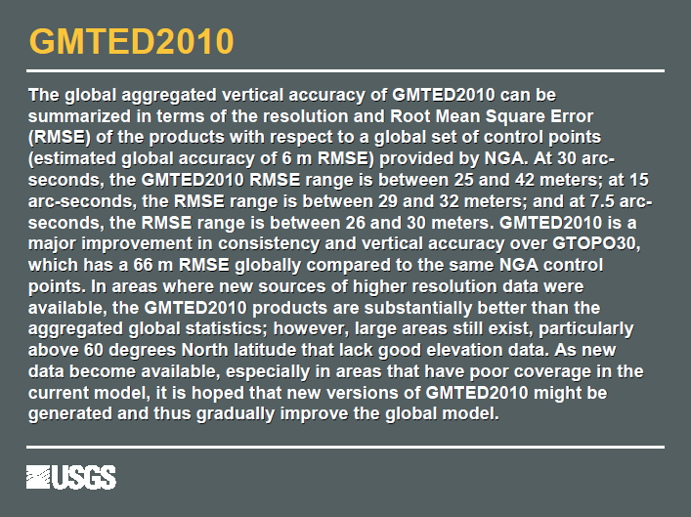

Slide 35
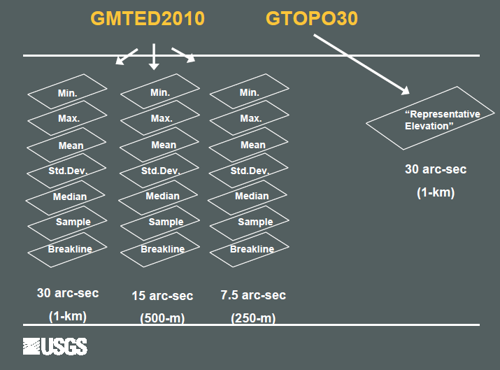

Slide 36
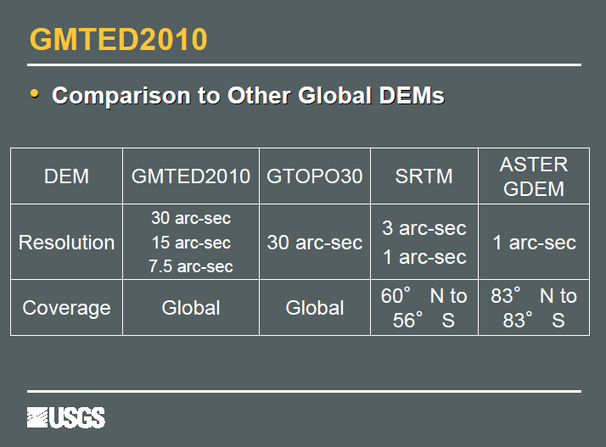

Slide 37
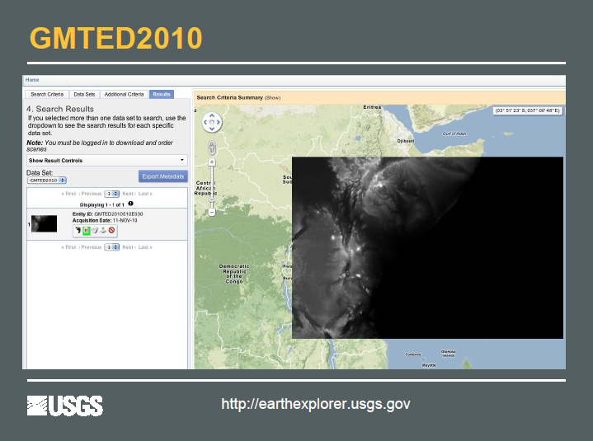

Slide 38
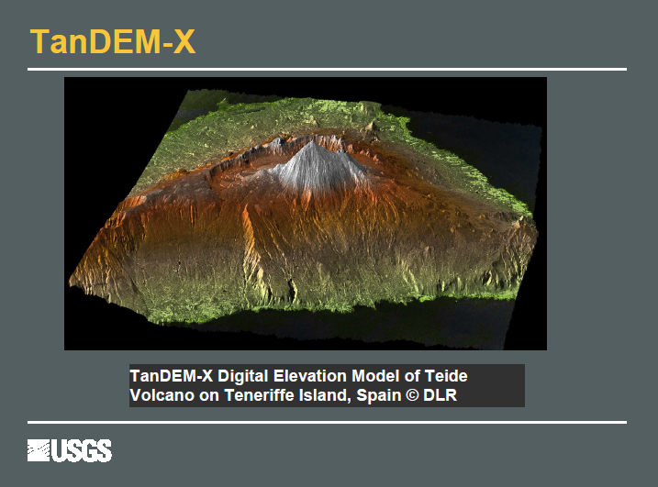

Slide 39
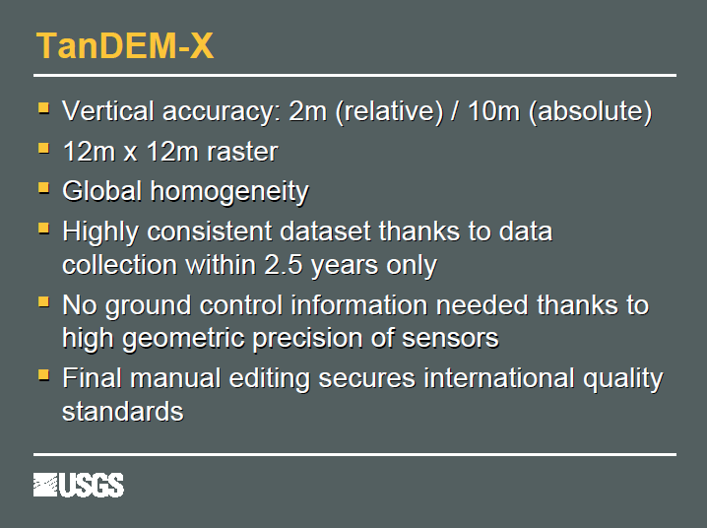

Slide 40
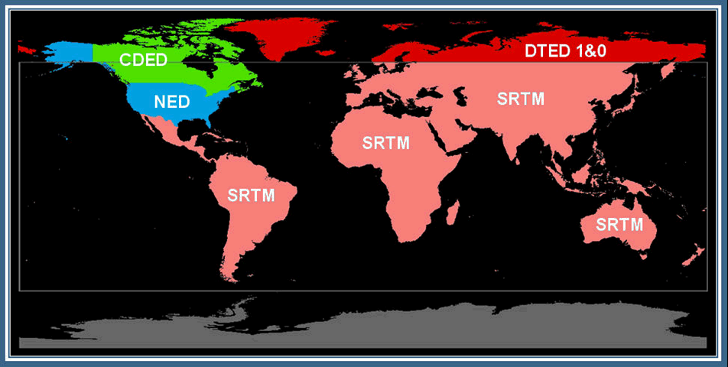
Global Land Survey 2000 DEM
Coverage/cell size/availability
  Global/3 arc-seconds (90 meters)/released
Vertical accuracy: ?
Source data
  NGA’s SRTM V1.0 Digital Elevation Model Data
  National Elevation Dataset (NED)
  Non-SRTM DTED
  Canadian Digital Elevation Data (CDED)
  GTOPO30
Costs
  none
Use/distribution
  Ambiguous restrictions – currently not redistributed
Citations

Slide 41
NASADEM
Coverage/cell size/availability
  Global/1-arcsecond (30 meters)/release estimated 2017
Accuracy
Source data
  NASA SRTM Digital Elevation Model Data at full resolution
  NASA ICESat/Geoscience Laser Altimeter (GLAS) surface elevation measurements
  ASTER Global DEM (GDEM) version 2.0
  National Elevation Dataset (NED) for US and Mexico produced by USGS
  USGS GMTED2010 developed by USGS and NGA
  Canadian Digital Elevation Data produced by Natural Resources Canada
Costs
  none
Use/distribution restrictions
  30-meter data will be distributable
Citations
  NASA, n.d., NASADEM: Creating a New NASA Digital Elevation Model and Associated Products, available at https://earthdata.nasa.gov/our-community/community-data-system-programs/measures-projects/nasadem-nasa-digital-elevation-model

Slide 42
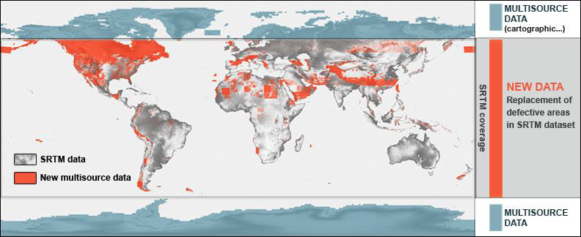
PlanetDEM
Coverage/cell size/availability
  Global/3-arcsecond (90 meters)/released
  83 north to 83 south/1-arcsecond (30 meters)/released
Accuracy
  Vertical (LE95): 14 meters (90m); 20 meters (20m)
  Horizontal (CE95): 10 meters; 30 meters (30m)
Source data 90 meter
  SRTM V4.1? Digital Elevation Model Data
    Corrected with national maps GDEM and NED
  Antarctica NSIDC at 200m
  Alaska Alaska Geospatial Data Clearinghouse
  Canada CDED
  National maps and GDEM v2.0
Source data 30 meter
  ASTER GDEM v2.0
  PlanetDEM 90 to correct anomalies and artifacts
Costs
  Commercial product
Use/distribution restrictions
  30-meter data is not redistributable - only granted rights to use the PRODUCT
  90-meter data is not redistributable - only granted rights to use the PRODUCT
Citations
  Planet Observer, 2014, Technical sheet PlanetDEM 30, available at www.planetobserver.com
  Planet Observer, 2014, Technical sheet PlanetDEM 90, available at www.planetobserver.com

Slide 43
TanDEM-X/TerraSAR WorldDEM
Coverage/cell size/available
  Global/12 meters/released in part
Accuracy
  Vertical error (LE90): 10 m absolute; relative (< 20% 2m; >20% 4m)
  Horizontal error (CE90): 10 m absolute
Source data
  TanDEM-X
  TerraSAR
Costs
  Science TanDEM-X DEM – 0.4 arc-second (12m); 1 arc-second (30m); 3 arc-second (90m)
  Commercial WorldDEM - 0.4 arc-second (12m)
Use/distribution restrictions
  Restricted use product, which cannot be transferred or disclosed
Citations
  TanDEM-X DEM Product Specification available at https://tandemx-science.dlr.de
  WorldDEM available at http://www.astrium-geo.com/worlddem/

Slide 44
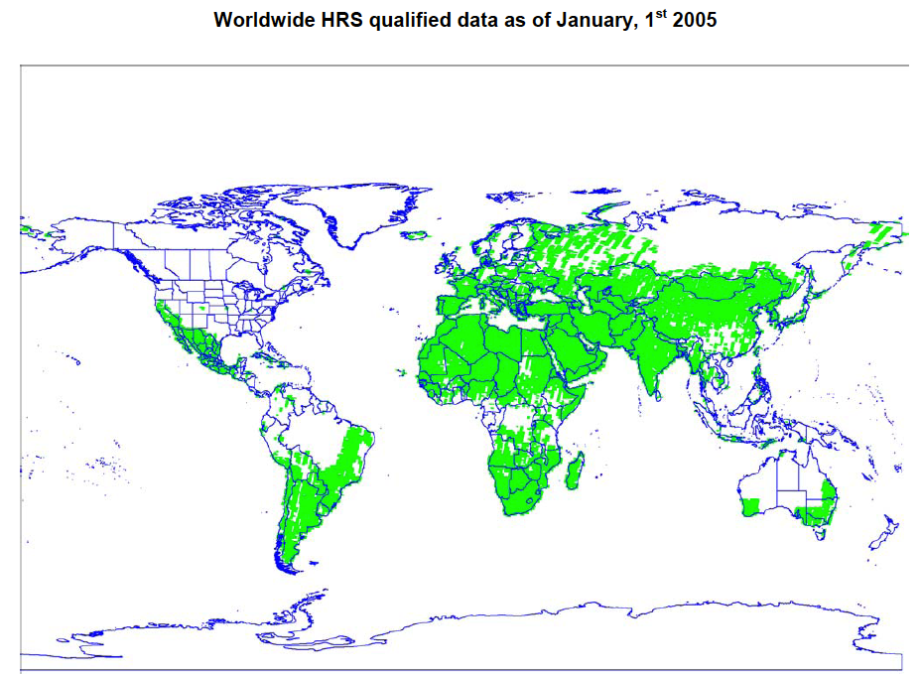
SPOT Elevation30
Coverage/cell size/available
  global/1-arcseconds (30 meters)/released in part
Accuracy
  Vertical error (LE90): 10-30m
  Horizontal error (CE90): 10-16m
Source data
  SPOT 5 HRS
  SRTM DEM fill
Costs
  Commercial product
Use/distribution restrictions
  Restricted use product, which cannot be transferred or disclosed
Citations
  Elevation30 Technical Information, available at http://www.astrium-geo.com/en/198-elevation30
  Astrium, 2005, SPOT DEM Product Description Version 1.2, available at http://www2.astrium-geo.com/files/pmedia/public/r467_9_spot_dem_product_description.pdf
  Astrium, 2006, SPOT DEM Precision Product Description Version 1.0, available at http://www2.astrium-geo.com/files/pmedia/public/r468_9_spot_dem_precision_product_description.pdf
  Astrium, 2011, Reference3D Product Description Version 6.1, available at http://www2.astrium-geo.com/files/pmedia/public/r469_9_reference3d_product_description_201105.pdf

Slide 45
ALOS World 3D
Coverage/cell size/available
  global/1-arcseconds/30 meters/after March 2016
Accuracy
  Vertical accuracy: 5m
  Horizontal precision: 5m
Source data
  ALOS-2 PRISM
Costs
  30-meter product free of charge
Use/distribution restrictions
  unknown
Citations
  Precise Global Digital 3D Map "ALOS World 3D" Homepage, 2014, available at http://www.eorc.jaxa.jp/ALOS/en/aw3d/index_e.htm

Slide 46
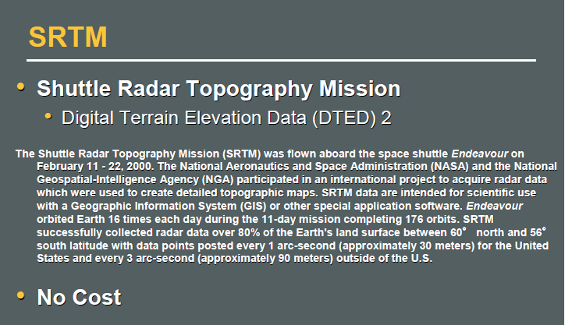

Slide 47
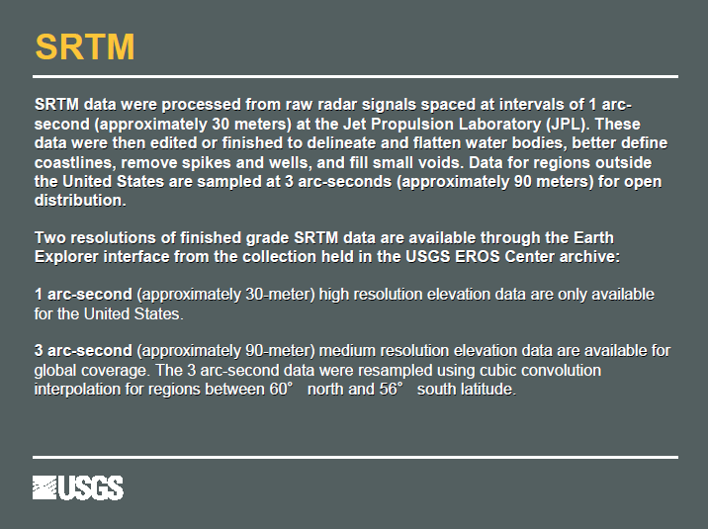
… until now!

Slide 48
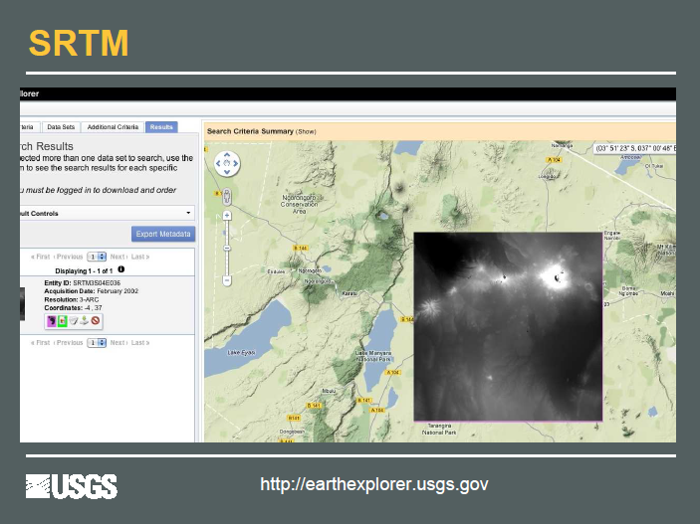

Slide 49
SRTM
NGA SRTM void filled
  90 meter released
  30 meter released
SRTM Plus (version 3) (2013)
  90 meter released
  30 meter released
PlanetDEM (SRTM v4? source)
  90 meter released
NASADEM (reprocess SRTM source)
  30 meter release date 2017

Slide 50
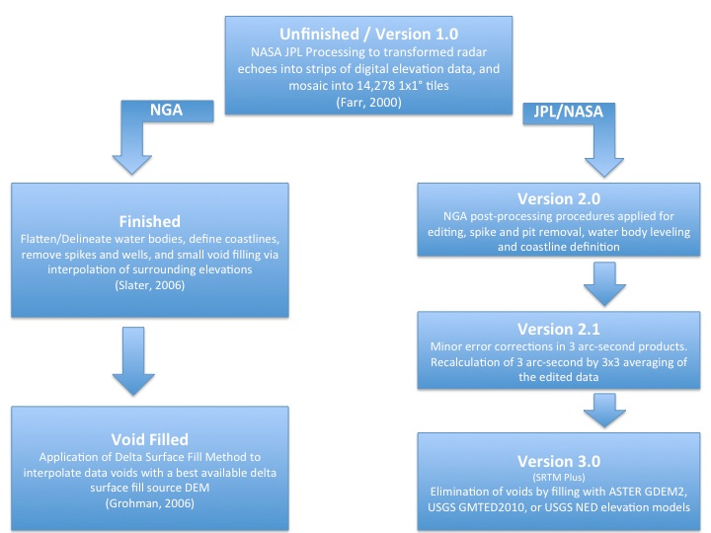
SRTM

Slide 51
NGA SRTM Digital Terrain Elevation Data
Coverage/cell size/availability
  Global/3-arcseconds (90 meters)/released
  Global/1-arcseconds (30 meters)/phased release pending
Vertical accuracy: 26-30 meters RMSE
Source data
  SRTM V1.0 Digital Elevation Model Data
  SPOT 5 Reference3D
  National Elevation Data (NED)
  GEODATA 9 second digital elevation model (DEM) for Australia
  Antarctica satellite radar and laser altimeter DEM
  Greenland satellite radar altimeter DEM
  GTOPO30
Costs
  none
Use/distribution restrictions
  30-meter data is not distributable
  90-meter data ?
Citations
  Grohman, G., G. Kroenung, and J. Strebeck, 2006, Filling SRTM voids: The Delta Surface Fill Method. Photogrammetric Engineering and Remote Sensing, v. 72, no. 3, p. 213-216.
  Slater, J. A., G. Garvey, C. Johnston, M. Haase, B. Heady, G. Kroenung, and J. Little (2006), The SRTM data ‘finishing’ process and products, Photogrammetric Engineering and Remote Sensing, v. 72, p 237-247.

Slide 52
NASA SRTM Plus (v3) DEM
Coverage/cell size/availability
  56 degrees south to 60 degrees north/3-arcseconds (90 meters)/released
  56 degrees south to 60 degrees north/1-arcseconds (30 meters)/restricted access
Accuracy
  Vertical error: absolute 16m; relative 10m
  Horizontal error (CE90): absolute 20m; relative 15m
Source data
  SRTM V1.0 Digital Elevation Model Data
  ASTER GDEM2 (Global Digital Elevation Model Version 2)
  National Elevation Dataset (NED)
  USGS GMTED2010
Costs
  none
Use/distribution restrictions
  30-meter data is being made available in phases from 2014-2015
  90-meter data available with no restrictions at https://lpdaac.usgs.gov/products/measures_products_table
Citations
  LPDAAC, 2014, SRTM Topography: Update Includes NASA Version 3.0 (SRTM Plus) at https://lpdaac.usgs.gov/sites/default/files/public/measures/docs/NASA_SRTM_V3.pdf

