Slide 1

Useful CEOS Tools & Resources
Committee on Earth Observation Satellites
Presented by: Kim Holloway
CEOS Systems Engineering Office (SEO)
April 7, 2015 – Webinar 1
Distance Education Course:
Webinar Series on Remote Sensing
Technology for
Disaster Management
Notes:
The CEOS Visualization Environment, known as the COVE Tool, was developed by the Systems Engineering Office of CEOS.
COVE predicts when specific satellite instruments will measure over various regions of the Earth - not only when, but how often, and to what degree. COVE can also tell you when multiple instruments’ measurements will coincide, facilitating calibration and validation efforts. In addition, the COVE tool displays this information on-screen using Google Earth.
For the purposes of this workshop, I will give you a concise summary of how COVE can help you address disasters, specifically how COVE can reduce the time it takes to identify what data might be available in your region of interest.
There are 109 CEOS Satellites in Orbit today. Over 50 of those are in the COVE Tool.
If you know which instruments you are interested in,
Cove will
Tell you when those instruments can see your region,
Show you what that coverage might look like,
And Help you effectively share this information with others.
COVE cannot guarantee that an instrument will collect data over your region when it passes by, but it can accurately predict the overpass.
This screenshot of the COVE Tool shows you just how simple it is to use.
You select an instrument from the list.
You select a timespan.
And then, you click Add Ground Swaths,
As a result, the Google Earth on the right side of the screen (under this text here) displays that instrument’s overpasses over the entire globe for the time period you selected. Clicking on that red swath displays more detailed information about that potential acquisition.
Below the Add Ground Swaths button, you will see the “Add Actual Acquisitions button”. This is a new feature we have implemented that allows you to see the actual acquisitions for some instruments.
Clicking the “Add actual acquisitions” button for Landsat 7 or Landsat 8’s instruments will allow you to see when they actually acquired over your region of interest. Clicking on those swaths on the Google Earth image reveals the browse image for that acquisition, as shown here. So you can see that Landsat 7 had a clear image of Cabo on November 12th of this year.
In the coming year, we are making every effort to add this capability for other instruments from space agencies as well as commercial data providers.
This means that in many cases, you will be able to use COVE to see what an image looks like without having to go to an agency website or data ordering service. You can see it in COVE.
Inside the COVE Tool, there is also the Rapid Acquisition Tool, shown here.
It works the same way, except you can select a specific region and the tool outputs the acquisition data in a table, instead of only visually on the globe.
So you select a time span, an instrument, and then you select or even draw a region of interest.
When you click compute acquisitions, the COVE tool computes them for you and puts them in a table that you can then export into a spreadsheet.
COVE has many many other features:
To name a few, COVE allows you to save your work in the form of a “state file” and return to that “state” later.
You and your colleagues can have a Collaboration Session in COVE, where you share your screens and work together live.
Even your COVE outputs can be exported as KML files in order to upload them into Google Earth or other GIS software.
COVE also comes built in overlays for land cover, cloud and precipitation statistics, and more.
To make COVE even more useful, we will release Spanish COVE very very soon.
As you can see, COVE has a lot of capability. Currently, COVE is supporting Flood response activities in Namibia, GEO Agriculture, Forest Carbon, and Disasters activities, as well as Calibration & Validation campaigns.

Slide 2
Agenda
The Earth Observation (EO) Handbook & Database
The Data Policy Portal
The Systems Engineering Toolset
  The CEOS Visualization Environment (COVE)
  The Rapid Acquisition Tool (RAT)
  The Coverage Analyzer

Slide 3
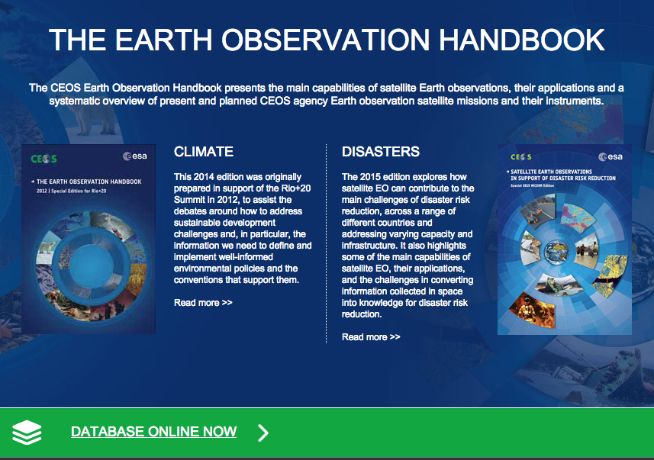
The EO Handbook & Database
The Earth Observation (EO) Handbook & Database
The Data Policy Portal
The Systems Engineering Toolset
  The CEOS Visualization Environment (COVE)
  The Rapid Acquisition Tool (RAT)
  The Coverage Analyzer
Notes:
http://www.eohandbook.com/

Slide 4
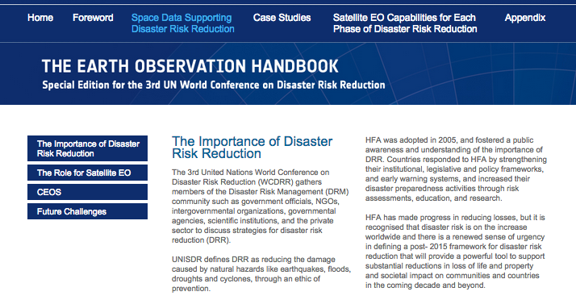
The EO Handbook

Slide 5
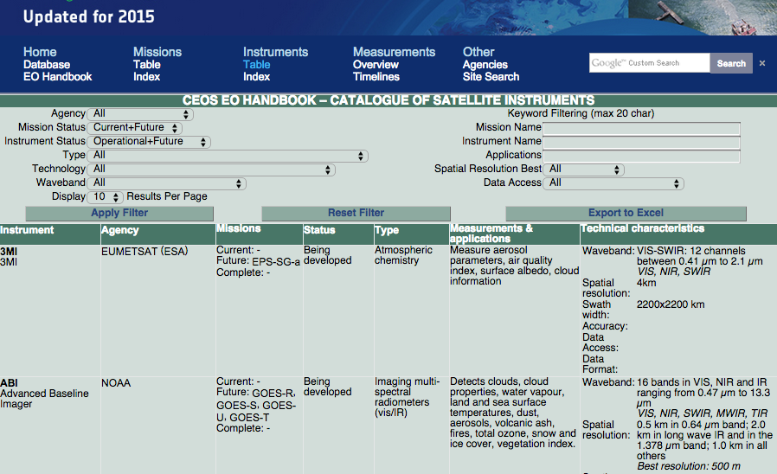
The “MIM” Database
Notes:
CEOS MIM Database: database.eohandbook.com
Includes 259 CEOS missions
(past, present and future)
CEOS Mission, Instruments and Measurements (MIM) Database is the “official” database of agency missions (now and in the future).
Developed by ESA, with support from NASA and the CEOS SEO.
Details about agencies, launch dates, orbital parameters, instrument parameters (i.e., swath, bands, resolution, accuracy), measurement applications, data access websites.
The community utilizes the MIM as the “best” site for Earth mission information

Slide 6
Agenda
The Earth Observation (EO) Handbook
The Data Policy Portal
The Systems Engineering Toolset
  The CEOS Visualization Environment (COVE)
  The Rapid Acquisition Tool (RAT)
  The Coverage Analyzer

Slide 7
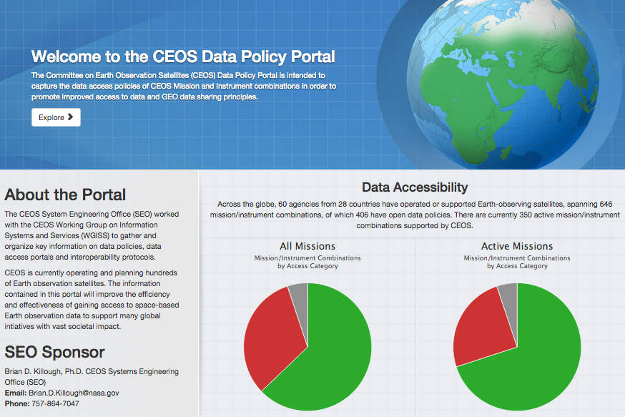
The Data Policy Portal
Notes:
www.ceos-datapolicy.org
Data access policies for:
318 current instruments
297 past instruments
(615 instruments from 25 countries)

Slide 8
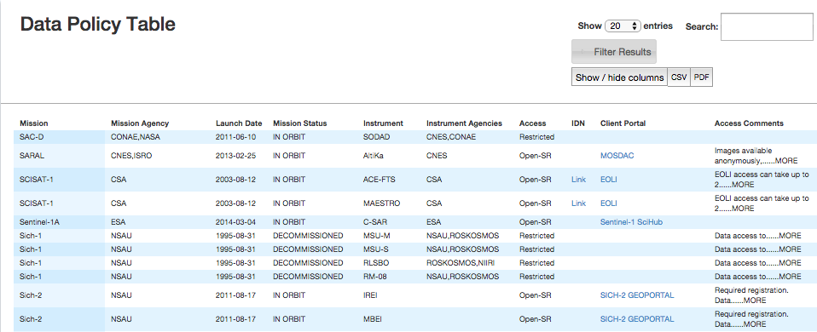
The Data Policy Portal
Mission (Satellite)
Agency
Launch Date
Status
Access level (Open, Restricted…)
Link to metadata/data access

Slide 9
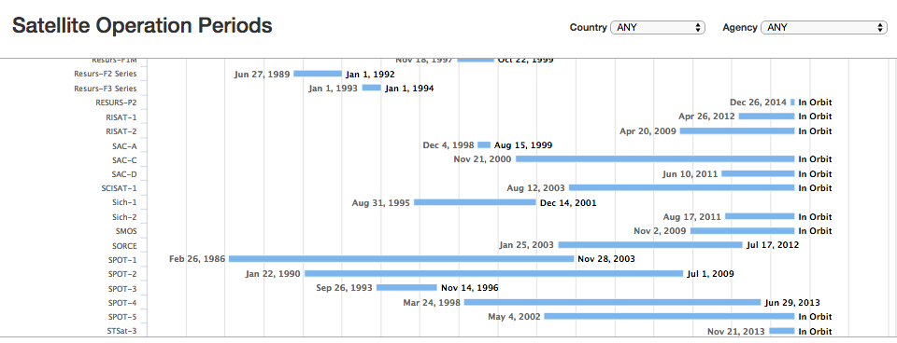
The Data Policy Portal
Mission Timelines
Filter by Country and/or Agency
And more…

Slide 10
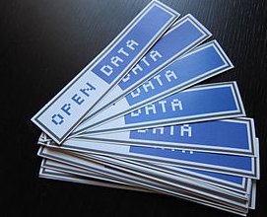
The Data Policy Portal
  Access Summary
  Open = 36%
  Open-SR = 21%
  Open-AP = 5%
  Restricted = 33%
  Unknown = 5%
  All CEOS instruments: 62% Open
  Current CEOS instruments: 72% Open
Notes:
OPEN: Anonymous access, no restrictions
OPEN-SR: Simple Registration within 2 days
OPEN-AP: Advanced Protocol more steps or pre-approval
Restricted: Controlled access or commercial
No Access: No outside access

Slide 11
Agenda
The Earth Observation (EO) Handbook
The Data Policy Portal
The Systems Engineering Toolset
  The CEOS Visualization Environment (COVE)
  The Rapid Acquisition Tool (RAT)
  The Coverage Analyzer

Slide 12
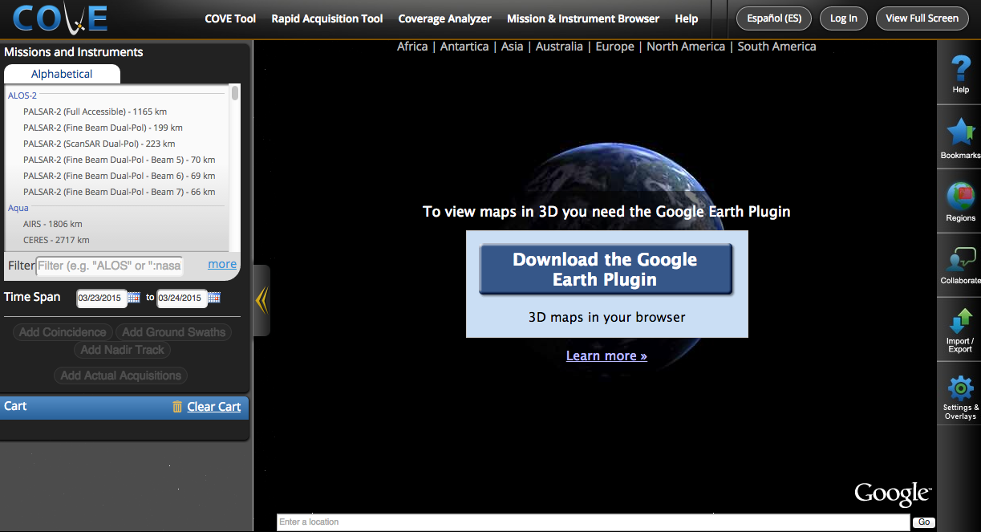
The COVE Tool

Slide 13
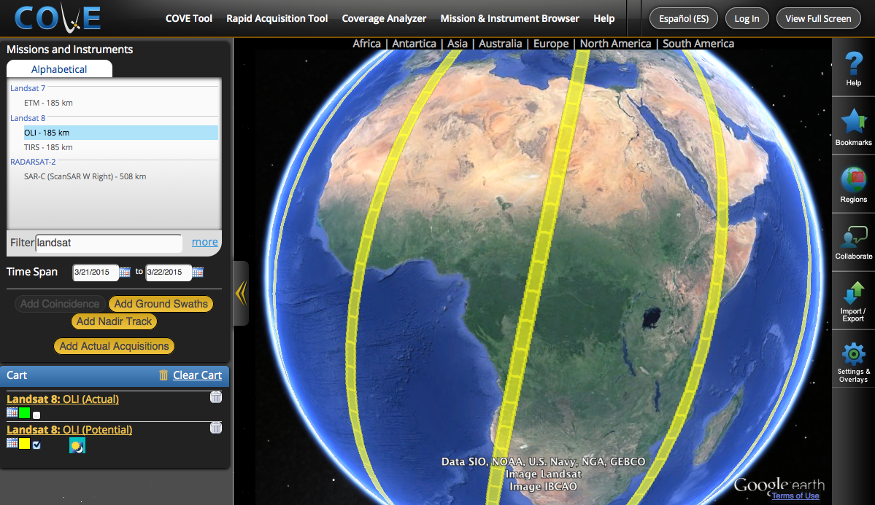
The COVE Tool
Notes:
256 Missions
694 Mission/Instrument combinations

Slide 14
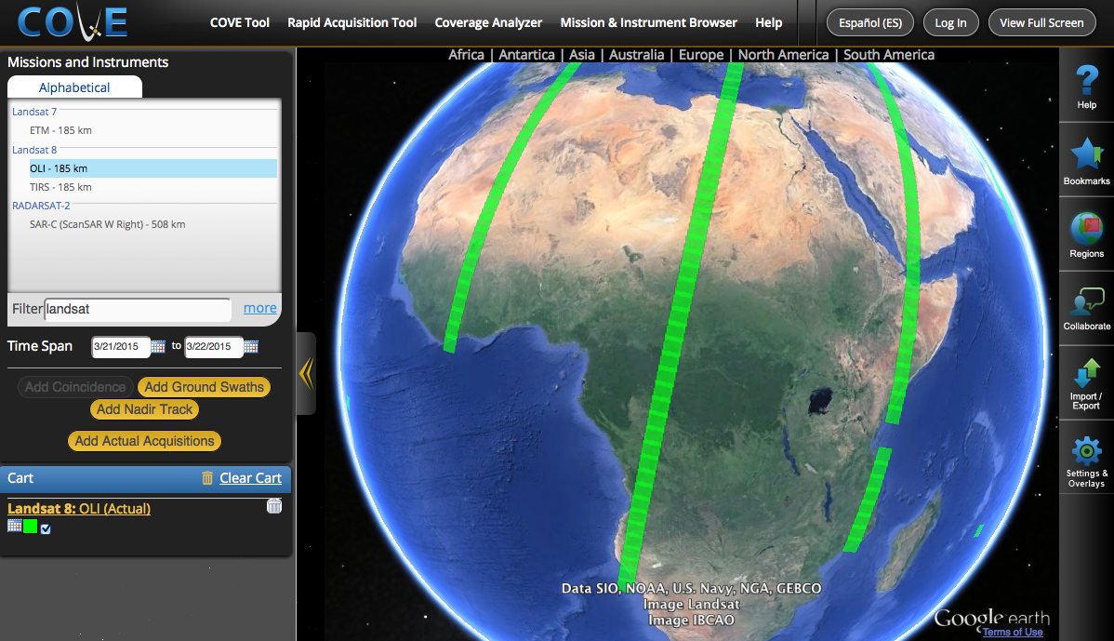
The COVE Tool

Slide 15
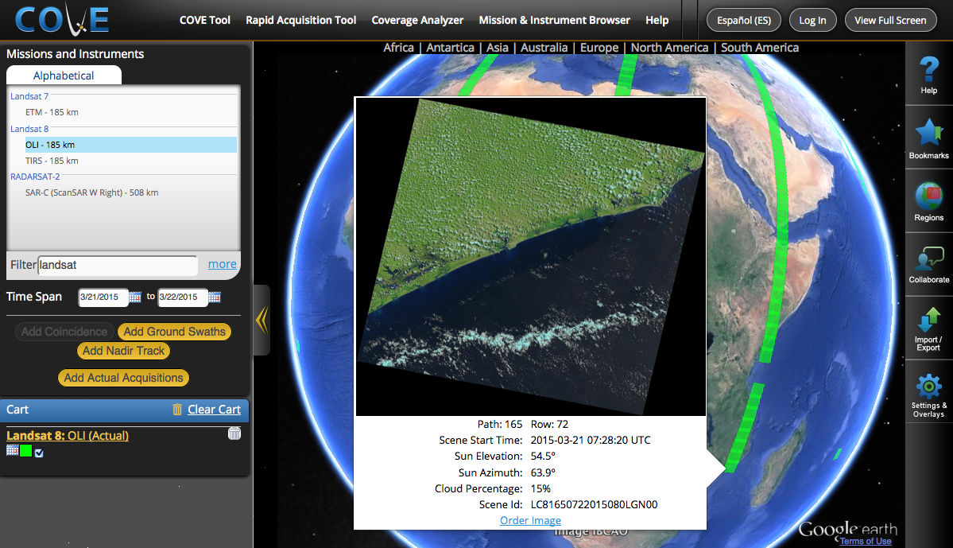
The COVE Tool
Browse Image Previews for:
Landsat 7/8
SPOT 1-6
Pleiades 1A/1B
Radarsat-2
ALOS-1
China
Laos
Notes:
As for archive links, here are the latest connections … an example is below. I tried a few of the ones below …
Landsat 7/8
SPOT 1-6
Pleiades 1A/1B
Radarsat-2
ALOS-1

Slide 16
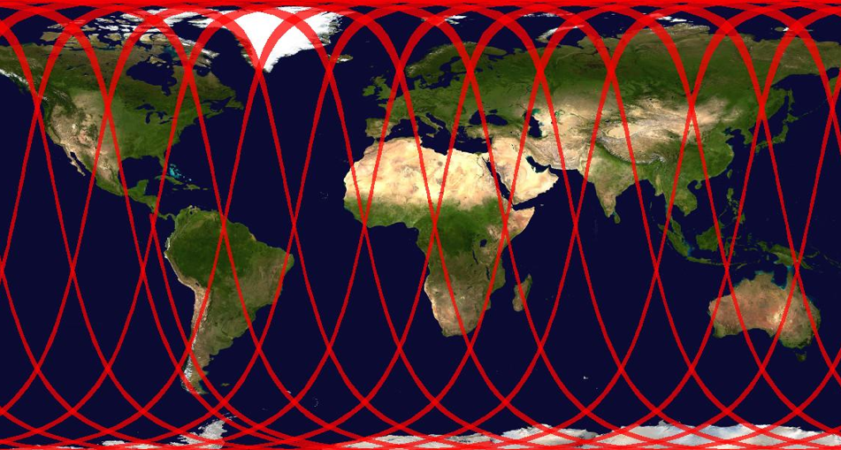
The COVE Tool
COVE in Spanish
Map image export
Virtual collaboration
Bookmarking
Data grids, ASTER Digital Elevation Model, MODIS Land Cover Classification, and other overlays
Notes:
As for archive links, here are the latest connections … an example is below. I tried a few of the ones below …
Landsat 7/8
SPOT 1-6
Pleiades 1A/1B
Radarsat-2
ALOS-1

Slide 17
Agenda
The Earth Observation (EO) Handbook
The Data Policy Portal
The Systems Engineering Toolset
  The CEOS Visualization Environment (COVE)
  The Rapid Acquisition Tool (RAT)
  The Coverage Analyzer

Slide 18
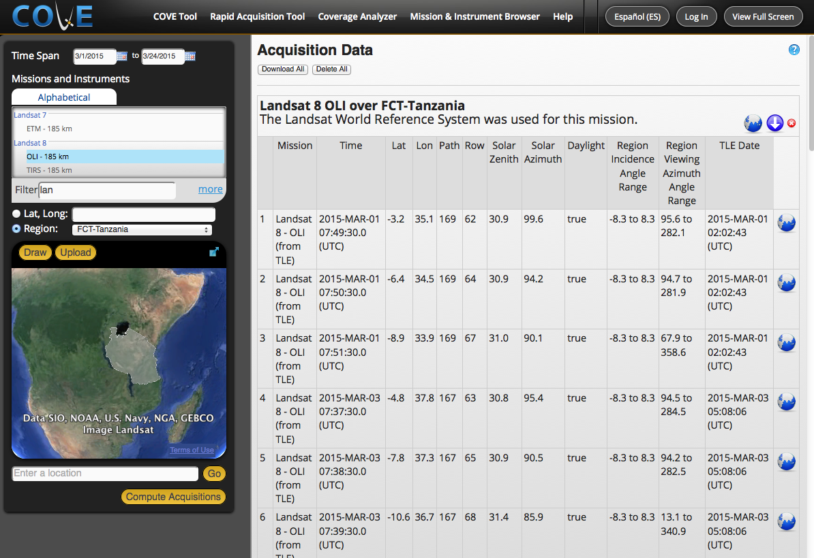
The RAT

Slide 19
Agenda
The Earth Observation (EO) Handbook
The Data Policy Portal
The Systems Engineering Toolset
  The CEOS Visualization Environment (COVE)
  The Rapid Acquisition Tool (RAT)
  The Coverage Analyzer

Slide 20
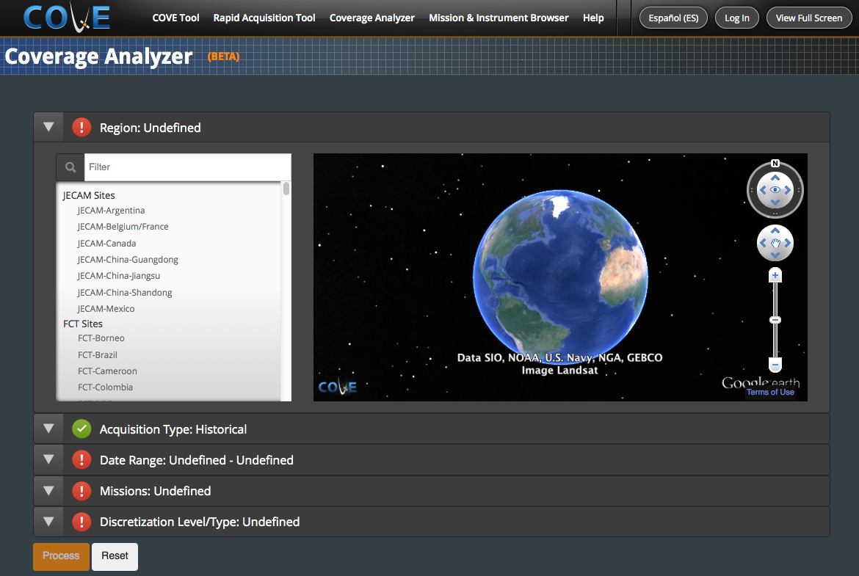
The Coverage Analyzer

Slide 21
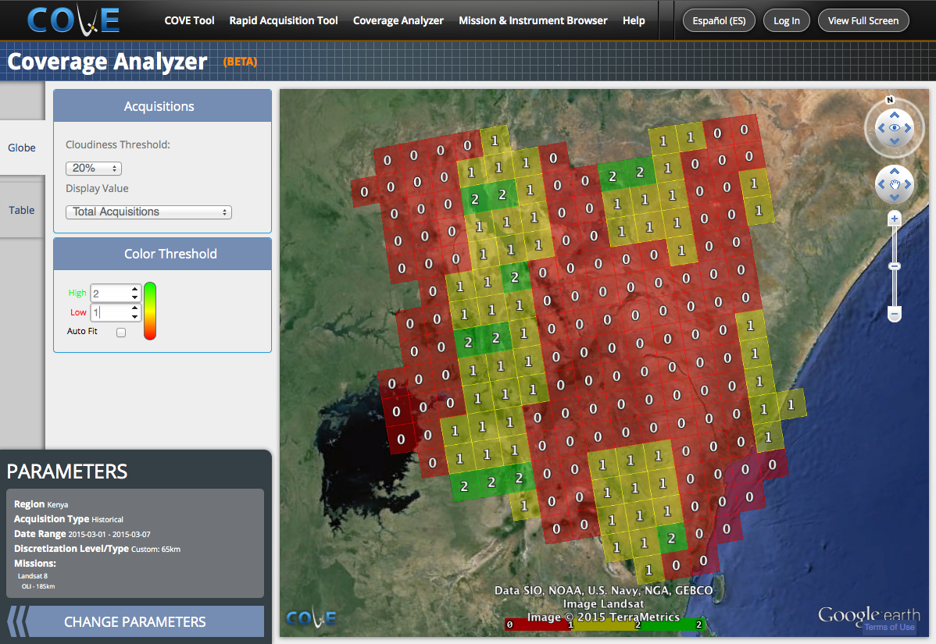
The Coverage Analyzer
Notes:
Archive analysis tool
Users select a date range, region, grid size (or Landsat WRS), and cloud cover threshold.
Output = number of acquisitions meeting the criteria for each grid cell in the region.

Slide 22

Summary
CEOS Website: http://www.ceos.org
MIM Database: http://database.eohandbook.com
COVE Tool: http://www.ceos-cove.org
Data Policy Portal: http://www.ceos-datapolicy.org
Thank You!

