Slide 1
CNES Capacity Building Activities Overview
Regional Spotlight: Europe
CNES
Dr. Linda TOMASINI
CEOS WGCapD-9 Annual Meeting
Sunnyvale, California
10-12 March 2020

Slide 2
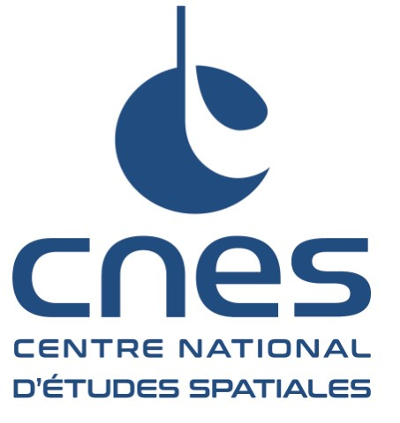







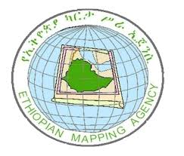

CNES Capacity Building Activities Main pillars and drivers
Synergies
CEOS : Datacube, Recovery Observatory, Chair Initiative…
Copernicus User Uptake Program
National Partnerships
Research Institutes (IRD, CIRAD, CESBIO…)
French Development Agency AFD
Open tools and data
Copernicus (open, multisensor, sustainable, calibrated dataset)
Orfeo Toolbox
International Partnerships
(Vietnam VNSC, Gabon AGEOS, Ethiopia EGII, Mexico AEM…)

Slide 3
CNES Capacity Building Activities Features
  Mainly on demand and opportunity driven approach…
  For the moment, only on-site and in-person training. Priority to relationships and user communities building
  Support to Copernicus User Uptake program : CNES is national coordinator of Copernicus relays and academies
  Based on CNES and french science expertise :
    Optical data processing (SPOT World Heritage archive, Pleiades)
    SAR times series processing for LCUC (CESBIO)
    GNSS precise processing (GET laboratory, GINS tool)
  Dedicated not only to scientists, but also to operational experts
  May be related also to the development of pilot services
  Make use of local and in-situ knowledge of ground truth : for instance, to test forest mapping algorithms on Gabon rainforest

Slide 4
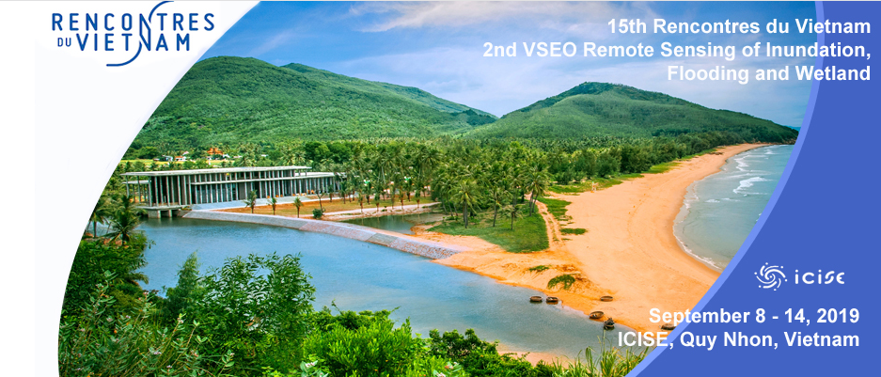
CNES capacity building activities
CNES co-organizer of Vietnam School of Earth Observation (VSEO)
One week Yearly Summer School created by USTH, ICISE/Les Rencontres du Vietnam and CNES
2018 Topic : Atmospheric Remote sensing
2019 Topic : Flood and Water Surfaces monitoring (ESA contribution, WGCapD deliverable)
2020 SAR processing for LULC

Slide 5
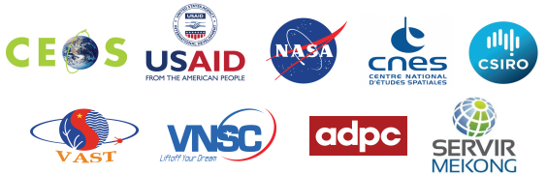
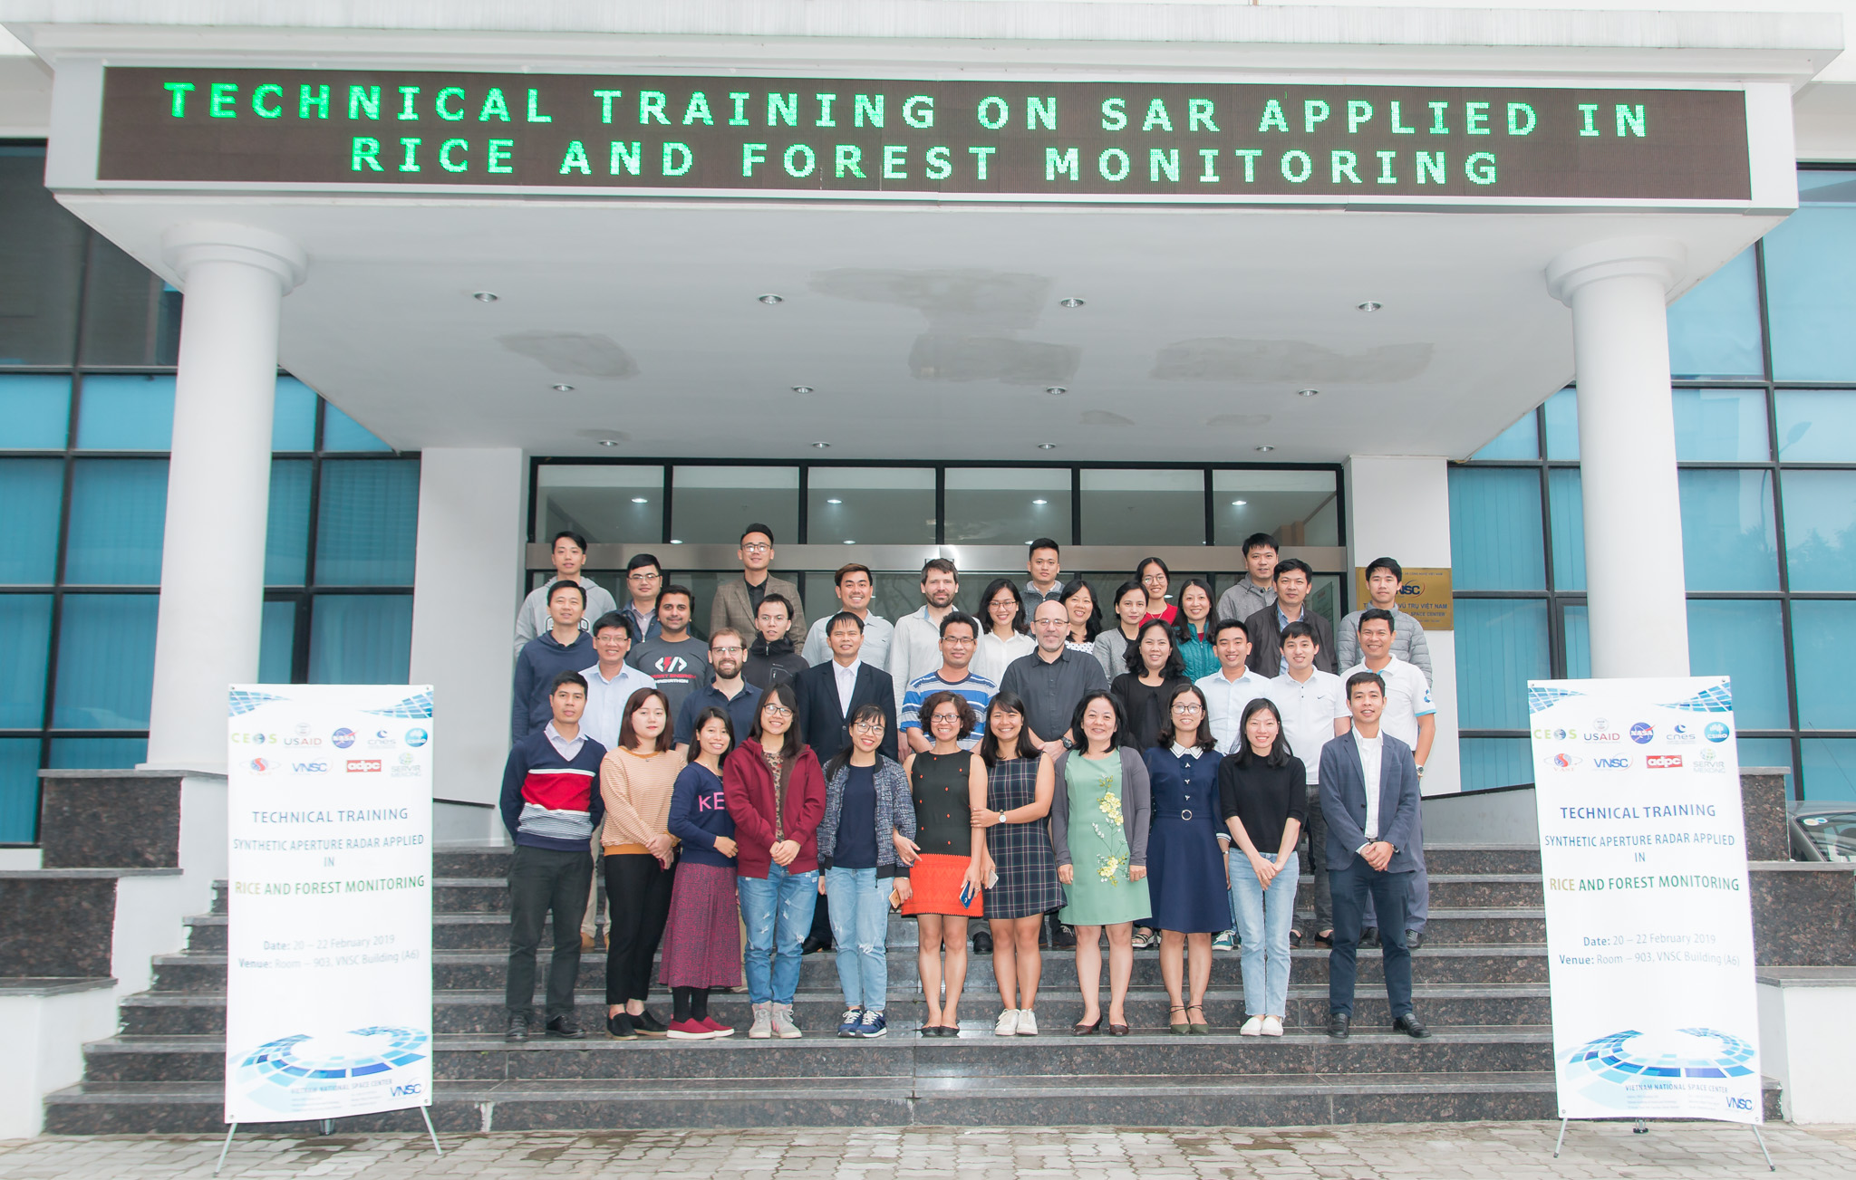
CNES capacity building activities
CNES Support to VNSC CEOS Chair Initiative (2019)
  Synthetic Aperture Radar Applied in Rice and Forest Monitoring in Hanoi, Vietnam (20-22 Feb., 2019)
  Participation of CESBIO experts to training for Vietnamese and Thailand remote sensing technical experts in applying SAR data and processing technology to support rice monitoring, and forest monitoring.
    Understand the physical information content of SAR data
    Access available EO data and free software
    Able to conduct time series processing

Slide 6
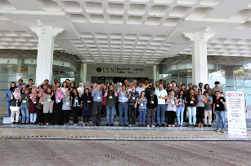
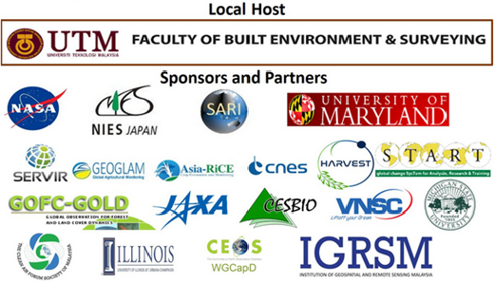
CNES capacity building activities
CNES Support to SARI (South-East Asia Research Initiative) Training
  Participation of CESBIO experts to LULC training on the use of SAR data for Rice Monitoring
Land Use/Cover Changes, Environment and Emissions in South/Southeast Asia – An International Regional Science Meeting

Slide 7
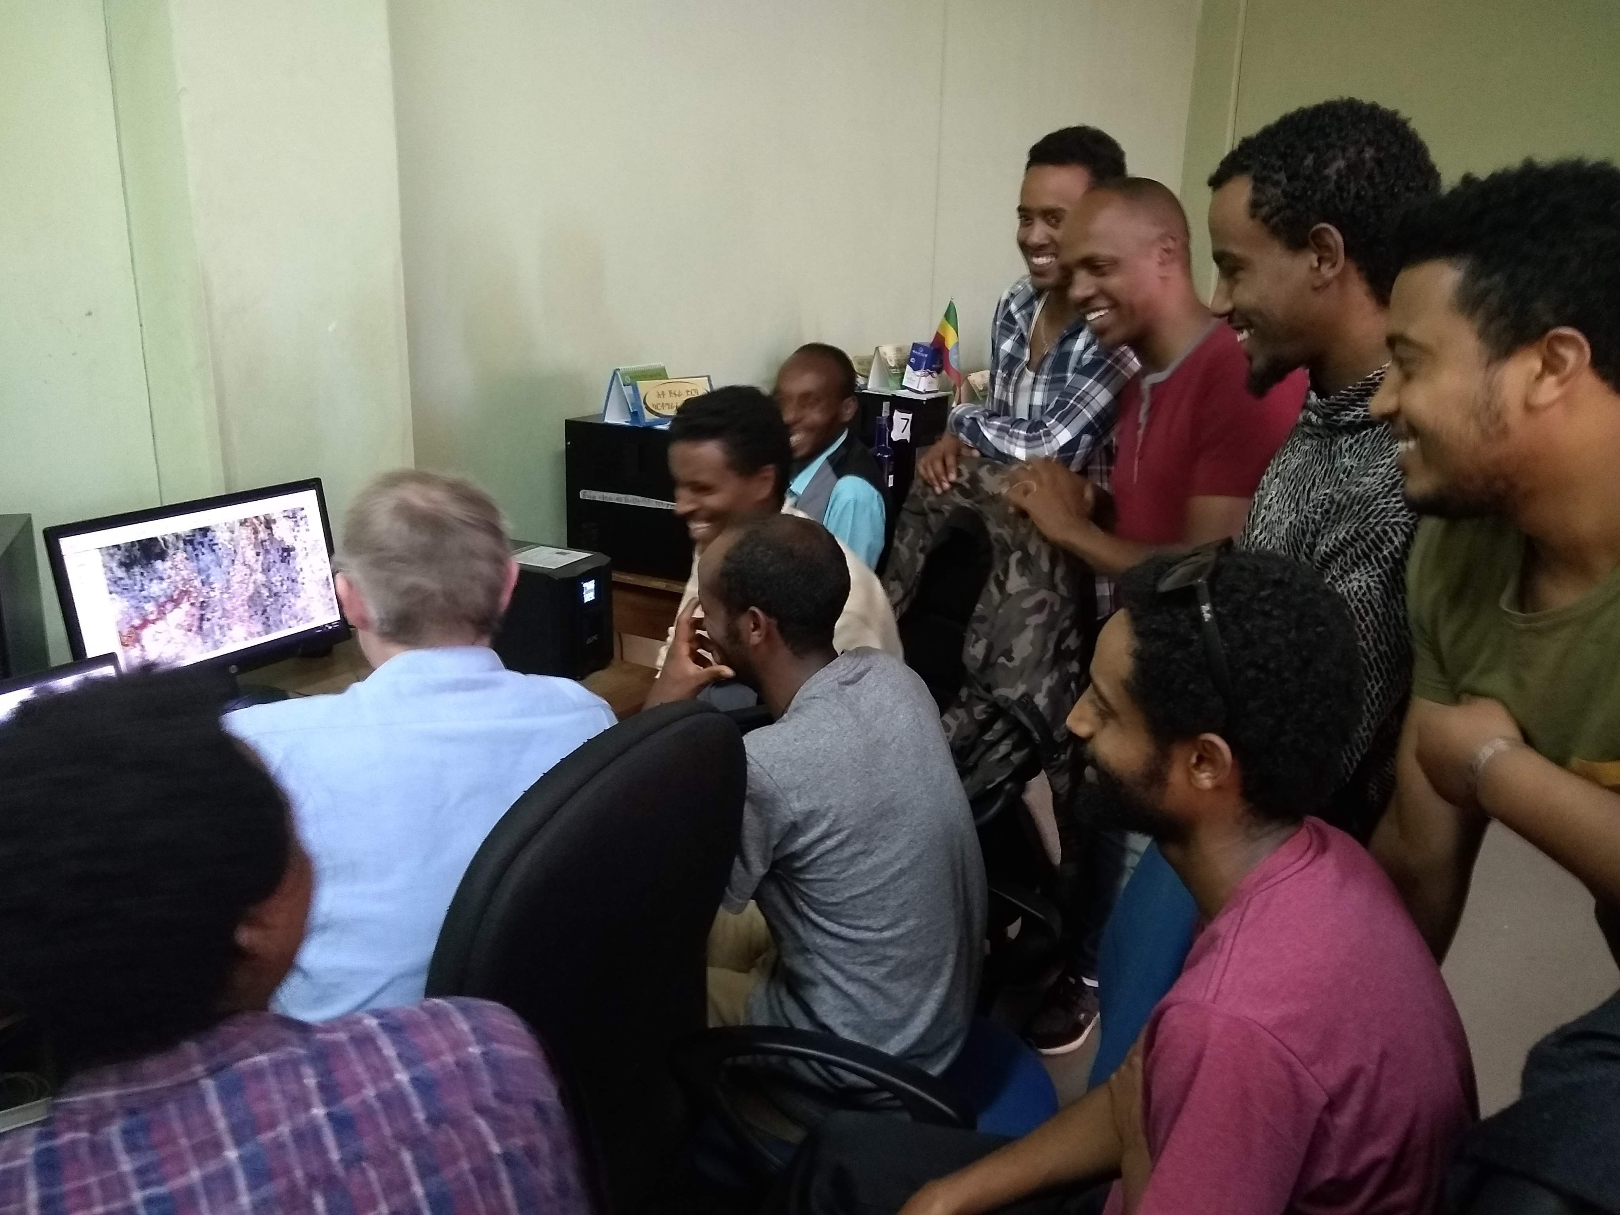

CNES capacity building activities
CNES Support to Ethiopian Geospatial Information Institute
  Training on the use of Sentinel 2 data for LULC Ethiopian territory mapping
  Tri-partite partnership (EGII, IGN-FI, CNES)
  IGN-FI expertise for the methodology and validation on 5 pilot sites

Slide 8
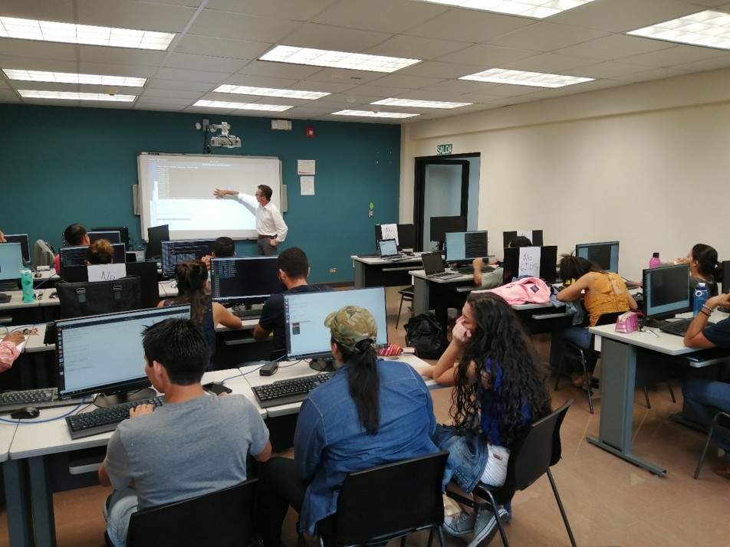
CNES capacity building activities
Training on GNSS-based remote sensing and Earth Dynamics studies
  GET lab (Geosciences Environment Toulouse) expertise
  Training on GINS tool https://ui.adsabs.harvard.edu/abs/2011AGUFM.G31B0962P/abstract
  Trainees : Universidad Nacional de Costa Rica, Instituto Geográfico Nacional
  May 2019

Slide 9


CNES capacity building activities
Scientific and Training Workshop with AEM on Forest Monitoring
  Participation from AEM, CONAFOR, CONACYT, ONF-I, CNES
  Training on OTB (Orfeo Toolbox) for forest mapping, application on Mexican Forests
  WGCapD deliverable
  January 2020

Slide 10

Fostering Entrepreunership in France
CNES is building a national Space Ambassadors Network outside CNES
  Participants from the French regions (territorial agencies, startups incubators, chambers of commerce and industry, …)
  2 days Outreach Seminar (originally in march, now in September)
  Including Remote Sensing, but also Satcom and GNSS capacities
CNES with the support of ISSAT has developped a catologue of opportunities for academic and professional training related to space-based applications development (http://www.formations-spatiales.fr/)

Slide 11
Ways of improvement
Facilitate access to optical high resolution data (SPOT series, Pleiades) and build processing capacities
  Spot World Heritage (SPOT satellites data archive being processed, already available on some countries)
Favor Long term approach (yearly Vietnam Summer school…)
Upgrade capacity (use Sentinel 1 for Gabon forest monitoring, prepare the use of BIOMASS satellite datat,…)
Develop e-learning tools
Implement capacity building activities related to co-development of services or proof-of-concepts development

Slide 12
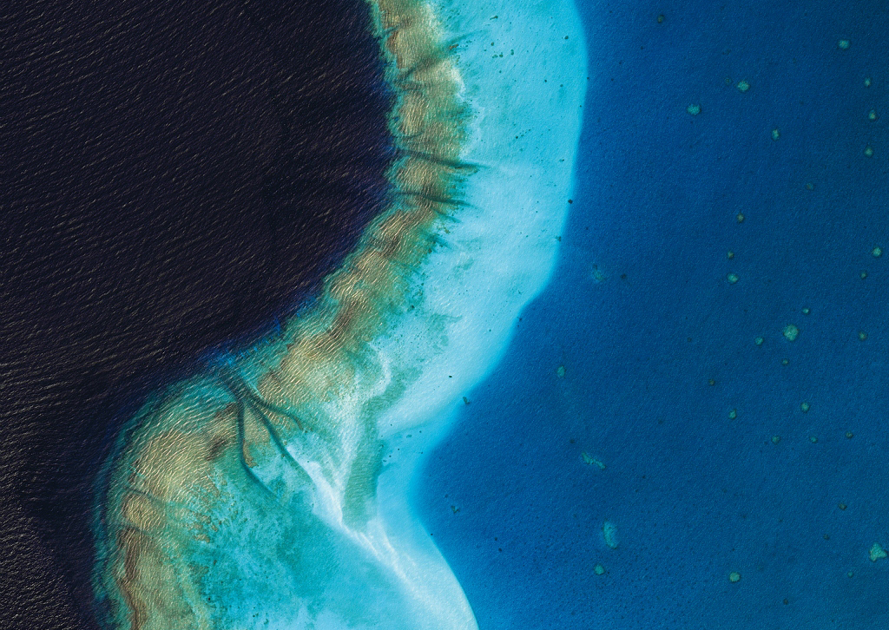
Thanks for you attention
www.cnes.fr

