Slide 1
Copernicus
Regional Spotlight: Europe
European Commission –DG DEFIS
KOCH Astrid-Christina
CEOS WGCapD-9 Annual Meeting
Sunnyvale, California
10-12 March 2020

Slide 2
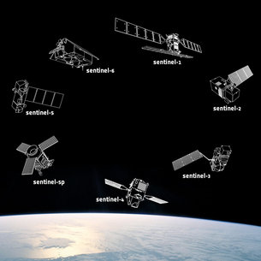
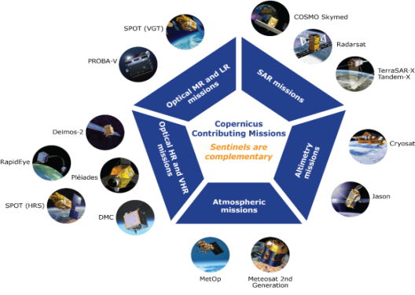
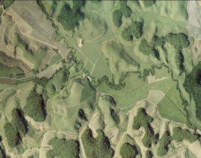


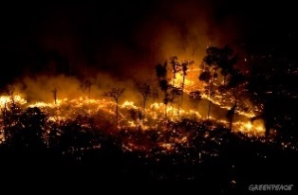



COPERNICUS ARCHITECTURE
6 services use Earth Observation data to deliver
added-value products
Contributing missions
Sentinels

Slide 3
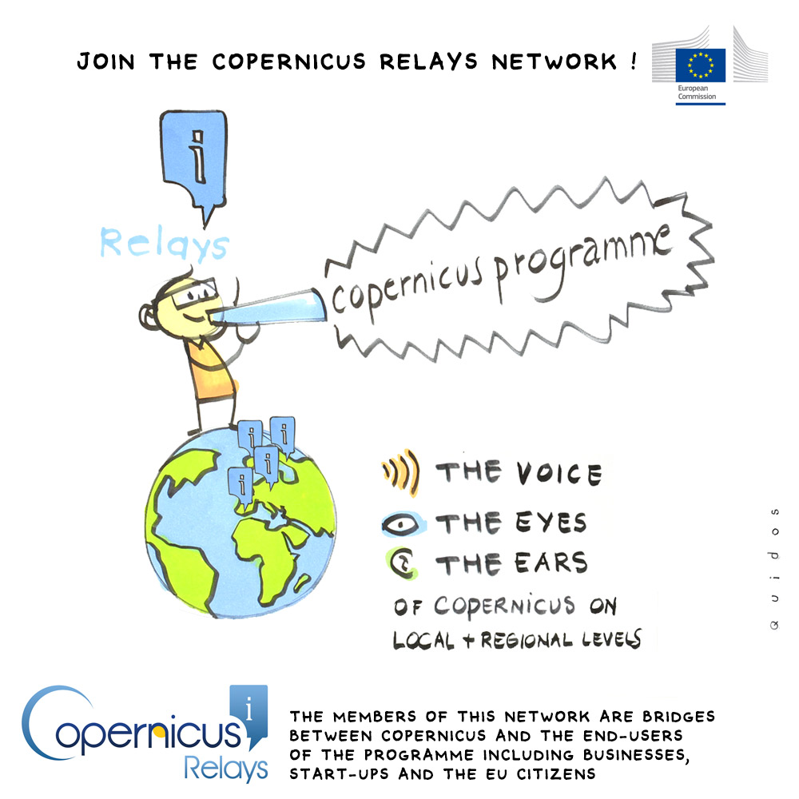
Copernicus Relays
Reaching end-users in different countries and regions worldwide
Content localization
Local and global cooperation
Support to local users
Organizing promotional events and training

Slide 4
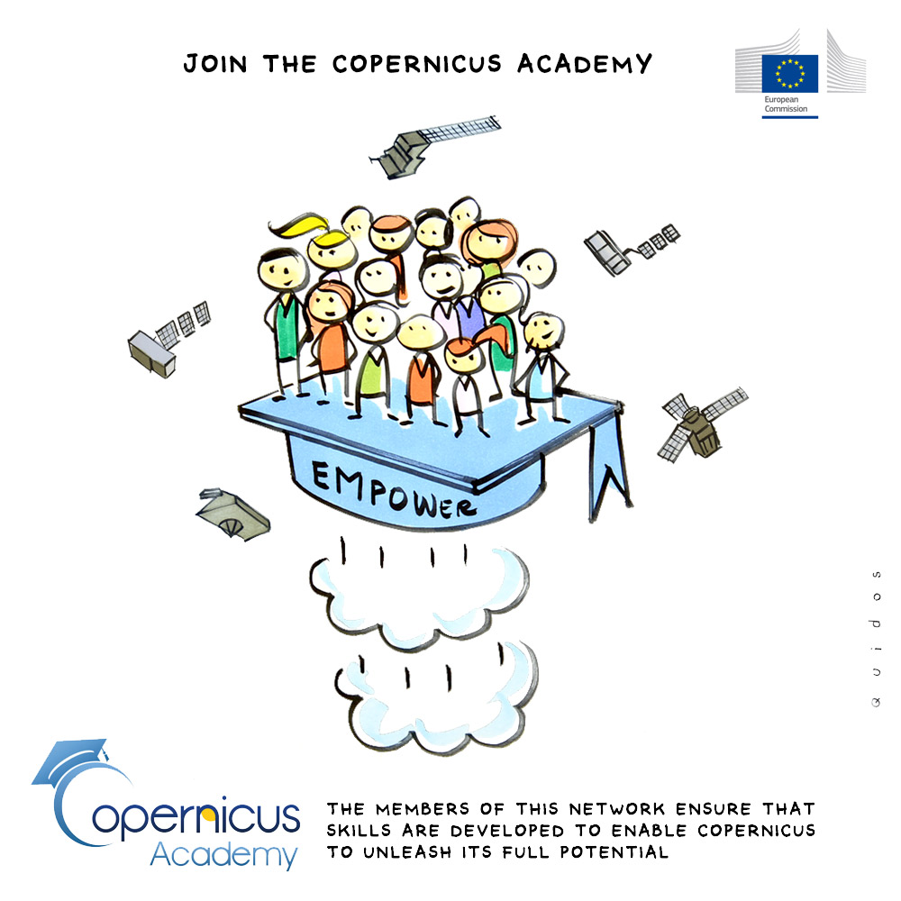
Copernicus Academy
Reaching academic institutions worldwide
Enabling global Earth Observation research network
Promoting space in education
Accelerate research to market link
Building skills

Slide 5





Space

Slide 6
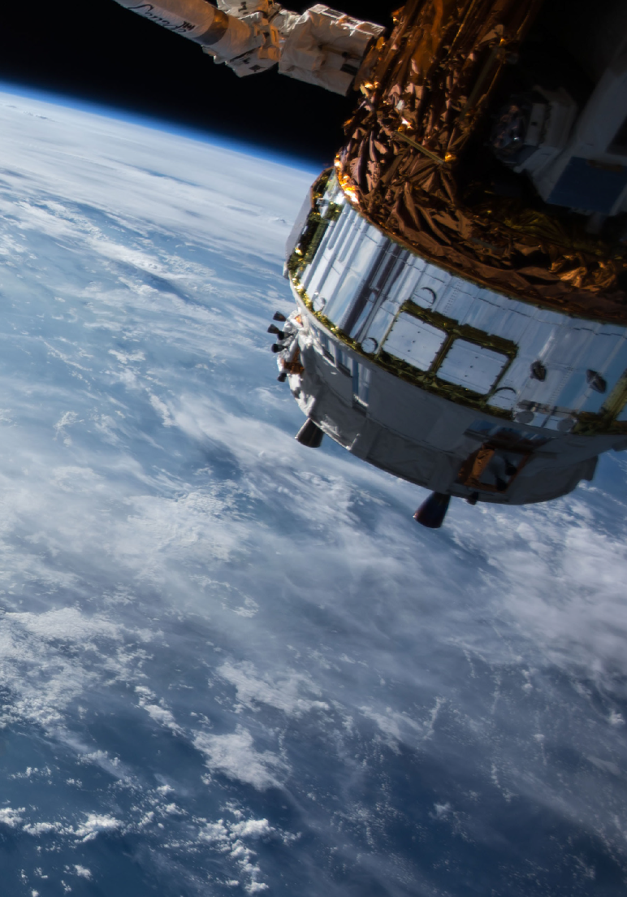
WHAT IS
COPERNICUS
MOOC
Massive Open Online Course dedicated to explaining how to use geo-information data to face environmental challenges and develop new business opportunities. The course, free of charge and accessible to all, is specifically addressed to professionals and entrepreneurs and will touch on the following topics:
How to access and use Copernicus data
Examples of success stories
Acquire the skills to navigate the Copernicus ecosystem.
Info and registration: https://mooc.copernicus.eu/
Starting March 9th 2020
3 themes, 12 lessons, 24 h in total, 2 h/week
Watch, listen, learn and engage with expert speakers and other students. Learning formats will include webinars, videos, short quizzes and digital interaction.
Class workbook
A downloadable workbook accompanies the class with lesson recaps, assignments and supplementary material.
Learn anytime, anywhere
Learn on your own terms. Link each class directly to your needs and objectives.

Slide 7

WHAT ARE THE
COURSES?
Chapter 1: What can Copernicus add to your organisation and how to get started
Module 1: Introduction to Copernicus
Module 2: What you need to know about accessing Copernicus data and services.
Chapter 2: Learning through success stories
Module 3: Land Use and Urban Management
Module 4: Sustainability I: Air quality, Water Pollution and Ecosystem Health Monitoring
Module 5: Sustainability II: Renewable Energy
Module 6: Security and Emergency Management
Module 7: Combining Copernicus Data with other types of Data; AI; Machine Learning
Module 8: Resource management
Chapter 3: Now it’s your turn
Module 9: Ideation – Build up your idea for a Copernicus-enabled product or service
Module 10: Prototyping – Test and validate your product or service
Module 11: Developing – Unlock the full value of Copernicus data and services
Module 12: Collaboration – Make the most of the Copernicus ecosystem

Slide 8
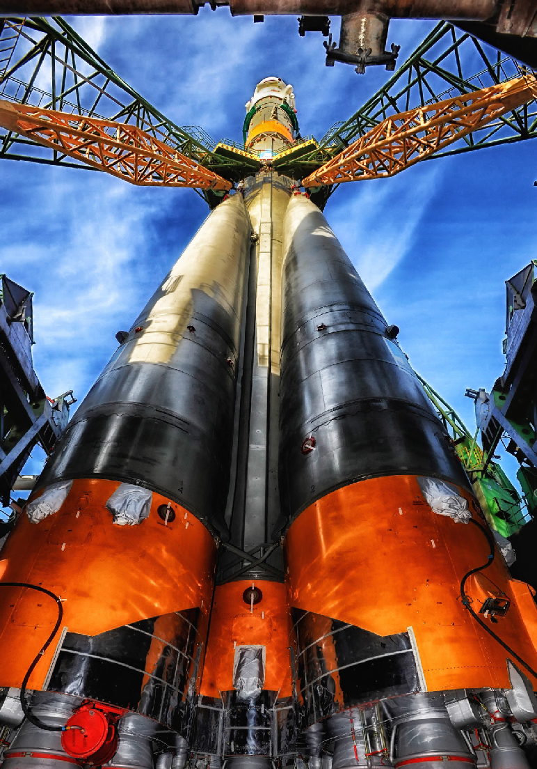
WHAT IS THE VALUE TO PARTICIPANTS?
User-driven approach that also enables you to plug in to the Copernicus ecosystem
Insight into developing highly relevant solutions for the public sector
For service providers and service developers, a clear path to new and improved products and services
Skills certification, professional mobility and digital upskilling

