Slide 1
WGCapD Overview
Regional Spotlight: Africa
WGCapD
Nancy Searby, WGCapD Chair
CEOS WGCapD-9 Annual Meeting
Sunnyvale, California
10-12 March 2020

Slide 2
CEOS Working Group on Capacity Building and Data Democracy
Formed in 2011
Pursues a variety of activities based on the four pillars of the Data Democracy Initiative Mission and aims to unify CEOS efforts toward:
Providing wider and easier access to Earth observation data
Increasing the sharing of software tools (open source software & open systems interface)
Increasing data dissemination capabilities and transferring relevant technologies to end users
Providing intensive capacity building, education, and training (including awareness and outreach) to enable end users to gather the information they need and for increasing communication on achieved results
Mission
Increase the capacity of
institutions in less
developed countries for
effective use of Earth
observation data for the
benefit of society and to
achieve sustainable
development.

Slide 3
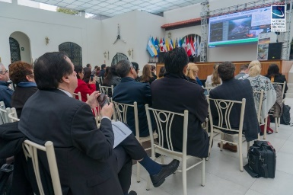
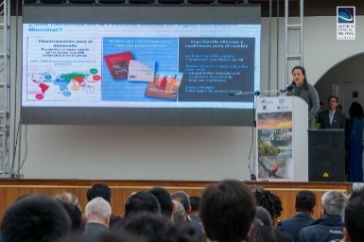
WGCapD activities
Virtual trainings
Organize free E-Learning courses and webinars for participants around the globe
Webinars:
MOOCs:
In-person workshops
Organize free training workshops for participants around the globe
EO Training Workshops
Thematic Training Workshops
Regional Workshops
GEO – AmeriGEO & AfriGEO
Southeast Asia
Awareness Webinars ex. Sustainable Development Goals
Webinar Series ex. Wildfires
SAR trainings
Forest monitoring
Land Cover Land Use Change
Flooding
Echoes in Space: Introduction to Radar Remote Sensing

Slide 4
Resources
CEOS training calendar – https://training.ceos.org/
CEOS WGCapD resources webpage – http://ceos.org/ourwork/workinggroups/wgcapd/resources-2/
Best practices guide for conducting trainings
Training report template
Sample post-training questionnaire
Links for various capacity building portals and web resources
Distribution lists – WGCapD maintains a distribution list that reaches all previous trainees and can be used for sharing appropriate news and opportunities
POCs:
WGCapD Chair
Dr. Nancy Searby (NASA)
nancy.d.searby@nasa.gov
WGCapD Vice Chair
Dr. Pham Thy (VNSC)
ptmthy@vnsc.org.vn

