Slide 1
ESA experience for EO CB in Latin America
Session 7: Regional Highlight - Americas
ESA
Francesco Sarti / Amalia Castro Gómez
CEOS WGCapD-9 Annual Meeting
Sunnyvale, California
10-12 March 2020

Slide 2
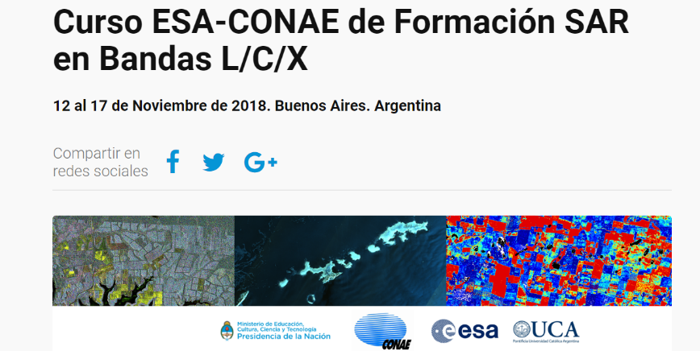
ESA EO CB activities in Lat Am
EO Training courses worldwide
Long series of joint EO Training Courses in America, started in the 90’s with ERS data exploitation
A few recent examples:
ESA Training course at the 14th Brazilian Remote Sensing Symposium (SBSR) 2009: use of ESA Toolboxes (BEAM, NEST, LEOWorks and the UNESCO software Bilko) for applications of disaster monitoring and environmental degradation monitoring.
AndesSAT 2010 (Bolivia/UNOOSA/CONAE/ESA)- workshop on the applications of integrated space technologies for sustainable development in the mountain regions of Andean countries and ESA training course on the use of the ESA EO software toolboxes.
ESA/CONAE/CSL SAR Course, San Carlos de Bariloche, Argentina, 2011
Course for the glaciological community in the area of SAR applications to glacier monitoring
ESA webinars for SELPER 2019: XII Jornadas de Educacion in Buenos Aires - Mercosur Region covering RS techniques and applications, with particular focus on SAR
Integration of SAOCOM data into ESA educational toolboxes

Slide 3
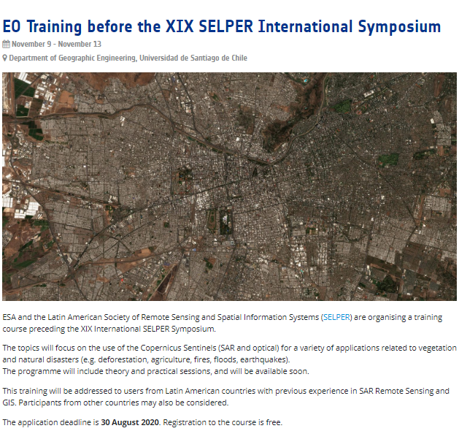
ESA coordination of the CEOS WG CapD Training course associated to the 2020 XIX SELPER Int. Symposium in Chile, Nov 2020
1 week duration (9-13 November), on applications related to vegetation and natural disasters.
40 users from Latin American countries with experience in SAR and GIS.

Slide 4
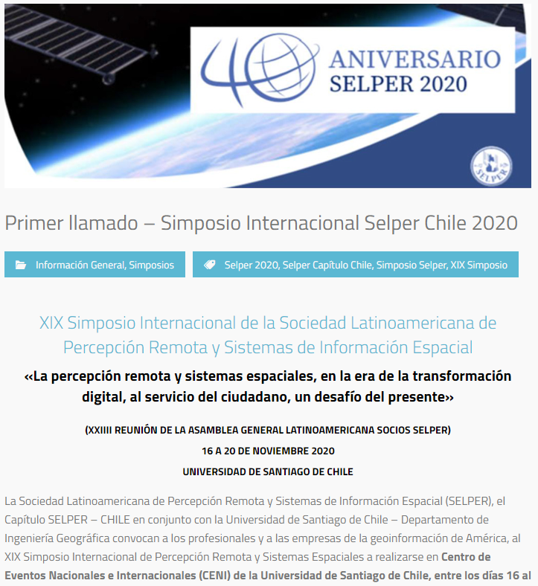
ESA coordination of the CEOS WG CapD Training course associated to the 2020 XIX SELPER Int. Symposium in Chile, Nov 2020
Agencies participating (tbc) & topics (tbc):
ESA – SAR for Forestry and Wildfires (TBC). ESA training resources
CONAE – SAR for Land and Emergencies
INPE – TerraMA project and Forest Fire Monitoring project
CRECTEALC – Flood Mapping (optical)
NASA - tbc

