Slide 1
Flash Talk: AmeriGEO
Regional Spotlight: Americas
AmeriGEO
Albert DeGarmo (NOAA), AmeriGEO Secretariat
CEOS WGCapD-9 Annual Meeting
Sunnyvale, California
10-12 March 2020

Slide 2
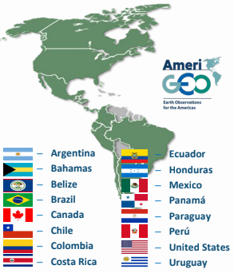
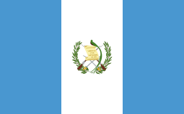
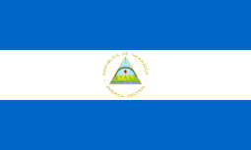
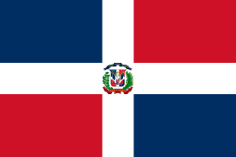
Current activities
Objectives for 2020
Strengthen National GEOs
Improve regional support to global GEO activities
Develop 2020-2025 AmeriGEO WorkPlan
New Members:
- El Salvador
Guatemala
Nicaragua
Dominican Republic
Notes:
Through strategic and relevant collaboration, the regional GEO, AmeriGEO, continues to promote in the region the use of Earth observations in the decision-making process. With a group of 19 members, which includes three new countries in Central America (El Salvador, Guatemala and Nicaragua), participating organizations of GEO, academia and other regional partners, AmeriGEO continues to strengthen national and regional agendas through activities that respond to the technological and cooperation needs in the use of the Earth Observations. AmeriGEO provides the incubation and demonstration space for research and applications that are later implemented in the operational and decision-making environments. Through these activities and within a framework of innovation and collaboration, the region and the GEO member countries empower their organizations to find solutions tailored to the local needs through the use of earth observations.
leadership established two initial objectives for the region. The first is to develop guidance to establish strong national GEOs capable of leading and coordinating activities with national organizations, while strengthening the connection of the national agenda to the activities of AmeriGEO. Strong national GEOs are a fundamental element of an active and successful regional GEO.
The second objective is to improve the support of National GEOs to global GEO activities within the region. The Caucus of the Americas requests to all GEO flagship activities, initiatives, and communities of Practice, with interest or projects in the region, to provide information on their plans within the American countries to the AmeriGEO Coordination Working Group (CWG). This collaboration will avoid duplication of efforts and lost opportunities to address the many needs of the region.
Finally, the most immediate priority for the community is to update the AmeriGEO Workplan. With this in mind, current projects are conducting evaluations to determine progress and possible adjustments needed to achieve their objectives. At the same time, new activities are being formulated to in part, respond to possible synergies with projects that are already underway, and in response to the emerging interest of addressing other societal benefit areas. An updated version of the Work Plan is available in the first half of 2020.

Slide 3
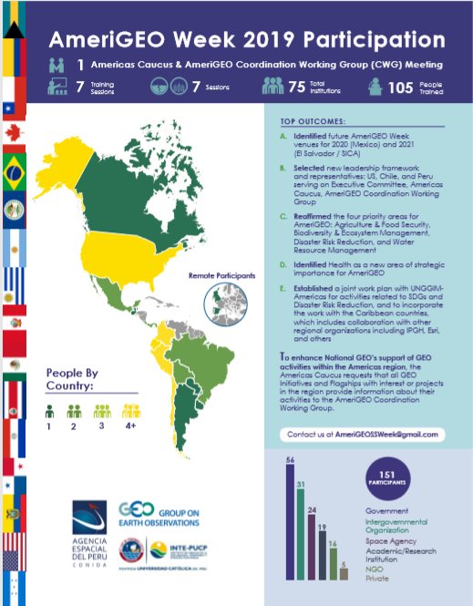
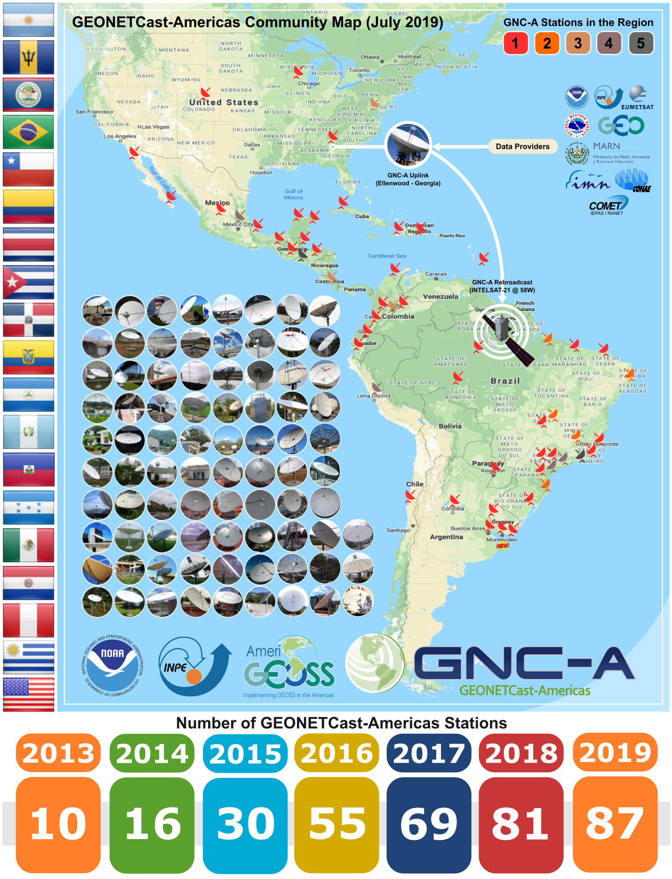
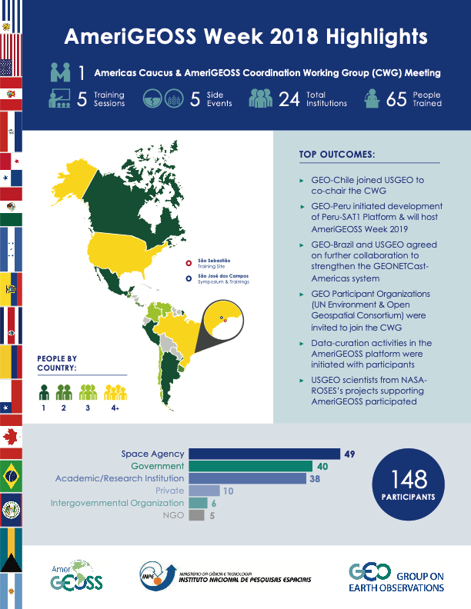
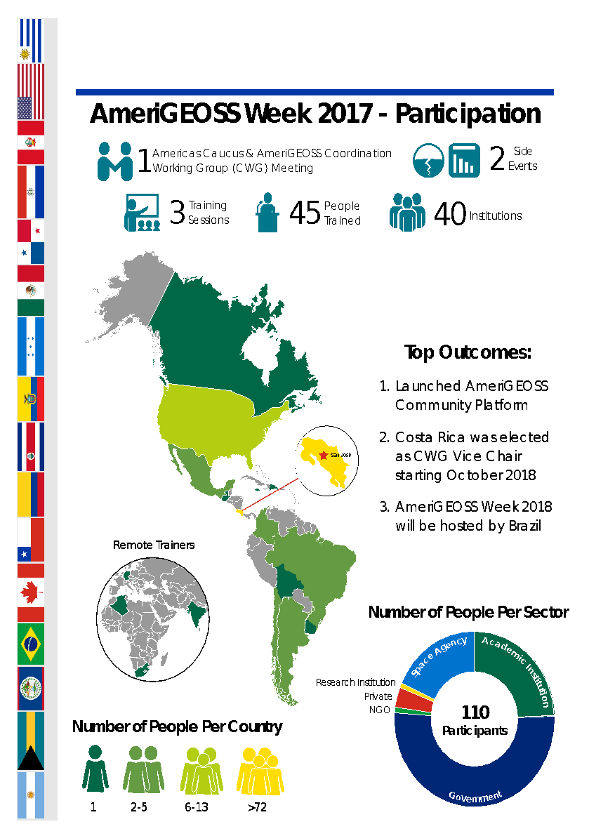
Notable outcomes
Notes:
AmeriGEO Week 2019 and over the years
- AmeriGEO continues to develop our annual symposium, “AmeriGEO Week”.
AmeriGEO Secretariat continues to grow our annual meeting with strong regional participation, with 151 participants at our last event in Lima Peru
Top outcomes for the week: 1) AmeriGEO will partner with UNGGIM-A to host AmeriGEO week in Agua Calientes, Mexico. Planning is well underway. AmeriGEO will work with UNGGIM to develop a joint work plan for activities related to SDGs and Disaster Risk Reduction. 2) During the Caucus of the Americas meeting in 2019, Peru, Chile and the United States were elected as the new board of directors of the Caucus and AmeriGEO until 2022. 3) AmeriGEO leadership not only reaffirmed our four priority areas, but also identified Health as a new area of strategic importance to AmeriGEO.
Lessons Learned:
Translation services needed
Strong local partnership for host
Well developed communication plan
GEONetCast
GEONETCast is a global network of satellite-based data dissemination systems designed to distribute space-based, air-borne and in situ data, metadata and products to diverse communities. GEONETCast Americas (GNC-A) is the Western Hemisphere component of GEONETCast, maintained by NOAA. GNC is a GEO Foundational Task and GNC-A is a Foundational Task within AmeriGEO.
Current ongoing efforts by the Foundational Activity,
Fostering relationships with GEO and AmeriGEO initiatives, flagship and community activities to access needs in the Societal Benefit Areas;
Facilitating improved access to disaster information in developing countries through collaboration;
Increasing outreach and capacity building to better determine user needs;
Developing a user-friendly interface to facilitate the visualization of products.
Advancing Capacity Development
The SAR-CBC: A Capacity Building Center for the Use of SAR in Decision Making project led by PI Franz Meyer of the University of Alaska-Fairbanks has been collaborating with the Institute of Hydrology, Meteorology and Environmental Studies (IDEAM) in Colombia, the Geological and Energy Research Institute (IIGE) and the Central University of Ecuador (UCE) in Ecuador, and El Salvador’s Ministry of the Environment and Natural Resources (MARN) to develop SAR use cases across the four AmeriGEO priority areas. The project’s “Integrating SAR into Hazard Monitoring” course materials are available in English and Spanish.
The Marine Biodiversity Observation Network Pole-to-Pole of the Americas (MBON Pole to Pole) project led by PI Enrique Montes of the University of South Florida is developing a network of scientists and managers monitoring marine life across the continent to detect changes in coastal biodiversity. The program relies on dynamic satellite seascape maps generated by NOAA to examine the impacts of shifting environmental conditions and overall ocean biogeography around monitoring sites. This year the project is preparing for its third "Marine Biodiversity Workshop: from the Sea to the Cloud" to be held at the José Benito Vives de Andréis Marine and Coastal Research Institute (INVEMAR) in Colombia, during the week of May 4-8. During this activity, participants will learn how to access and analyze seascape data and other satellite products to characterize ecosystem conditions and water quality with potential impacts on marine life.
The Earth Observations for Indigenous-Led Land Management (EO4IM) project led by PI Karyn Tabor of Conservation International has been working with the Achuar Nation in Ecuador and the Regional Office for the Development of Indigenous Peoples San Martin (Peru) to support their use of Earth observation data. The project also supported the launch of GEO’s Indigenous Peoples Community of Practice website, in follow-up to the EO4IM session at the GEO Week in Canberra, Australia last November.
The Agricultural Monitoring of the Americas (AMA) project led by PI Alyssa Whitcraft of the University of Maryland and the GEOGLAM secretariat has likewise been working with the National Institute of Agricultural Technology (INTA) in Argentina and the National Supply Company (CONAB) in Brazil in the enhancement of existing agricultural monitoring systems in those countries. The AMA project is also collaborating with the Institute of Agricultural Research (INIA) toward developing a national agricultural monitoring system for Chile.
In 2019, the National Aeronautics and Space Administration (NASA) and the Central American Integration System (SICA) signed a Joint Declaration with the aim of sharing scientific information on Earth observation data obtained by NASA satellites. With this initiative, SICA member countries are able to have geospatial technologies in order to strengthen the management and protection of natural resources and mitigate the vulnerability to climate change.
AmeriGEO Portal
-

Slide 4
Challenges – and the path to overcoming them
Interoperable Leadership
Regional Coordination
Notes:
Challenges:
Interoperable Regional Leadership: While in recent years AmeriGEO Secretariat has been devoted to increasing regional capacity to lead this organization, the resilience of the group is still limited. If the current leadership of the organization were to no longer serve in their capacity, the groups activity may turn stagnant. That being said, the organization has made significant strides in developing the capacity of the region to assume leadership roles and will continue to invest. AmeriGEO Secretariat hopes to empower other regional leaders to take on a more active role in leading this organization in the upcoming year(s).
Regional Coordination of ALL opportunities: Similar as to above, this challenge has already been identified, with current efforts underway to address. Lack of a previous coordination arm stifled strong regional participation/coordination on shared activities or trainings. The AmeriGEO secretariat is working to leverage the shared abilities to develop resilient regional products. To achieve this, the organization is in their final steps to approve their 2020-2025 Work Plan which identifies shared priorities and responsible parties who support this initiatives.

Slide 5
Key takeaways and lessons learned
What is Working?
- Stronger Meeting Coordination
- Collaboration at different levels (Technical and Political)
- Improved coordination with Academia
What has changed since the capacity building work began?
- Stronger engagement form the region
How did collaboration affect the outcomes?
- Decision-makers communicating importance of participation
Are any particular Earth observations, models or data products becoming more relevant?
- Increased interest in the new satellite data assets
Notes:
What has worked (or not worked)?
Collaboration at different levels (technical, and political), and also working with academia to improve the use of EO in the Americas.
How did collaboration affect the outcomes?
Decision-makers have communicated the importance of participating in different initiatives including those in the context of GEO. In the last year, 4 countries from Centro America joined GEO.
What best practices are emerging?
Communication is the key to connecting different efforts. Informational webinars will also help facilitate work in the 4 priority areas.
What capacity building approaches and methodologies are most effective (or least effective)?
Very effective: Conducting training activities during the AmeriGEO week
What has changed since the capacity building work began?
There has definitely been more interest in engagement from the region and interest in participating in the broader AmeriGEO community.
Are any particular Earth observations, models or data products becoming more (or less) relevant?
Yes, there has been an increased interest in the new satellite data assets, including SAR data and spaceborne LiDAR (e.g. GEDI).

Slide 6
Priority needs and areas for collaboration
Continued support for trainings at AmeriGEO Week
Notes:
Our CEOS WGCapD deliverable description says: Meeting in Mexico City, early Sept; support trainings; conduct a needs assessment for trainings. While historically WGCapD is responsible for one training, this last year we supported 2 trainings

Slide 7
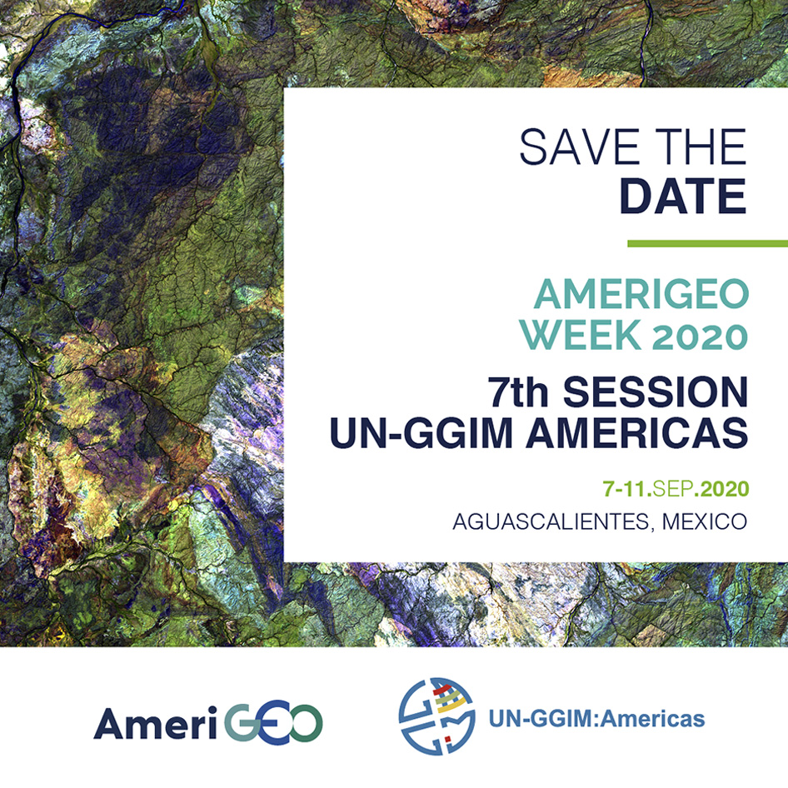
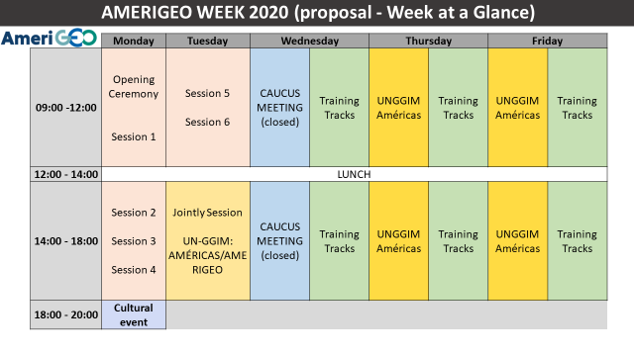
Notes:
CEOS WGCapD deliverable description says: Meeting in Mexico City, early Sept; support trainings; conduct a needs assessment for trainings
Sergio and Nancy are identified as responsible for the deliverable. WGCapD needs to define this training now, based on the needs of Mexico and the broader region. There are planning subgroups working on different aspects of AmeriGEO Week, including training.
Please note there have been discussions on training in conjunction with SELPER. It will be great if they can join this deliverable also, especially since Julio is from AEM there in Mexico.

