Slide 1
WGCapD Work in the Americas
Regional Spotlight: Americas
WGCapD
Christine Mataya, WGCapD Secretariat
CEOS WGCapD-9 Annual Meeting
Sunnyvale, California
10-12 March 2020

Slide 2
CEOS Working Group on Capacity Building and Data Democracy
Formed in 2011
Pursues a variety of activities based on the four pillars of the Data Democracy Initiative Mission and aims to unify CEOS efforts toward:
  Providing wider and easier access to Earth observation data
  Increasing the sharing of software tools (open source software & open systems interface)
  Increasing data dissemination capabilities and transferring relevant technologies to end users
  Providing intensive capacity building, education, and training (including awareness and outreach) to enable end users to gather the information they need and for increasing communication on achieved results
Mission
Increase the capacity of
institutions in less
developed countries for
effective use of Earth
observation data for the
benefit of society and to
achieve sustainable
development.

Slide 3

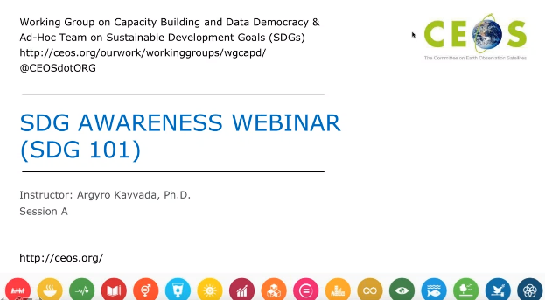
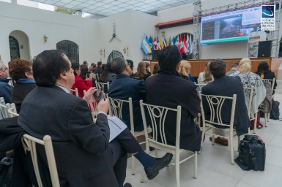
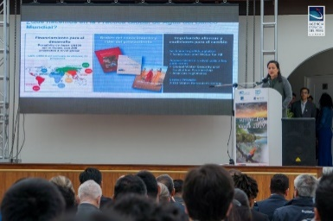
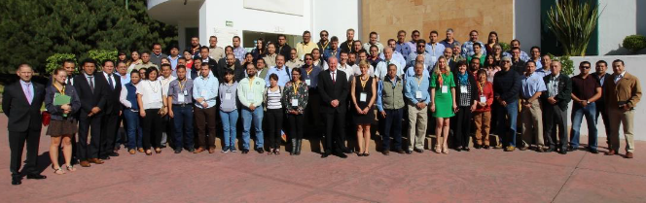
WGCapD activities
Virtual trainings
Organize free E-Learning courses and webinars for participants around the globe
Webinars:
MOOCs:
In-person workshops
Organize free training workshops for participants around the globe
EO Training Workshops
Thematic Training Workshops
Regional Workshops
  GEO – AmeriGEO & AfriGEO
  Southeast Asia
  Awareness Webinars ex. Sustainable Development Goals
  Webinar Series ex. Wildfires
  SAR trainings
  Forest monitoring
  Land Cover Land Use Change
  Flooding
  Echoes in Space: Introduction to Radar Remote Sensing

Slide 4
Resources
CEOS training calendar – https://training.ceos.org/
CEOS WGCapD resources webpage – http://ceos.org/ourwork/workinggroups/wgcapd/resources-2/
  Best practices guide for conducting trainings
  Training report template
  Sample post-training questionnaire
  Links for various capacity building portals and web resources
Distribution lists – WGCapD maintains a distribution list that reaches all previous trainees and can be used for sharing appropriate news and opportunities
POCs:
WGCapD Chair
Dr. Nancy Searby (NASA)
nancy.d.searby@nasa.gov
WGCapD Vice Chair
Dr. Pham Thy (VNSC)
ptmthy@vnsc.org.vn

Slide 5
Americas
2019 activities
AEM-CNES Training Workshop on Forest Monitoring in Guadalajara, Mexico (26-28 February, 2019) - Organized by CONAFOR and AEM to share knowledge on research studies and tools on remote sensing for forest monitoring with a focus on forests fires.
AmeriGEO Week 2019 in Lima, Peru (21-23 August, 2019) – WGCapD supported trainings in alignment with the symposium focused on remote sensing tools such as SAR.
Future deliverables
AmeriGEO Week 2020 in Mexico (Q3 2020) led by CRECTEALC – WGCapD will support trainings and a needs assessment for the design of the trainings.
SELPER 2020 (Q4 2020) led by ESA – Chile will organize SELPER 2020, and ESA is planning to deliver a training on EO for applications relevant to the region.
Recovery Observatory Project Capacity Building (Q4 2020) led by CNES – provide training to national Haïti institutes involved in Recovery Observatory project.
Indigenous Peoples-focused Training (Q4 2021) led by NASA and CSA – engage indigenous peoples in a workshop to build their capacity in the use of EO information for their community needs.
Collaborative Feasibility Study (Q3 2020) led by NASA – 10-week dual capacity building feasibility study focused on data cube algorithm creation in the Americas.

