Slide 1
THE NIGERIAN SPACE PROGRAMME: REGIONAL CAPACITY BUILDING
Dr. M.O. ADEPOJU FGEOSON
National Space Research & Development Agency (NASRDA), Airport Road, Abuja, Nigeria
CAPACITY BUILDING AND MANPOWER DEVELOPMENT FOR NATIONAL DEVELOPMENT

Slide 2
Institutional Arrangements
CENTRE FOR ATMOSPHERIC RESEARCH (CAR), ANYIGBA
NASRDA AND ITS OPERATIONAL CENTRES
CENTRE FOR GEODESY & GEODYNAMICS (CGG), TORO
GEOAPPS PLUS LTD. ABUJA
CENTRE FOR BASIC SPACE SCIENCE (CBSS), NSUKKA
CENTRE FOR SATELLITE TECHNOLOGY DEVELOPMENT (CSTD), ABUJA
CENTRE FOR SPACE TRANSPORTATION & PROPULSION (CSTP), EPE
NATIONAL CENTRE FOR REMOTE SENSING (NCRS), JOS
CENTRE FOR SPACE SCIENCE & TECHNOLOGY EDUCATION (CSSTE), ILE-IFE

Slide 3
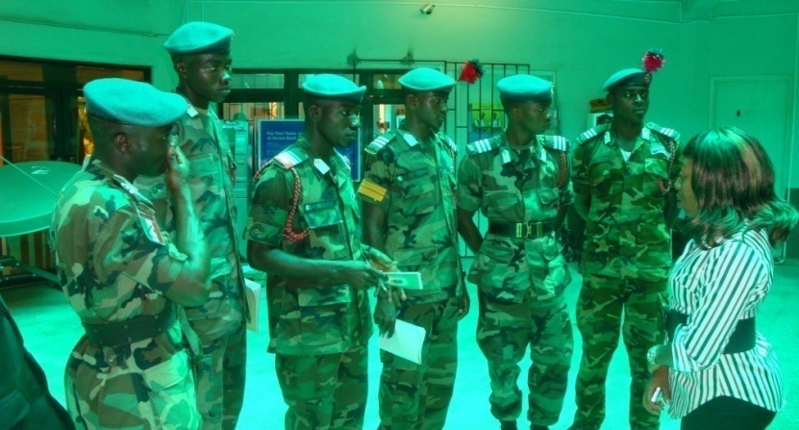
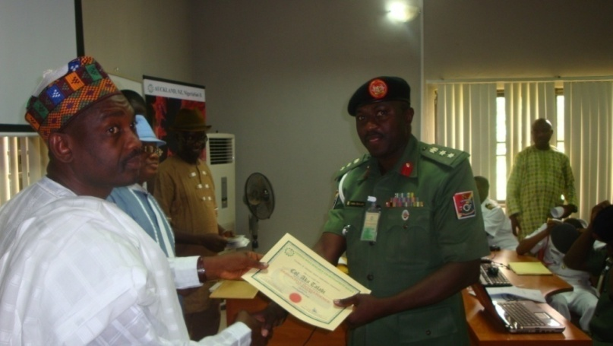
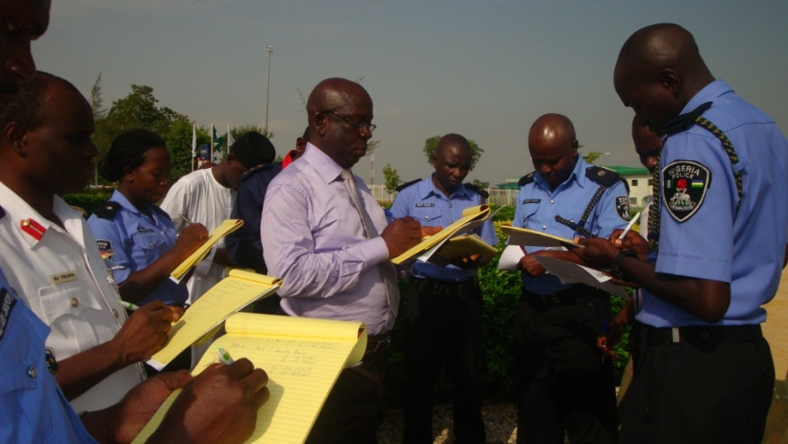
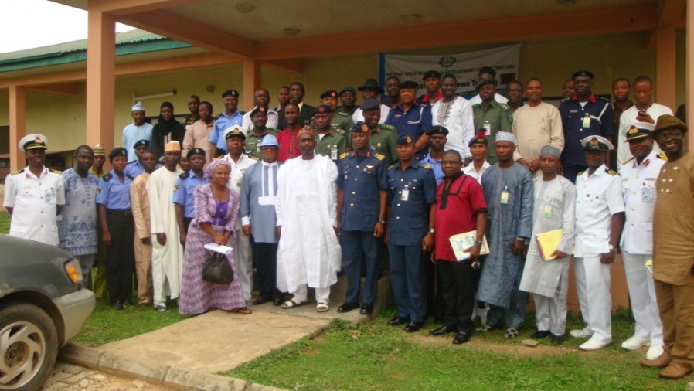
Capacity Development Support
Over 500 Officers and Men of the Armed Forces have been trained by NASRDA on the use of space based technologies for defence intelligence gathering at the Postgraduate Level.
This saved Nigeria 1.7billion Naira from oversea training cost.
NASRDA will continue to conduct training for Armed Forces from time to time as the need arises.
The Agency through GeoApps+ offered specialized training to participants from MDAs, the Military and Para-military. A total number of 57 personnel were trained in 2013.

Slide 4
AFRICAN REGIONAL CENTRE FOR SPACE SCIENCE AND TECHNOLOGY EDUCATION IN ENGLISH (ARCSSTE-E)
Mandate
To develop skills and knowledge in four prime areas of Space Science Technology: Remote Sensing/GIS; Satellite Meteorology & Global Climate; Satellite Communication and Basic Space & Atmospheric Science, Global Navigation Satellite Systems
Vision
Human Resources Development and Public Awareness in Africa of the benefits and applications of Space Science & Technology for the sustainable development and improvement on the quality of life of the people, through rigorous education/ training and outreach programmes.

Slide 5
Master’s Program
The Masters programme in remote sensing and GIS is in collaboration with the Federal University of Technology, Akure (FUTA).
At the end of the programme, participants are awarded a Master of Technology (M.Tech) degree in their chosen area of specialization. So far, over eighty (80) participants have graduated since the inception of the programme in 2013.

Slide 6
Post Graduate Diploma
ARCSSTE-E offers PGD in Remote Sensing and GIS, Satellite Communications, Global Navigational Satellite Systems, Basic Space and atmospheric science, Space meteorology
Since 1999 when the Centre began offering these courses, more than 400 participants from Botswana, Cameroon, Egypt, Ethiopia, Ghana, Kenya, Liberia, Malawi, Mozambique, Nigeria, Sierra Leone, South Africa, Sudan, Swaziland, Tanzania, The Gambia, Uganda and Zimbabwe have passed through the Postgraduate Diploma programme.

Slide 7
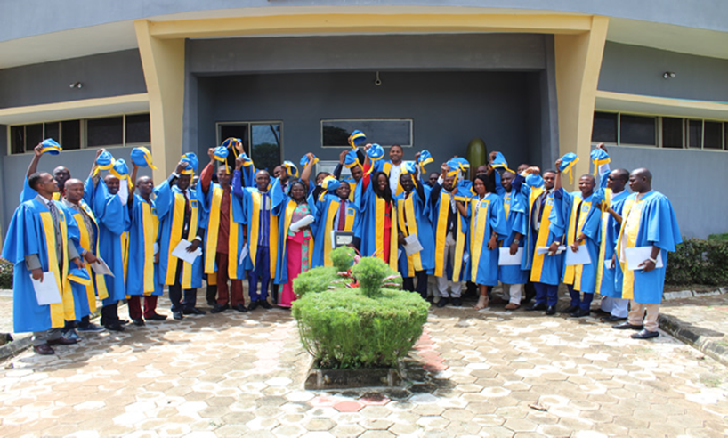
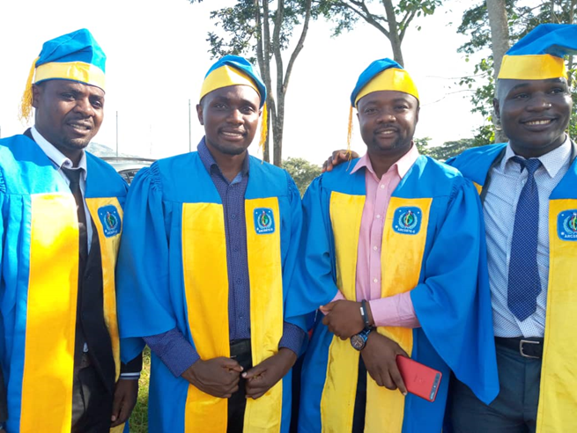
Programme Structure
PGD/MSc. Graduation Ceremoney
Course | Programme | Duration
Remote Sensing and GIS | PGD/Masters | 9 months/18 Months
Satellite Communications | PGD/Masters | 9 months/18 Months
Global Navigation Satellite Systems | PGD | 9 months
Basic Space and Atmospheric Science | PGD | 9 months
Space Meteorology | PGD | 9 months

Slide 8
Space Education Outreach
ARCSSTE-E runs a vibrant Outreach Programme designed to create public awareness, sensitize nursery/primary and secondary school children in the area of space science and technology education.
These workshops provide opportunities for students to try their hands on different science- based activities like assembling of mock-ups of satellite, rocket, rocket launchers and performance of simple on-the-spot experiments

Slide 9
Institute of Space Science and Engineering (ISSE)
The Institute of Space Sciences & Engineering (ISSE) was established in Abuja on 2nd June, 2015 in accordance with (NASRDA) Act 2010.
The Institute ia an Affiliate of African University of Science & Technology (AUST)
It is a unique postgraduate Institute set to address the growing needs of Space Science and Engineering skills, knowledge and innovations in Nigeria and Africa continent at large.
The Institute comprises of Department of Space Sciences and Department of Space Engineering Systems with programmes drawn from the specialized studies in Space Sciences, Engineering, Mathematics, Computerization, and Technology Innovations leading to the award of MSc and PhD.
The first set of MSc. And PhD Students commenced in 2019.

Slide 10
Programme Structure
Course | Programme | Duration
Space Physics. | MSc. / PhD | 18 Months/36 Months
Systems Engineering | MSc. / PhD | 18 months/36 Months
Aerospace Engineering | MSc. / PhD | 18 Months/36 Months
Geographic Information Science and Geoinformatics | MSc. / PhD | 18 Months/36 Months

