Slide 1
SANSA HCD Pipeline
Regional Spotlight: Africa
SANSA
Daniel A. Matsapola
CEOS WGCapD-9 Annual Meeting
Sunnyvale, California
10-12 March 2020

Slide 2
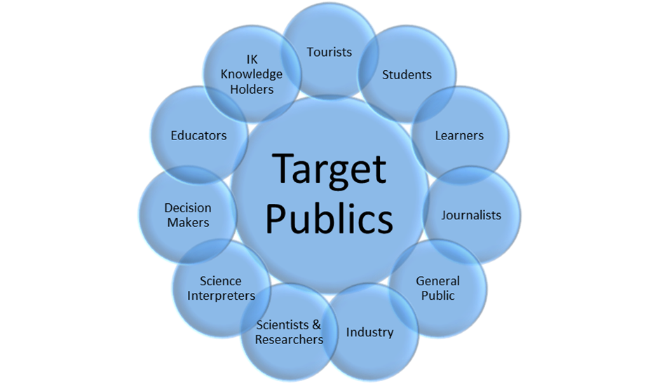
Current activities
Space awareness and education in South Africa towards knowledge economy
STEMI education through space awareness for grade school
Planet Earth & Beyond in Natural Science curriculum
GIS & remote sensing in Geography curriculum (grades 10 – 12)
Partners (DSI, DoBE, NRF SAASTA*, Industry).
HCD begins after grade school: individuals & institutions
Professionals to decision makers
Three spheres of government – thematic areas
Partners (Universities, Industry)
Public engagement through media
Develop a society that values and appreciates science

Slide 3
Notable outcomes
HCD Pipeline: youth (<35) – professionals & institutions
+25 000 youth directly engaged during 2019 2020 (+90% in grade school)
All nine provinces of South Africa
Four national government ministries trained during 2019 2020
Introduction to remote sensing & GIS to support mandates
Food Security, Census Planning, Disaster Risk & Water Management
Outreach to government and the national space industry annually
02nd Space for National Development Conference (Nov2019)
04th Earth Observation Innovation Challenge focused on mining industry
Building resilient communities through DRR outreach (CDM case study)
Partnering with mandated entities is the key success factor
CDM case study can be replicated in the other 47 districts and 8 metros.
EO Innovation Challenge can be replicated in other African countries in 2020.

Slide 4
Challenges – and the path to overcoming them
Limited funding, loss of key personnel and competing priorities of government
Leverage the National System of Innovation to unlock value i.e. train mandated institutions to develop their capacity to use Earth Observation to deliver their mandates.
Use the long-term HCD pipeline approach to mitigate against loss of personnel and take the SA Inc. approach.
Lessons learned:
Thou shall not re-invent the wheel. Problems are opportunities.
Plug and play into existing initiatives. HCD for Innovation.
Promote success stories for replication elsewhere. Prioritize institutional capacity development over individual. Take the bottom-up/inside-out approach for sustainable development.
Do the technological advances of 4IR take away the need for capacity development as robots take over human tasks?

Slide 5
Key takeaways and lessons learned
SANSA reflections
Capacity development must be demand-driven and relevant to the national development agenda, e.g. StatsSA, SAVAC, DWS training to support operational mandates.
Collaboration unlocks massive value and ensures greater impact with minimal input.
Earth Observation Innovation Challenge Flagship.
What best practices are emerging? HCD Community of Practice. Convert staff losses into opportunities. Develop the EO Sector. SA Inc. systematic approach.
What capacity building approaches and methodologies are most effective (or least effective)? SA Incorporated approach driven by Innovation Challenges. Train the trainer model.
What has changed since the capacity building work began? EO Sector is growing.
Are any particular Earth observations, models or data products becoming more (or less) relevant?
SAR training in Africa for African Maritime Domain Awareness
Train them where they are. Virtual access to data is preferred.
Measure impact at the district level. Ride the Presidential District Development model.

