Slide 1
WGCapD & WGISS Synergies, Intersections and Opportunities to Collaborate
Session 5a
CEOS WGCapD-9 Annual Meeting
Sunnyvale, California
10-12 March 2020

Slide 2
WGCapD & WGISS Overviews
WGCapD
Created in 2011, WGCapD undertakes activities based on the four pillars of the Data Democracy Initiative and aims to unify CEOS efforts toward:
  Providing wider and easier access to Earth Observation data
  Increasing the sharing of software tools such as the use of open source software and open systems interface
  Increasing data dissemination capabilities and transferring relevant technologies to end users
  Providing intensive capacity building, education, and training (including awareness and outreach) for enabling end users to gather the information they need
WGISS
Formed in 1995, WGISS promotes collaboration in the development of systems and services that manage and supply EO data. WGISS addresses the internal management of EO, creation of information systems, and the delivery of interoperable services. WGISS provides support to four focus areas: data preservation, data access, data use, and technology exploration. Overall goals are to:
Enable EO data & info to be more accessible and usable to both data providers and data users world-wide through international coordination
Foster easier exchange of EO and related data & info to meet the requirements of users and data providers
Foster development of best practices and encourage interoperable services that exploit space-borne EO data
Enhance the complementarity, interoperability, and standardization of EO data & info management and services with other types of geospatial data such as in-situ data

Slide 3
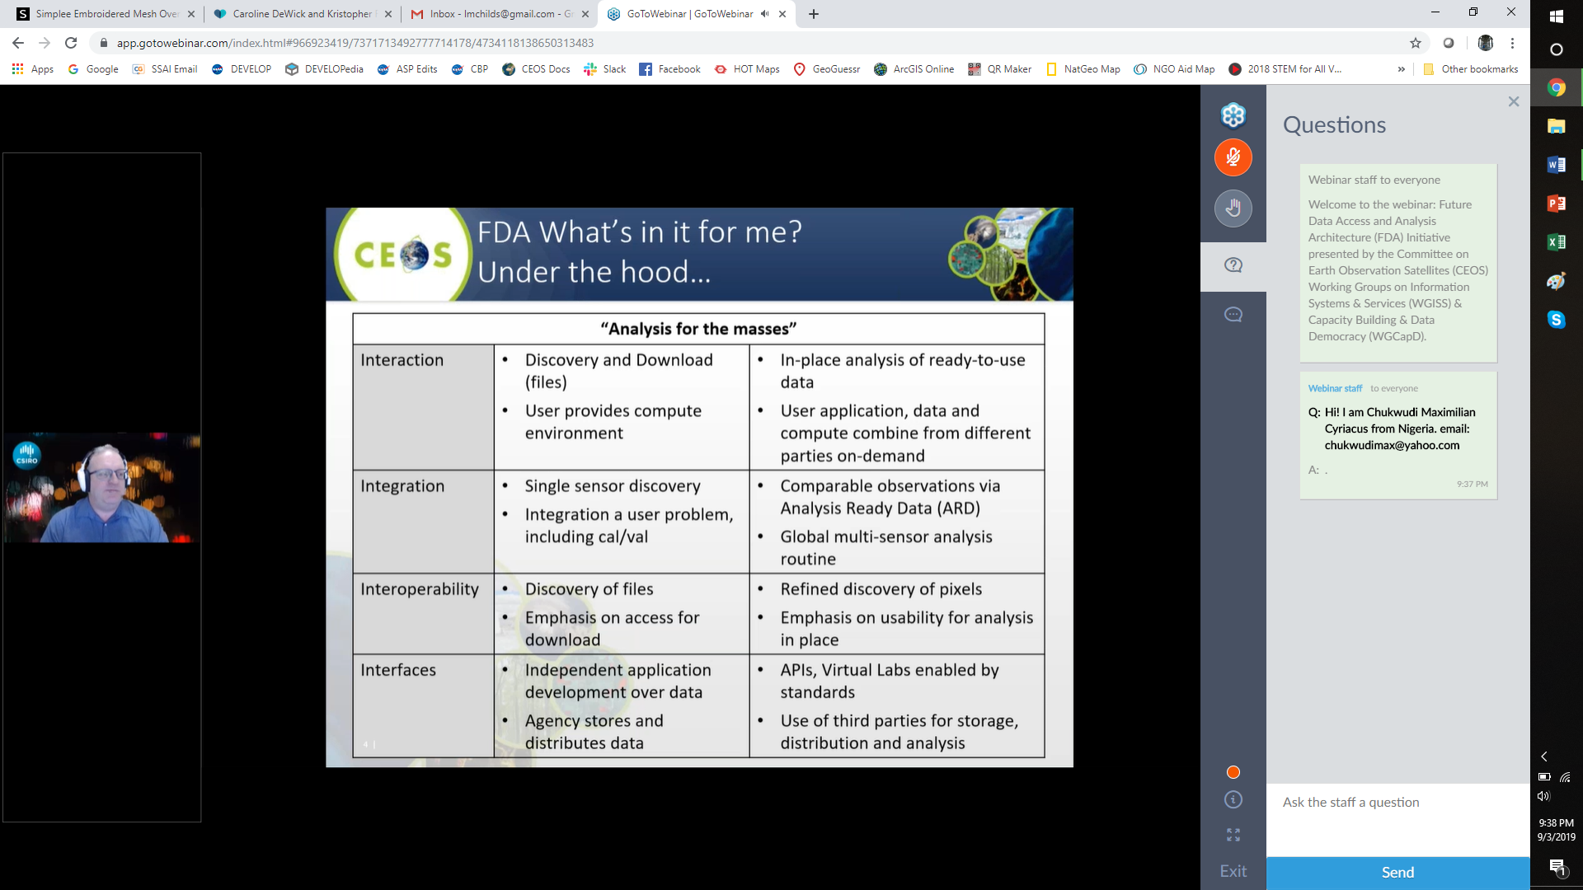

Collaborative Activities: Past, Present & Future
Past Collaborative Activities:
FDA-05: Future Data Architecture Awareness Webinar: http://ceos.org/meetings/future-data-access-analysis-architecture-initiative/ (Sept 2019)
Opportunities for Future Collaboration:
CB-45: Jupyter Notebooks Awareness Webinar
CB-47: Metadata Standards Tiger Team
Follow-on FDA webinar

