Slide 1

WGCapD & WGISS
Committee on Earth Observation Satellites
Esther Conway (NCEO/CEDA), Heiko Balzter (NCEO), Phil Kershaw (NCEO/CEDA), Rob Woodcock(CSIRO), Chris Lynnes (NASA) and Makoto Natsuisaka (JAXA)
WGCapD - 9
Virtual meeting
11 March 2020

Slide 2
Objectives & Members
1. Establishing effective coordination and partnerships among CEOS agencies offering EO education and training
Facilitate education and trainings
Exploit the cumulative capabilities of CEOS Agencies
Partner with local & regional partners to increase effectiveness and decrease duplication
Focus on user needs for data and capabilities to inform action
2. Working with CEOS entities to address data accessibility and use
Work closely with CEOS entities to increase data accessibility
Publicize resources, datasets, and software
Promote the use of dissemination systems to effectively reach areas that lack consistent internet access
Organize workshops and training activities to provide individual and institutional capacity to effectively use EO resources

Slide 3

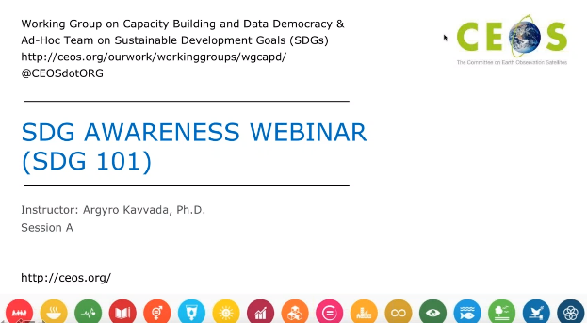
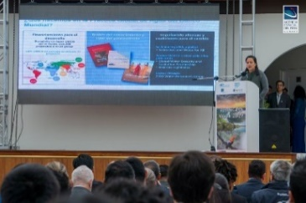

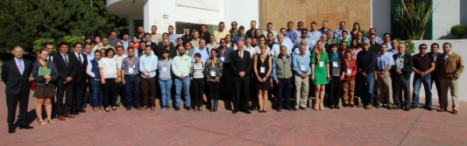
WGCapD Activities
E-Learning
Organize free E-Learning courses and webinars for participants around the globe
Webinars:
MOOCs:
Workshops
Organize free training workshops for participants around the globe
EO Training Workshops
Thematic Training Workshops
Regional Workshops
  GEO – AmeriGEO & AfriGEO
  Southeast Asia
  Future Data Architecture
  Sustainable Development Goals
  SAR trainings
  Forest monitoring
  Flooding
  Etc.
  Echoes in Space: Introduction to Radar Remote Sensing

Slide 4

Jupyter Notebook Collaboration ?
What is a Jupyter Notebook?
A Jupyter Notebooks allows you to combine
rich documentation
live and adaptable code
data visualizations
As a tool to share your data analysis with others, collaborate, teach, and promote reproducible science.
The Jupyter notebook began as an (IPython Notebook), this use of Python makes it ideal starting point for many people using EO data for the first time. In addition it currently supports around 40 programming languages, including Python, R and Julia (Ju-pyt-R)

Slide 5
Why might be this be useful for CEOS CapD
Lowers barrier to use, Jupyter notebooks can be provided alongside data in an executable form (Click and Run)
Good starting point for users wishing to improve Python
User able to obtain meaningful result quickly
A lot of freely available training materials to support user and help improve python skills
Can be integrated with data cubes and CEOS Analysis Ready Data
Jupyter Lab technologies means they be deployed as a webservice
Jupyter Hub technologies mean they can train large classes (for more advanced countries)

Slide 6
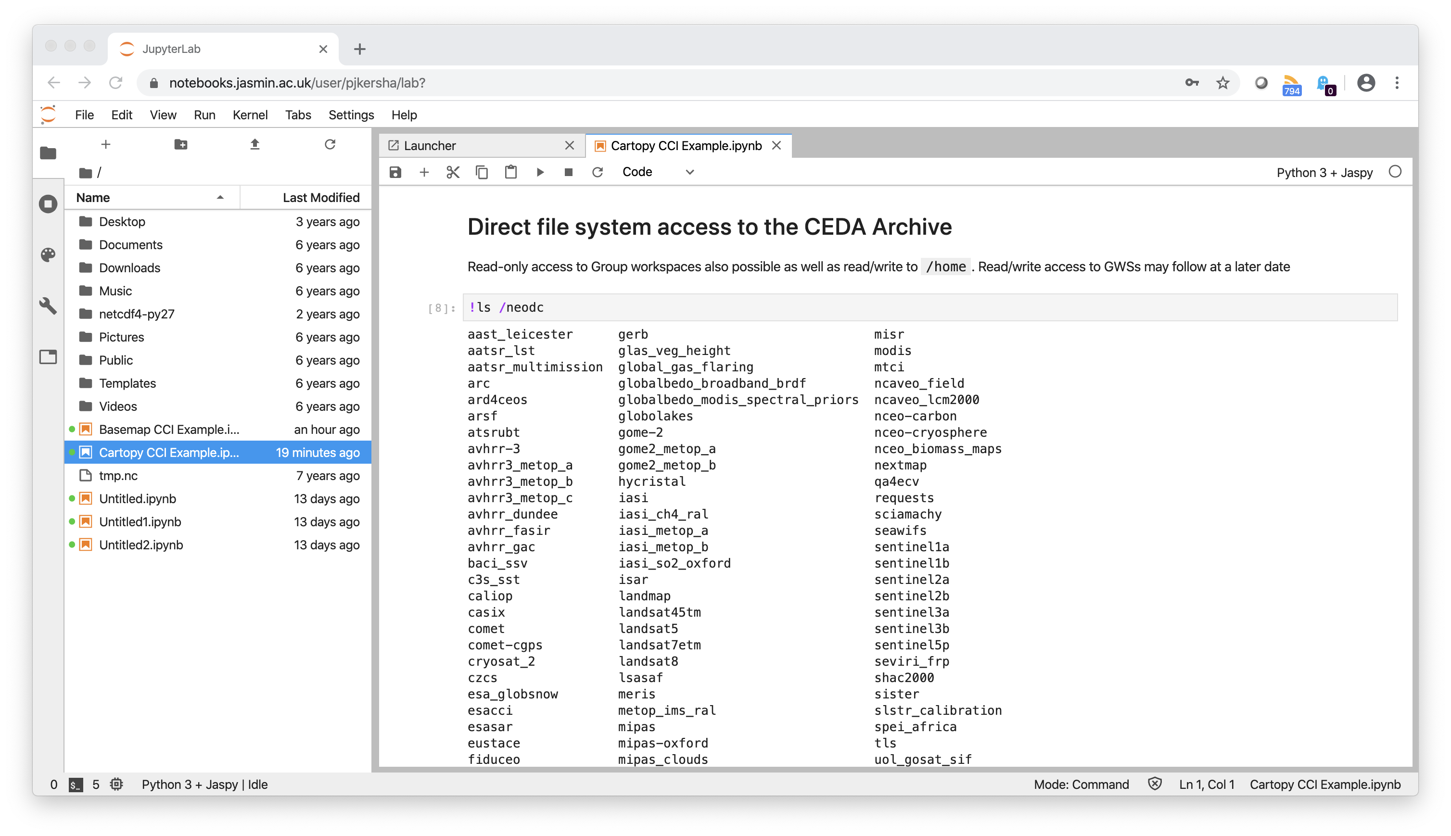

Slide 7
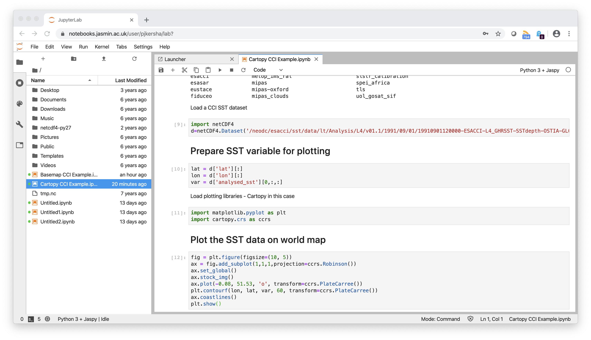

Slide 8
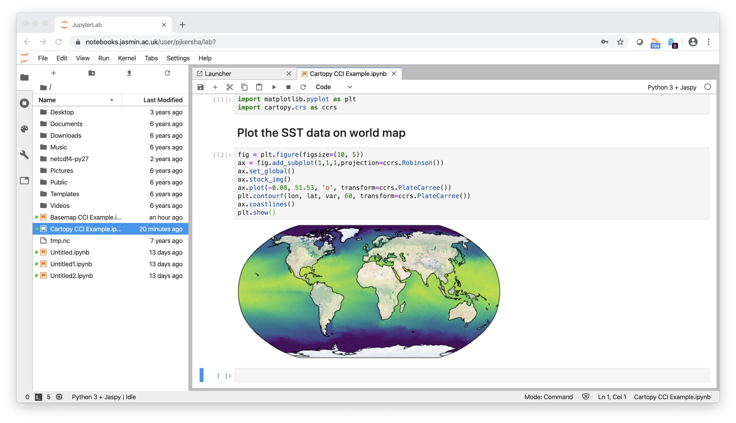

Slide 9
Many data analysis platforms including JASMIN are on the road to developing Jupyter Notebook services which can read from central archives

Slide 10
Where can they be deployed and what are the issues ? Why the need for a collaboration with WGISS?
Standalone computer notebooks can be supplied alongside the relevant data
  Issue around notebooks breaking due to dependencies on python version and libraries etc. Quality issues with code and documentation there are lot of notebooks and a lot rubbish amongst them). Need for CEOS standard and stamp of approval. Also an issue with large datasets and updates to datasets.
In classroom/institutional setting using Jupyter Hub
  Issue around many of the poorest countries not having this capability and has same dependency/quality issues as above.
As a centralised web services using a Data Cube (SEO, WGISS?)
  Issues with development overheads, compatibility with atmospheric pollution data and data cubes, challenges with diverse data from different domains, non standard ARD. Access to hosted processing and security access.
As different services on data analysis platforms
  Issue with development overheads, capacity and support. Dealing with diversity has its own overhead. May require catalogue of services and dealing with many administrations. Different agencies are at different point technically.

Slide 11
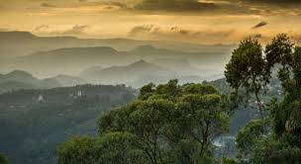



Example of ODA targeted from the NCEO ODA Programme

Slide 12
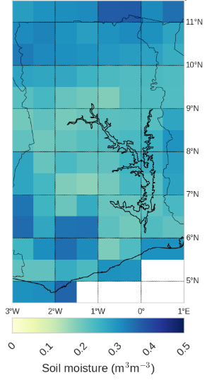
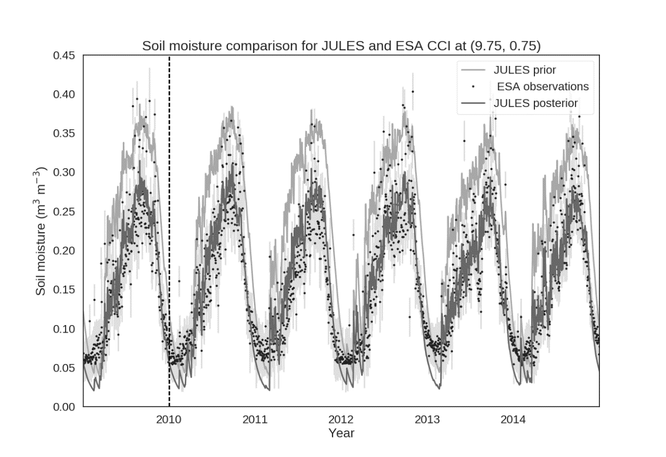
Soil moisture estimates for Ghana
Estimates of soil moisture over Ghana, found by combining model predictions with satellite observations.
Prototype for larger scale Africa wide soil moisture dataset.
Dataset description:
  Pinnington, E., Quaife, T., and Black, E.: Impact of remotely sensed soil moisture and precipitation on soil moisture prediction in a data assimilation system with the JULES land surface model, Hydrol. Earth Syst. Sci., 22, 2575-2588, https://doi.org/10.5194/hess-22-2575-2018, 2018.
Notes:
Initially used this setup to improve soil moisture estimates for Ghana
Ghana is in West Africa, can see that coast line and lake volta here

Slide 13
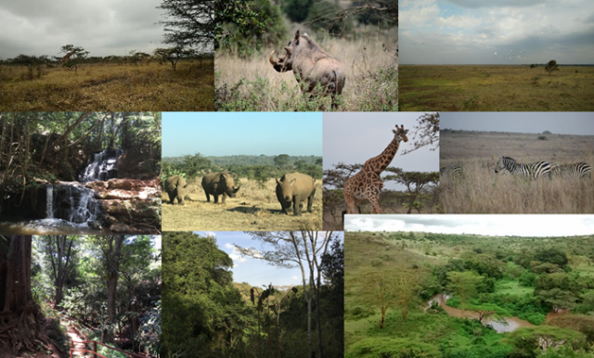
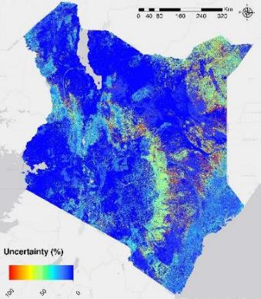


Kenya Aboveground Biomass
The NCEO ODA AGB map is the most detailed and accurate biomass map for Kenya that has been produced to date. The accuracy assessment found coefficients of determination (R²) between 0.64 and 0.90, and root mean square errors (RMSE) ranging from 35.9 t ha⁻¹ to 65.2 t ha⁻¹
The highest AGB densities are found in the dense tropical forests with values up to 530 t ha⁻¹ (average 92 t ha⁻¹). Despite the low levels of biomass density (average 13 t ha⁻¹), the large area of wooded grassland and savannah in Kenya potentially stores up 58% of the total AGB in the country

Slide 14


Maps of stable and change classes in Kenya
Classification likelihood
Likelihood scale defined according to IPCC (2010):
“unlikely”: < 0.33
“about as likely as not” : 0.33-0.66
“likely”: > 0.66
Country statistics 2014-2017 (“likely” classes)
Stable Forest (SF): 4.1%
Stable Other Vegetation (SOV): 53.0%
Stable Other Land (SOL): 17.0%
Stable Water (SW): 2.0%
Forest Loss (Floss): 0.1%
76.2% of the country classified as “likely”, and
23.8% as “about as likely as not”

Slide 15

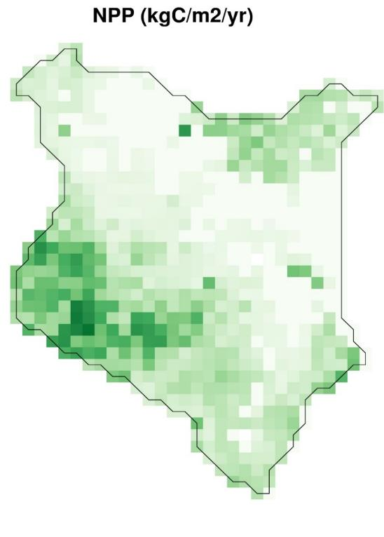
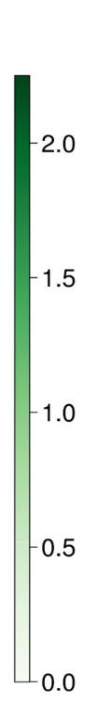
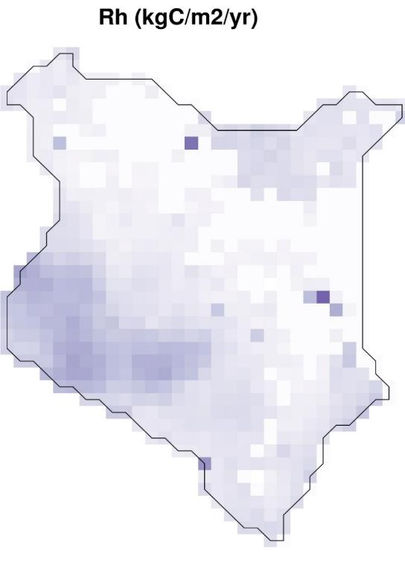
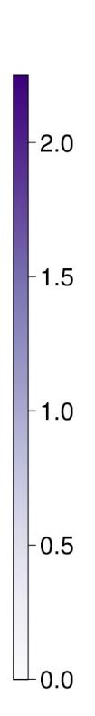
Kenyan forest C-cycle analysis
Rh = Heterotrophic (non-plant originating) respiration, result of soil and litter decomposition
The NCEO ODA used the CARDAMOM model-data fusion framework combining the latest NCEO created - Earth Observations based maps of forest land cover and above ground biomass, and time varying meteorological information to create a state-of-the-art carbon cycle model for forest areas over Kenya.
Our analysis estimates that for the period 2015-2017 Kenya’s forests were a net sink of 11.5 (3.8 / 20.2) TgC/yr or 2.1 (0.7 / 3.7) MgC/ha/yr. The areas of greatest biomass accumulation (indicated by NPP) are found is the mangrove forests along the south east coast and central western areas towards Lake Victoria
NPP = Net Primary Productivity, i.e. photosynthesis less autotrophic (plant originating) respiration

Slide 16
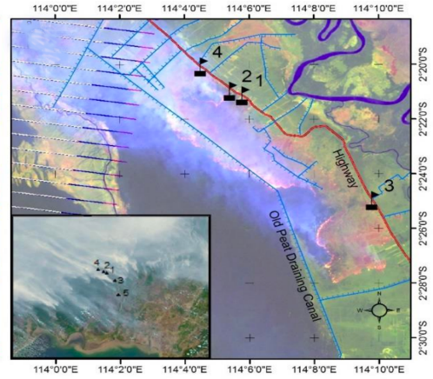

Emission Factors for SE Asian Peatlands
30 peat fire plumes sampled in-situ with FTIR Spectrometer in 2015 across 5 locations on Kalimantan, Indonesia.
New carbonaceous trace gas emission factors (CO₂, CH₄, CO) generated for tropical peat fires.
New particulate emission factors (PM_{2.5} and black carbon) generated for tropical peat fires.
Update emission and fuel consumption totals generated for 2015 SE Asian peatland fires

Slide 17
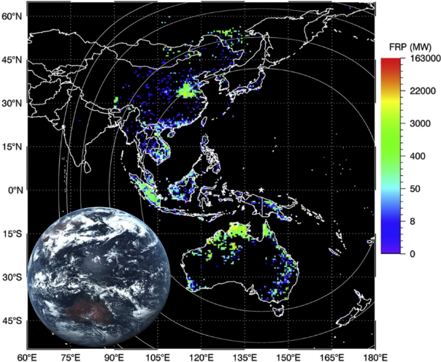
Geostationary FRP Emission Source Mapping
Very high temporal resolution (10 minute) fire radiative power data from Himawari geostationary sensor produced.
Emission source maps generated for Kalimantan at 2km resolution. Far higher resolution than in other emission inventories.

Slide 18
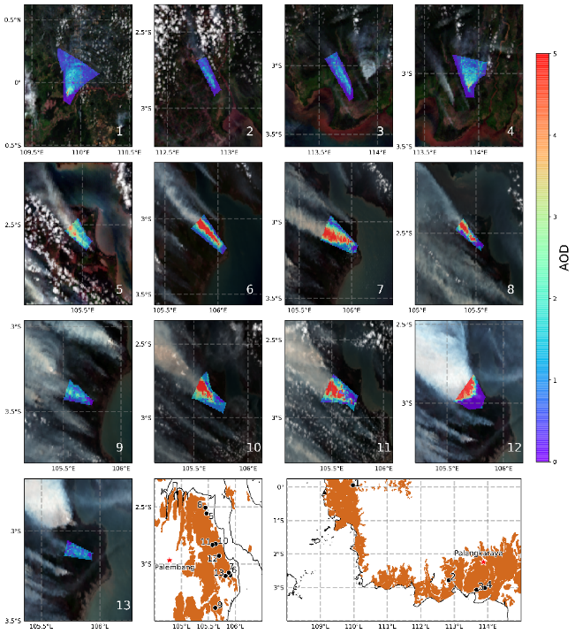
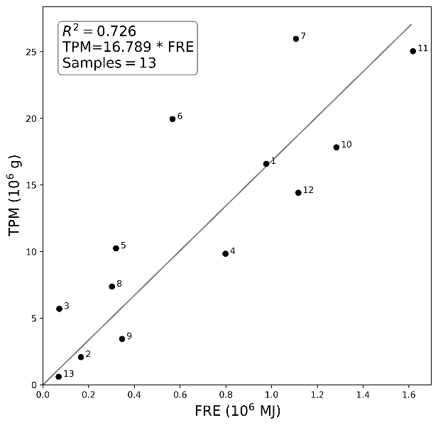
New ‘Top-Down’ Emission Coefficient
'Top-down’ particulate matter emission coefficient generated for surficial peat fires in SE Asia.
Appropriate for flaming peat fires this new coefficient has demonstrated the importance of fire phase when estimating emissions.

Slide 19

The Way Forward ?
Survey of Agencies
  CapD targeted datasets and associated notebooks
  Key Datasets for CapD and associated notebooks
Input of relevant in country capabilities and needs
Technical discussion at WGISS 49
Notebook standards and CEOS endorsement
Discuss !

