Slide 1
NASA Earth Science Data Systems (ESDS) Program
Session 8: Expanding our work on data democracy
NASA/DEVELOP Program
Kent Ross
CEOS WGCapD-9 Annual Meeting
Sunnyvale, California
10-12 March 2020

Slide 2
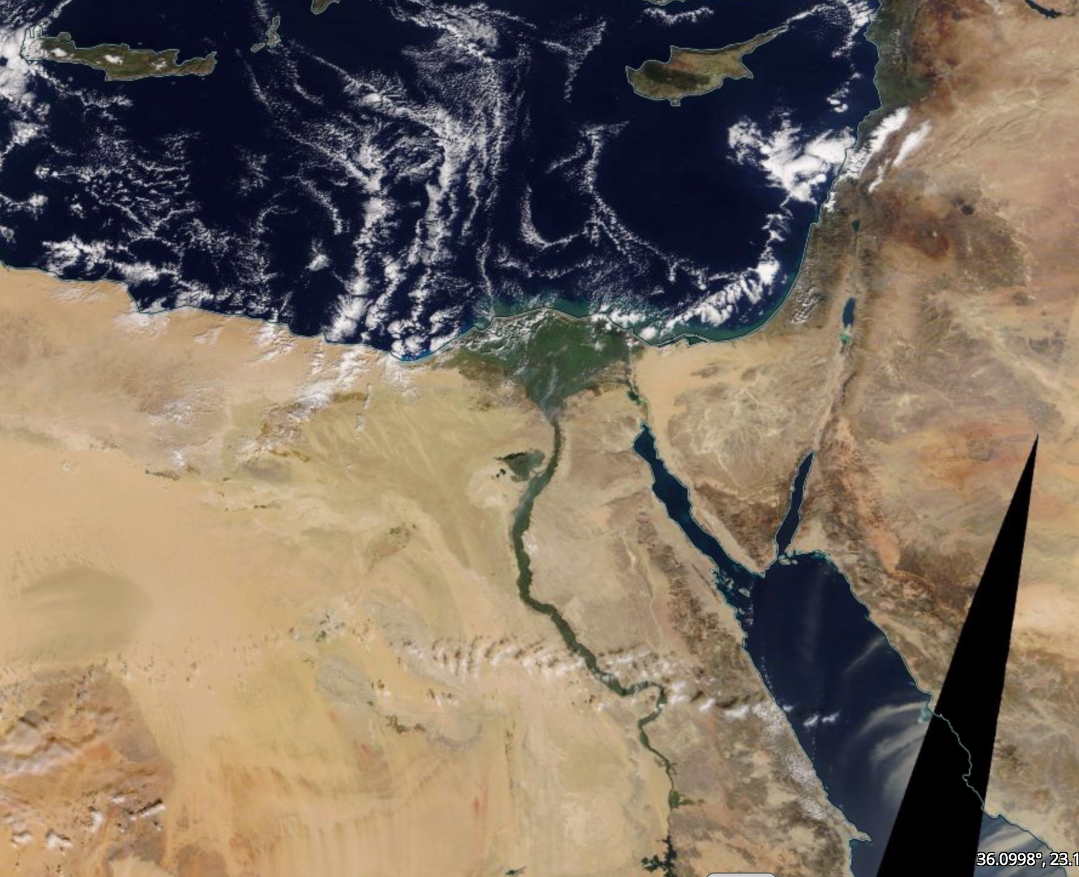
Earth Science Data Systems Program
NASA established the Earth Science Division (ESD) to understand and protect our planet through:
Advanced technologies and satellites
Analysis and prediction of Earth system change
To achieve these goals, NASA's Earth Science Data Systems (ESDS) program promotes data democracy through:
Tackling the big data question
Earth Observing System Data and Information System (EOSDIS)
Supporting research and technology through NASA’s Open Data policy
Embracing the new paradigm for data system stewardship
Notes:
Talking Points
The Earth Science Data System Program engages members of the Earth science community in the evolution of data systems. With this in mind – ESDS has implemented several components across the Program in support of data democracy.
To best meet these goals, NASA's Earth Science Data Systems (ESDS) program promotes the full and open sharing of all data, metadata, documentation, models, images and research results, and the source code used to generate, manipulate, and analyze them.
Embraces advanced technologies and satellites in order to study the Earth and improve the analysis and prediction of Earth system change
Discovering innovative way to meet the new paradigm for data system stewardship as it is projected the NASA’s Earth science data archive will hold over 200 PBs of data by 2025

Slide 3
Data Democracy Across ESDS Program
EOSDIS currently has over 33.6 Petabytes
of accessible Earth science data
Easy access and discovery of data to over
~12,000 unique data products
… of which 95% of granule searches complete in less than 1 Second
EOSDIS delivered over
1.6 Billion data products
to over 4.1 Million
users from around the world
34,535 Data Collections
in the Common Metadata Repository (CMR)
EOSDIS also delivers near-real-time products in under 3 hours
from observation …
Over 570,000 users
have registered with EOSDIS to date
And Over 380 Million
data granules
American Customer Satisfaction Index (ACSI) survey scoring 78 from over 6,000 respondents
https://earthdata.nasa.gov/about/system-performance
Notes:
Talking Points
Actively manages NASA’s Earth science data (Satellite, Airborne, and Field) as a national asset.
Develops unique data system capabilities optimized to support rigorous science investigations and interdisciplinary research.
Processes (and reprocesses) instrument data to create high quality long-term Earth science data records.
Upholds NASA’s policy of full and open sharing of all data, tools, and ancillary information for all users.

Slide 4
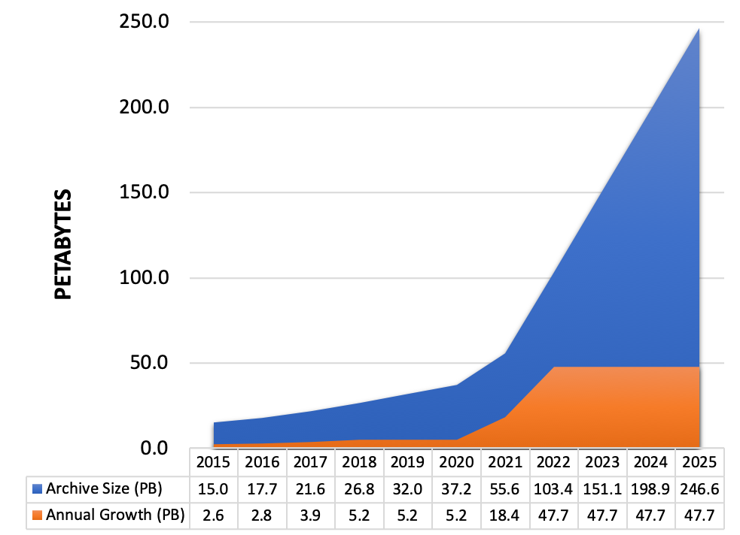
Big Data: Earth Science
Challenge
Volume of data in NASA Earth science archives to increase to 250 Petabytes by 2025.
Need
Efficiently handle storage and computation needs for large data volumes through new data management technologies and architectures.
Notes:
Talking Points
NASA’s Earth Observing System Data and Information System (EOSDIS) acquires, processes, preserves, and distributes observational data from various sources (satellites, aircraft, field measurements, and various other programs) to support Earth Science research focus areas. It is responsible for defining and communicating requirements and standards to data providers. From its current size of approximately 30 petabytes (PB), the volume of data in the EOSDIS archive is expected to increase to approximately 250 PB by 2025.
To efficiently handle storage and compute needs for the large SWOT and NISAR data volumes, new data management technologies and architectures are needed.
Growth of Mission Data & Processing: Projected rapid archive growth and the need to effectively process significantly larger volumes of new mission data requires rethinking existing architectures. Estimating 132 TB daily ingest by 2022
Data Systems: More cost effective, flexible, and scalable data system ingest, archive, and distribution solutions are needed to keep pace with new mission advancement and capabilities
Science Users: Significantly larger data volumes requires additional ways to access and utilize these data, with “Data Close to Compute”

Slide 5
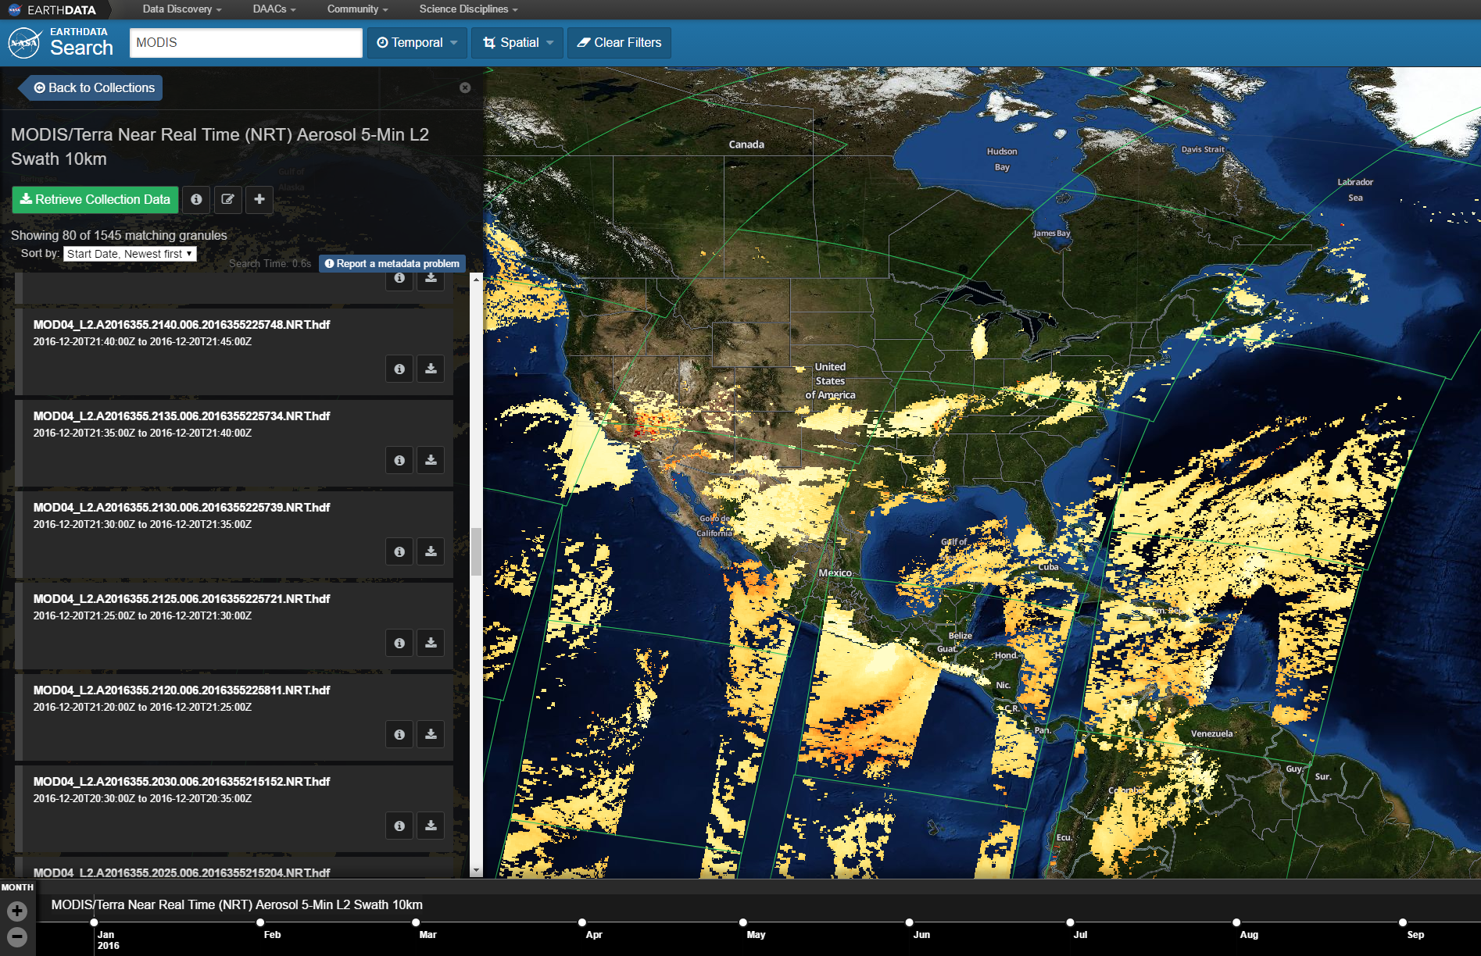
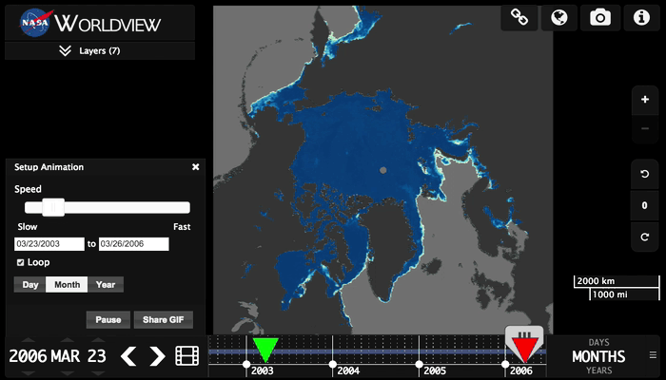
EOSDIS Data Search and Access Tools
Data Centric End Users
https://search.earthdata.nasa.gov
Imagery Centric End Users ̶̶ https://worldview.earthdata.nasa.gov
Notes:
Talking Points
EOSDIS publicly distributes and provides user services the data archived at NASA’s DAACs for thousands of products and millions of users.
EarthData Search combines the latest EOSDIS service offerings with user experience, research, and expertise, producing a state-of-the-art client for discovering, searching, visualizing, and retrieving Earth science data. Earthdata Search provides access to all DAAC data via a map web-based interface
Worldview tool from NASA's Earth Observing System Data and Information System (EOSDIS) provides the capability to interactively browse over 900 global, full-resolution satellite imagery layers and then download the underlying data. Many of the imagery layers are updated daily and are available within three hours of observation - essentially showing the entire Earth as it looks "right now".

Slide 6
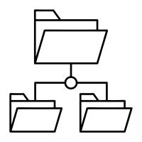
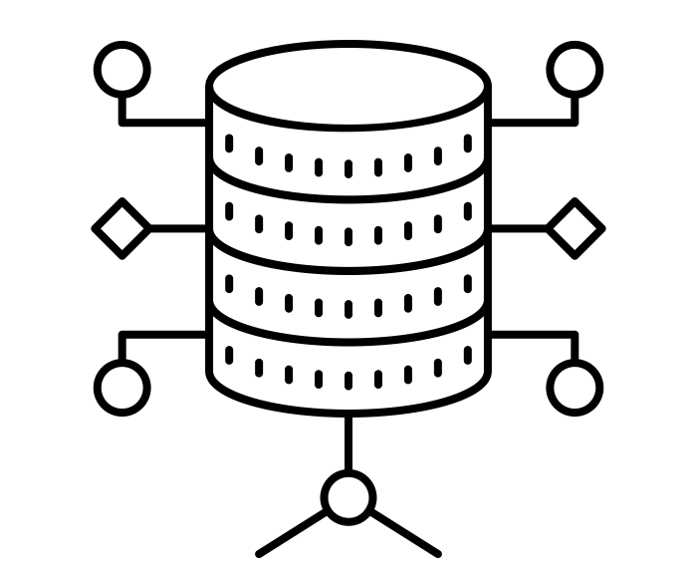
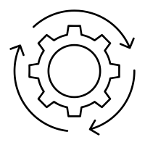
Supporting Research and Technology Through Open Data Policies
Since 1994, data have been free and open to all users for any purpose as quickly as practical after instrument checkout and calibration.
Earth Observing System Data Information System (ESDIS) is the single largest repository of Earth science data, integrating multivariate/heterogeneous data from diverse observational platforms.
End User Web Clients
Earthdata Search: data access/discovery*
Worldview: imagery*
Open Service APIs
CMR: Metadata Catalog*
User Login
GIBS: Global Imagery Browse Services*
Earth Science Data Holdings
Open APIs
Free Data Download
DAAC specific tools
EOSDIS central tools
Federated resources
Notes:
Talking Points
NASA’s earth observation data is collected continuously. Open data drives system architecture and evolution
EOSDIS ensures that the data and information content are reliable, of high quality, easily accessible, and usable for as long as they are considered to be of value
The Earth Observing Data and Information System (ESDIS) Project manages a set of 12 discipline-based Distributed Active Archive Centers (DAACs) across the United States serving over 4.1 million users globally.
Starting in 2015, all data systems software developed through research and technology awards or in-house development has been made available to the public as Open Source Software (OSS).

Slide 7
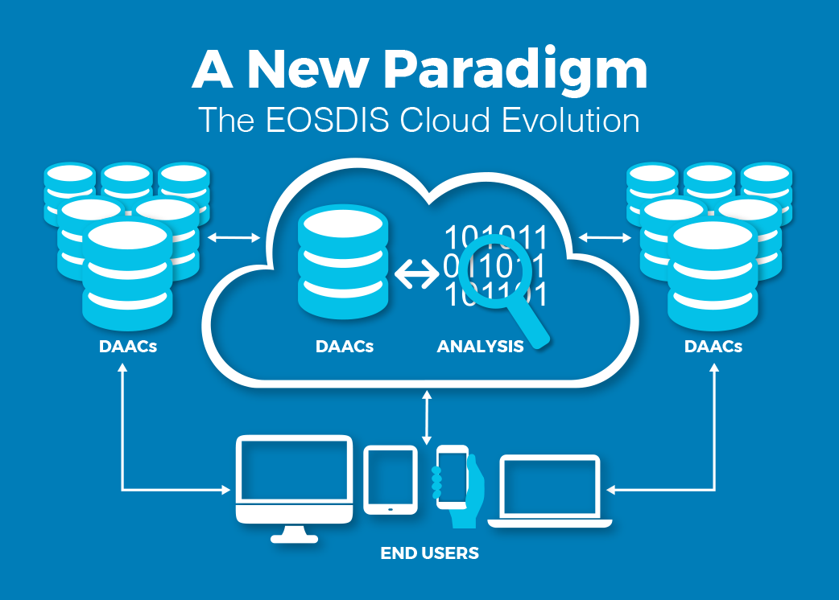
New Paradigm for Data System Stewardship
Cloud offers performance and cost benefits.
Realize storage, processing and operational efficiencies.
Improve cross-archive center collaboration.
Enable users to work across multiple datasets managed by different archives without transmitting data over networks
Notes:
NASA’s Earth Science Data and Information System (ESDIS) Project has established the Earthdata Cloud Project aimed at operationalizing how EOSDIS (Earth Observing System Data and Information System) data collections can be archived collectively and disseminated in the cloud. As part of these efforts, EOSDIS successfully demonstrated that cloud environments offer performance and cost benefits.
Goals for EOSDIS cloud evolution:
Improve the efficiency of NASA’s data systems operations – continuing free and open data access to data
Prepare for new high-data-rate on-orbit missions
Increase opportunity for researchers and other users to access/process petabytes of data quickly without the need for complex data management capabilities
Allow for a transparent/extendable open source processing framework

