Slide 1
NISAR Early Adopters and Training
Session 4: Expanding our Work on Data Democracy
NASA/JPL/Caltech
Paul A. Rosen
CEOS WGCapD-9 Annual Meeting
Sunnyvale, California
10-12 March 2020

Slide 2
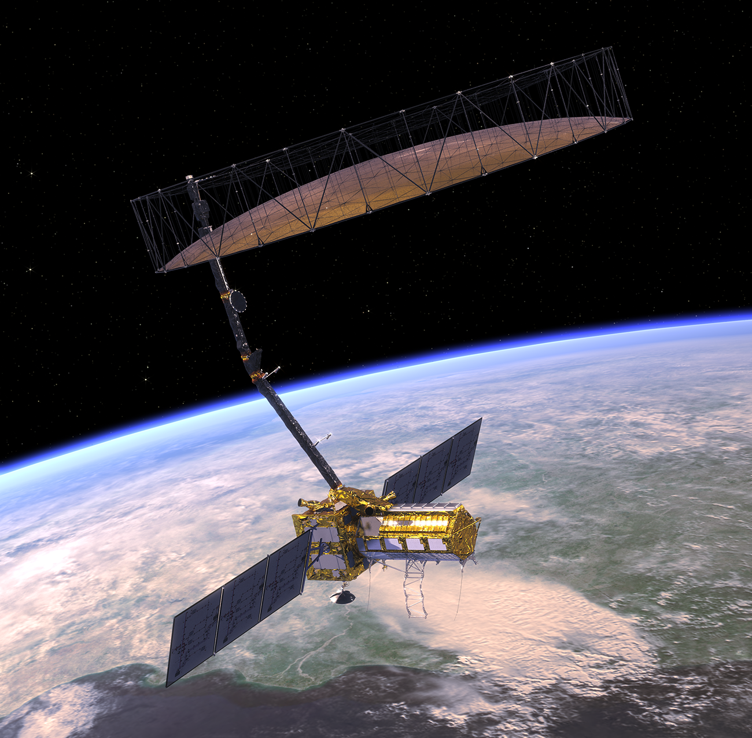
NISAR Overview
NASA-ISRO Partnership
Launch in 2022
Global L-band and Regional S-band SAR imagery
  Polarimetric, and interferometric geocoded products with 12-day repeat cycle, ascending and descending
Free and Open data
Key Objectives
  Response of ice sheets and glaciers to climate change and the interaction of sea ice and climate
  Dynamics of carbon storage and uptake in wooded, agricultural, wetland, and permafrost systems
  Improve knowledge for forecasts of earthquakes, volcanic eruptions, and landslides
  Applications including urgent response, agriculture, water storage, forest management

Slide 3
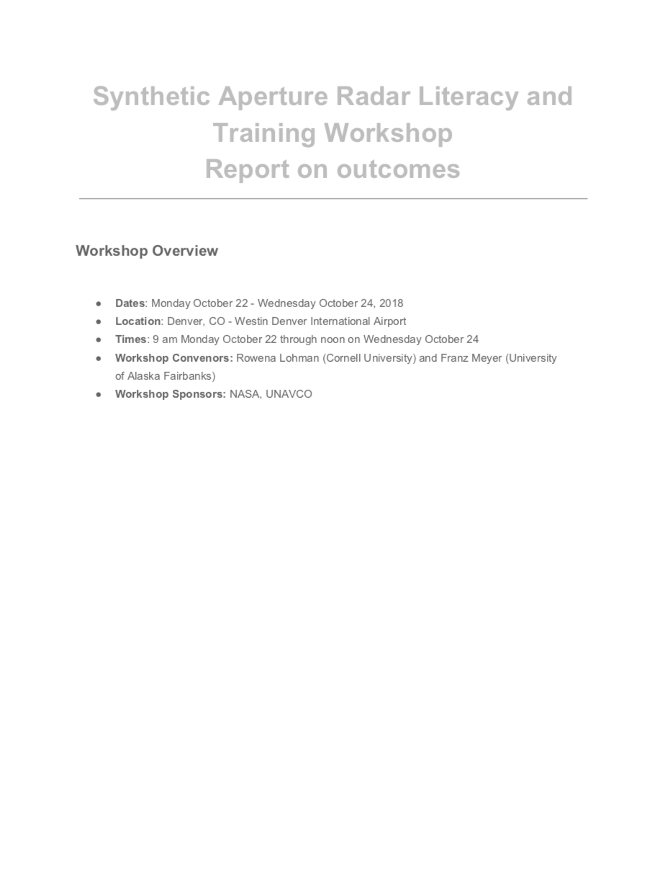
Training Activities associated with NISAR
SAR Literacy and Training Workshop
Brought together many already engaged in the WGCapD activities related to SAR
Provided recommendations to NASA to:
Foster leveraging of training activities
Invest in training materials development
Emphasis on web-based tools like jupyter notebooks

Slide 4
NASA Applied Science Capacity Building Programs
NISAR to highlight key resources from these programs through the NISAR Applications Webpage
DEVELOP - Feasibility Studies
  Strategically propose these through Applications Working Groups to help foster support from bottom up (management unit scale)
  Some completed: USDA ARS, USFS, NPS, BLM, FEMA
  Public access reports on study and 3-min videos; some of mention:
    https://develop.larc.nasa.gov/2015/spring_term/CaliforniaDisasters.html
    https://develop.larc.nasa.gov/2018/spring/NorthDakotaGeorgiaAg.html
ARSET
  NASA ARSET Introduction to SAR webinar series
  ARSET Advanced SAR webinar series
  Advanced Webinar: SAR for Disasters and Hydrological Applications
  Advanced Webinar: SAR for Landcover Applications
SERVIR
  Biomass Estimation Handbook
  One-Pagers: 1) SAR-Vegetation indices, and 2) Pre-processing steps
  Movie: SAR explained for Forest Structure

Slide 5
Early Adopters Program Plan
Defined as Early Engagers dedicated to working with NISAR data before public release and providing feedback to the project as to the utility of it
Avenues for working with NISAR(-like) data:
  NISAR-like data from UAVSAR L-band
  Level 2 NISAR-like data derived from satellite radars (e.g., Sentinel-C band, ALOS L-band)
  Unvalidated NISAR data before science operations phase
Tier | Description
A1 | May request additional NISAR-like data and are focused on demonstrating processing on the cloud
A2 | May request additional NISAR-like data and are focused on helping the project with calibration and validation as collaborators

Slide 6
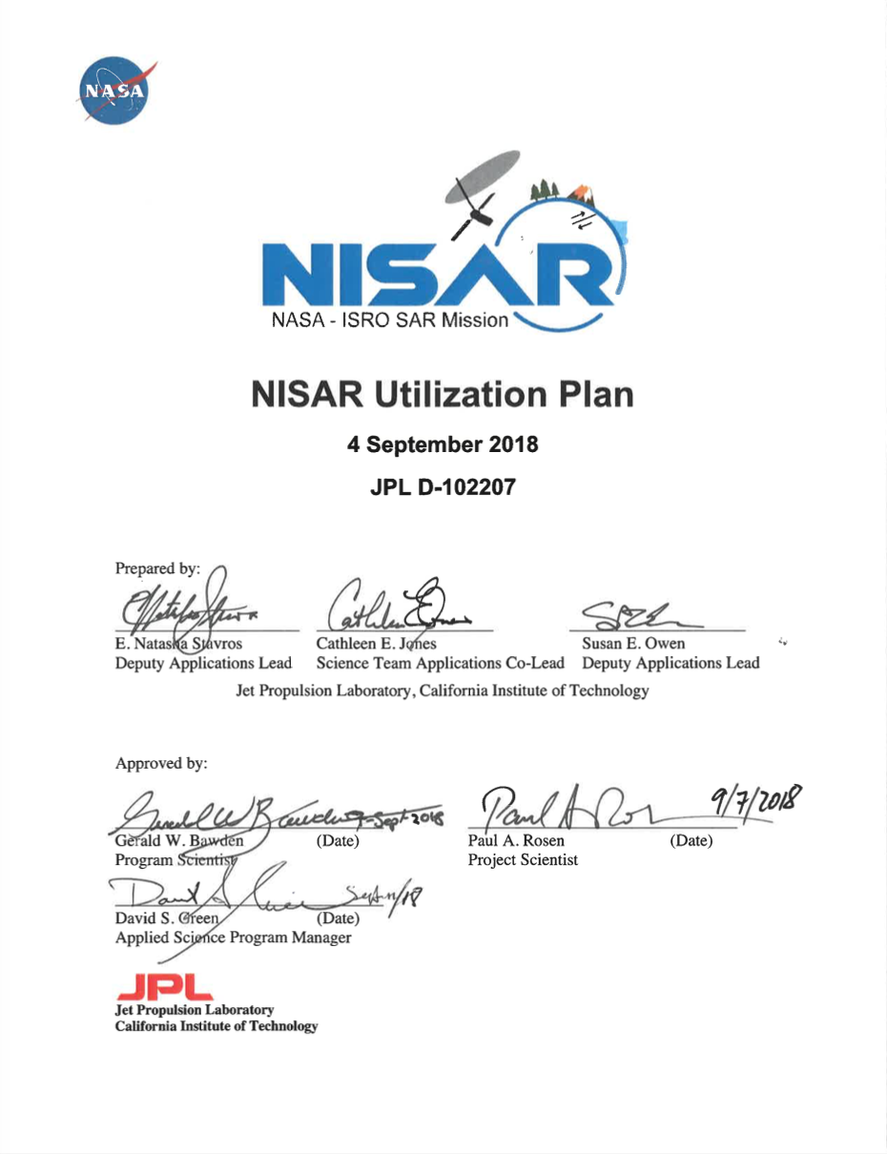
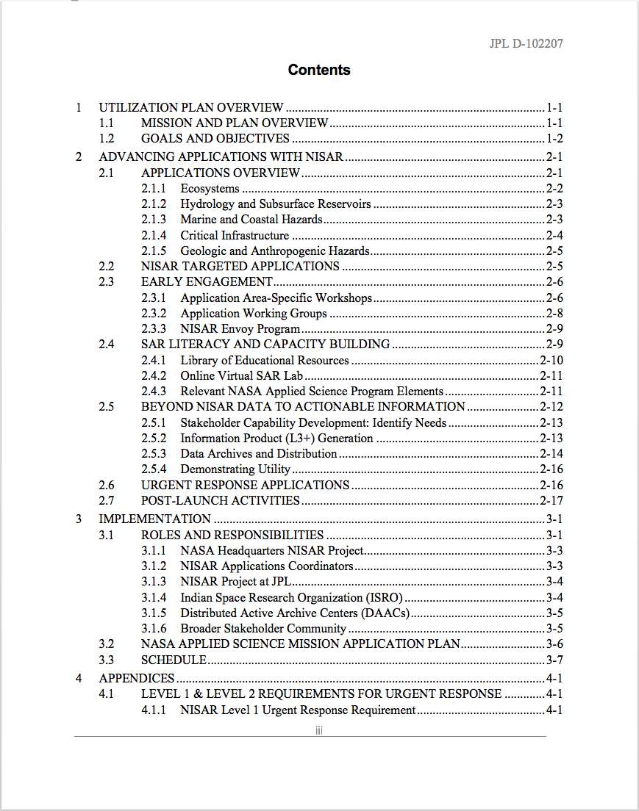
NISAR Utilization Plan in Place
NISAR plan includes a rich set of activities and coordination efforts to foster the use of NISAR data by the science and applications communities.
Engagement with Satellite Needs Working Group in the US helps to socialize the data across US government agencies

