Slide 1
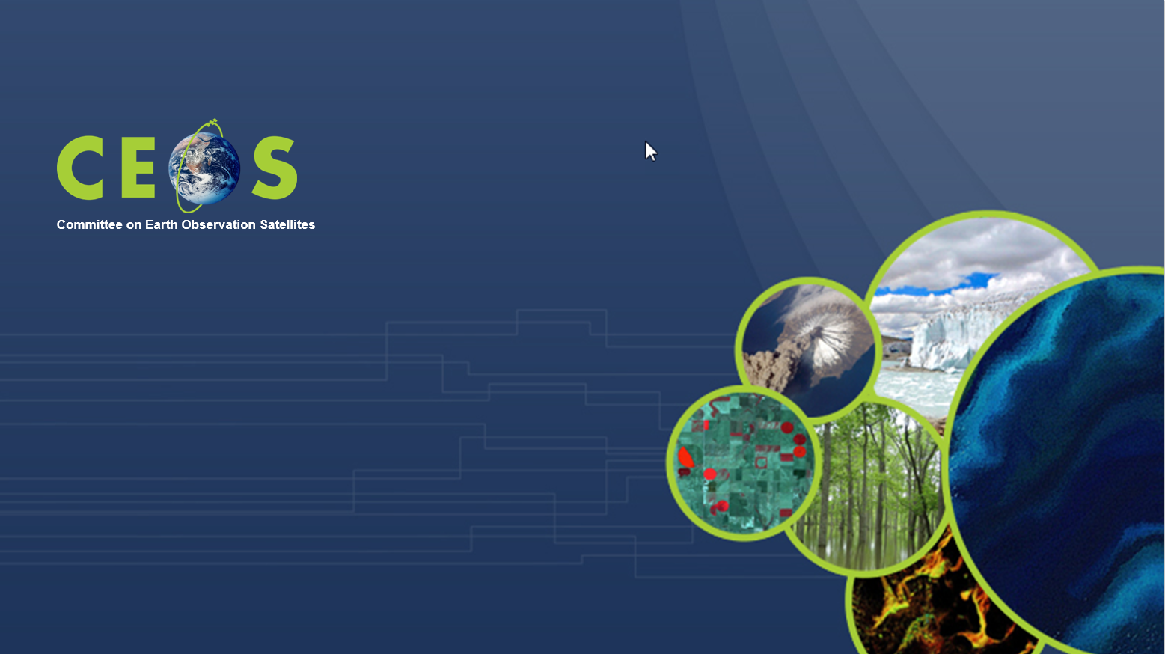
ESA contribution to EO data democracy: data access and availability, future perspectives
Session 4: Expanding our work on data democracy
ESA
Francesco Sarti, Amalia Castro Gomez
CEOS WGCapD-9 Annual Meeting
Sunnyvale, California
10-12 March 2020

Slide 2

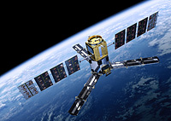
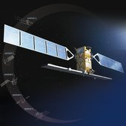

ESA EO data:
Heritage Missions
(ERS & Envisat)
Earth Explorers
Copernicus Sentinels
Third Party Missions
All datasets accessible for free by everyone (also outside ESA Member States)
Registration and access procedures vary a bit (see next slide), especially for Third Party Mission (restrictions on quota and user type)

Slide 3
Extra info on ESA EO data Access
Free datasets
Search/browse products openly.
Download after registration at https://earth.esa.int/web/guest/home
(EO-SSO account in My Earthnet), via On-The-Fly processing.
Immediate access to data
ERS & Envisat
Free datasets.
No registration needed for some. Others are accessible from ``
(EO-SSO account in My Earthnet)
Access is immediate
Earth Explorers
Free, full and open data policy.
Self registration at Copernicus Open Access Hub https://scihub.copernicus.eu/
Access is immediate data from last 12-18 months. Older data are available via Long Term Archive https://scihub.copernicus.eu/userguide/
Copernicus Sentinels
Registration needed at https://earth.esa.int/web/guest/home
(EO-SSO account in My Earthnet) and, depending on the TPM, immediate access, or after a few days, or after a few weeks (if project proposal needed for TPM restrained datasets)
Third Party Missions

Slide 4
Facilitating EO data user uptake:
Large number of face-to-face trainings (majority in Europe but not only)
Increasing number of ESA EO MOOCs (free and open to anybody), webinars (also via RUS)
Further development of free ESA EO toolboxes, and web-based tools for EO education (EOBrowser)
Intention to provide (limited) access to ESA Thematic Exploitation Platforms & Euro Data Cube for training and CB purposes, also outside Europe, via CEOS WG CapD

Slide 5





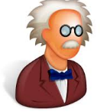





A new approach for training and for data access
Thematic Exploitation Platforms (TEPs)
From hierarchical supply chain (PRODUCTS)…..
….to network-like interaction between all players (SERVICES)
Tailored environment (data, algorithms, tools) for specific community
Thematic expert advice on how to use the data
Hosting your algorithm on a scalable cloud environment, ready for operational use
Sharing your data & results with community
Sponsored use available via Network of Resources “nor.cloudeo.store”
Algorithms
expertise
Sharing
Platform
Tools
ICT
Data
Software vendors
Cloud Providers
Data Owners
Notes:
Investment into the platform-based ecosystem has to lead industry from the traditional “pipe” approach – characterised by a hierarchical organisations of supply chains – into the next industrial revolution platform economy, where the platform enables a network-like interaction between all players, helping to dynamically establish the business links whenever an opportunity can be exploited.
What is common to most platforms is that they make connections between “creators” and “extractors” of value and the platform generates a profit from making these connections, either by taking a commission or advertising.
Implicitly this will lead to a transition from a “product”- to a “service”-based approach and from project-limited activities to operationally sustained environments
Platforms implement a “sharing economy” attractive also for the young generation, allowing owners of partial assets to conveniently integrate their competence into a bigger overall picture. Europe needs to take leadership to develop adequate trust-, revenue- ad risk-sharing models to be the champion in this new EO economy. These models can help to provide services e.g. by SMEs at a cost level acceptable to the market, where the “Pipe” approach characterized by big operators could not arrive .
Science can take enormous profit in using these environments to advance the speed and dimension of scientifical results making full use of the co-creation and co-engineering capabilities of a shared platform.

Slide 6




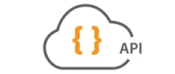
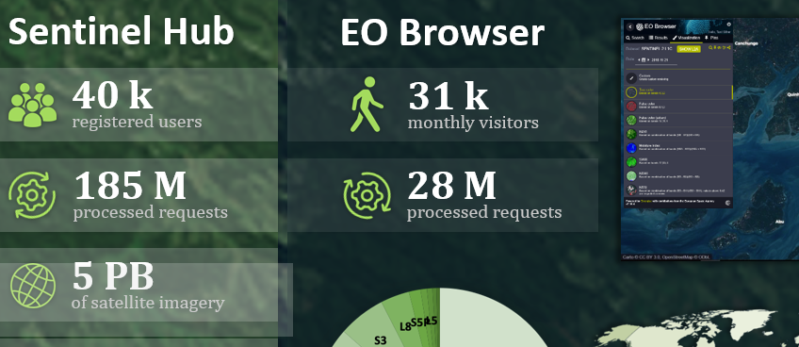
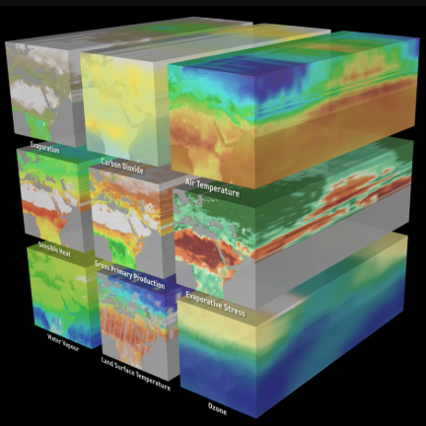
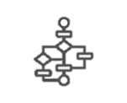






















Data Access via European Data Cube
GeoDB
Algorithms
Apps
on-the-fly &
batch processing
multi-temporal
analysis (xarray)
vector data
service
hosted app engine
jupyter Notebooks
DATA
SERVICES
Access to full archives
Analysis Ready Data
Data
CLOUD
EO commercial
in-situ sensor
GIS data
Thematic
data
03/10/2020
Notes:
DATA (bottom line): Copernicus, Landsat (USGS), in-situ & GIS, thematic info
Data services: Sentinel data Hub (and EOBrowser), X-cube, etc
Interfaces: Python, OGC
Cloud facilities: CREODIAS etc.
The Open Geospatial Consortium (OGC) is an international consortium driven to make geospatial information and services FAIR - Findable, Accessible, Interoperable, and Reusable.
General concept of the Euro Data Cube:
-works with large volumes of data, which are hosted on various clouds (DIAS et al)
-Euro Data Cube is on top of the cloud infrastructure, providing services for data processing (on-the-fly processing, batch processing, multi-temporal analysis, vector data service. Very important fact being is that it provides access to _complete_ data archives – Sentinel-1,-2,-3,5p, Landsat, MODIS, etc.
-Euro Data Cube also offers hosted app execution and Jupyter Notebooks for data scientists
-users can contribute their algorithms, applications and data
-the data can be served via standard APIs, including OGC standard one

Slide 7
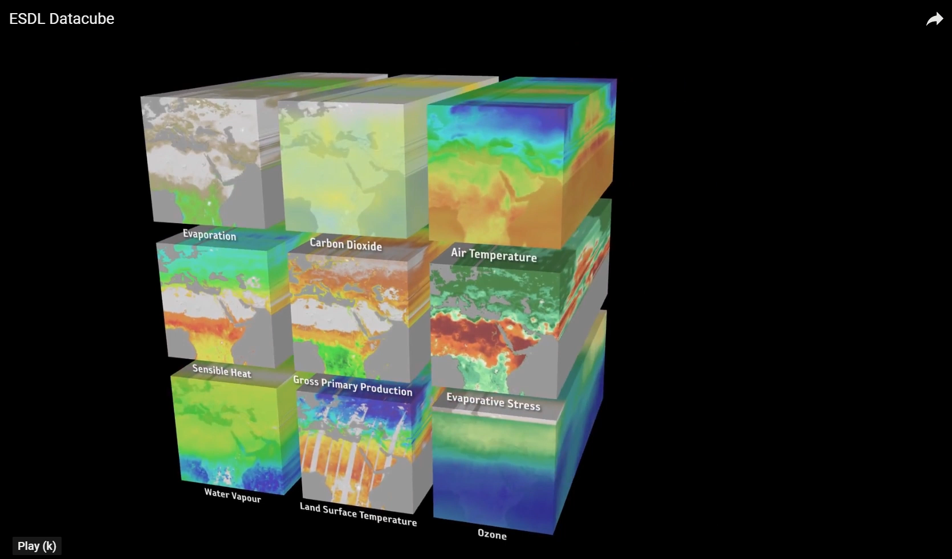
One particular array for multi-temporal scientific analysis (xcube) is the Earth System datalab:
www.earthsystemdatalab.net
Please click on the image below
The Earth System Data Lab (ESDL) is a multi-variable data set of essential earth variables. Each of them can be represented as a stream of spatial data or a datacube (lat, lon, time). A subset of ECVs can be selected in order to evidence intercorrelations in time/space: strong anomalies thereof (represented as dense clouds) correspond to extreme events like droughts (see example)
Extracted from www.youtube.com/watch?v=9L4-fq48Ev0
Notes:
The Earth System Data Lab (ESDL) seeks to be a service to the scientific community to greatly facilitate access and exploitation of multivariate data sets in Earth Sciences.

Slide 8

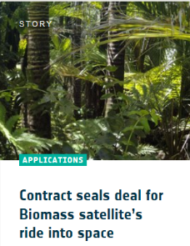
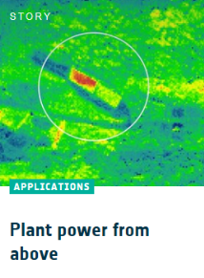
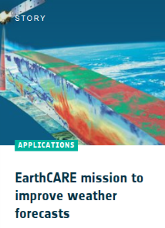
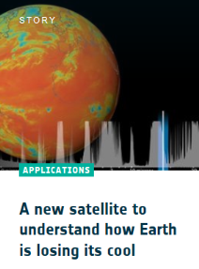
Perspectives on future ESA and Copernicus EO data:
Block 2 – Research Missions
Earth Explorers to be launched:
Biomass (2022)
Earth Care (2022)
Flex (2024)
All scientific BIOMASS products: free & open
For the first time, the source code of all scientific processors free and open.
data availability time frame:
  Mid-2023: First data (L1) available.
  End-2024: Global biophysical measurements available.
Notes:
EarthCare extends our knowledge of aerosols and clouds with a “high-sophisticated” instrumentation (LIDAR [ATLID], multi-spectral [MSI], radiometer [BBR], cloud radar [CPR: JAXA])
Biomass takes up the budget of biomass - especially in the tropics and gives us a level of knowledge with an accuracy of up to ~ 15-20%
With Flex, the fluorescence of the vegetation stress of plants from space is determined for the first time
FORUM as just been selected and fills the gap in atmospheric measurement in the long-wave IR spectral range. As a result, the radiation budget of the earth can be determined with much higher accuracy and an essential prerequisite for better climate predictions can be met. The mission also provides valuable information about water vapor and the water cycle in the climate.

Slide 9

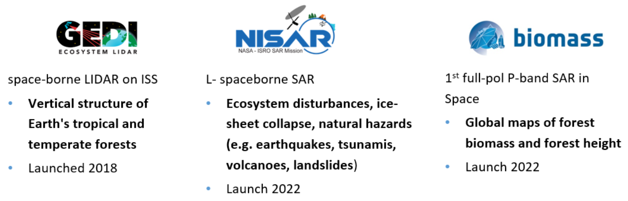




New model for working with EO data: The Biomass Mission Algorithm and Analysis Platform
Joint Mission Algorithm and Analysis Platform model
An innovative operations concept: users access a work environment containing data and resources required (no need to download data): Virtual open and collaborative environment (Exploitation platform)
MAAP
Joint access to data and algorithms
bringing together:
Data storage (EO and non-EO data)
Computing and network resources, hosted processing
Collaborative tools & toolboxes
Communication tools (social network)
Data and computing
Data and computing
Notes:
For BIOMASS we plan a new way to make available the data. All data will be available in a cloud and be a accessible through a platform which will include data processing capacities, access to auxilliary data (ground data, lidar data).
The aim is to build a community that works on Biomass together. At the moment there is also the vision for a joint ESA NASA platform including the data fro GEDI and NISAR.

Slide 10
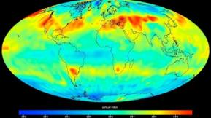
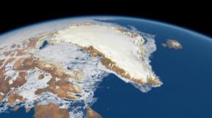
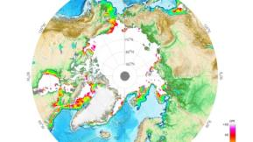
Copernicus Space Component @ Space19+
“High Priority Candidate Missions”
 | CO2M CO₂ Imaging spectrometer | Monitoring of anthropogenic CO2 emissions at regional and local level (cities / industrial plants) | Instrument: Spectrometer, Cloud Imager, Multi-angle Polarimeter resolution: ca. 2x2 km² revisit 3 days @ 40°N Start: 2025/26
 | PICE/CRISTAL polar Ice & snow topography | Monitoring sea ice concentrations in the Arctic | Instrument: Radar-Altimeter, Radiom. resolution: 20m revisit: 365 days (with 1 Satellit) Start: 2026/27
 | CIMR Passive microwave | Measures the thickness of ice sheets and sea ice as well as snow depths for climate change applications | Instrument: Microwave-Radiometer resolution: 5km Seaice, 15km SST revisit: < daily Start: 2028

Slide 11
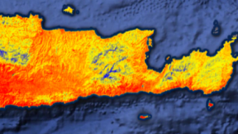
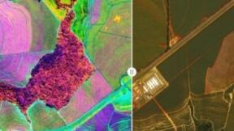
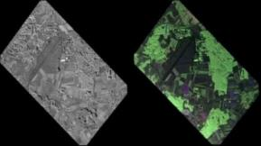
Copernicus Space Component @ Space19+
High Priority Candidate Missions
 | LSTM surface temperature | Evapotranspiration for agricultural applications, water management, etc. | Instrument: VIS/NIR/SWIR/TIR Res: <50m Revisit: 1-3 Days Start: 2027
 | Chime Hyperspectral mission | Resource use & management, e.g. Agriculture (nutrients, water, soil), mineral raw materials, etc | Instrument: Spectrometer, 400 - 2500nm Res: 30 m Revisit: 11,5 Days (2 Sats) Start: 2027/28
 | ROSE L L-Band SAR | Vegetation parameters (especially forest), soil movements, etc. | Instrument: L-Band SAR (voll polarisiert) Res: 50m² Revisit: every 6 days (2 Sats) Start: 2025/26

