Slide 1
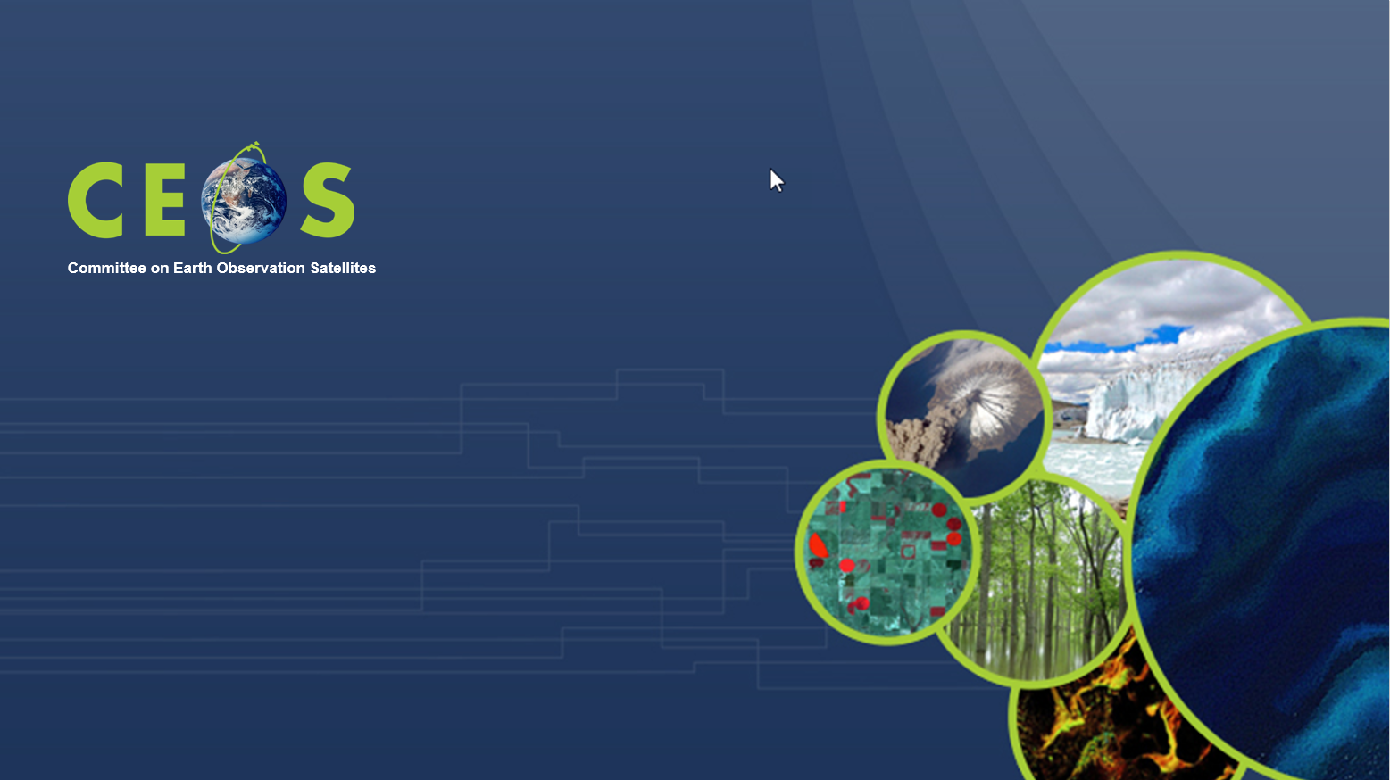
ESA contribution to EO data democracy: data access and availability, future perspectives
Session 4: Expanding our work on data democracy
ESA
Francesco Sarti, Amalia Castro Gomez
CEOS WGCapD-9 Annual Meeting
Sunnyvale, California
10-12 March 2020

Slide 2
ESA EO data have always been since the very beginning “free” and easily accessible for research and training purpose, also outside ESA MS, the only real restriction related to the amount of data (users had to submit a request, explaining the purpose of their request, the processing SW, etc.)
Nowadays, both EO data from Copernicus and from ESA are free and basically open, however the procedure for data access is not the same in the 2 cases:
COPERNICUS data: Sentinel data hub (plus a number of other servers), free and open to all users
ESA EO data access: most data are freely accessible, only a part needing a registration and/or project submission. Restrictions (in terms of quota and user types) apply on ESA TPM data (see next slide)
Notes:
Subject to case-by-case restrictions, TPM data may be distributed ALSO to users outside Europe

Slide 3

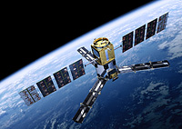
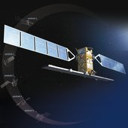

ESA EO data Access
Free datasets
Search/browse products openly.
Download after registration at https://earth.esa.int/web/guest/home
(EO-SSO account in My Earthnet), via On-The-Fly processing.
Immediate access to data
ERS & Envisat
Free datasets.
No registration needed for some. Others are accessible from ``
(EO-SSO account in My Earthnet)
Access is immediate
Earth Explorers
Free, full and open data policy.
Self registration at Copernicus Open Access Hub https://scihub.copernicus.eu/
Access is immediate data from last 12-18 months. Older data are available via Long Term Archive https://scihub.copernicus.eu/userguide/
Copernicus Sentinels
Registration needed at https://earth.esa.int/web/guest/home
(EO-SSO account in My Earthnet) and, depending on the TPM, immediate access, or after a few days, or after a few weeks (if project proposal needed for TPM restrained datasets)
Third Party Missions

Slide 4
Facilitating EO data user uptake:
Large number of face-to-face trainings (majority in Europe but not only)
Increasing number of ESA EO MOOCs (free and open to anybody), webinars (also via RUS)
Further development of free ESA EO toolboxes, and web-based tools for EO education (EOBrowser)
Intention to provide (limited) access to ESA TEP’s & Euro Data Cube for training and CB purposes, also outside Europe, via CEOS WG CapD

Slide 5
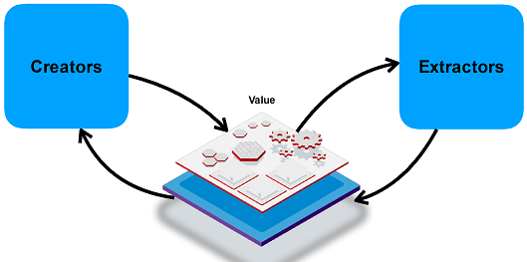
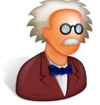









Platform Technology enables a new approach for training and for data access
TEPs:
From “PIPES” …
… PRODUCTS
(project-limited)
… to PLATFORMS
… SERVICES
(operationally sustained)
Notes:
Investment into the platform-based ecosystem has to lead industry from the traditional “pipe” approach – characterised by a hierarchical organisations of supply chains – into the next industrial revolution platform economy, where the platform enables a network-like interaction between all players, helping to dynamically establish the business links whenever an opportunity can be exploited.
What is common to most platforms is that they make connections between “creators” and “extractors” of value and the platform generates a profit from making these connections, either by taking a commission or advertising.
Implicitly this will lead to a transition from a “product”- to a “service”-based approach and from project-limited activities to operationally sustained environments

Slide 6






… of co-creation, co-engineering
Community
expertise
Scientists
Researchers
Algos
Sharing
Platform
Value
Adders
Tools
ICT
Data
Cloud
Providers
Data Owners
Software vendors
Notes:
Platforms implement a “sharing economy” attractive also for the young generation, allowing owners of partial assets to conveniently integrate their competence into a bigger overall picture. Europe needs to take leadership to develop adequate trust-, revenue- ad risk-sharing models to be the champion in this new EO economy. These models can help to provide services e.g. by SMEs at a cost level acceptable to the market, where the “Pipe” approach characterized by big operators could not arrive .
Science can take enormous profit in using these environments to advance the speed and dimension of scientifical results making full use of the co-creation and co-engineering capabilities of a shared platform.

Slide 7
Thematic Exploitation Platforms
Offer a tailored environment (data, algorithms, tools) for the specific community
Thematic expert advice on what can be done with what data
Hosting your algorithm on a scalable cloud environment, ready for operational use
Sharing your data with the community
Sharing your results with the community
Sponsored use available via Network of Resources “nor.cloudeo.store”
Notes:
Blog offers thematic expert advice
Algorithms, data, results may be shared (totally or partially or not at all; EC recommendations for sharing)

Slide 8



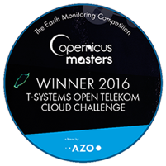

Euro Data Cube Introduction
Data Access via European Data Cube
Euro Data Cube Consortium
Notes:
Not created / developed by ESA, but pre-existing

Slide 9
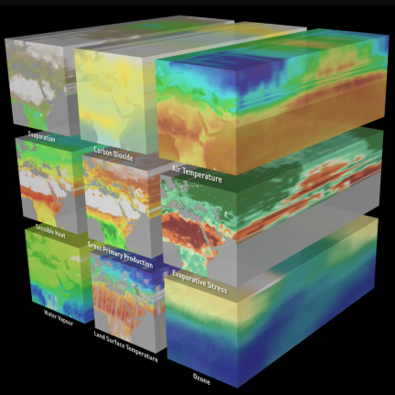
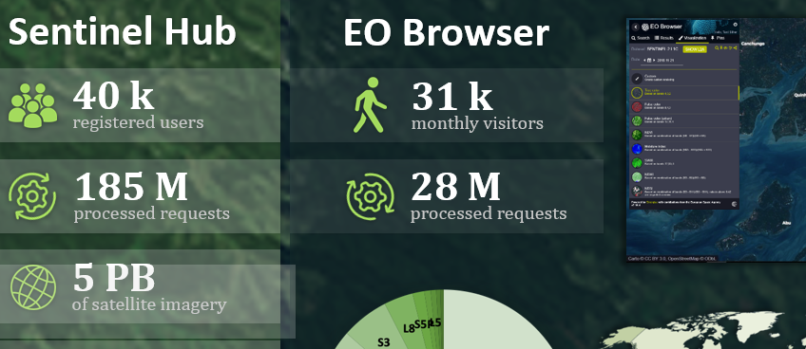




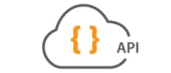























GeoDB
Algorithms
Apps
on-the-fly &
batch processing
multi-temporal
analysis (xarray)
vector data
service
hosted app engine
jupyter Notebooks
DATA
SERVICES
Access to full archives
Analysis Ready Data
Data
CLOUD
EO commercial
in-situ sensor
GIS data
Thematic
data
03/08/2020
Notes:
DATA (bottom line): Copernicus, Landsat (USGS), in-situ & GIS, thematic info
Data services: Sentinel data Hub (and EOBrowser), X-cube, etc
Interfaces: Python, OGC
Cloud facilities: CREODIAS etc.
The Open Geospatial Consortium (OGC) is an international consortium driven to make geospatial information and services FAIR - Findable, Accessible, Interoperable, and Reusable.
General concept of the Euro Data Cube:
-works with large volumes of data, which are hosted on various clouds (DIAS et al)
-Euro Data Cube is on top of the cloud infrastructure, providing services for data processing (on-the-fly processing, batch processing, multi-temporal analysis, vector data service. Very important fact being is that it provides access to _complete_ data archives – Sentinel-1,-2,-3,5p, Landsat, MODIS, etc.
-Euro Data Cube also offers hosted app execution and Jupyter Notebooks for data scientists
-users can contribute their algorithms, applications and data
-the data can be served via standard APIs, including OGC standard one

Slide 10

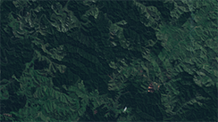

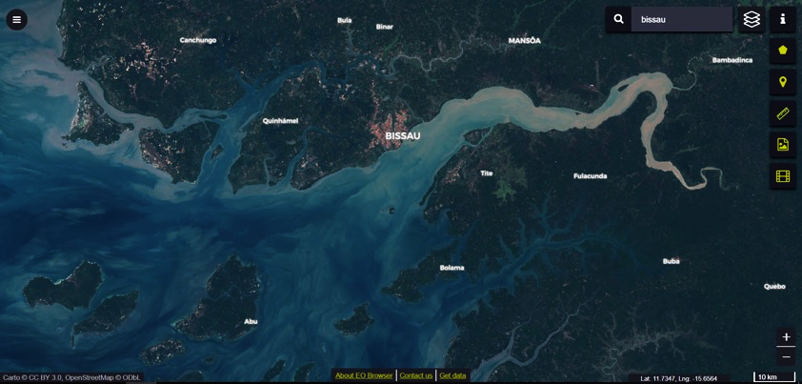
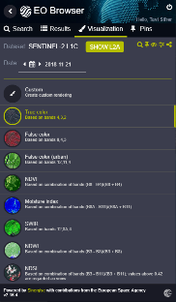




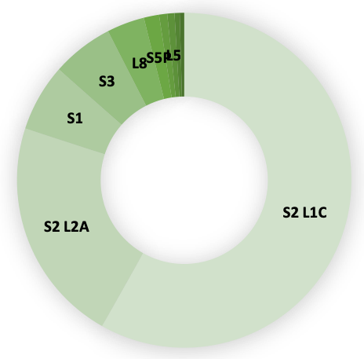
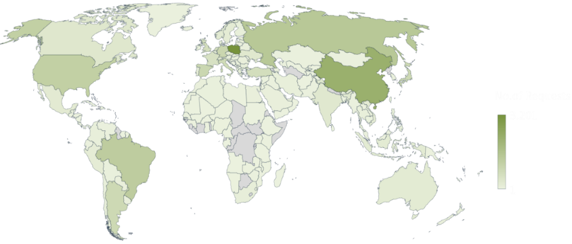

Statistics – April 2019
Sentinel Hub
EO Browser
40 k
registered users
31 k
monthly visitors
185 M
processed requests
28 M
processed requests
5 PB
of satellite imagery
Open-source and free to use
300 TB
added every month
4 Sentinel missions
3 Landsat missions
MODIS
Envisat
Visitors from 159 countries
Notes:
Left column: monthly statistics of Sen Hub

Slide 11
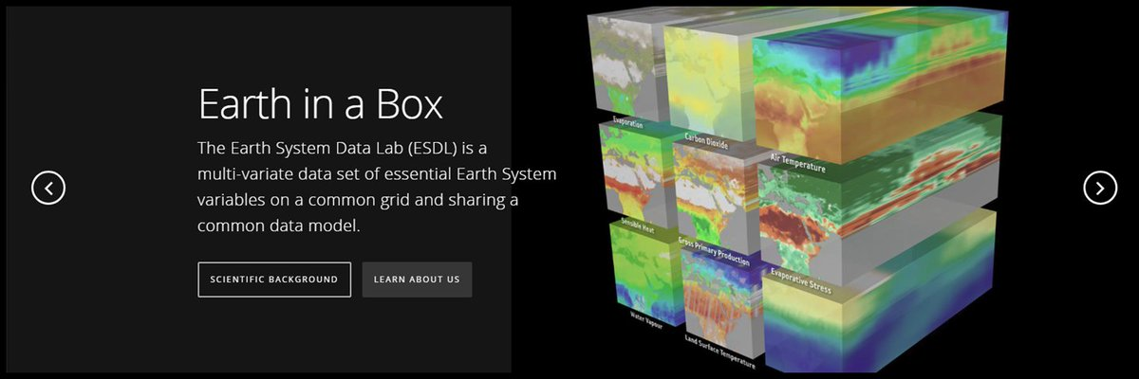
One particular array for multi-temporal scientific analysis (xcube) is the Earth System datalab:
www.earthsystemdatalab.net
https://www.youtube.com/watch?v=9L4-fq48Ev0
Notes:
The Earth System Data Lab (ESDL) seeks to be a service to the scientific community to greatly facilitate access and exploitation of multivariate data sets in Earth Sciences.

Slide 12
Perspectives on future ESA and Copernicus
EO data:

Slide 13

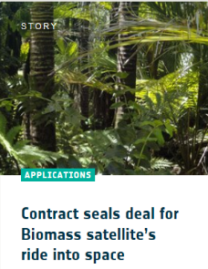
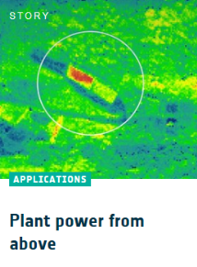
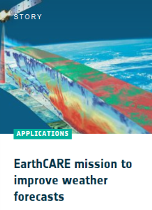
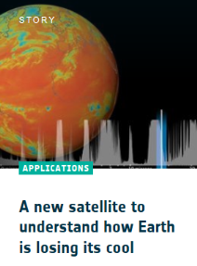
Block 2 – Research Missions
Earth Explorers to be launched
Biomass (2022),
Earth Care (2022),
Flex (2024)
Notes:
EarthCare extends our knowledge of aerosols and clouds with a “high-sophisticated” instrumentation (LIDAR [ATLID], multi-spectral [MSI], radiometer [BBR], cloud radar [CPR: JAXA])
Biomass takes up the budget of biomass - especially in the tropics and gives us a level of knowledge with an accuracy of up to ~ 15-20%
With Flex, the fluorescence of the vegetation stress of plants from space is determined for the first time
FORUM as just been selected and fills the gap in atmospheric measurement in the long-wave IR spectral range. As a result, the radiation budget of the earth can be determined with much higher accuracy and an essential prerequisite for better climate predictions can be met. The mission also provides valuable information about water vapor and the water cycle in the climate.

Slide 14

The BIOMASS mission
All the scientific BIOMASS products will be free and open.
For the first time, the source code of the all the scientific processors will be free and open.
Current time frame and data availability:
  2005: A P-band SAR payload was proposed to provide the spatial distribution and dynamics of forest biomass.
  2013: Biomass selected to become the 7th ESA Earth Explorer Mission.
  End of 2022: Expected launch.
  Mid-2023: First data (L1) available.
  End-2024: Global biophysical measurements (AGB, FH, FD) available.
Notes:
L1a: SLC
L1b: GRD: Ground Detected
L2 (local) / L3 (global):
AGB: Above Ground Biomass
FH: Forest Height
FD: Forest Disturbance

Slide 15

New model for working with EO data: The Biomass Mission Algorithm and Analysis Platform
An innovative operations concept: users access a work environment containing the data and resources required, as opposed to downloading and replicating the data ‘at home’.
→ a scenario for data intensive exploitation gradually complementing the traditional operations concept for the ground segment
Exploitation Platform
EO
software
ICT
resources
EO data
non-EO data
Exploitation platform
=
Virtual open and collaborative environment
bringing together:
Data storage (EO and non-EO data)
Computing and network resources, hosted processing
Concurrent design and test bench functions
Collaborative tools (processing tools, user toolboxes, …)
Communication tools (social network) and documentation
Community
Collaboration
Notes:
For BIOMASS we plan a new way to make available the data. All data will be available in a cloud and be a accessible through a platform which will include data processing capacities, access to auxilliary data (ground data, lidar data).
The aim is to build a community that works on Biomass together. At the moment there is also the vision for a joint ESA NASA platform including the data fro GEDI and NISAR.

Slide 16





Unified user access to the functions of a joint ESA/NASA MAAP
Joint Mission Algorithm and Analysis Platform model
Approved during bilateral ESA-NASA meeting!
MAAP
Joint access to data and algorithms
Data and computing
Data and computing
Up to date data and algorithms + Collaborative community

Slide 17

3 innovative missions, 1 goal
NASA mission
space-borne LIDAR on ISS
Vertical structure of Earth's tropical and temperate forests
Launched in December 2018
NASA-ISRO mission
L- spaceborne SAR
Ecosystem disturbances, ice-sheet collapse, and natural hazards such as earthquakes, tsunamis, volcanoes and landslides.
Launch planned in 2022
ESA mission
First fully polarimetric P-band SAR in Space
Global maps of forest biomass and forest height
Launch planned in 2022
Notes:
3 innovative instruments

Slide 18
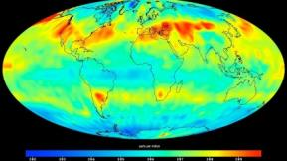
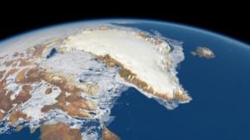
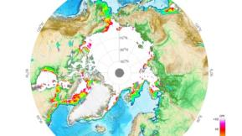
Copernicus Space Component @ Space19+
“High Priority Candidate Missions”
 | CO2M CO₂ Imaging spectrometer | Monitoring of anthropogenic CO2 emissions at regional and local level (cities / industrial plants) | Instrument: Spectrometer, Cloud Imager, Multi-angle Polarimeter resolution: ca. 2x2 km² revisit 3 days @ 40°N Start: 2025/26
 | PICE/CRISTAL polar Ice & snow topography | Monitoring sea ice concentrations in the Arctic | Instrument: Radar-Altimeter, Radiom. resolution: 20m revisit: 365 days (with 1 Satellit) Start: 2026/27
 | CIMR Passive microwave | Measures the thickness of ice sheets and sea ice as well as snow depths for climate change applications | Instrument: Microwave-Radiometer resolution: 5km Seaice, 15km SST revisit: < daily Start: 2028

Slide 19
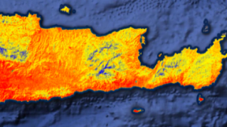
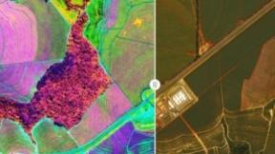
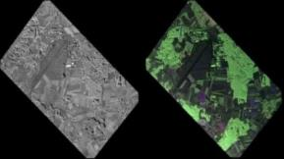
Copernicus Space Component @ Space19+
High Priority Candidate Missions
 | LSTM surface temperature | Evapotranspiration for agricultural applications, water management, etc. | Instrument: VIS/NIR/SWIR/TIR Res: <50m Revisit: 1-3 Days Start: 2027
 | Chime Hyperspectral mission | Resource use & management, e.g. Agriculture (nutrients, water, soil), mineral raw materials, etc | Instrument: Spectrometer, 400 - 2500nm Res: 30 m Revisit: 11,5 Days (2 Sats) Start: 2027/28
 | ROSE L L-Band SAR | Vegetation parameters (especially forest), soil movements, etc. | Instrument: L-Band SAR (voll polarisiert) Res: 50m² Revisit: every 6 days (2 Sats) Start: 2025/26

