Slide 1
SEO Overview on Data Democracy Initiatives
Session 4: Expanding our work on data democracy
NASA, CEOS SEO
Brian Killough
CEOS WGCapD-9 Annual Meeting
Virtual Meeting
10-12 March 2020

Slide 2
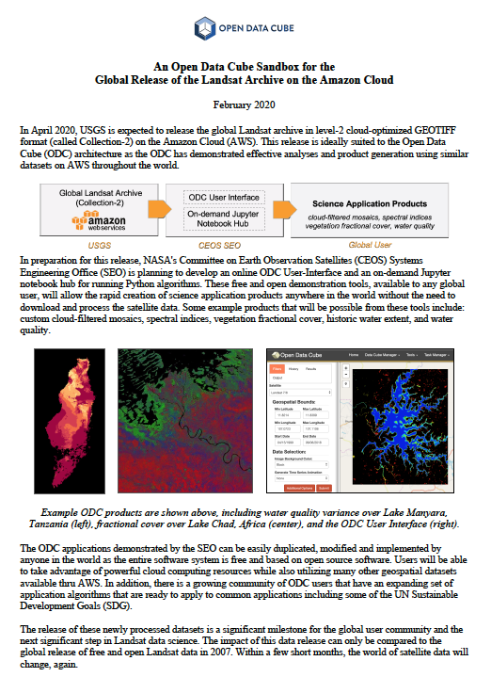
Data Democracy Update
The CEOS SEO maintains a database of CEOS data policies in relation to missions and instruments. This database is not well known, but represents the most comprehensive summary of CEOS data policies and data democracy. It is updated annually.
https://ceos-cove.org/en/data_policy/
60 CEOS Agencies, 32 countries, 164 active missions, 65% free/open (unrestricted) data
The CEOS SEO is working on a new initiative (not part of the current WGCapD plan) to create an online cloud-based “Data Cube Sandbox” tool based on the Landsat Collection-2 release.
This will allow users to rapidly run analyses anywhere in the world and demonstrate the power of Landsat data for various applications.
This creates a new opportunity for webinars and tutorials and may be linked to the CB-45 task (Jupyter Notebooks Webinar)

Slide 3
How data is making a difference
More recent CEOS mission launches have added a large amount of new free/open data to the user community.
30 new missions in 2018
15 new missions in 2019
~40 possible new missions in 2020
The impact of this new data is rather significant and the need for capacity building is increasing.
The new Digital Earth Africa initiative will use most of its $30M of funds for capacity building. This region will be a focus for many CB initiatives in the coming years. The CB-65 deliverable is linked to this activity.
The new release of Landsat Collection-2 data is another example of a new data release that could have capacity building implications. This is one of the most-used datasets in the world and now it will be on the Amazon Cloud.
WGCapD may want to include the DE-Africa training events in its new database and calendar (CB-21). Contact Adam Lewis (GA) for more information.

Slide 4
Learning from challenges
As we annually update the list of active CEOS missions, it is often very difficult to get the status of decommissioned missions. This is typically the most challenging for missions from China, Russia and other smaller CEOS Agencies.
For example, we are uncertain about the status of 33 of our 164 active missions.
We will continue to work this issue, but we are not sure there are any good solutions
Another challenge ... though we have lots of new free/open data, it is often NOT easy to access and is often regionally limited. For example, how can we get China and Russia data into ARD format and on easily accessible cloud frameworks? Downloading data is no longer a good option for the future.

Slide 5
Key takeaways and lessons learned
Lesson Learned ... the world is moving to cloud computing and downloading data is no longer the preferred way to get data.
My opinion ... we need more training and capacity building for tools and services related to using cloud computing and new technologies (e.g. data cubes)

Slide 6
Opportunities for WGCapD
Recommendations ... consider new webinars, training, and tutorials related to promotion and use of new CEOS datasets. Can we take advantage of cloud computing, the COVE tool (CB-43), Jupyter notebooks (CB-45)?
There are opportunities surrounding the SDGs. We have a current task (CB-42) on this topic, led by NASA, and focused on 11.3.1 (urbanization).
There are opportunities to focus on datasets beyond NASA (MODIS, Landsat), NOAA (oceans, atmosphere) and ESA/EC (Sentinels). For example, can we think about ways to get China, Russia and India data more easily accessible for the broader user community? Again, downloading and processing data are NOT valid solutions.

