Slide 1
ESA partnership with China for advanced scientific EO training-DRAGON Programme
Session 3: Regional Spotlight: Asia-Oceania
ESA
Francesco Sarti / Amalia Castro Gomez
CEOS WGCapD-9 Annual Meeting
Sunnyvale, California
10-12 March 2020

Slide 2
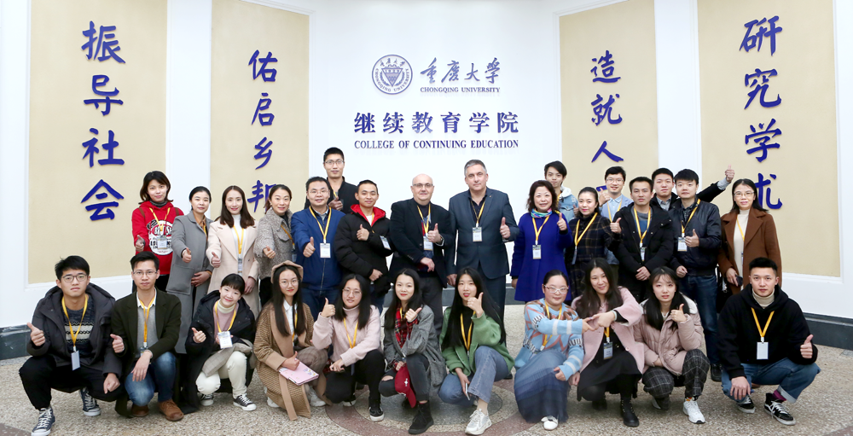
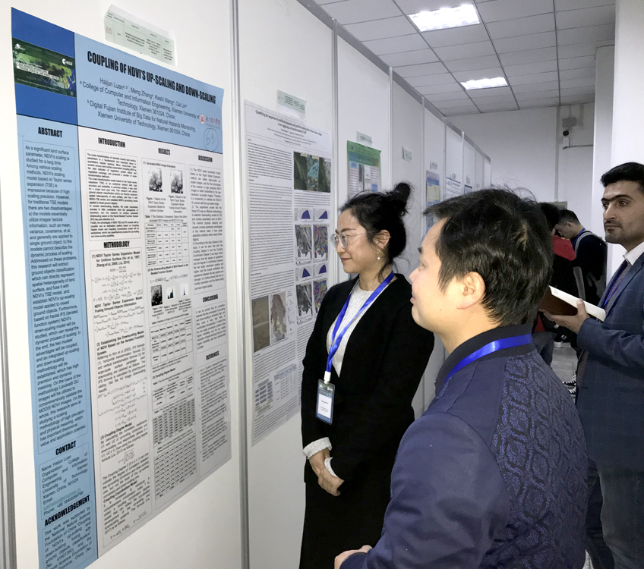
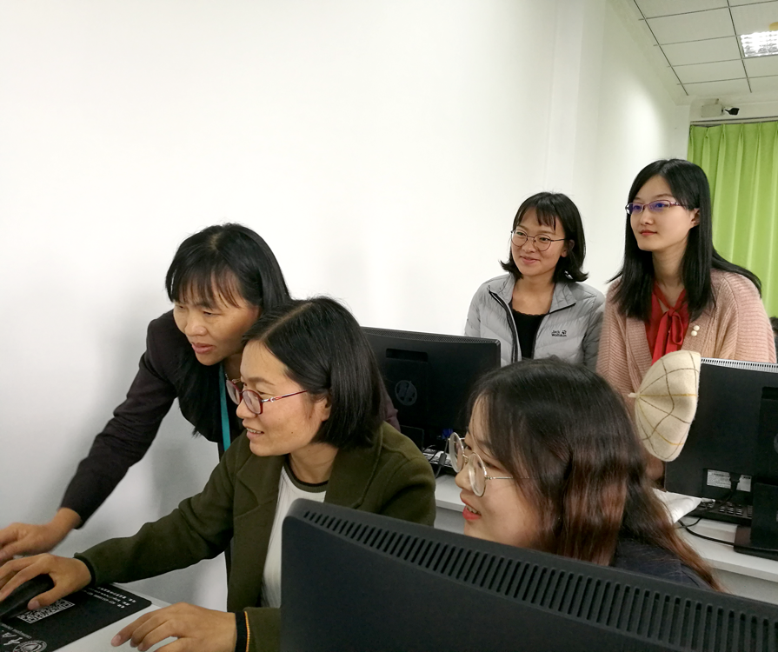
Dragon Advanced Training Courses
Objective: To train the next generation of researchers in land, ocean, atmospheric, geodetic, cryosphere and climate applications.
Since 2004, 16 training courses have been successfully held:
land (8),
terrestrial water & cycle (1),
ocean (4)
atmosphere (3)
Up to 2019, 1181 young scientists trained, with courses taught by leading Dragon scientists with hands on EO data processing using ESA open source toolboxes

Slide 3
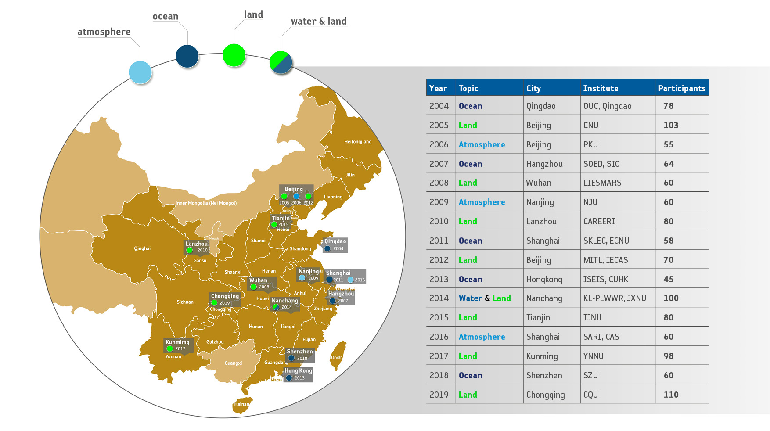
Locations of Dragon Training Courses in China
1181 young scientists trained

