Slide 1
Progress on the Space Capacity Development Advisory Board (SCDAB)
Session 4: Spotlight on Partnerships
NASA
Dr. Nancy D. Searby on behalf to SCDAB Organizing Group
CEOS WGCapD-9 Annual Meeting
Sunnyvale, California
10-12 March 2020

Slide 2
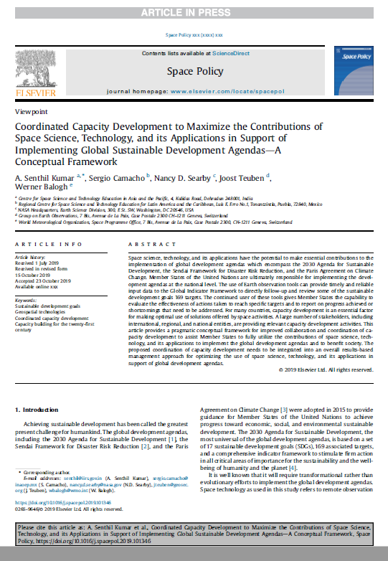
SCDAB Overview
Origin:
Grew from discussions within WGCapD
WGCapD prepared and presented a white paper at SIT-34 (deliverable CB-37)
Followed by a peer-reviewed publication (Space Policy) with input from CEOS, GEO, WMO and others
Objectives:
Improved collaboration and coordination of capacity building/development across the various networks
Fully utilize the contributions of space science, technology, and its applications to implement the global development agendas and benefit society
Share capacity building good practices and methods and guidance to strengthen skills to use EO to meet SDG goals and to report on them
Framework:
4 aspects – harmonizing, planning, executing, and delivering
https://www.sciencedirect.com/science/article/pii/S0265964619300761

Slide 3
Framework for Coordinated Capacity Development
Harmonizing
Planning
Executing
Delivering
Global
Organisations
UNOOSA,
UNESCAP,
CEOS, GEO,
CGMS, WMO,
…
In-person & blended
Long & short term: in-shore,
off-shore,
caravan, …
Webinars
MOOC
Tutorials/ Symposia/ Theme based Seminars
Setting up SCDAB
Region Specific CD & CB Coordination
Core Technical on EO-SDGs
Research & Knowledge Sharing
Inter- governmental planning, regional practices
Resources Sharing, Management
Regional Partners
UN affiliated Regional Centres
Regional
Partners:
e.g. AOGEO,
APRSAF,
ASEAN,
SAARC DMC,
Space agencies.
INGOs …
Professional
Societies:
National,
Regional,
International
Recognized Capacity Development Institutions

Slide 4
SCDAB Activities To Date
WGCapD deliverable CB-37 completed (Q2 2019)
Peer-reviewed publication in Space Policy – posted in 2019, formerly published in Feb 2020
Currently working in the harmonizing and planning phases
Defining the focus of the SCDAB
Identifying SDGs to focus on
SDG 11 Sustainable Cities and Communities, or
SDG 2 Zero Hunger, or
SDG 5 Gender Equality with SDG 4 Education Equality, or
SDG 7 Equitable Energy Access (ties to ISRO Chair initiative)
Identifying potential SCDAB members

Slide 5
Opportunities for WGCapD
What is your agency doing to build capacity to use EO in these SDGs?
SDG 11 Sustainable Cities and Communities, or
SDG 2 Zero Hunger, or
SDG 5 Gender Equality with SDG 4 Education Equality, or
SDG 7 Equitable Energy Access (ties to ISRO Chair initiative)
Who is doing it? For whom (target audience) – global, regional, national? What methodology? Working with which global or regional organizations, or professional societies?
What gaps do you know about?
What capacity development networks should be contacted to nominate managerial and technical experts as points of contact who have extensive experience in capacity development programs for different regions?

