Slide 1
Tools to enable UN Member States at national and local level to use EO to help deliver SDG 11 and the NUA
Session 4: Spotlight on Partnerships
NASA
Dr. Argyro Kavvada
CEOS WGCapD-9 Annual Meeting
Sunnyvale, California
10-12 March 2020

Slide 2
Partnering with UN Habitat
EO integration in global methodologies
testing, piloting
Tools dissemination, practical guidance on EO uses in support of sustainable urbanization
SDG 11/ NUA EO Toolkit & Coordinated Capacity Development
End-user needs assessment, opportunities for collaboration
Collaboration support to countries/ cities for monitoring & to inform decisions
Exploring and testing usability of emerging EO data/products for local and global monitoring

Slide 3
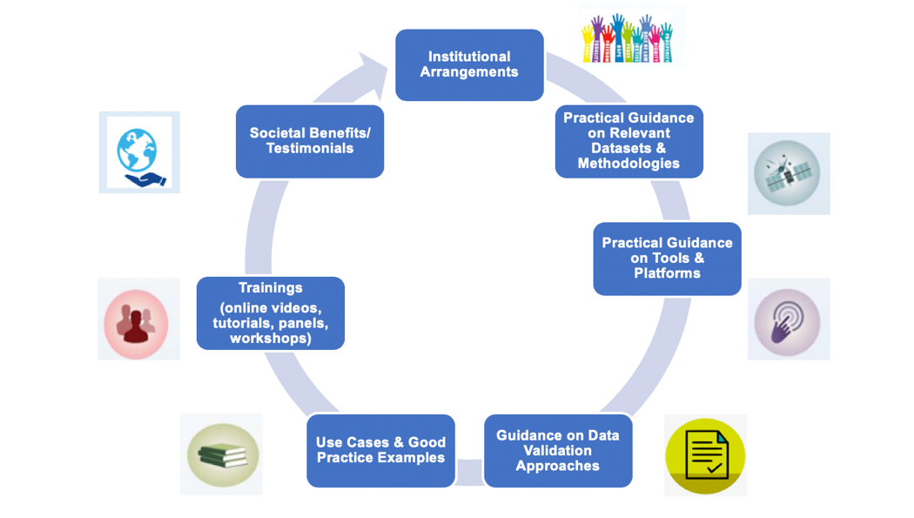
GEO SDG EO Toolkits

Slide 4
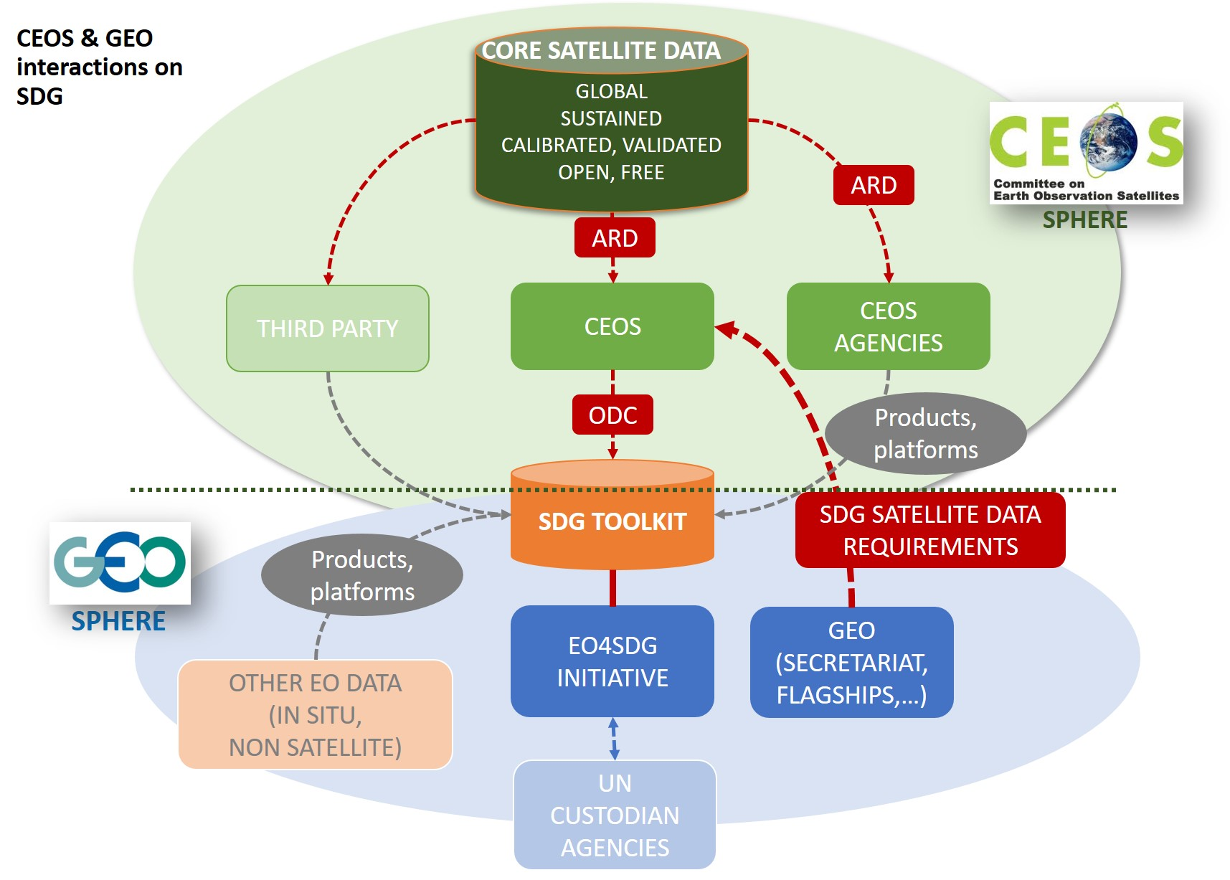
CEOS Contributions
Main AHT SDG Deliverables
ARD products in support of 11.3.1, Land Use Efficiency (and two other indicators, 15.3.1, 6.6.1)
Open Data Cube examples to support 11.3.1 (and 15.3.1, 6.6.1)
Key Milestones
Define (and communicate) CEOS core missions supporting the 3 indicators
Where to find the data and ARD status
Collect and list CEOS agencies products that support the 3 SDG indicators
A single simple template will be developed to provide to GEO SEC/ GEO thematic initiatives to help connect data needs to requirements
Draft

Slide 5
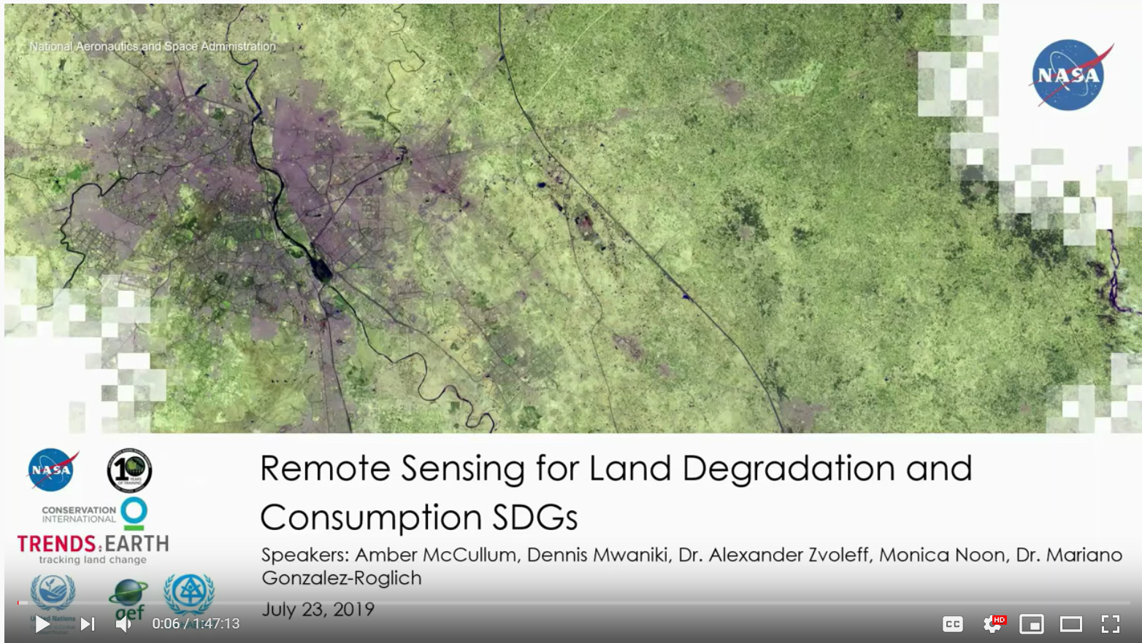
Benefits of Partnership & Lessons Learned
Benefits of partnership with UN Habitat:
EO integration in global SDG indicator methodologies
Pilots for EO-informed indicators (land use efficiency (11.3.1), open shared space in cities (11.7.1), access to public transport (11.2.1))
Global & regional workshops on methods, tools development & dissemination
Country level trainings (virtual, in person) — e.g., NASA ARSET, CI, UN Habitat webinar on 11.3.1 & 15.3.1
Lessons Learned
Better coordination of EO activities
Need for more coordinated capacity development &
practical guidance on EO uses with SDGs
Focus on municipality/city level
Beyond SDG indicators
Need for common voice & guidance
Notes:
What was the value-added for capacity building? How did partnership enable greater gains, in terms of, for example: the methodology, the geographic reach of the activities, data availability, the application and/or dissemination of technology, efficient use of resources, etc.?
How did partners benefit from working together? How did target audiences benefit?
What were key factors for successful partnership?

Slide 6
Opportunities for WGCapD
Support enhanced coordination of EO activities on specific SDG themes such as urban SDG (e.g., via SCDAB)
Help showcase method applicability across regions (e.g., regional workshops)
Enhance awareness on CEOS core missions, associated data products (and ARD status), tools that can inform SDG targets/ indicators (e.g., via webinars)
Support GEO SDG EO Toolkits activity to provide customizable, iterative guidance on tools, good practices, information products, contributory project results, training material etc.
Notes:
Guidance: Use this slide to identify key messages for WGCapD. For example:
What are your recommendations for how WGCapD can build on or leverage this work?
Should WGCapD play a greater role in facilitating or supporting partnerships?
Can the positive outcomes be scaled or replicated elsewhere?
Feel free to provide any other feedback relevant to the working group.

Slide 7
Thank you!
Argyro.Kavvada@nasa.gov
@EO4SDG
Session 4: Spotlight on Partnerships
NASA
Argyro Kavvada, Ph.D.
CEOS WGCapD-9 Annual Meeting
Sunnyvale, California
10-12 March 2020

