Slide 1
ESA partnerships for EO Education, training and CB
Session 2: Spotlight on Partnerships
ESA
Francesco Sarti, Amalia Castro Gomez
CEOS WGCapD-9 Annual Meeting
Sunnyvale, California
10-12 March 2020

Slide 2
ESA Partnerships in Europe for secondary school education
Long-term cooperation with EGU/GIFT (European Geosciences Union – Geosciences Information for Teachers). Workshops for Secondary School teachers selected worldwide.
Enlarged since 2016 to Africa and South America.
Cooperation with DLR and other space agencies in Europe to create joint school labs associated to large scientific events
Cooperation other space agencies in Europe to create European Space Education Resource Offices in ESA MS

Slide 3
ESA Partnership with the European Commission for Sentinel data training using VM (part of R.U.S.)
Sentinel data processing with VM & training within R.U.S. (Research and User Support for Sentinel Products / Service operation – with focus on “training the trainers”). Face-to-face trainings and webinars.
Priority: Europe

Slide 4
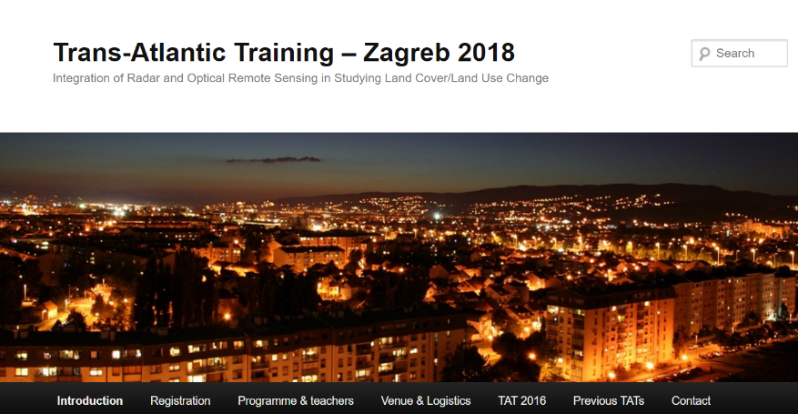
Long-term NASA / ESA Trans-Atlantic cooperation in EO Training (TAT courses), related to LCLUC
ESA Partnership with NASA
EO Training courses in Europe
Earth Observation of Land Cover/Land Use Change in the Era of Big Data
NASA recently expanding this series of training courses outside Europe (ASIA) – good candidate for CEOS WGCapD cooperation in CB

Slide 5
Unified user access to the functions of a joint ESA/NASA MAAP
Joint Mission Algorithm and Analysis Platform model
Approved during recent bilateral ESA-NASA meeting!
MAAP
Joint access to data and algorithms
Data and computing
Data and computing
This platform might be also used by WGCapD for training purposes
Up to date data and algorithms + Collaborative community

Slide 6
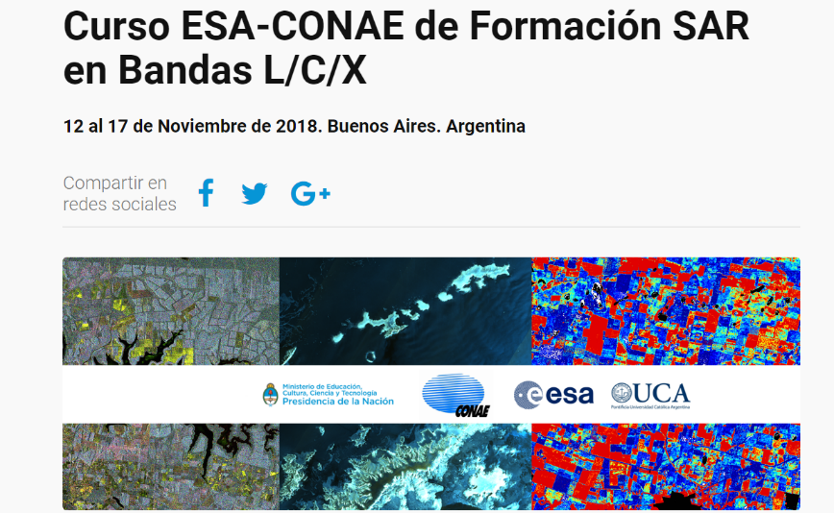
ESA Partnership with CONAE
EO Training courses worldwide
Long series of joint EO Training Courses in Argentina and Latin America, started in the 90’s with ERS data exploitation
INGESTION of SAOCOM DATA into ESA TOOLBOXES: SNAP, POLSARPRO

Slide 7
ESA Partnership with Associations of Remote Sensing experts and laboratories: Europe (EARSEL) and Latin America (SELPER)
now a CEOS WG CapD training course

Slide 8
ESA international cooperation for CB in Africa and for scientific EO training in China
See dedicated sessions/presentations (Asia, Africa)

Slide 9
ESA Partnership with World Bank and Asian Development Bank
“Space in support of International Development Aid/Cooperation” (Space for IDA)
Stephen Coulson, Chris Aubrecht (WB), Paolo Manunta (ADB)
Directorate of Earth Observation Programmes
European Space Agency (ESA/ESRIN)

Slide 10
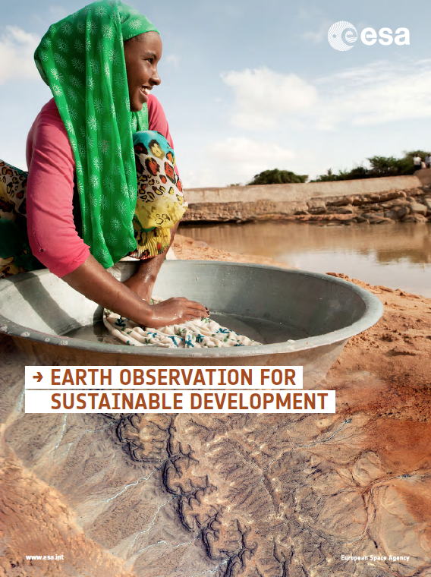
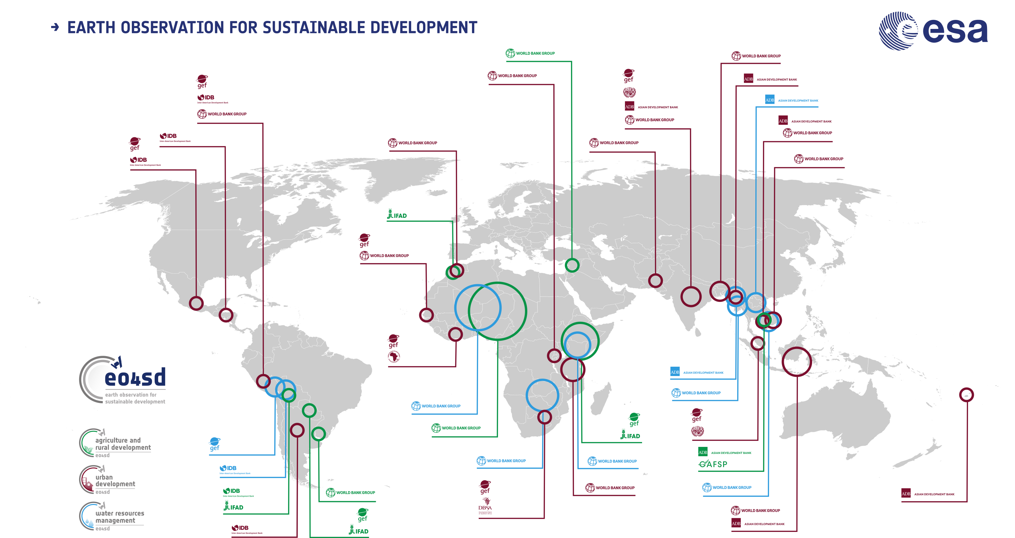
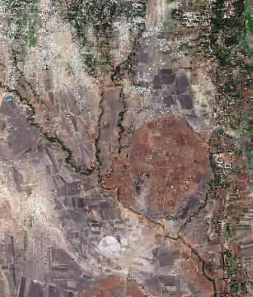
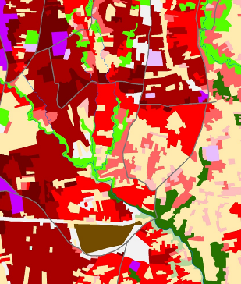
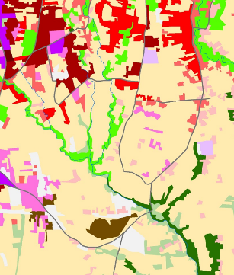
Earth Observation (EO) for Sustainable Development (eo4sd.esa.int)
2016: Agriculture, Urban Development, Water Resources,
2018: Marine & Coastal, Disaster Risk Reduction, Climate Resilience…..
2020: Forestry
Arusha, Tanzania

Slide 11
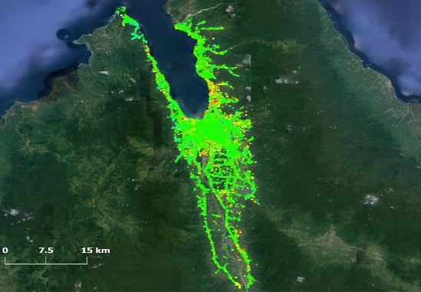
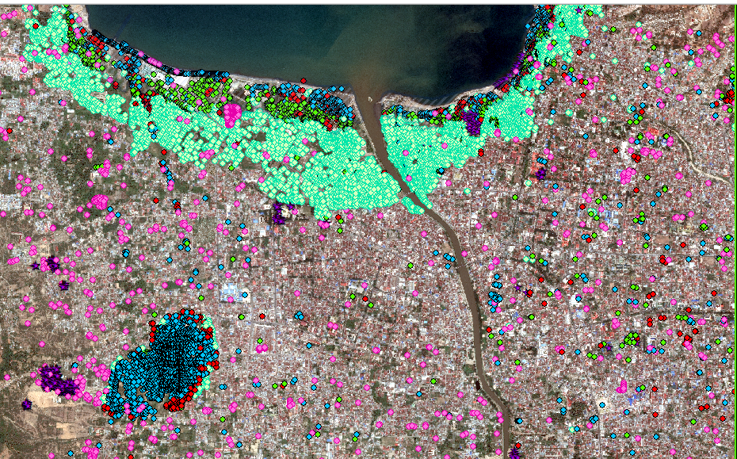
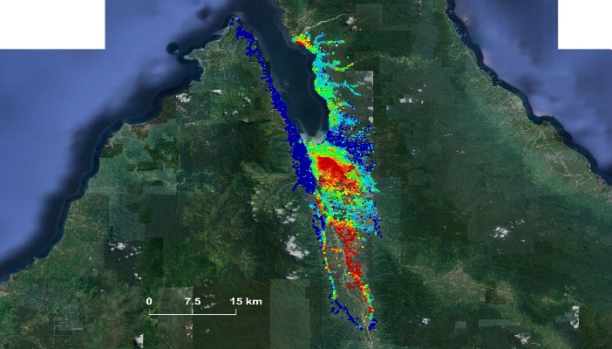
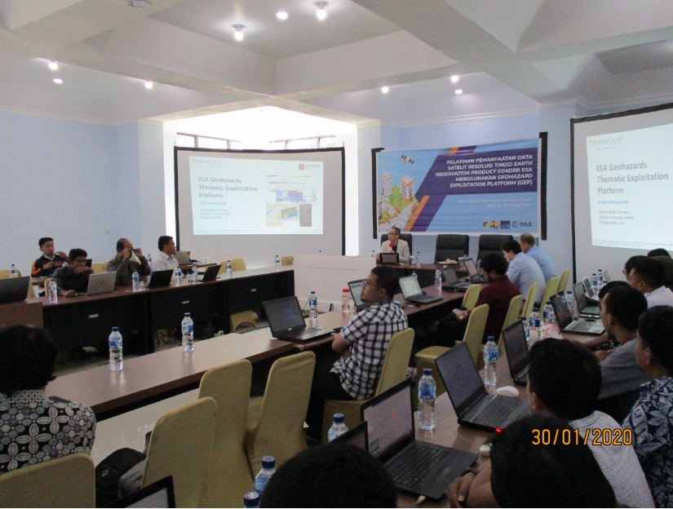
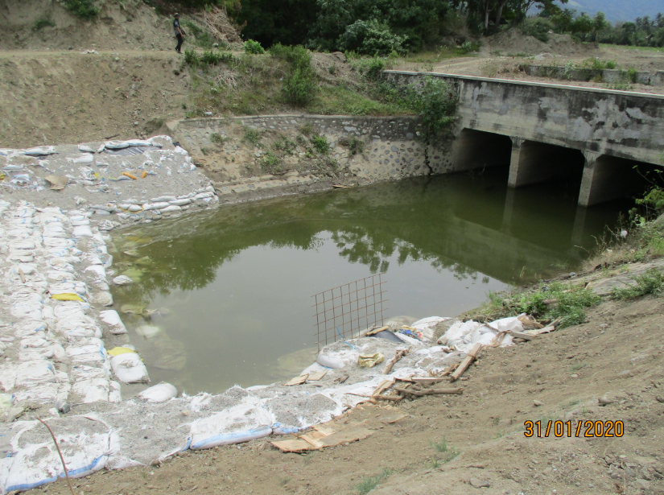
E04SD Capacity Building Example : RECONSTRUCION IN CENTRAL SULAWESI, INDONESIA
ESA has supported ADB and Gov. Indonesia for the rehabilitation and reconstruction in Central Sulawesi with EO services and capacity building (Jan. 2020)
Terrain deformation analysis (pre and post event)
Reconstruction monitoring (1 year after the event)
Objectives: Facilitating SD Worldwide
Strategy:
Provide Longer-Term Vision
Transfer environmental information from satellites into Development Assistance (operations, activities & financing)
Benefits:
improving
efficiencies of existing operations/activities
decision-making for future activities (planning, policy-making)
capabilities (e.g. assessing Climate & Disaster resilience)
-
0
+15 mm/year
-15 mm/year
-
0
-15 mm/year
+15 mm/year
Capacity building & skill transfer (i.e. GEP training)
Field visit & EO service validation
CAPACITY BUILDING TRAINING SESSIONS IN INDONESIA

