Slide 1
EO Data Innovation Challenge
Session 1: Spotlight on innovation
SANSA
Daniel A. Matsapola
CEOS WGCapD-9 Annual Meeting
Sunnyvale, California
10-12 March 2020

Slide 2
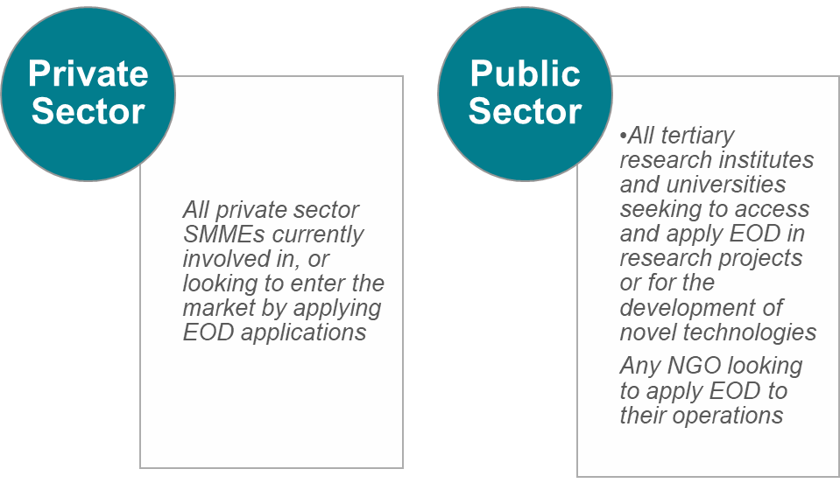


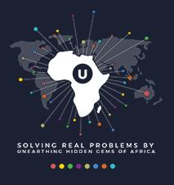


Current activities
Earth Observation Data Innovation Challenge for increased use of Earth Observation Data to develop innovative applications. Targeting private and public sector.
How can innovative technology applications for multi-sensor satellite data be used to advance societal and commercial competitiveness the South African mining industry?

Slide 3
Notable outcomes
In its 5th year running in 2019:
  +100 companies in 5 years reached
  Access to data is guaranteed for participants. Innovations take time to emerge due to lack of business conversion skills.
  Have you seen these capacities being applied? Still in the early stages of application.
  Key success factors: Securing the business support partners for the participants with prospects of securing business incubation, vendor finance etc.
  The EO DIC can be scaled to other African countries but the right mix of technical and business skills is required to create sustainable value proposition.

Slide 4
Challenges – and the path to overcoming them
Solving one problem created another one.
  Use this slide to identify immediate and long-term obstacles, barriers or risks to your activities, and how you have tried to address them. The immediate challenge is that people who respond to the EO Data Innovation Challenge are remote sensing professionals who understand remote sensing but don’t have business skills to start and run a business.
  Our short-term solution was to get them business support services built into the challenge partners but this doesn’t guarantee success.
  Recommended solution: build entrepreneurship into capacity building efforts in Earth Observation.
  Automated processes will make it easier for entrepreneurs with no Earth Observation technical background to create sustainable business value.
  Training people in Earth Observation for the job market is unsustainable and violates Sustainable Development principles. It creates dependency on employment being available. The 4IR is challenging this model.

Slide 5

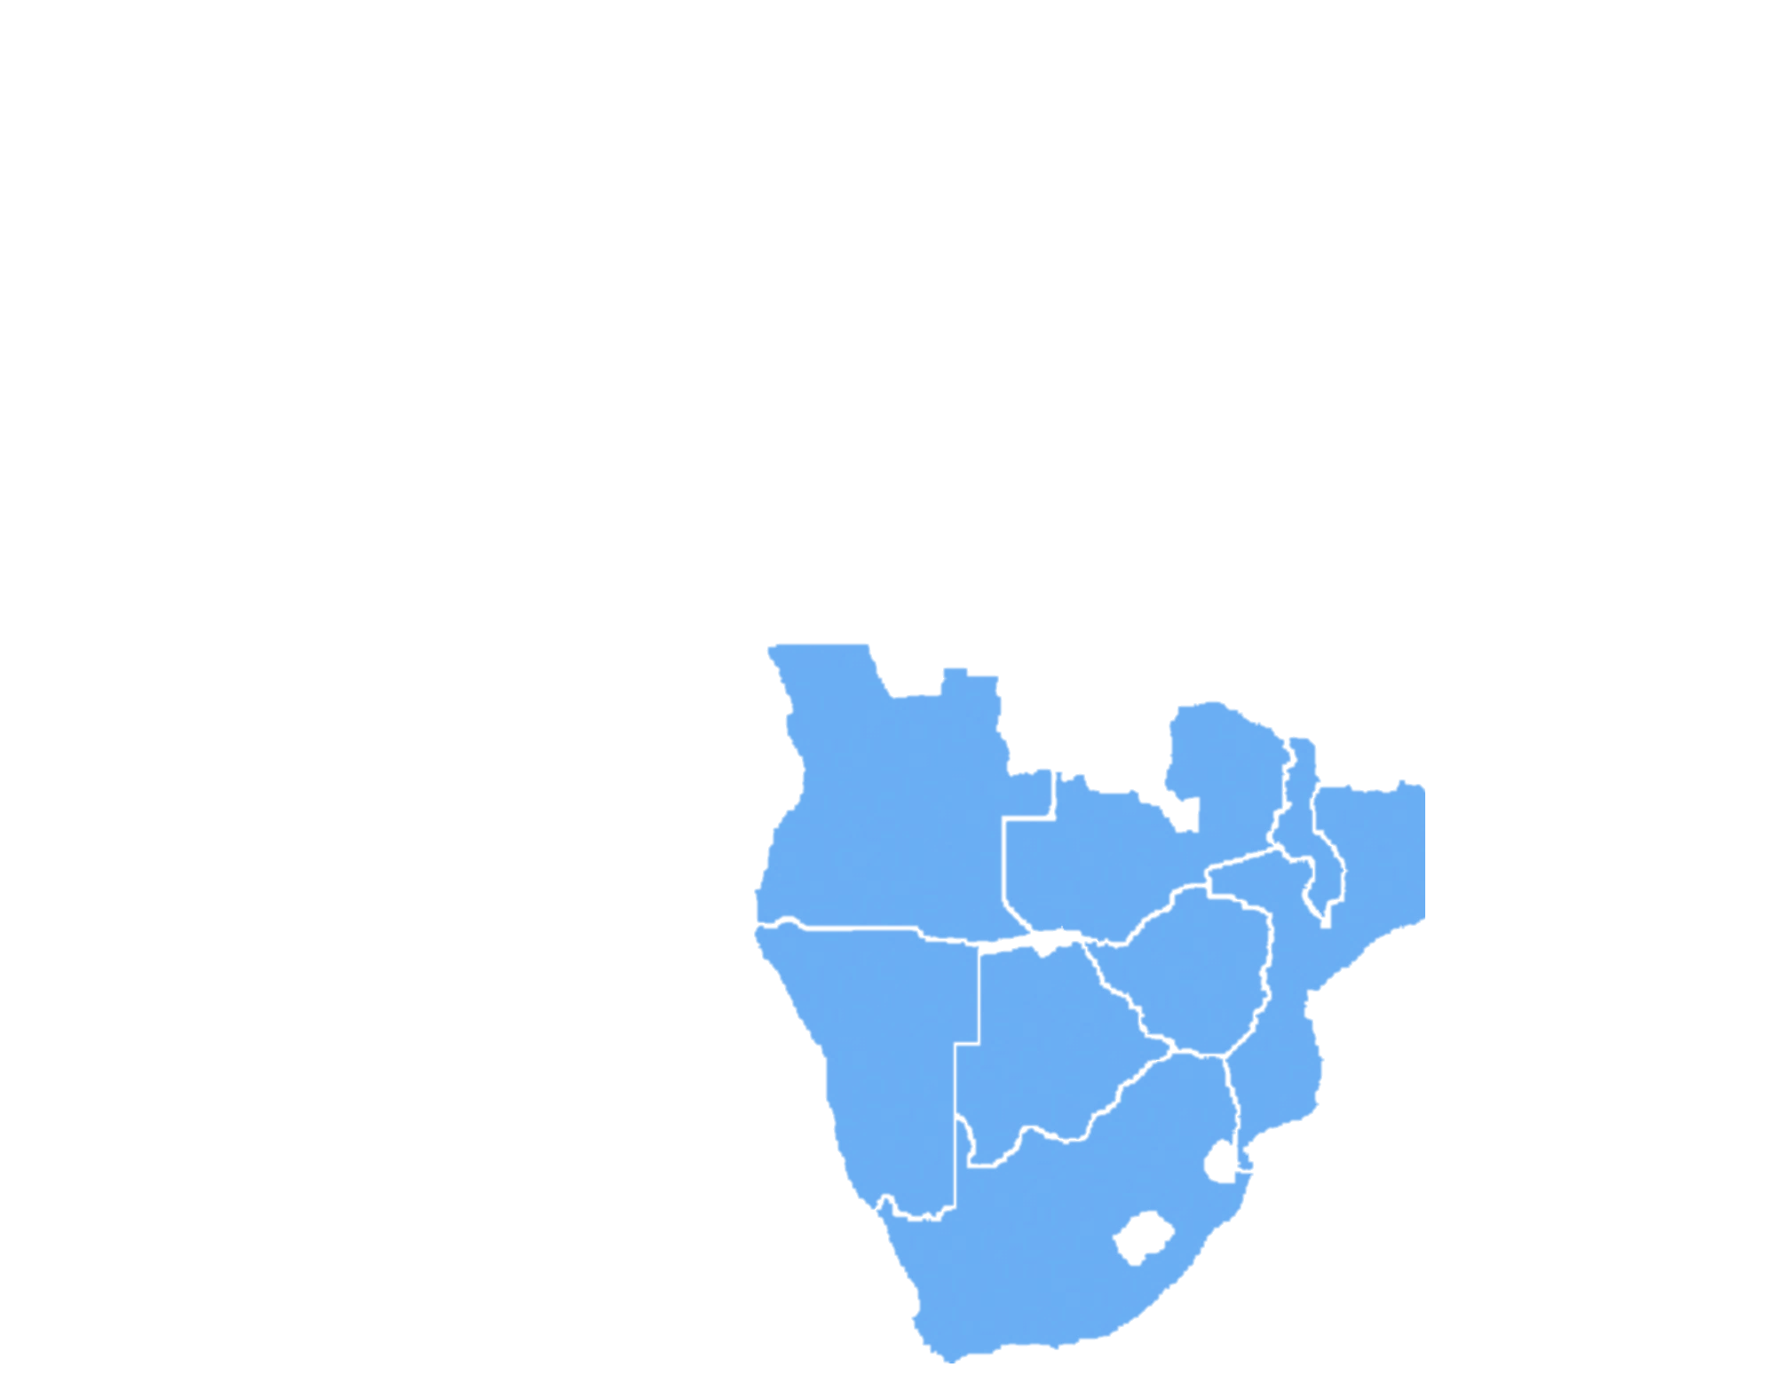
Key takeaways and lessons learned
Reflection on the purpose of capacity building:
  Capacity building for personnel who are already employed to deliver a mandate e.g. agriculture in government, academic institutions, helps to unlock value from effective use of Earth Observation.
  The EO DIC revealed weaknesses in training and capacity building
  Economics of supply and demand dictate what service the market needs
Tracking
Geology
Agri-tech
Climate
Data Analytics
Rescue
Community engagement
Healthcare
Training
Exploration
Stats
Zero Harm
Education
Job Creation
Security
Conservation

