Slide 1
Massive Open Online Course (MOOC) for Radar Remote Sensing Education
Session 2: Spotlight on Innovation
Canadian Space Agency
Janin Huard (ack to Paul Briand and Guy Aubé)
CEOS WGCapD-9 Annual Meeting
Sunnyvale, California
10-12 March 2020

Slide 2
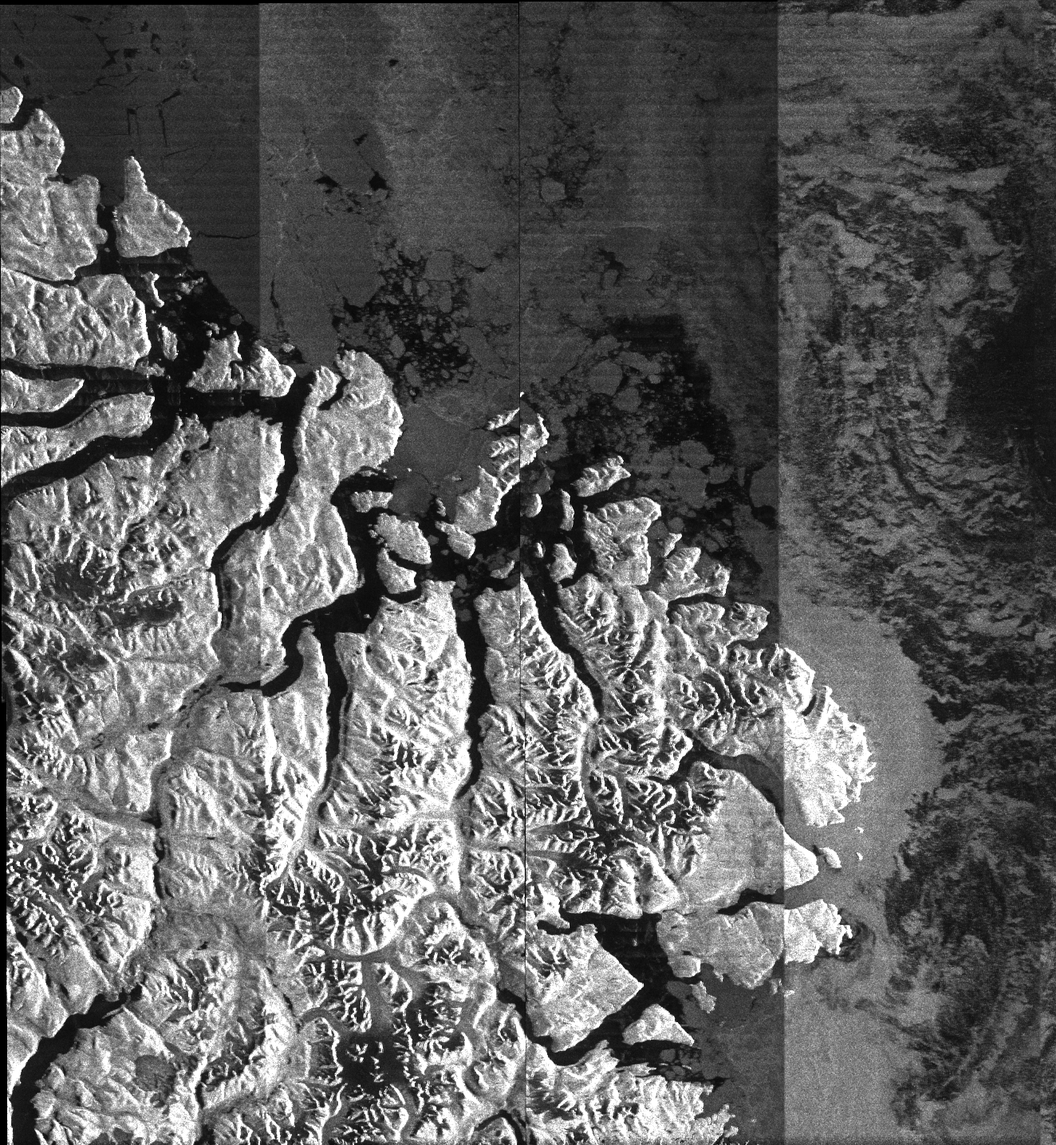
Activity snapshot
In partnership with ESA and the University of Jena, the CSA will contribute to the existing MOOCs by providing SAR education and training related information and material on specific Canadian applications (ex: coastal changes, agriculture, land and river ice dynamics, floods, etc.)
Initiated under CSA-ESA cooperation
Jena University (Germany) and Canada (CSA, NRCAN/CCMEO, ECCC/CIS, AAFC)*
Under development – Online target date: September 2020
Concept calls for a MOOC on uniquely Canadian SAR applications
Thematic focus on “Winter, Water, Warming” (the 3 “W”)
Innovation: Demonstrate SAR research and practical user experience
Participants will learn how Canadians are utilizing EO by means of SAR to address important environmental issues, and get a sense of the evolution in SAR images processing using new analytical approaches such as AI
*NRCAN/CCMEO = Natural Resources Canada’s Centre for Mapping and Earth Observation
ECCC/CIS= Environment and Climate Change Canada – Canadian Ice Service
AAFC = Agriculture and Agri-Food Canada

Slide 3
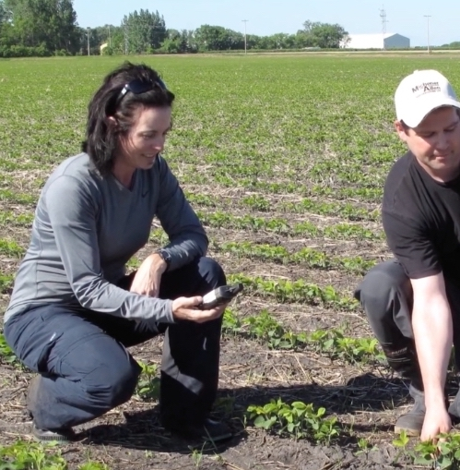
Innovations in this activity
This activity aims to introduce something new:
Clarify the Canadian context within the 3 “W” environmental themes
Explain the underlying SAR-related research
Describe the role of Canadian researchers, managers and users
Define SAR processing evolution and theme-specific products, and
Inform on essential RADARSAT/RCM* program connections
MOOC will instruct on:
Canadian actors, agencies and applications
Outline geography, climate, socio-economic factors involved
Focus on specific challenges and solutions
Traditional techniques, SAR options and evolution of capabilities
Overall benefits
*RCM = RADARSAT Constellation Mission

Slide 4
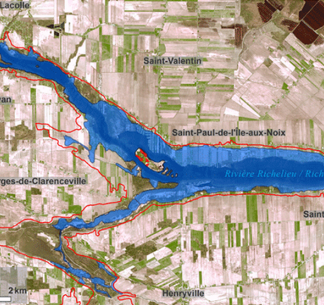
Challenges – and the path to overcoming them
The Canadian context:
Vast territory, different climates, diverse stakeholders/users, various cultures
The Canadian EO ecosystem:
Need for a better integration of EO capacity and capabilities
Infrastructure not up-to-date
CSA is a SAR enabler needs and subject matter experts (SMEs) are outside
Users: various Canadian departments, provinces, communities
The challenge of collaboration
SME and researchers from other federal departments are busy
(different priorities/objectives/commitments/projects, etc.)
Collaboration/Partnership = Key element of success
Let the users (SMEs) speak of their work/expertise/needs
Create an EO community awareness (better integration, common vision, etc.)
SAR Applications = Services given to Canadians!

Slide 5
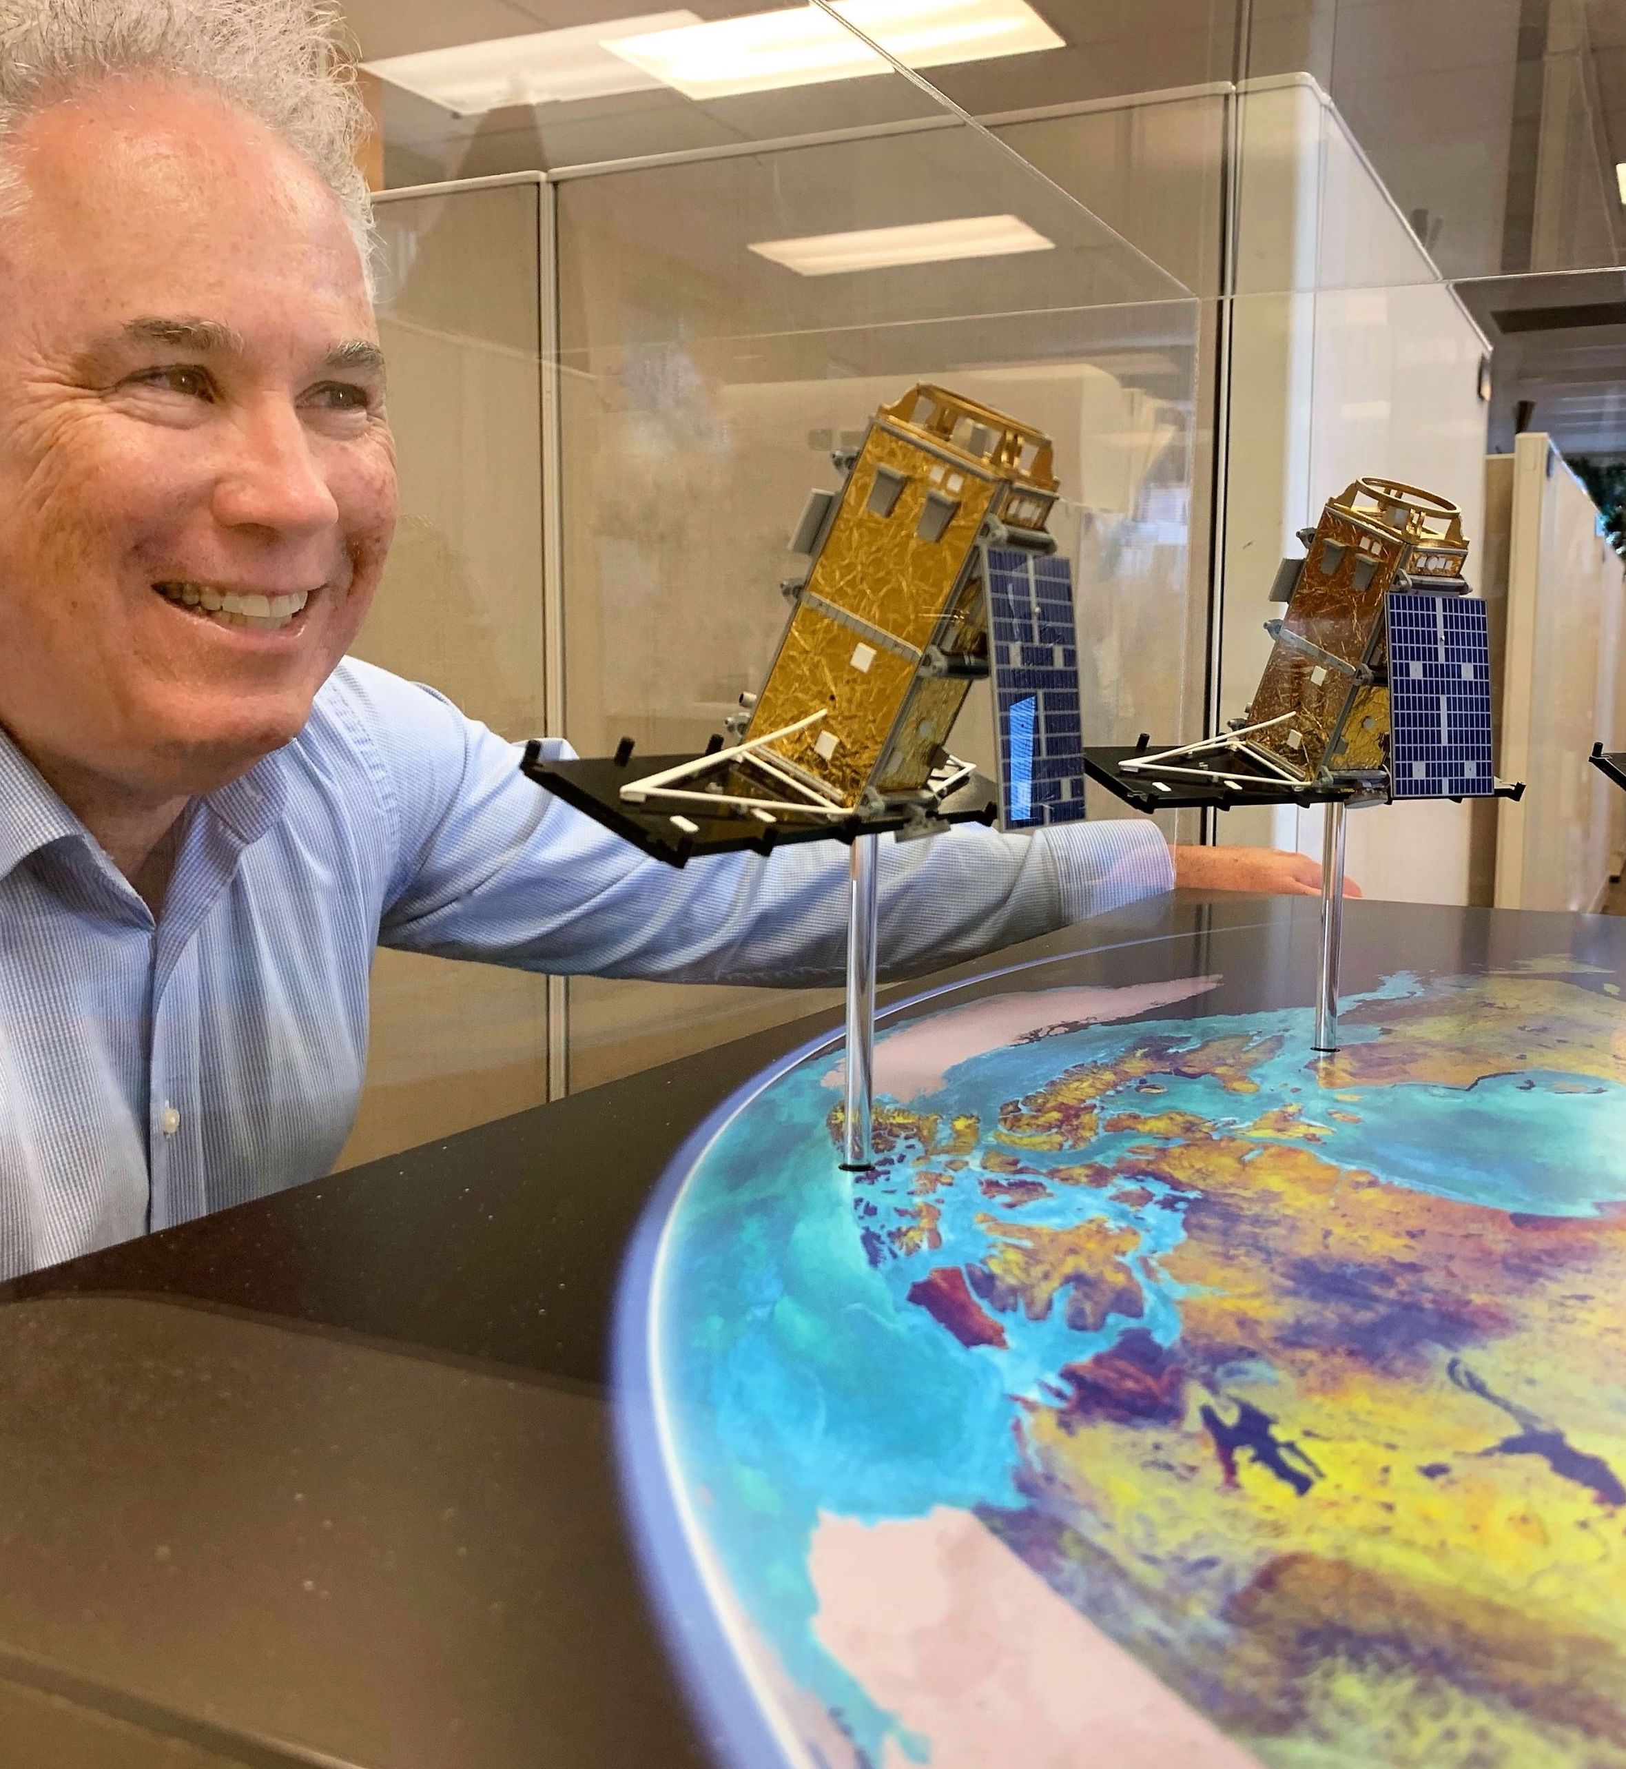
Key takeaways and lessons learned
MOOC still in development (should be online at the end of September 2020)
Key takeaways and lessons learned would come up later, however…
Don’t underestimate the effort required to engage stakeholders
Identify key and dedicated resources
Define a project leader and establish a work plan
Objectives, deliverable, timelines
Thank you to the ESA and the University of Jena for their expertise and support!
Key partners are essentials

Slide 6
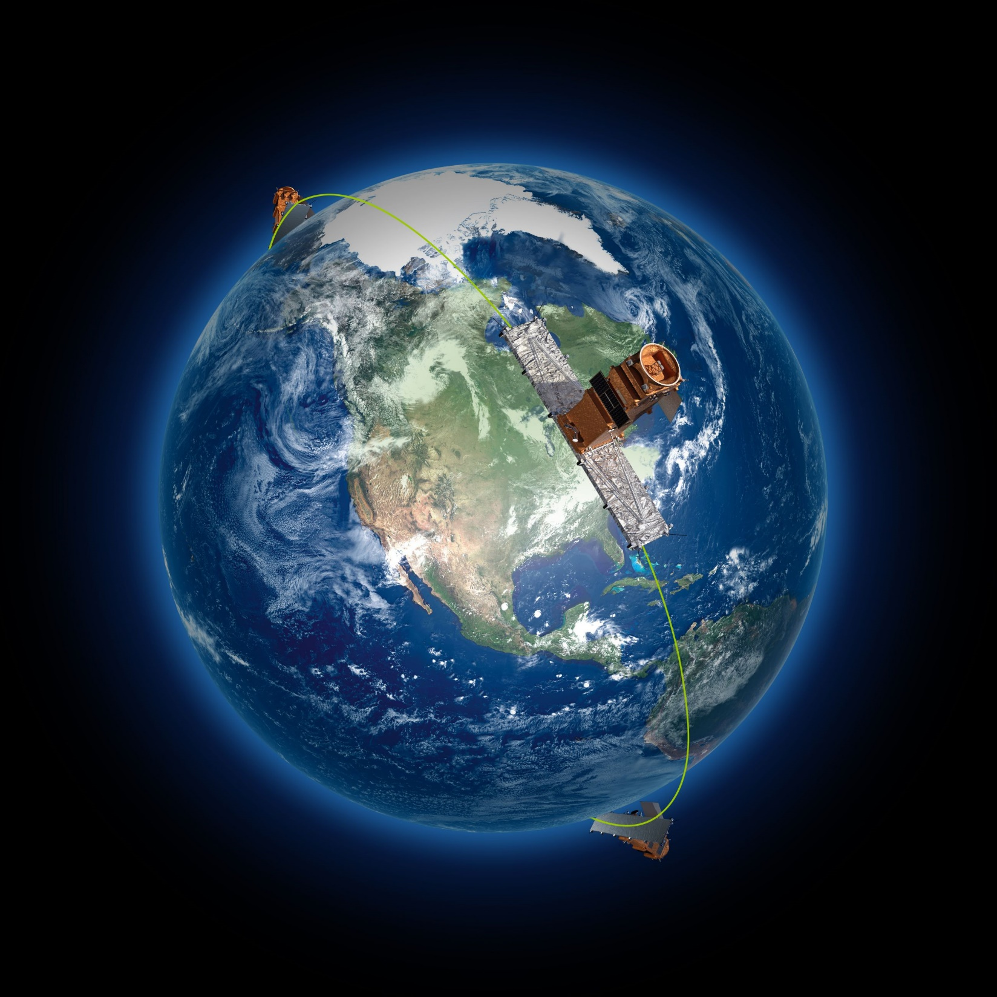
Opportunities for WGCapD
WGCapD members could promote the MOOC upon delivery
Possibility of adding to the SAR building capacity by complementary MOOCs
Building Capacity and Democracy: Thinking outside the box!
How can we make EO trendy?
Boomers to zoomers!
How can we better enhance the data?
Simulation over time (deforestation growth, cities expansion, etc.) using existing applications (Google Earth, etc.)
Educative games and applications for the young generation
Etc.

