Slide 1
Landsat Collection 2: Science Enhancements & Improvements
Session 1: Spotlight on Innovation
U.S. Geological Survey
Christopher Barnes
CEOS WGCapD-9 Annual Meeting
Sunnyvale, California
10-12 March 2020

Slide 2
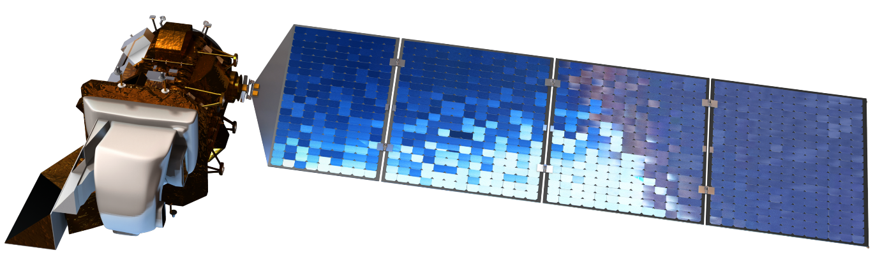
Activity snapshot
In 2016, the USGS reorganized the Landsat archive into a tiered collection management structure:
  Need for consistent Landsat 1–8 sensor data and in anticipation of future periodic reprocessing of the archive to reflect new sensor calibration and geolocation knowledge
Landsat collection-based management structure represented a significant change in the inventory of the USGS Landsat Archive
  Ensuring consistent quality through time and across instruments
  While maintaining the heritage archive specifications;
    ~185 km × ~180 km Worldwide Reference System (WRS-2) path/row scene coordinates
    Universal Transverse Mercator (UTM)/Polar Stereographic projections
    World Geodetic System 1984 (WGS84) datum

Slide 3
Innovations in this activity
In 2018, the USGS started planning and defining specifications for Landsat Collection 2
Landsat Collection 2 maintains continuity with Collection 1, but there are several enhancements that harness more recent advancements in processing, algorithm development, and access and distribution services
Including:
  Improved per-pixel geodetic accuracy by incorporating updated Landsat 8 ground control points harmonized with the European Space Agency/Copernicus Sentinel-2 Ground Reference Image (GRI)
  A global inventory of scene-based surface reflectance and surface temperature data products that meet the solar elevation angle criteria (i.e., <76 deg)
  Updated digital elevation model sources for various global regions to support Level-1 processing

Slide 4
Innovations in this activity - 1
  Improved per-pixel geodetic accuracy by incorporating updated Landsat 8 ground control points harmonized with the European Space Agency/Copernicus Sentinel-2 Ground Reference Image (GRI)
  Comparisons of GRI and Collection 1 Landsat 8 OLI-based GCPs showed ~26m CE90 registration accuracy
  Updated Collection 2 Landsat 8 OLI-based GCPs were extracted and triangulated to Sentinel-2 GRI
  Collection 2 Landsat 8 OLI-based GCPs results yield Landsat/Sentinel-2 registration accuracy <10m CE90

Slide 5
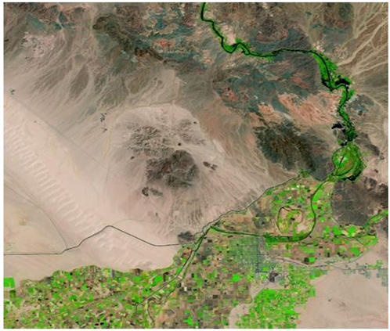
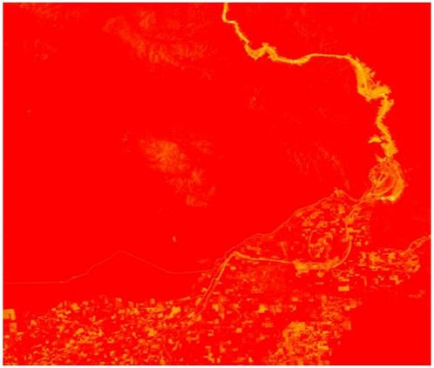
Innovations in this activity - 2
  A global inventory of scene-based surface reflectance and surface temperature data products that meet the solar elevation angle criteria (i.e., <76 deg)
  Landsat 4-8 only (Landsat 9 in 2021)
  Surface Reflectance
  Landsat 4-8 LEDAPS & LaSRC
  Surface Temperature
    Single-channel

Slide 6
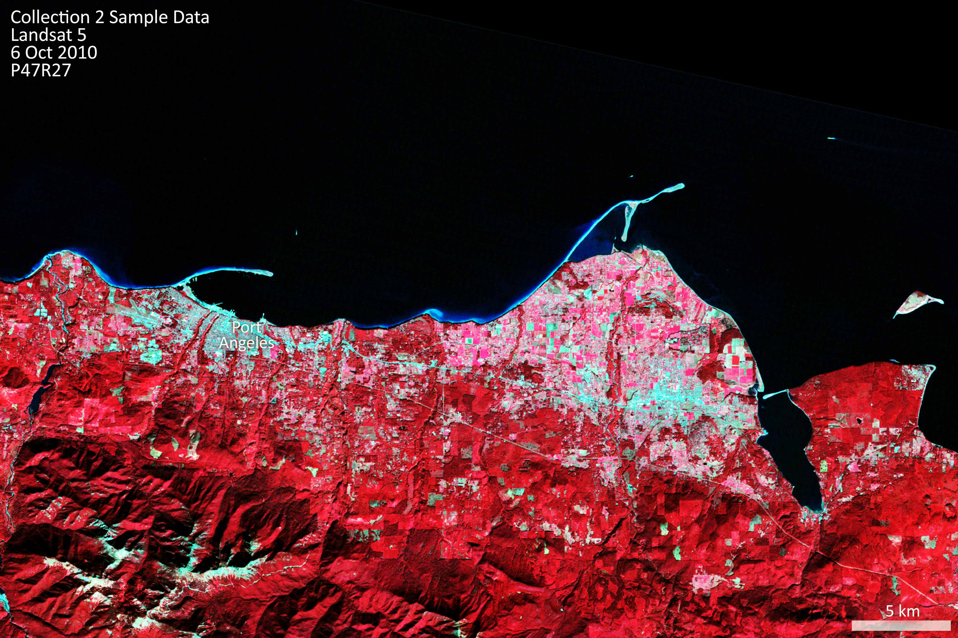
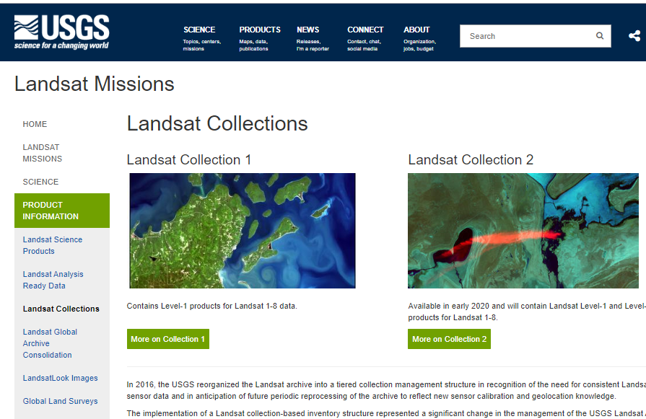
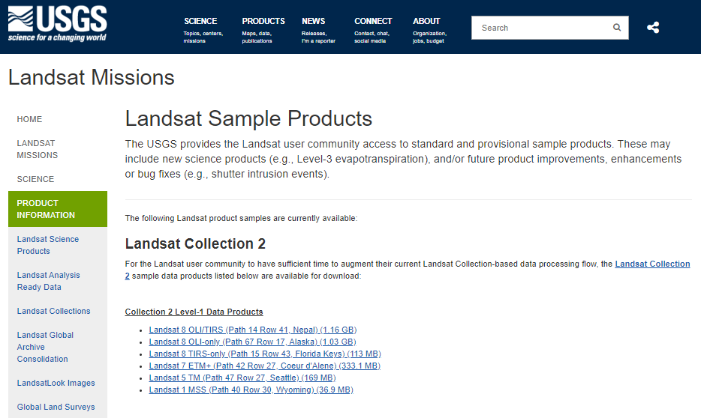




Opportunities for WGCapD
Comments welcomed on Collection 2 samples
  Contact User Services (custserv@usgs.gov) with any questions, comments or concerns
  Consider your feedback as early input to Landsat Collection 3 development
usgs.gov/landsat

Slide 7



Contact/Connect
usgs.gov/landsat
+1 800-252-4547
+1 605-594-6151
custserv@usgs.gov
@USGSLandsat
@NASA_Landsat
@usgslandsat
Landsat Updates
Landsat Headlines
@NASA.Landsat

