Slide 1

Synergy with WGISS, Future Data Architectures (FDA) and System Engineering Office (SEO)
Committee on Earth Observation Satellites
Brian Killough (NASA, SEO), Mirko Albani (ESA, WGISS Chair)
CEOS WGCapD-8 Annual Meeting
Agenda Item # 38
Working Group on
Capacity Building & Data Democracy
Indian Institute of Remote Sensing
Indian Space Research Organisation
Dehradun, India
March 06th – 08th, 2019

Slide 2
WGISS Scope
Data Preservation and Stewardship
Interoperability and Use (including FDA)
WGISS promotes collaboration in the development of systems and services that manage and supply Earth Observation data
Data Discovery and Access
Technology
Exploration
Notes:
Recent advances in technology open the floor for new and innovative approaches for data exploitation and use and require an adaptation and evolution of the approaches, infrastructures and services provided by CEOS agencies. WGISS contribution and role in providing a forum for technical exchange and sharing, and for the definition and prototyping of common and interoperable approaches and architectures for data management and exploitation will become more and more central for CEOS agencies and for CEOS as a whole in support to the achievement of its objectives

Slide 3
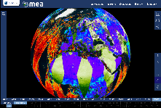






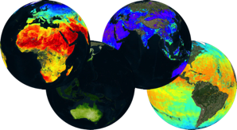
Future Data Access & Analysis Architectures
Shared vision needed to enhance and encourage the use of EO data for science, operational services, and commercial applications.
Example:
Web based GUI
(including third-party applications)
Jupyter Notebook
CLI / REST API
Visualization layer
Standardised data access interfaces allow connecting a wide range of user interfaces
Datacube Engine/API VMs
The deployment of DAS in front of each data source enables effective access services
Data layer
Data remain at their own location (multiple data centers) with the original data format
Mission-specific data
Thematic data
Other geospatial data

Slide 4


WGISS synergy with WGCapD
Technology Webinars
Past Technology Webinars
Relevancy Ranking of Data Search Results
Data Cubes for Large Scale Data Analytics
Burgeoning Role of Python for Earth Observation Data Analysis
The OGC Coverage Standards Suite: Introduction and Overview
Scrum and scale agile methods
Joint webinars and advertising with WGCapD
http://ceos.org/ourwork/workinggroups/wgiss/technology-exploration/
  DATA-11: Data and Technology Exploration webinars and workshops
FDA-5: Promote awareness of FDAs (support WGCapD)
Next Technology / FDA webinars:
FDA Elements Demonstration at WGISS#47, 29 April - 2 May (Silver Spring, USA)
WGCapD proposals?
Notes:
Relevancy Ranking of Data Search Results
14th of March 2017
Stefano Nativi (GEOSS EVOLVE)
Chris Lynnes and James Norton (NASA)
Data Cubes for Large Scale Data Analytics
19th of June 2017
Rob Woodcock (CSIRO)
Brian Killough (CEOS SEO)
Burgeoning Role of Python for Earth Observation Data Analysis
22nd of August 2017
Syed Rizvi (Open Data Cube)
Rich Signell (USGS)
Alber Sanchez (INPE)
The OGC Coverage Standards Suite: Introduction and Overview
19th of January 2018
Dr Peter Baumann (Rasdaman)
Scrum and scale agile methods
31st of July 2018
Ms. Dana Shum (Raytheon NASA)

Slide 5
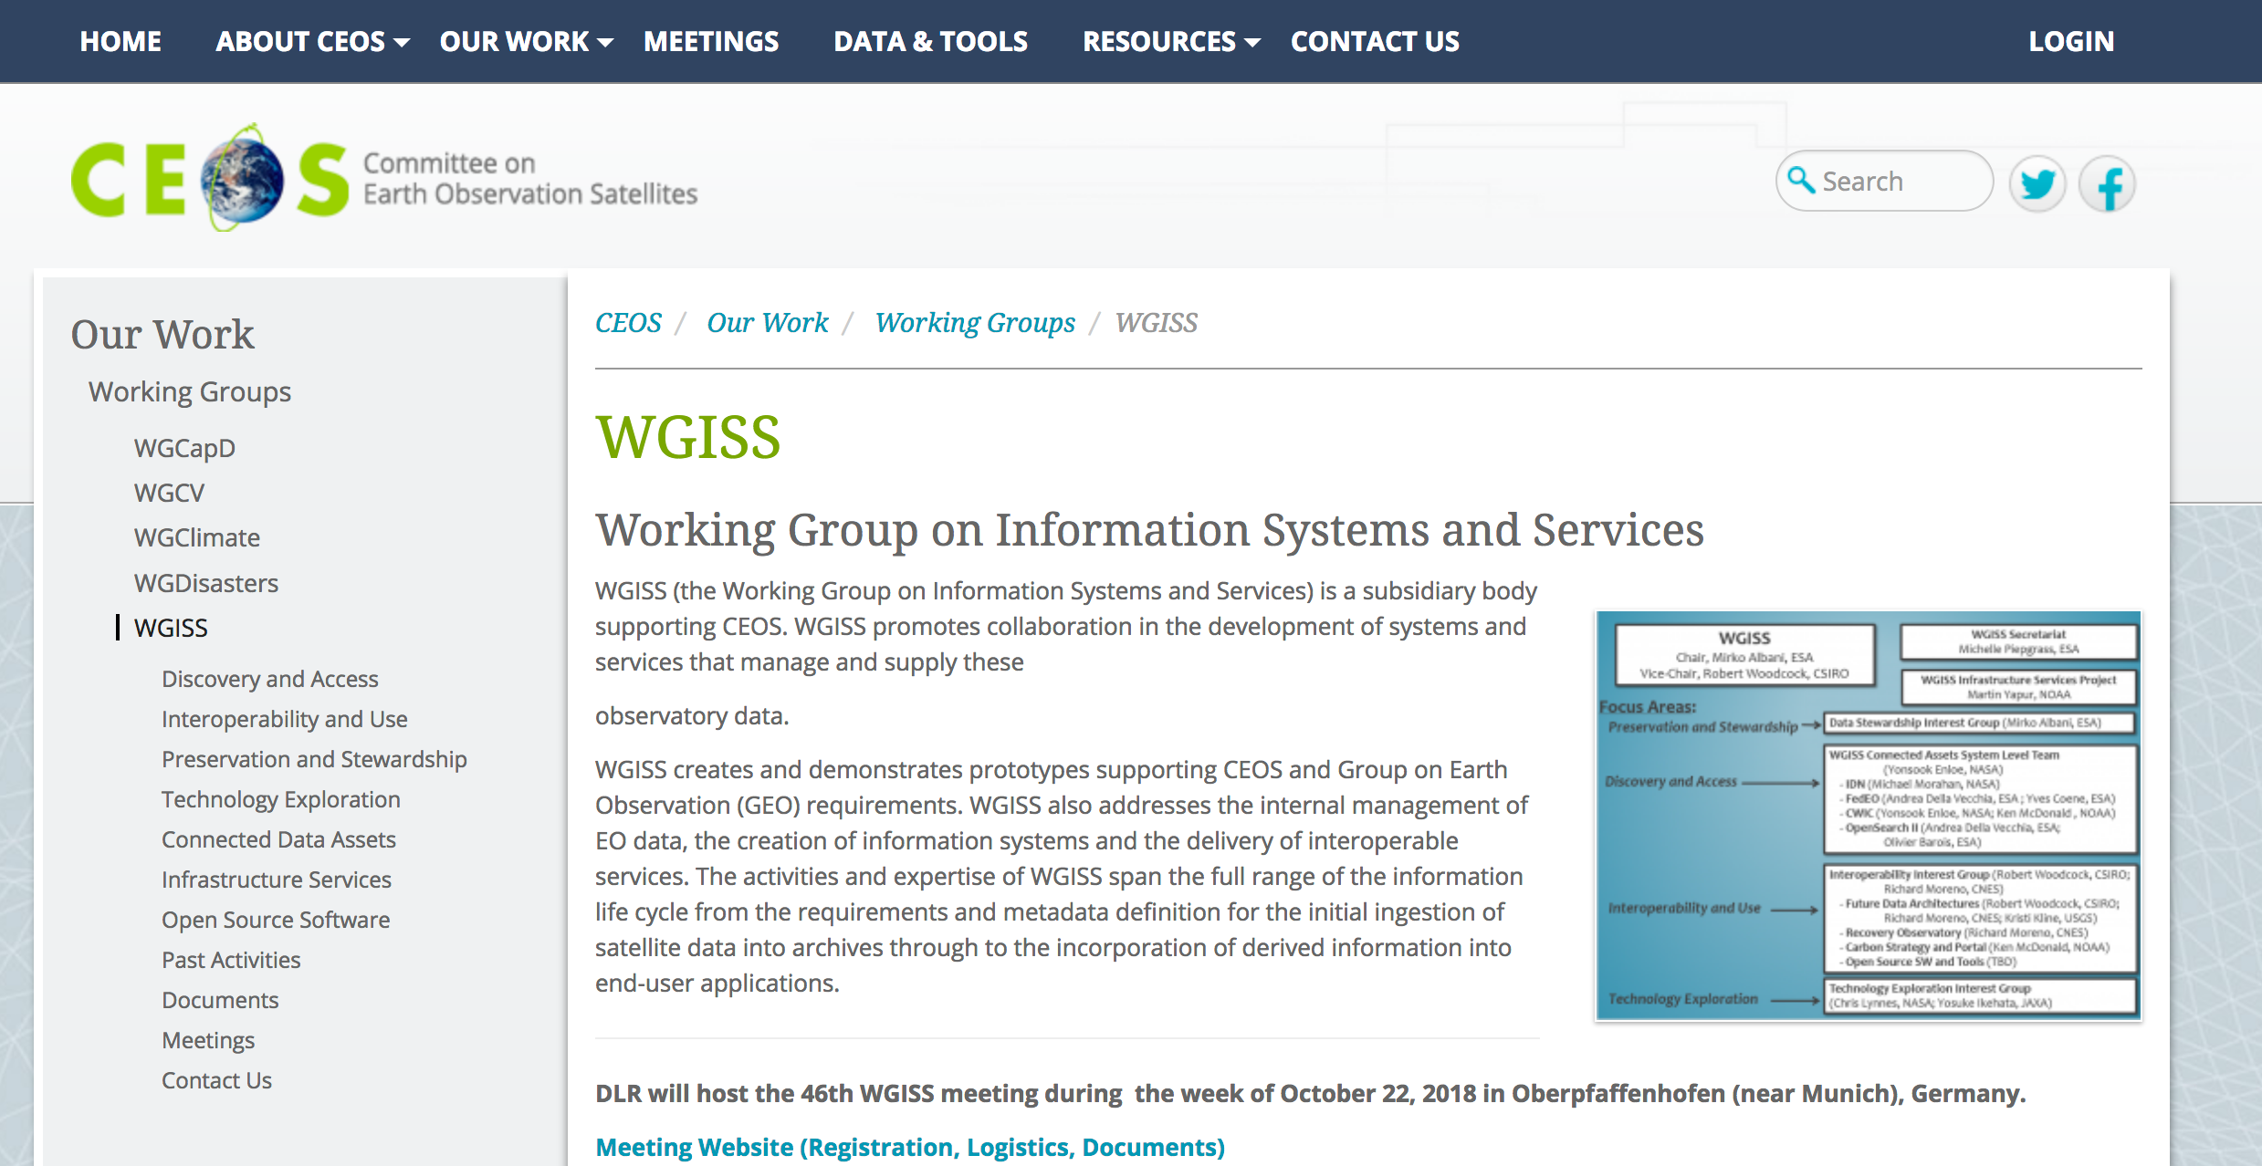
WGISS Information
http://ceos.org/ourwork/workinggroups/wgiss/

Slide 6
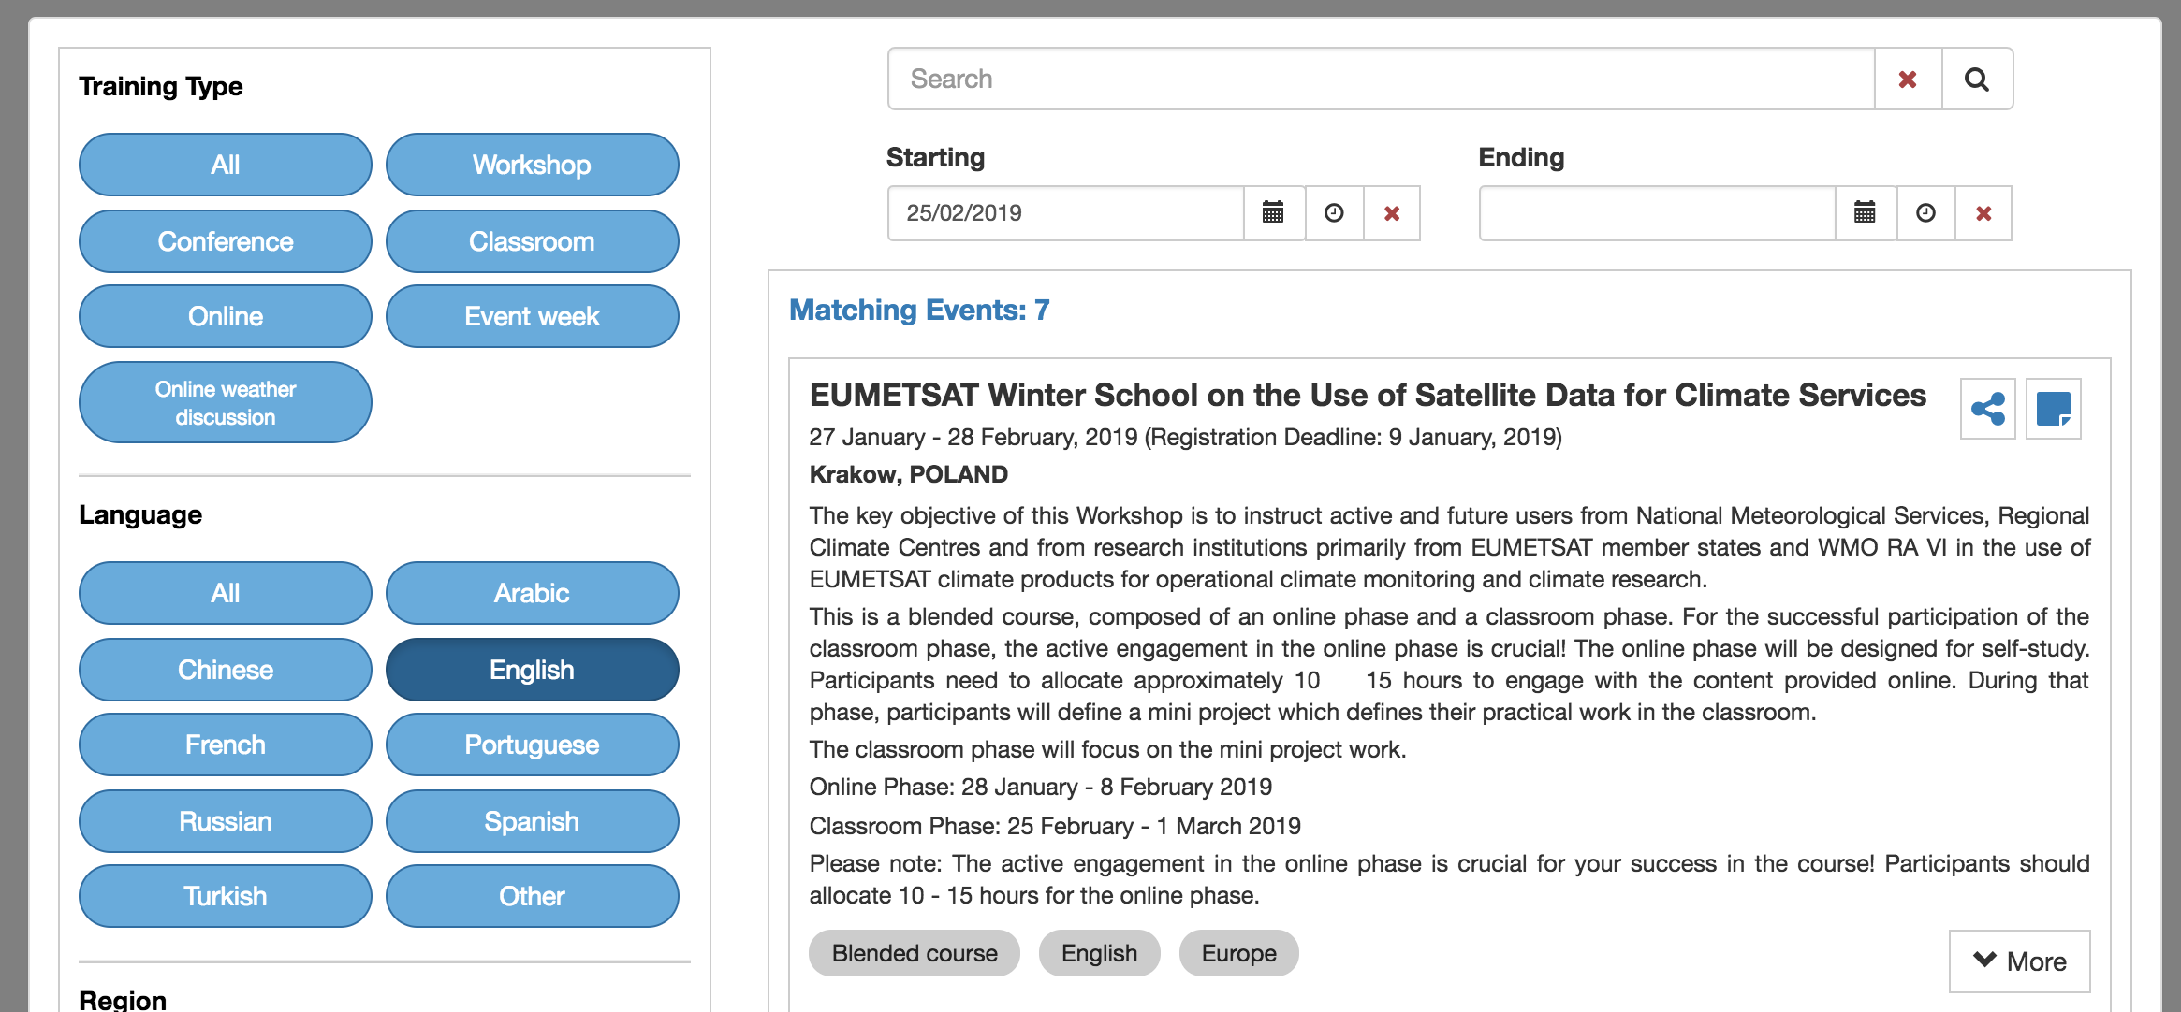
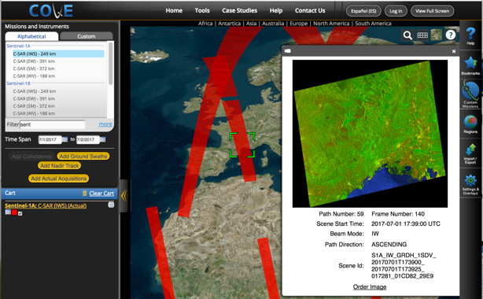
SEO Collaborations
The SEO is working with WGCapD on the definition and development of a new WGCapD Training Portal. The SEO team is evaluating data parameters and database features before moving ahead with a first prototype.
The SEO lost its core COVE developer in late 2018. A new developer is now in place and COVE will be complete its updates in mid-2019. At that point, the SEO would like to work with WGCapD to conduct some COVE training webinars and create other training material.

