Slide 1
Capacity Building and SDGs
Committee on Earth Observation Satellites
Argyro Kavvada, Ph.D., NASA/BAH & SDG Ad-Hoc Team
CEOS WGCapD-8 Annual Meeting
Agenda Item 36
Working Group on
Capacity Building & Data Democracy
Indian Institute of Remote Sensing
Indian Space Research Organisation
Dehradun, India
March 7, 2019

Slide 2
SDG Awareness Webinar
Organizing Committee: Argyro Kavvada, NASA, Hilcea Ferreira, INPE, Robert Eckardt, University of Jena, Nancy Searby, NASA
78 Registered, 32 Participants (~43% of registered), 2 Sessions
Learning Material and Recorded Session:
http://learningcenter.obt.inpe.br/
Organization/Affiliation
Analytical Mechanics Associates Analytical Mechanics Associates BLB - Norwegian research and consulting company Centre for Sustainable Development, University of Ibadan CONAE (Argentina Space Agency) European Commission Friedrich Schiller University Ghent University Immigration and Refugee Protection Act - IWOPA International Consultant International Labour Organization - ILO Knowledge Management for Development (KM4Dev) London School of Economics and Political Science | NASA NASA ARSET National GEO Board National Museum Zoological Garden NextGen Africa Initiative Office of the Prime Minister Bahamas RBI SAC/ISRO Taraba State University Telespazio VEGA UK Universidad Rafael Landivar University of Nottingham University of Santa Maria University of Tokyo USGS
Job Title / Positions:
Advisers
Consultants
Professors
Graduate Students
Researchers
Policy Officers
Scientists
Policy officers
Software Engineer
Training Coordinator ...
Notes:
Additional SDG areas highlighted included: air quality & health, indicator 6.6.1 (spatial extent of water-related ecosystems), 11.3.1 (ratio of land consumption rate to population growth rate), and 15.3.1 (proportion of land that is degraded over total land area).

Slide 3
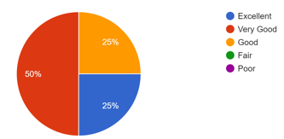
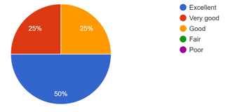
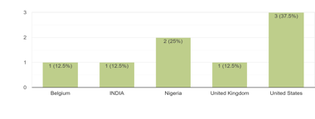
SDG Awareness Webinar
Feedback Survey
https://goo.gl/forms/K21js8kOvzg6yArl2
8 Responses (after 3 remiders…)
Learning
Materials
Organization / Affiliation
8 Responses
Your overall rating of the webinar session
Analytical Mechanics Associates
European
Commission- Copernicus
NASA ARSET
SAC ISRO
University of Nottingham
National Museum
Zoological Garden
Taraba State
University
Are you interested in receiving additional trainings on SDG topics, including general awareness as well as trainings to develop elementary and/or advanced skills with specifc
SDG targets/ indicators?
Country
8 Responses
Notes:
Additional SDG areas highlighted included: air quality & health, indicator 6.6.1 (spatial extent of water-related ecosystems), 11.3.1 (ratio of land consumption rate to population growth rate), and 15.3.1 (proportion of land that is degraded over total land area).

Slide 4
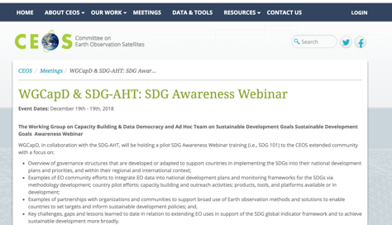
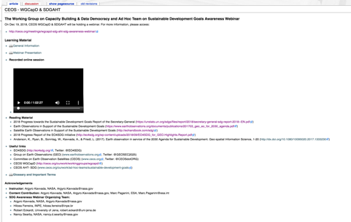
SDG Awareness Webinar
Challenges Timing of training webinar Overall timeline (from announcement to survey distribution & completion) Training Tool (Go To Webinar) Limited participation of registered participants
Lessons Learned & Future Plans Engage with broader CEOS and sustainable development community to increase the number of individuals & institutions benefiting from SDG trainings (e.g., SDG Academy) Review and incorporate training best practices from CEOS & GEO CB contributors; Collaborate with CEOS Agencies as well as GEO thematic initiatives in conducting future trainings (on specific SDG areas / awareness)
INPE Learning Center: Education and Training - Remote Sensing and Geospatial Technology
http://learningcenter.obt.inpe.br/

Slide 5
Capacity Building & SDGs
CB & SDGs Deliverables | Title | Completion Date | Description
CB-29-2019 | Webinar: Introduction to SDGs and progress in using EO to address them | 2019-Q3 | Collaboration between AHT-SDG and WGCapD to organize SDG-related training on the use of space-based EO to meet the data challenges of the 2030 Agenda for Sustainable Development
CB-35 | Provide CB support to AmeriGEO Week 2019 in Peru. | 2019-Q3 | Provide training and capacity building support to AmeriGEO with training opportunities as part of their annual AmeriGEO Week.
CB-35-2019-1 | Provide hands-on training on SDG 6.6.1/6/3.2 as part of AmeriGEO Week. | 2019-Q3 | Provide training and capacity building support to AmeriGEO with training opportunities as part of their annual AmeriGEO Week.

Slide 6
Ad-Hoc Team on SDGs
SDG Objectives / Deliverables
AHT-SDG Deliverables | Title | Completion Year | Description of Task
SDG-02 | Compile and maintain a compendium of CEOS Agencies engagement on SDGs | 2019-Q2 | Collect and centralize information across CEOS Agencies on their SDG engagement and related activities, through online surveys and other consultation channels. The Compendium of CEOS engagement on SDGs is meant to be used for CEOS internal use only.
SDG-03 | Review and assess the contribution of EO to the SDG Targets and Indicators. Produce a compendium and policy brief. | 2019-Q3 | Assess the current and potential contribution of EO to the SDG Targets and Indicators (through the lens of space-based EO) and identify areas of better EO uptake, with the objective to increase the effective use of satellite observations and products in the overall SDGs processes (targets achievement and indicators? monitoring) and by all key players (global to local)
SDG-04 | CEOS engagement plan on SDGs | 2019-Q2 | Develop a coherent, flexible and adaptive CEOS engagement strategy on SDGs to maximize CEOS efforts and available resources on SDGs for a higher impact (on the use of EO in SDGs) and for more tangible benefits for CEOS agencies.
SDG-05 | Analyze the SDG satellite data requirements | 2019-Q4 | Produce, in cooperation with the GEO EO4SDG initiative, a “SDG satellite data requirement Table” for a number of SDG indicators that are already or can be supported by satellite data. The SDG satellite data requirement Table will summarize the satellite data needs (satellite observations, geographical coverage, time frame, frequency of observations, spatial resolution, EO data products etc.) for countries to achieve their SDG targets and report on SDG indicators.
SDG-06 | Open Data Cube algorithms for the SDGs | 2019-Q4 | Develop and demonstrate a set of Data Cube algorithms that use CEOS satellite data and can be applied to several SDGs (e.g. 6.6.1, 11.3.1, 15.3.1). Seek feedback from statistical agencies and other stakeholders to understand how to improve these algorithms.

Slide 7
Capacity Building and SDGs
Thank you!
Argyro Kavvada@nasa.gov

