Slide 1

The GEO Capacity Development Strategy
Committee on Earth Observation Satellites
CEOS WGCapD-8 Annual Meeting
Agenda Item # 34
Working Group on
Capacity Building & Data Democracy
Indian Institute of Remote Sensing
Indian Space Research Organisation
Dehradun, India
March 06th – 08th, 2019

Slide 2
GEO’s interpretation of capacity development is based on widely-accepted definitions from UNCED, UNDP and OECD
  “Building capacity, as well as sustaining and enhancing existing capacity, is essential for developing the competencies of GEO Members and Participating Organizations in the effective use of Earth observations for responding to societal challenges and addressing sustainable development issues.”

Slide 3
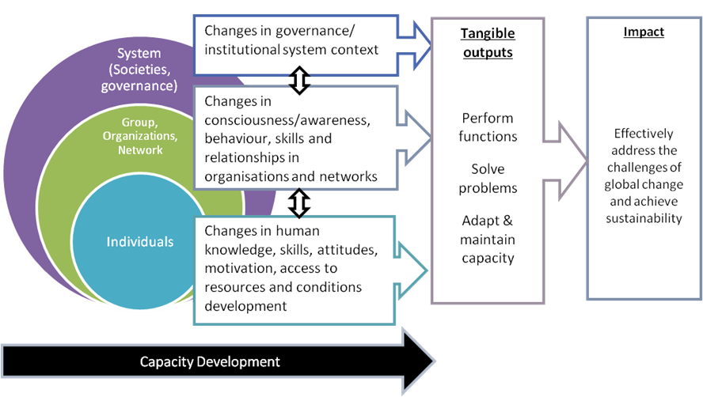
GEO promotes a holistic approach on CD, addressing three different levels of interventions
interpretation of capacity development is based on widely-accepted definitions from UNCED, UNDP and OECD

Slide 4


Going from a traditional approach, strengthening individual capacity through training, to co-creation
Traditional Approach
Co-Creation Approach
User organization identifies a need
Provider organization develops & delivers a course (on-site or virtual)
Users participate as recipients
Assessment based on participant satisfaction
Complex problem addressed by joint effort
Participants may bring: technological capabilities, contextual knowledge, identified needs
Assessment based on real learning, performance improvement, future management of the problem

Slide 5
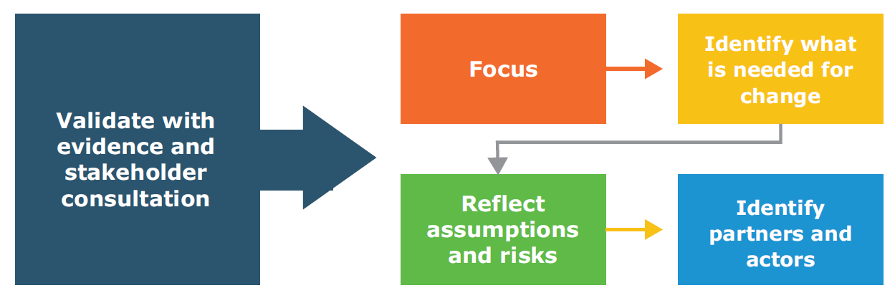
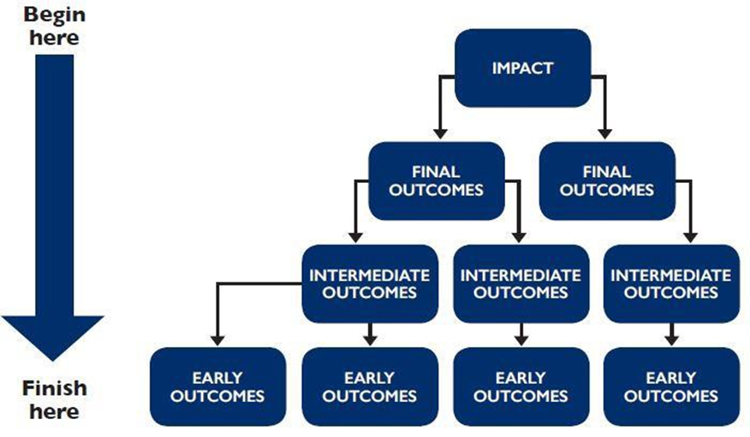
The Theory of Change and related pathways to change supports the co-creation processes
Theory of Change is used by many UN and national agencies. Here is a diagram describing the general approach from the UN Development Group.

Slide 6
GEO’s efforts on capacity development building are redirected in the new strategy
From
To
Capacity Building Coordination
Capacity Development Facilitation
Maintaining databases
Assisting with the design, development & implementation of CD activities
Target Audience of the Capacity Building Working Group
Leads and Participants of GEO Flagships, Initiatives & Regional GEOs
Target Audience of GEO Flagships, Initiatives & Regional GEOs⇨
End Users of Earth Observations

Slide 7
Summarizing
Focus lies on supporting GEO Flagships and Initiatives in developing and implementing CD interventions, applying a holistic view (going beyond individual training) and the concept of co-creation.
Applying the ToC will ensure measurable results and contribute to sustainable impact.
Tools, methods and best practices will be developed and shared among the GEO community.
Additional efforts are needed to strengthen the WG-CBC by active participation of the members.
The GeoCab Portal, actually off-line, will not be supported anymore by the WG.

Slide 8
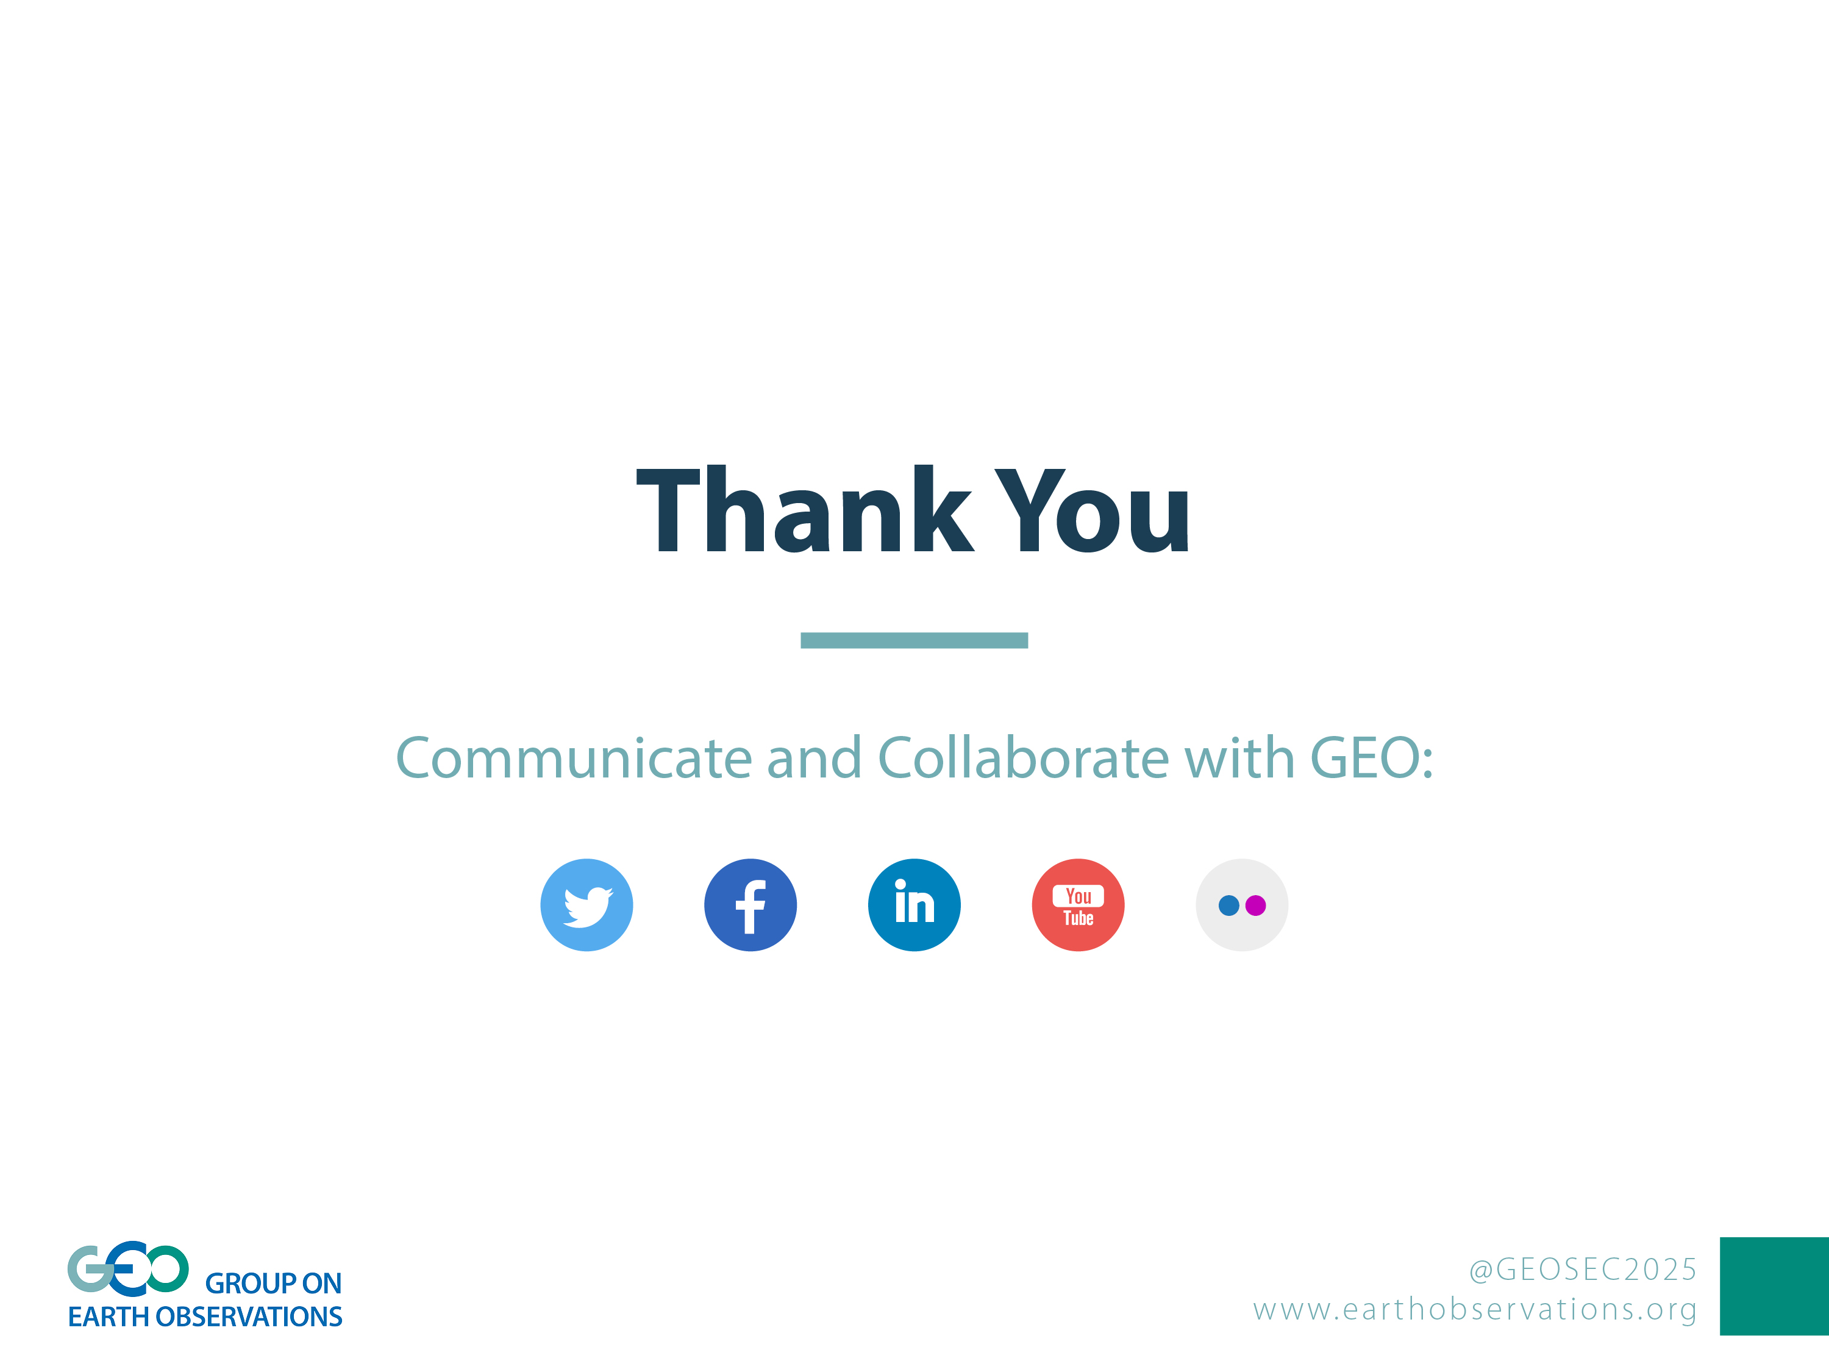
Joost Teuben, GEO Secretariat
WG-CBC coordinator (secondment by ITC, The Netherlands)
jteuben@geosec.org

