Slide 1
Capacity Building Infrastructure on North Eastern India
Committee on Earth Observation Satellites
PLN Raju, Director
North Eastern Space Applications Centre (NESAC)
CEOS WGCapD-8 Annual Meeting
Working Group on
Capacity Building & Data Democracy
Indian Institute of Remote Sensing
Indian Space Research Organisation
Dehradun, India
March 06th – 08th, 2019

Slide 2
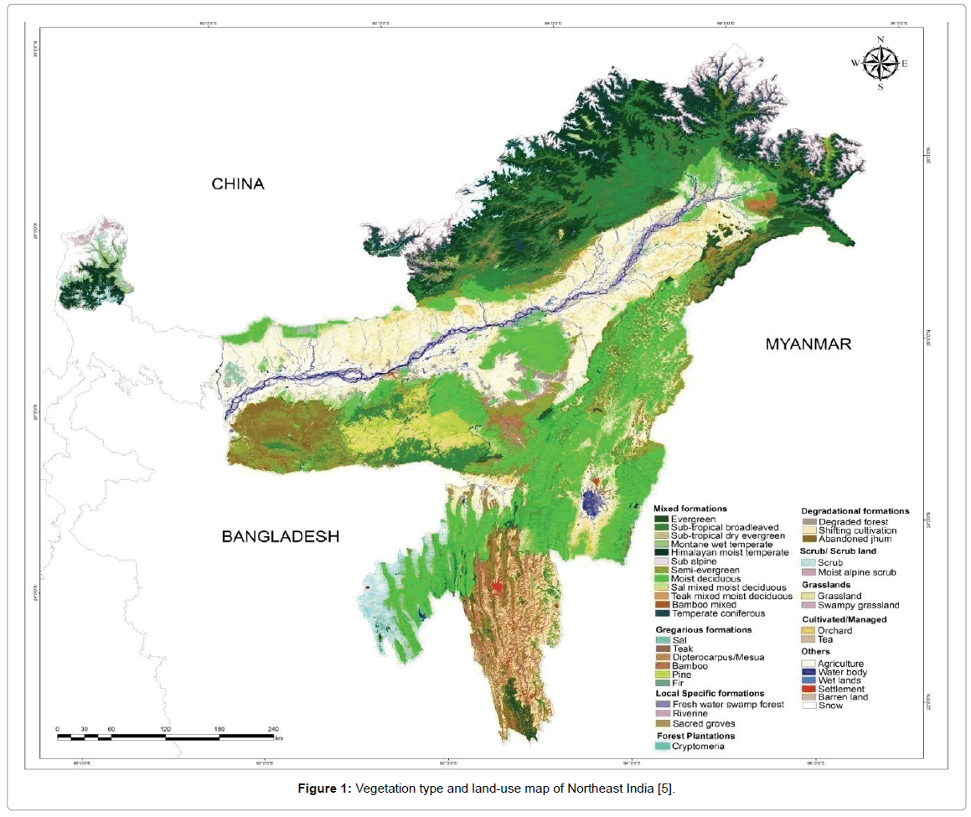
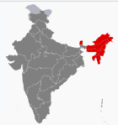
NER at a Glance
Total Geographical Areas (TGA) | 263181 Sq. km. (8% of India’s TGA)
Total states/districts | 8/110
Total population | 45587982 as per 2011 census
Population density | 148 /Sq. km
Languages spoken | 220
Traditional agriculture | Jhum / shifting cultivation
Biodiversity hotspot | 51 forest types, 6 out of 9 vegetation types found in NE, 8000 out of 15000 species of flowering plants, highest species diversity in NE (AP – 5000 7 Sikkim – 45000), 800 out of 1500 endangered floral species reported in NE
Average annual Rainfall | ~ 2000 mm
Average road density | 66 km/ 100 Sq. km.
Capacity Building Infrastructure on North Eastern India
Socio-economic development in the region governed by MDoNER’s (Ministry for Development of North Eastern Region) and North Eastern Council (NEC).

Slide 3
NR Statistics in NER
State-wise natural resources statistics
State | Area in Sq. km.
 | TGA | Agriculture |  | Shifting cultivation | Forest |  | Wastelands |  | Wetlands |  | Land degradation
 |  | Total area | % TGA |  | Total area | % TGA | Total area | % TGA | Total area | % TGA | Total area | % TGA
Arunachal Pradesh | 83743 | 2339.32 | 2.79 | 1413.27 | 67410.00 | 80.50 | 14895.24 | 17.79 | 4.39 | 0.01 | 9197.96 | 10.98
Assam | 78438 | 29086.83 | 37.08 | 238.57 | 27673.00 | 35.28 | 8453.86 | 10.78 | 1.72 | 0.00 | 7162.47 | 9.13
Manipur | 22327 | 1685.49 | 7.55 | 618.93 | 17090.00 | 76.54 | 5648.53 | 25.30 | 266.87 | 1.20 | 8368.82 | 37.48
Meghalaya | 22429 | 2074.88 | 9.25 | 749.47 | 17275.00 | 77.02 | 4127.43 | 18.40 | 62.81 | 0.28 | 6248.19 | 27.86
Mizoram | 22081 | 930.44 | 4.21 | 2616.51 | 19117.00 | 86.58 | 4958.64 | 22.46 | 00.00 | 0.00 | 6501.90 | 29.45
Nagaland | 16579 | 1886.44 | 11.38 | 1461.53 | 13318.00 | 80.33 | 4958.64 | 29.91 | 0.04 | 0.00 | 7661.24 | 46.21
Sikkim | 7098 | 696.42 | 9.81 | 00.00 | 3359.00 | 47.32 | 3273.15 | 46.11 | 00.00 | 0.00 | 780.31 | 10.99
Tripura | 10486 | 1857.06 | 17.71 | 252.97 | 7977.00 | 76.07 | 964.64 | 9.20 | 07.68 | 0.07 | 1030.53 | 9.83
 | 263181 | 40556.88 | 15.41 | 7351 (2.8%) | 173219 | 65.82 | 47280.13 | 17.96 | 343.51 | 0.0013 | 46951.42 | 17.84

Slide 4
Major End-Users of NESAC: Towards Utilizations of Space Tech inputs
State Departments (45 +) | Central Departments/Academia (20 +)
SRSAC, Itanagar, Land Record, Planning, S&T, O/o CEO, Horti Dept, Forest & Env.- Arunachal Pradesh S&T, Urban Development, Soil & Water Conservation, Irrigation & Flood control, Fishery, SLNA/IWMP, ASDMA, T&D, O/O CEO – Assam MARSAC, Revenue, R&D/Panchayatiraj, O/o CEO – Manipur Election, Soil, MBDA/IWMP, DDMA, Forest, Urban Planning, Agriculture, MePGCL, Water Resources etc. – Meghalaya MIRSAC, Forest, Planning, O/o CEO - Mizoram P&C/NRSGISC, Forest, Urban, O/o CEO- Nagaland PWD/PMGSY, TSAC, PWD (R), Tourism, O/o CEO- Tripura S&T, Forest, O/o CEO, – Sikkim | MDoNER NEC, GOI ICAR, Umiam Brahmaputra Board NEHU RMRC, Assam CDAC, Pune SIB, GOI IITG (Civil) Dibrugarh University Tezpur University Gauhati University etc.

Slide 5
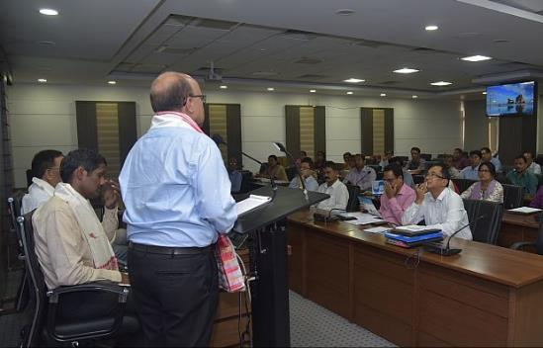
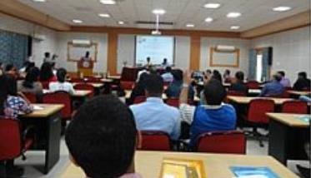
Academic Linkages: Research Collaborations (major achievements)
Short term courses – 522 participants
Academic interactions – 155 participants & 21 Institutions
MoU - NEHU, USTM, DU, DBU, NIT-M, MIT (AU), IISc etc.
Collaborations - ICAR, NEIST, NU, NEC, MDONER, AAU, CSB etc.
5-9 March, 2019
Shri R.R. Okhandiar, IFS, Member Secretary, CSB, Bengaluru giving his opening remarks during inauguration function 22-23 Oct, 2018
Brainstorming Workshop on Space Science & Technology and its Applications was organized at Dibrugarh University, Assam on 9 Nov, 2018

Slide 6
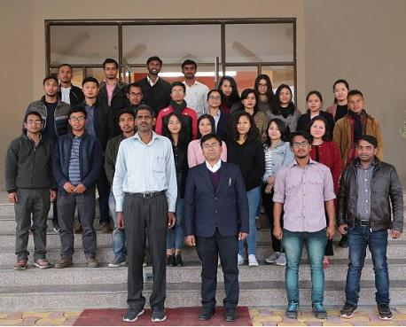
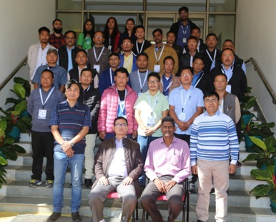
Outreach: Utilization of Space Tech. Applications for Decision makers
Training & Outreach activities | Nos
 | 2017 | 2018 | 2019
1 to 2-days training for Decision Makers | 251 | 300 | 23
1 to 2 Weeks training programmes | 160 | 170 | --
Exhibitions / videos / Distance Learning Programme | 9 | 11 | 1
Two days training for Asst. tech. Managers of MAMETI
7-8 Feb, 2019
Outreach for Forestry Officials, Arunachal Pradesh, 12-16 Nov, 2018

Slide 7
Outreach: Utilization of Space Tech. Applications Course Conducted
Short Term Courses: 77 candidates
- Basic Courses on RS&GIS – 47 candidates
- UAV Remote Sensing – 30 candidates
Project specific training: 100 officials
- AMRUT Capacity Building – 100 officials
Region specific Workshop : 282 participants
- Training for collection of Data on border villages for Meghalaya - 5
- Application of modern tools and technologies for state forest service
officers, Byrnihat Meghalaya– 29
- Development of CRM Tools in Agriculture and water resources management – 25
- State Meet on promoting Space Technology - 223
State Meets Conducted:
- Arunachal Pradesh
- Assam
- Manipur
- Meghalaya
- Mizoram
- Nagaland

Slide 8
Expanding Outreach: Existing & Proposed Programme
Proposed Programme***
Regular Thematic courses (1 WK)
Water Resources
Geosciences
Disaster management
Atmospheric Science
Agriculture
Forestry
UAV RS
Tailor made course
(as per demand)
Courses for BIMSTEC countries
Three Weeks res. Courses (2)
2 Weeks Short term Courses (2)
Existing Outreach activities
Regular Certificate courses
2 weeks Basic course (Once in every yr)
2 weeks Adv. course (Once in every yr)
Tailor made course
1-2 weeks for Govt. Depts
1-2 weeks for Educational Inst.
Encouraging students
Students internships
Students visits
*** Existing Outreach programme will continue

Slide 9
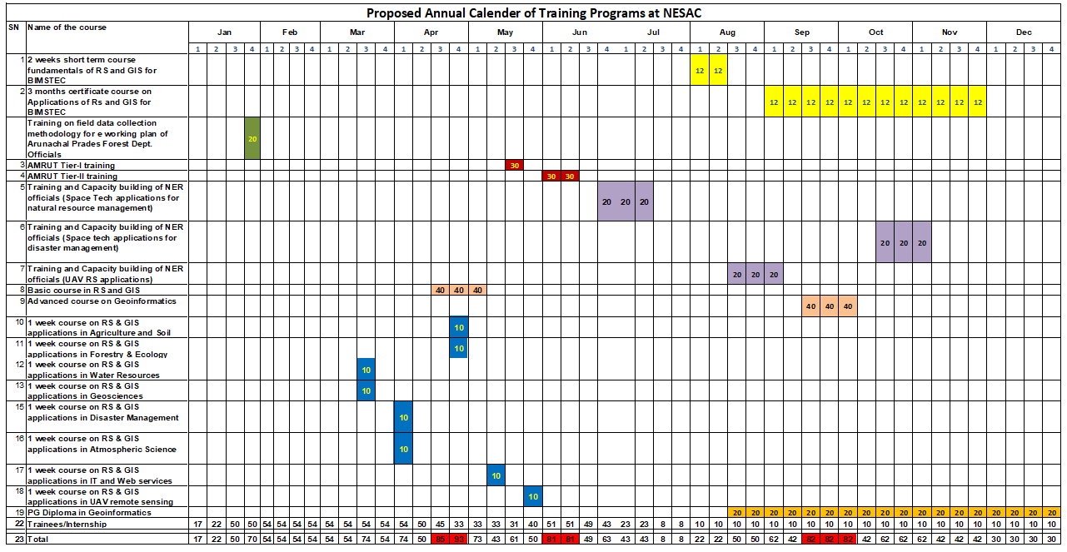
Proposed Course Calendar: Including all Training courses

Slide 10
Potential Organizations: Associated with Outreach & Research activities
Sl No. | Research & operational activities | No of Institutes involved in NER
 |  | Colleges | IITs/NITs/Engg. colleges | Universities | State/Central Research organization
1 | Remote Sensing & GIS | 5 | 12 | 5 | 8
2 | Early warnings | 0 | 0 | 0 | 4
3 | Atmospheric Science | 2 | 3 | 4 | 5
4 | Statistical modeling | 7 | 11 | 5 | 11
5 | Machine/Deep learning/Big data analysis etc. | 6 | 12 | 2 | 11
Total |  | 20 | 38 | 16 | 39

Slide 11
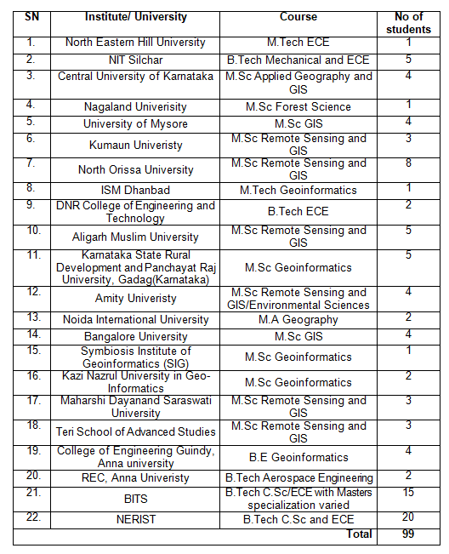
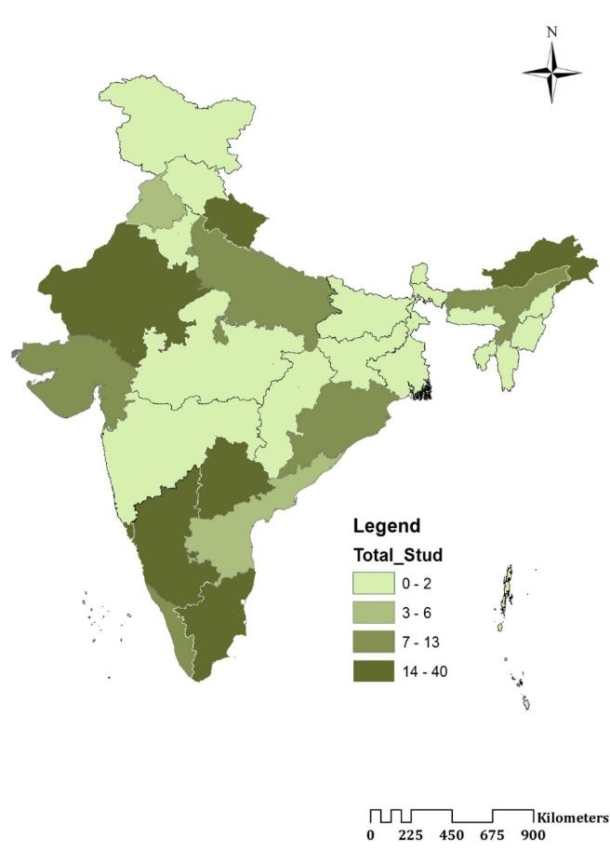
Student enrolment statistics
Coverage
From various places
Details of dissertation students/summer trainees: 2018
2017-2019

Slide 12
Students Enrolment : During 2019 from various Educational Institutions

Slide 13
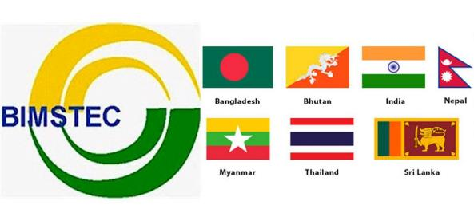
Capacity building for BIMSTEC countries
Hon'ble Prime Minister of India declared that the Government of India will provide outreach and capacity building programme to the researchers, students and professors of BIMSTEC countries on Space Technology Tools and Applications at NESAC.
4th Summit of BIMSTEC, Kathmandu, Nepal,
30-31 August, 2018
Bay of Bengal Initiative for Multi Sectoral Technical and Economic Cooperation
Three Month Residential Certification Course: 12 Research Personnel from BIMSTEC countries (2 candidates from each country) will attend the course. Stipend will be provided to the candidates in addition to their other travel/boarding expenses etc.
Short Term Residential Course: This course is planned for 12 Research Personnel from BIMSTEC countries (2 candidates from each country) on the Fundamentals of Remote Sensing and GIS. The entire expenses including travel/boarding etc. will be taken care.
Two such courses are planned every year for 24 persons
Two such courses are planned every year for 24 persons

Slide 14
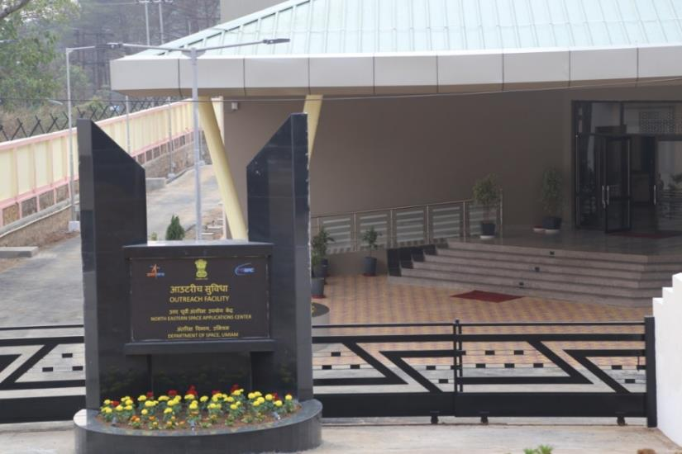
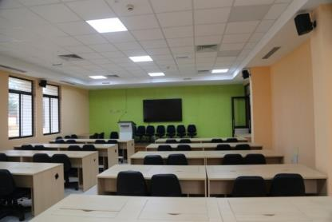
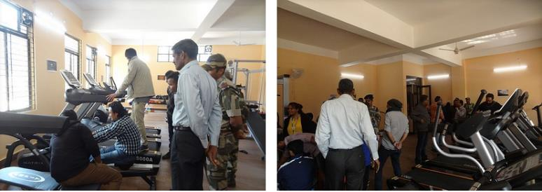
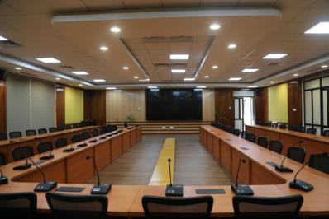
New Outreach Facility at NESAC: Infrastructures
Facilities
High speed campus 1G Wifi
Smart class room (2)
Sophisticated lab (2)
Outreach Cloud facility for student
100 seater conference room
Dedicated VC/conference
Library facility
Hostel (80 seater)
Fitness centre

Slide 15
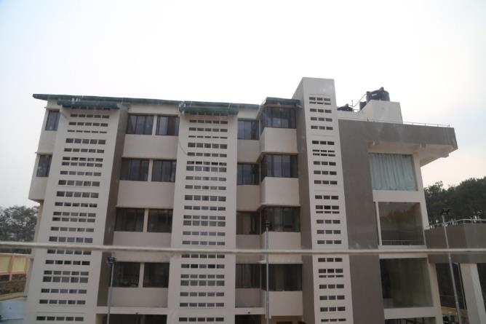
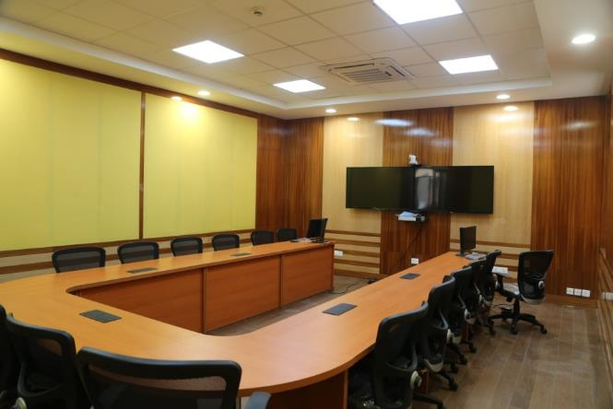
New Outreach Facility at NESAC: Infrastructures
Outreach entrance
Hostel Facility
VC Hall
Conference hall

Slide 16
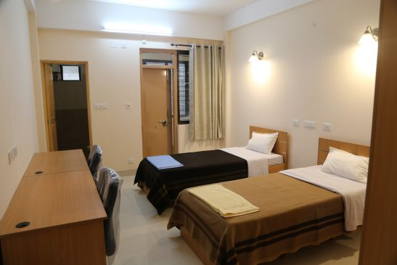
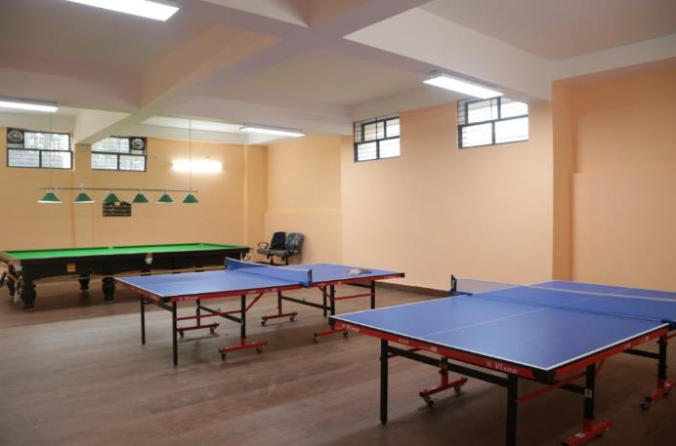
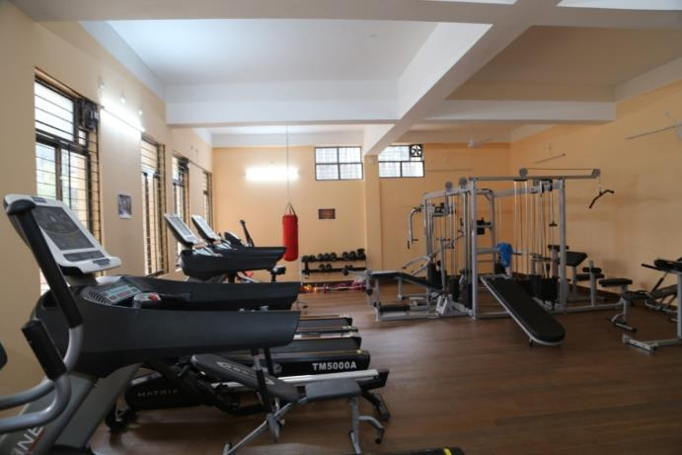
New Outreach Facility at NESAC: Infrastructures
Hostel accommodation
Smart classroom
Recreation room
Multi gym

Slide 17
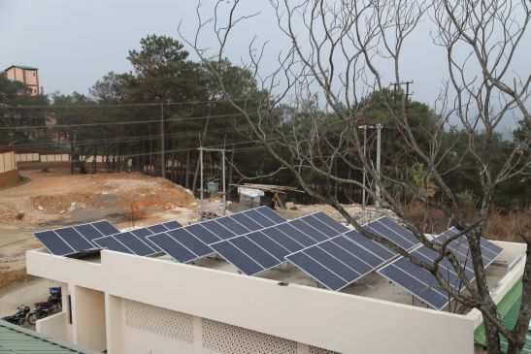
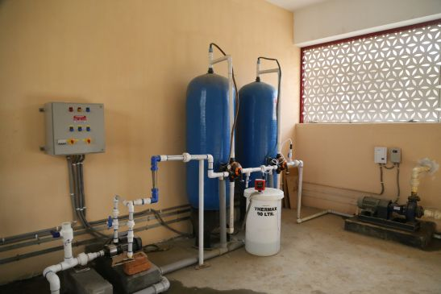
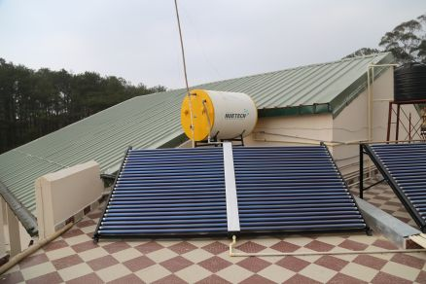
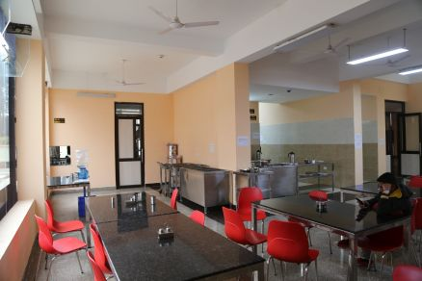
New Outreach Facility at NESAC: Infrastructures
Solar panels
Water treatment plant
Solar water heater
Mess

Slide 18
Few Flagships Projects carried out at NESAC

Slide 19
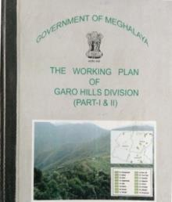
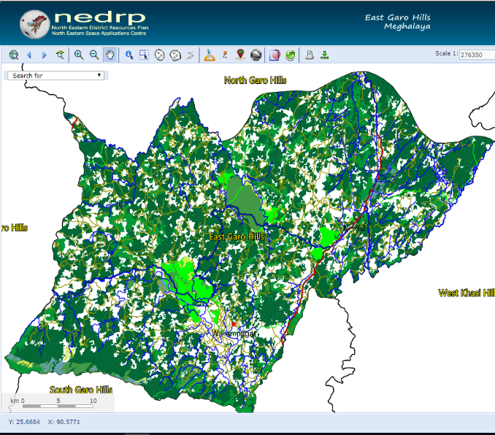
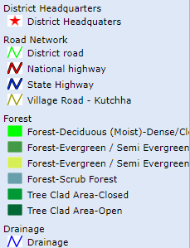
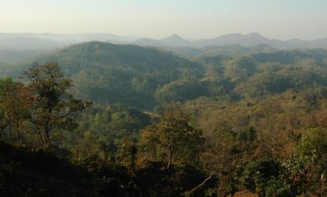
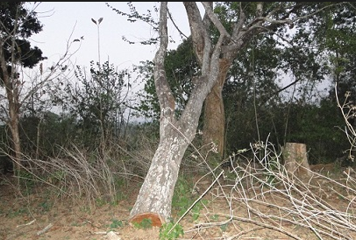
FOREST WORKING PLAN
Working Plan coverage in NER
Approved Working Plan for Garo Hills Forest Division
Land Resources & Forest type map
Success Story
Forest Working Plan for Meghalaya and Mizoram have been approved
Working Plan for
Lunglei Forest Division

Slide 20
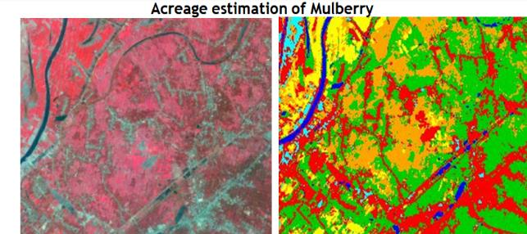
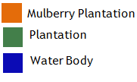
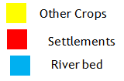
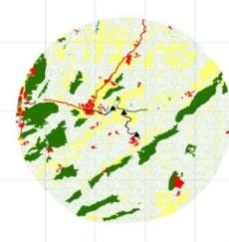
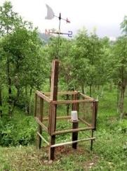
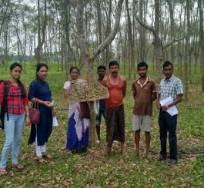
DEVELOPMENT OF SERICULTURE
Mapping of potential areas for silkworm food plants and Updation of SILKS portal (Phase II)
Potential area mapping: Mulberry, Muga, Eri and Tasar
70 priority districts from 25 States.
SILKS portal upgraded and is available in 12 languages
Mulberry acreage and leaf protein estimation
Area: Four districts of West Bengal
Technique: Hyperspectral study of leaf protein
Development of MIS: Decision making tool at farmers level and integrated with SILKS
Early warning of Muga Silkworm diseases and pests
Identification of landscape and climatic parameters crucial for disease incidence
Development of decision support system for diseases in progress
Geo-tagging of assets created under CSB funded projects
Monitoring of Sericulture assets created under CSB funded project/ schemes in the country with GAGAN
LULC of Muga farm taking 5km Buffer
Notes:
BILL 199

Slide 21
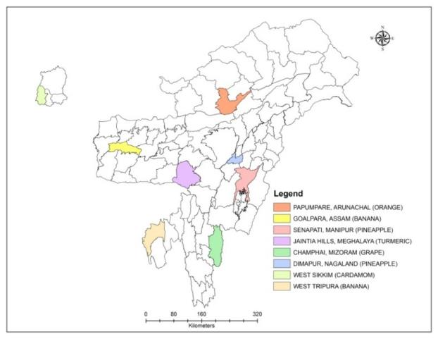
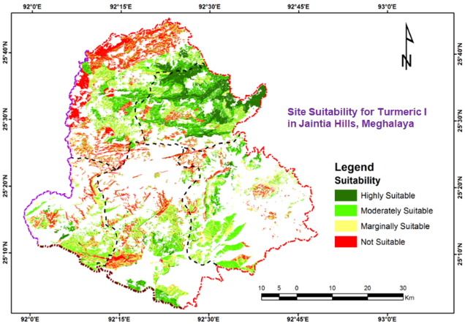
CHAMAN Project
Objectives
Identification and mapping of suitable areas for important horticultural crops in NER
One selected crop for 8 selected districts of NE states.
Study areas
One selected crop for 8 selected districts of NE states.
Current status
Completed the site suitability analysis of the selected crops in 8 selected districts of NE states.
Report submitted to MNCFC, New Delhi with detail maps and area statistics.
Future plan
In the second phase, one more crop will be selected from 8 districts of NE states for site suitability analysis.
NORTH EASTERN SPACE APPLICATIONS CENTRE
Notes:
Orange (AP), Banana(AS, TR), Pine apple (MN, NL), Cardamom (SK)

Slide 22
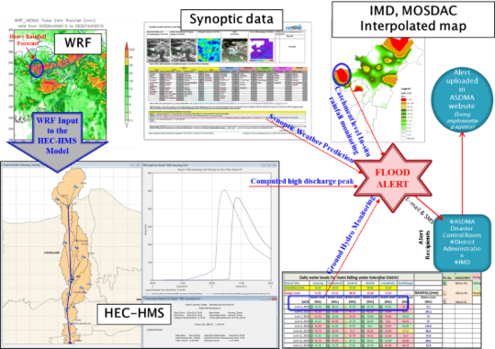
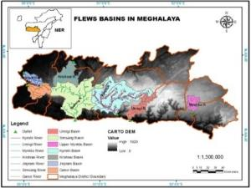
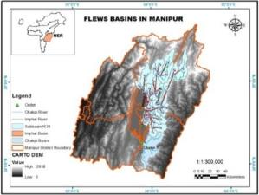
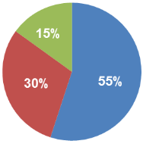
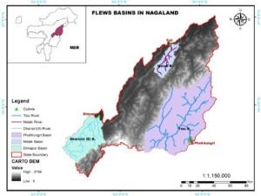
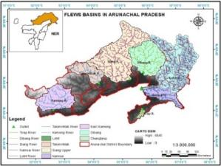
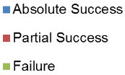
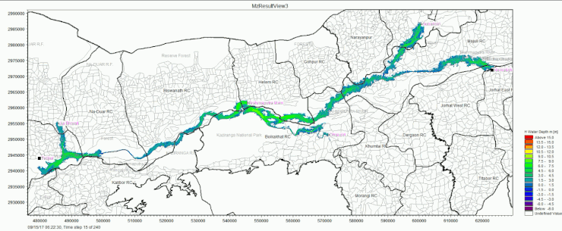
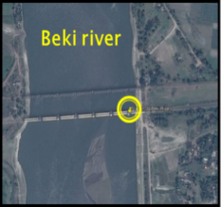
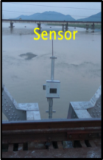
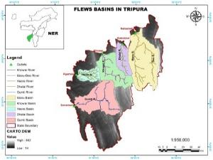
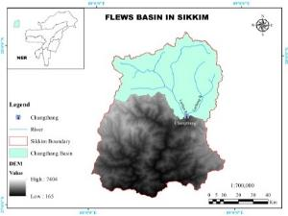
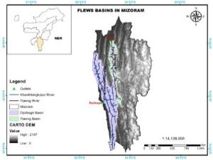
FLOOD EARLY WARNING SYSTEM (FLEWS) for NER
The Assam operational exercise
Mean Seasonal alert success score
(2012-2018)
Flood models developed for other NER states
Meghalaya (8 models)
Manipur (2 models)
Discharge based hydro-dynamic flood inundation simulation (under NHP) by NESAC hydro team
Nematighat
Nagaland (3 models)
Arunachal (7 models)
Tezpur
DWLR installed at two rivers (Beki & Aei) under FLEWS, Assam
Highlights & Issues:
FLEWS, Assam has completed 7 years as an operational exercise from 2012 to 2018. An average yearly alert success score of 75% with lead time ranging from 12- 36 hrs
Presently focus is on for extension of the service to other NER states.
Unlike Assam, hydro-met observations in other NER states is inadequate leading to difficulty in calibration and validation of the flood forecasting models. No funding support available at present for extension of FLEWS services to the other NER states
Tripura (5 models)
Sikkim (1 model)
Total of 28 models have been built and made ready for calibration and validation as part of extension of FLEWS to other NE states
Mizoram (2 models)

Slide 23
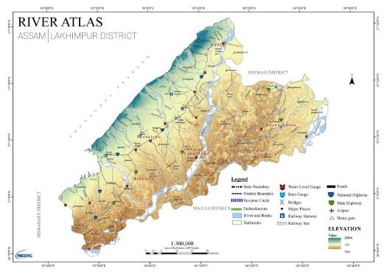
RIVER ATLAS FOR ASSAM
Achievements (Phase I):
Map all major and minor rivers of Assam (1:4,000) within state with emphasis on flood & erosion protection as well as flow regulation structures.
Map the source of origin of all the major rivers and tributaries
To delineate river catchments at different hierarchy
To map the structural measures for flood and erosion management
Prepare LULC map at 1:10K scale along the river banks with defined buffer
Discharge and sediment transport related model studies (Phase II)
Detailed district map showing all the major and minor rivers
Catchment map showing the source of origin of all rivers entering the district
Interim review & Map release by Hon’ble CM, Assam
LULC map for all the rivers with defined buffer
An interactive high resolution information system for river channels (Upto Sub-tributaries) in Brahmaputra & Barak valley of Assam
First of it kind baseline database for planning & execution of interventions for flood & bank erosion management

Slide 24
District Resources Plan in NE region
Receipt of National e-Governance Award 2017-18

Slide 25
GeoTagging & GeoMonitoring of Government Schemes/Projects
GeoTagging of
1500+ NEC funded projects
4000+ BTC Schemes
Agro-Horti assets /Sericulture assets
Infra. under AMRUT project
GeoTagging/Monitoring via
Mobile App with GAGAN/SBAS
Satellite/Drone images/Videos
Distributed 500 GAGAN dongles to planning departments of state for geo-tagging NLCPR assets.
Monitoring Dashboard
Near-realtime monitoring tools/MyDoNER App
GeoVisualization of schemes
Monitoring via high resolution satellite imagery
Monitoring of Orchid Lake resort construction
ONTIME UC
MAX. UTILIZATION OF RESOURCES
ENHANCHED GAP ANALYSIS
ACCURATE PLANNING
TRANSPERANCY IN MONITORING
25.07.2018
25.07.2018
25.07.2018

Slide 26
List of Institutions offering courses EO courses in North East
There are more than 100 Overall Institutions offering EO and Geo-information in India
In North East there are 15 Government / Central universities and 30 no of private universities but very few offer EO and Geo-informatics education and training.
Limited awareness and short term programs are offered at different Centres in NE.
Seminars / Conferences / Workshops are offered in Remote Sensing and Geoinformatics are organized as part professional Societies i.e. ISRS/ISG/INCA/ISPRS/IMS etc.

Slide 27
Capacity Building Infrastructure Development in North East India
NESAC established Outreach and Capacity Building infrastructure facility and plan to offer short and long duration programs in EO and Geo-information.
Recognizing well established state of art infrastructure and proximity to BIMSTEC Countries, honorable PM of India announced short courses (2 weeks) and Certificate Courses (3 months) at NESAC, funded by MEA, GOI
It is possible to conduct three parallel programs simultaneously with a capacity of 40 to 50 participants.
Three state of art IT & Geo-informatics laboratory facility for the participants for hands on and practical meeting the short and long term training programs
Theme based training short term training programs (i.e. AS/WR/FE/UR/AS etc.) are planned to be conducted.

Slide 28
Capacity Building Infrastructure Development in North East India
Basic training programs in RS & GIS on regular basis
Advanced training programs in HSRS/MWRS/UAV RS / ML/AI/DL etc. etc.
Tailor – made programs in Agriculture / Forest/ Urban Planning etc.
Planning training programs specific to eight states of NE jointly with IIRS/NRSC/SAC under NNRMS
Short / long term research / operational project support programs for graduate / post-graduate students / researchers / academic institutions at the newly established outreach facility
Visits to NESAC are organized to large number of Students / Academicians / Researchers from allover India, majority from North East of India.

Slide 29
NESAC offer to WGCapD-8
NESAC can take up any initiatives of WGCapD-8 in the area of Remote Sensing, geo-information, UAV RS, Space Science, Meteorology, satellite communication and their applications for the eastern part of India as well as neighboring countries being proximity to this region
Thank you all for the opportunity

