Slide 1
Implementation of WGCapD Training Calendar
Committee on Earth Observation Satellites
Lauren Childs, National Aeronautics and Space Administration
CEOS WGCapD-8 Annual Meeting
#30
Working Group on
Capacity Building & Data Democracy
Indian Institute of Remote Sensing
Indian Space Research Organisation
Dehradun, India
March 06th – 08th, 2019

Slide 2
WGCapD-8 Annual Meeting
IIRS, Dehradun, India March 06th – 08th, 2019
Current Training Announcement Process
WGCapD announces upcoming trainings through the CEOS WGCapD website and through a growing CEOS WGCapD-World distribution list that includes past training participants.
Active WGCapD agencies use their own approaches and provide different information to advertise upcoming training events.
Each agency has its own approach and provides different information about their upcoming training events.
While reaching intended training audiences, a more standardized and similar approach to that used across the broader training community should allow easier discovery and more access to our training events.

Slide 3
WGCapD-8 Annual Meeting
IIRS, Dehradun, India March 06th – 08th, 2019
Implementation of WGCapD Training Calendar
Overview:
One shared training calendar for WGCapD
To be hosted on the CEOS WGCapD website
Similar calendars will be hosted on NASA, DLR, and others’ websites and will feed the WGCapD calendar
Follows the approach developed by EUMETSAT and their training activities, as well as by the WMO/CGMS VLab training network and by WMO’s on-line learning platform WMO Learn
Acceptance of the EUMETSAT calendar approach and format was based on its history of use, a reasonable amount of information to be included, and general acceptance by the training community of this tool

Slide 4
WGCapD-8 Annual Meeting
IIRS, Dehradun, India March 06th – 08th, 2019
Implementation of WGCapD Training Calendar
Benefits:
Encourages sharing of training events and plans
Supports building skills to use Earth observations for informed decision making and societal benefit
Simplicity of training activities available on a standardized calendar
Clarity in consistent information
Allows training participants to more easily find, participate, and learn from our training activities to use Earth observations for their needs

Slide 5
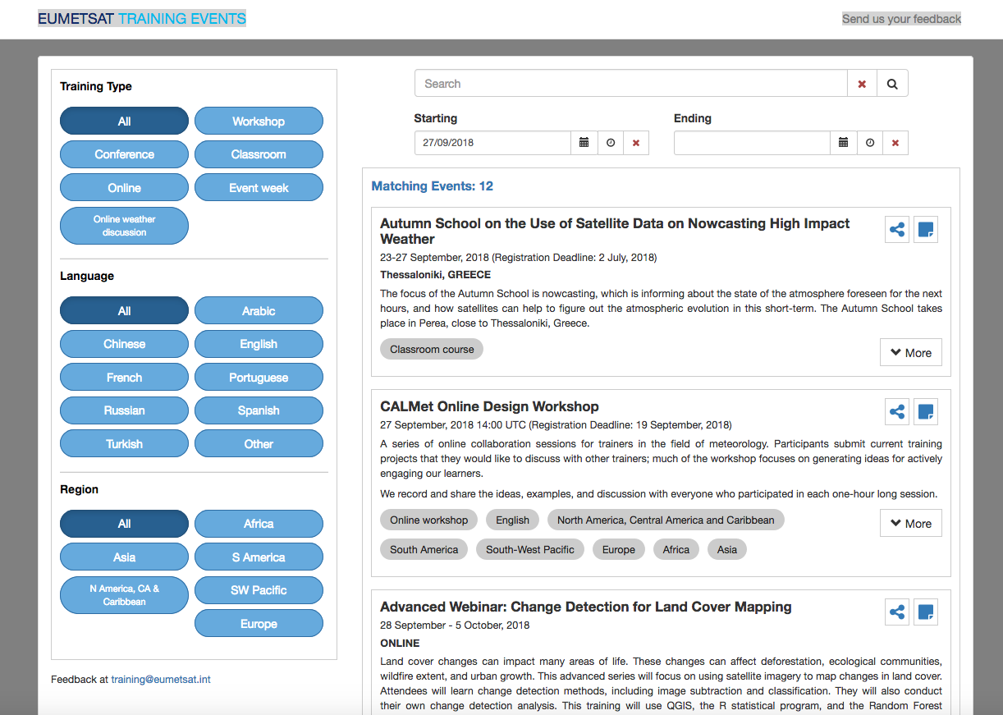
WGCapD-8 Annual Meeting
IIRS, Dehradun, India March 06th – 08th, 2019
Training Calendar Example: EUMETSAT
http://trainingevents.eumetsat.int/

Slide 6
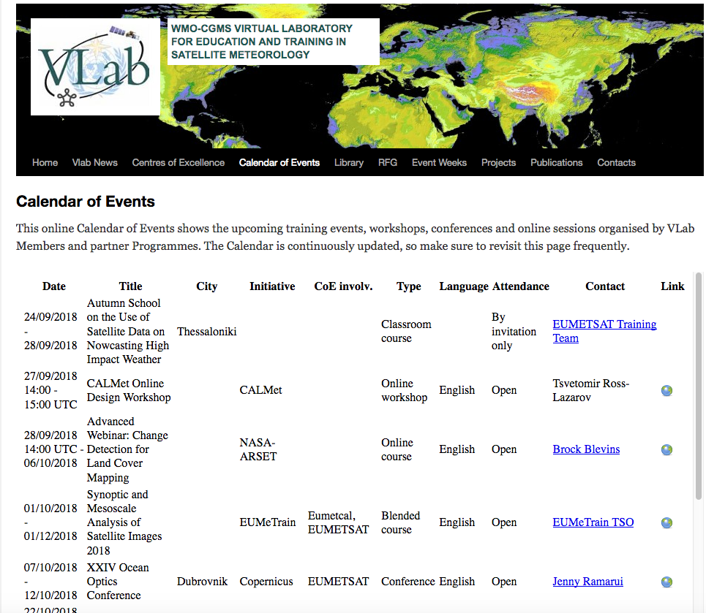
WGCapD-8 Annual Meeting
IIRS, Dehradun, India March 06th – 08th, 2019
Training Calendar Example: VLab
https://www.wmo-sat.info/vlab/calendar-of-events/

Slide 7
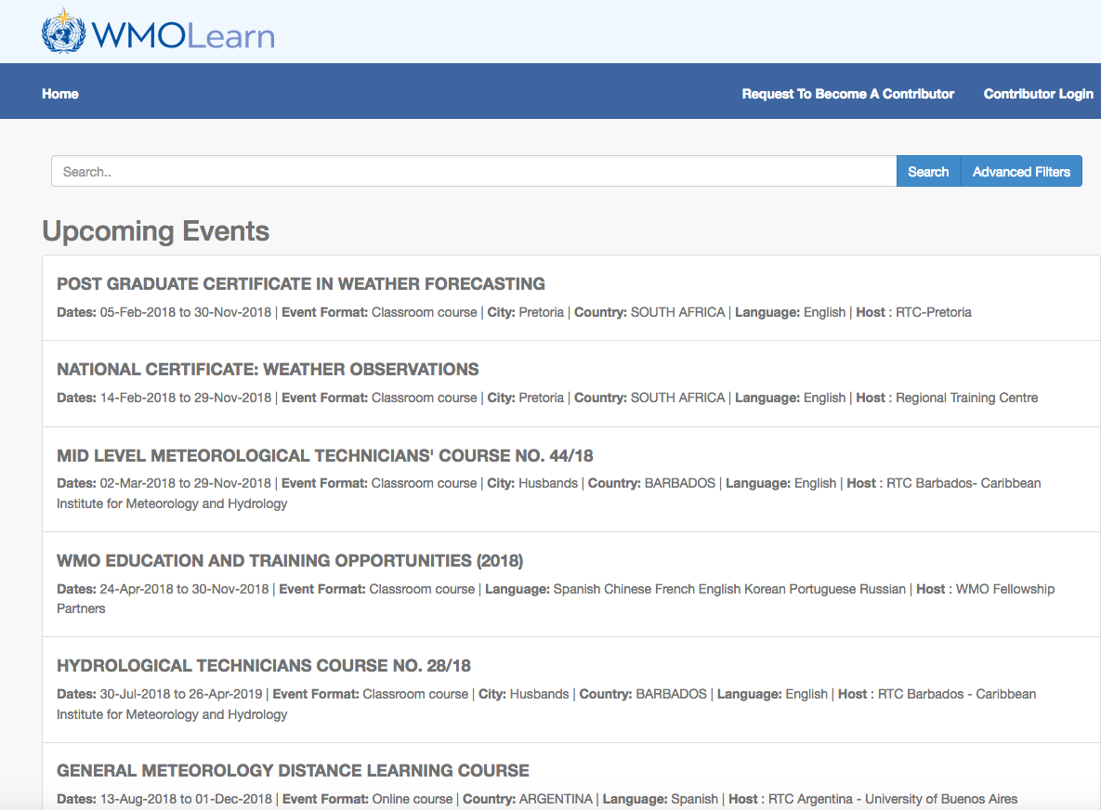
WGCapD-8 Annual Meeting
IIRS, Dehradun, India March 06th – 08th, 2019
Training Calendar Example: WMO Learn
https://learningevents.wmo.int/#/events

Slide 8
WGCapD-8 Annual Meeting
IIRS, Dehradun, India March 06th – 08th, 2019
Implementation Plans
Three pronged approach:
CEOS SEO implements a training calendar for WGCapD
NASA will implement a training calendar on the Applied Sciences website
DLR will implement a training calendar through EOCollege
Collaborative efforts:
Evaluate the centralized database to see if additional fields might be needed
Determine if the fields required suggest entering data into the existing database or whether a new one is needed with additional fields, to be hosted by the CEOS SEO
Work with EUMETSAT as they revise the API and provide feedback, identify POCs from pilots and receive training from EUMETSAT
Tiger team of developers working on development
Pilots define their “front end” independently then compare approaches and discuss
Finalize plans for where to host the calendar and its component parts
A Concept of Operations will be developed to explain how the calendar(s) will be operated, e.g. how to enter information, relationships between calendars, and permissions
The WGCapD calendar design will be provided to the WGCapD participating agencies for final review and then will be implemented

Slide 9
WGCapD-8 Annual Meeting
IIRS, Dehradun, India March 06th – 08th, 2019
Current Activities
Compiling fields used by EUMETSAT, VLab, and WMO Learn calendars
Reviewing and compiling fields for discussion and selection of a suggested list of fields for inclusion in the calendars
Investigating user interface options
Evaluating pros/cons for each approach
Next planning call in mid-March
Exploring tiger team of developers to discuss implementation
Timeline
March: Reviewing fields & user interfaces
April: NASA/CEOS finalize fields
May-June: NASA/CEOS build and beta testing; EO College implementation
July-August: Refinement
September: All calendars live

Slide 10
WGCapD-8 Annual Meeting
IIRS, Dehradun, India March 06th – 08th, 2019
POCs
Brian Killough: Brian.D.Killough@nasa.gov
Robert Eckardt: Robert.Eckardt@uni-jena.de
Lauren Childs-Gleason: Lauren.M.Childs@nasa.gov
Nancy Searby: Nancy.D.Searby@nasa.gov

