Slide 1


AfriGEOSS-Capacity Building and Data initiatives
Committee on Earth Observation Satellites
Mr Zipho Tyoda -Department of Science and Technology-AfriGEOSS
CEOS WGCapD-8 Annual Meeting
Agenda Item #CB36
Capacity Building & Data Democracy
Indian Institute of Remote Sensing
Indian Space Research Organisation
Dehradun, India
March 06th – 08th, 2019

Slide 2
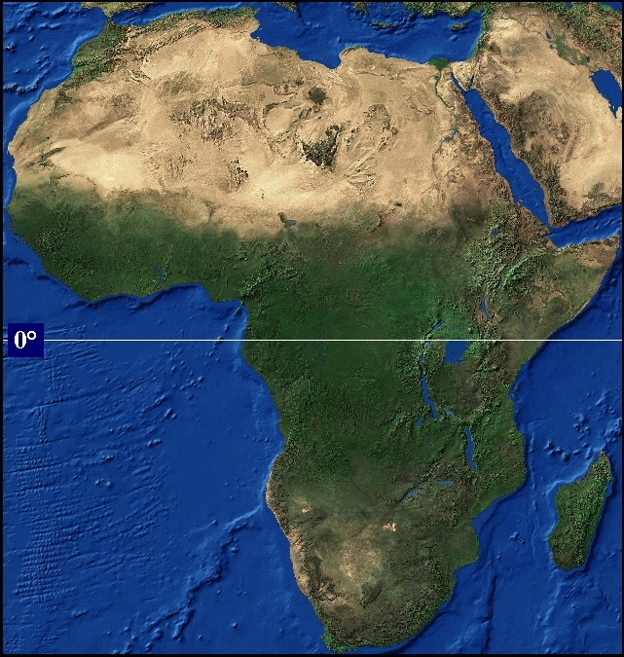
… Earth Observations for complex issues
  world’s second largest continent (30.2 m km2) including islands
  second most populous continent (about 15% of the world’s population)
  has a vast land area with difficult terrain (deserts, rainforest, inland water bodies, complex and inhomogeneous topography, the Great Rift Valley
  30% of oil resources
  Earth observations are critical to support environment and natural resources management for protection of life and property and sustainable socio-economic development of Africa.
United States of America
India
Argentina
Europe
New Zealand
China

Slide 3
AfriGEOSS Initiative
Africa led, driven and implemented;
Inclusive, flexible;
  GEO Member or Not
  All national and regional institutions - government, public sector agencies, non-governmental entities, specialized organizations, education and research institution and private sector, in all its forms.
  Earth observations provider, user or potential for either.
Values international collaboration.

Slide 4
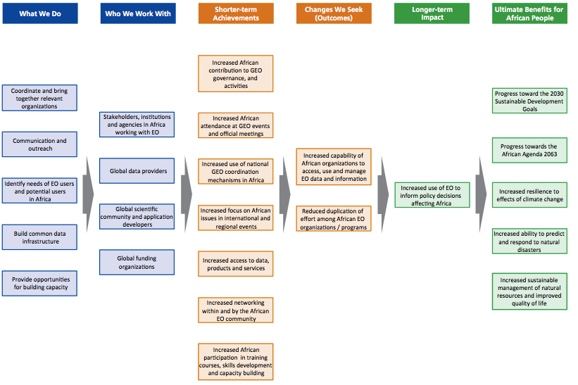
AfriGEOSS Initiative
  Who is doing What Where

Slide 5


Observations and Opportunities
Data is critical for informed decisions and improved livelihoods;
Growing free and open data;
Increased uptake of Earth observations in the continent;
Africa has capacity incl. infrastructure;
Increase in data initiatives; and
Leveraging opportunities and building collaborations;

Slide 6
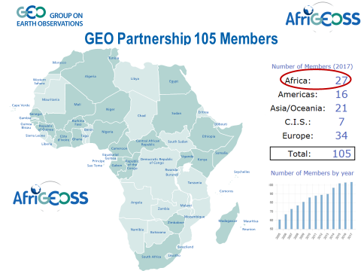
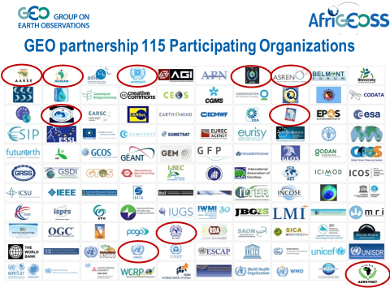
GEO MEMBERS & PARTICIPATING ORGANISATION IN AFRICA
+RWANDA
+TOGO
+BENIN

Slide 7
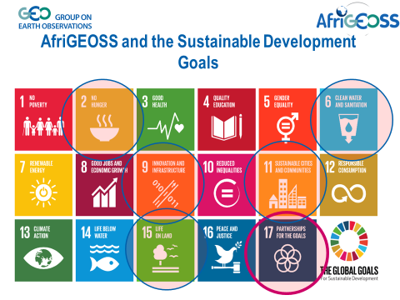
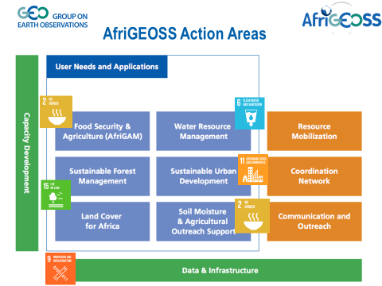
SDGs and AfriGEOSS ACTION AREAS

Slide 8
Libreville Outcomes “ CB related”
  Across the board comprehensive capacity building (Institutional, Human Capital, and Infrastructure).
  Communication: Community Outreach to create more awareness on the value and impact of EO to the public or citizens, bridge the communication gap between the scientist, decision makers and political mandates.
  Ensure end user focused approach where outreach and open data are critical for the development of high impact products and services.
  Enhance coordination of EO activities in the region (national, regional and global initiatives) in order to maximize successful and sustainable impact.
  Coordination of cross-border project objectives is urgently required in order to reduce duplication of efforts and outcomes.

Slide 9
Gaps
  Dedicated funding for the CB initiatives.
  Uneven distribution of capacity ( user, practitioners) on the different RECS ( SADC, ECOWAS, ECCAS, AMU, EAC)
  Skills gap in the user community and practitioners.

Slide 10
OPPORTUNITIES
  AfriGEOSS should ensure longevity of externally funded Capacity Building (institutional, infrastructure, human) initiative.
  AfriGEOSS should repackage the communication of the impact of externally funded Capacity Building initiatives for appreciation by the political leaders.
  AfriGEOSS should keep a registry of Capacity Building initiatives in order to avoid duplication.

Slide 11
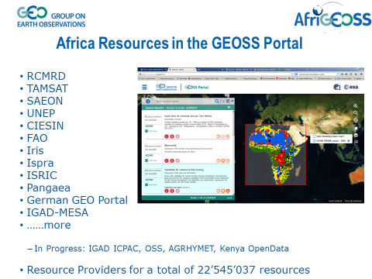
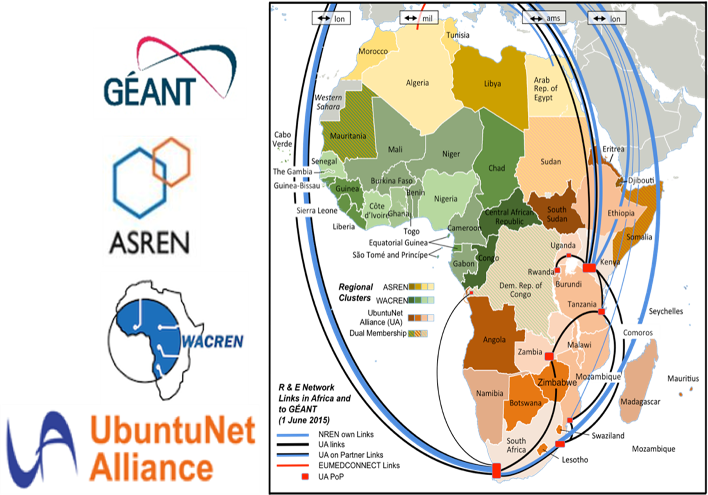
Africa Data Infrastructure & Resources

Slide 12
Sunyani outcomes on Data Infrastructure
  Facilitate linkages of National Research and Education Networks (NRENs) with the connectivity needs of national and regional institutions.
  Adopt international standards for data quality, metadata & interoperability.
  Connect African GEO-Portals with GCI to strengthen discovery and access for Africa owned & held.
  Leverage partnerships/co-location with other disciplines e.g. Astronomy and ICT.
  Explore innovative means to address issues of data access, processing, funding and coordination.

Slide 13
Libreville Outcomes “ Data Infrastructure”
  Ensure end user focused approach where outreach and open data are critical for the development of high impact products and services.
  Enhance coordination of EO activities in the region (national, regional and global initiatives) in order to maximize successful and sustainable impact.
  Coordination of cross-border project objectives is urgently required in order to reduce duplication of efforts and outcomes.

Slide 14
Ideal approach on Data Infrastructure initiatives in Africa
  Co-location and leverage on the SKA computing capabilities.
  Develop the EO platform in ADIRC ( prototype focused on Food Security).
  AfriGEOSS to coordinate Data Cube and other data infrastructure initiatives in Africa.
  AfriGEOSS to ensure that data initiatives in Africa respond to the African Space programme and Regional agenda.

Slide 15
OPPORTUNITIES
  AfriGEOSS should ensure longevity of externally funded Capacity Building (institutional, infrastructure, human) initiative.
  AfriGEOSS should repackage the communication of the impact of externally funded Data Infrastructure initiatives for appreciation by the political leaders.
  AfriGEOSS should keep a registry of Data Infrastructure initiatives in order to avoid duplication.

Slide 16
CHALLENGES
  Dedicated Funding
  Coordination
  Support

Slide 17

HOW CAN WE MEASURE PROGRESS?
Reason for the existence of the regional GEO “ GEOs-IKIGAI”
GEO FOUNDING PRINCIPLES
OPEN, FLEXIBLE AND SHARED PLATFORM.
USER-CENTRIC APPROACH
PASSION
GOOD VISSION BUT POOR IMPLEMENTATION
EFFICIENT, INEFFECTIVE GEOSS
IMPACT
TECHNICAL CAPABILITIES
GEOSS IKIGAI
SBA PRODUCTS
UN-SDG PRODUCTS
SENDAI PRODUCTS
GLOBAL CHANGE PRODUCTS
MEMBER STATES VISION AND POLICY
OPEN DATA AND KNOWLEDGE
DATA INFRASTRUCTURE
STRUCTURED DATA CUBE INITIATIVES
GEO MEMBERS CAPACITY BUILDING
GEOSS WITH SHARED DATA, PLATFORMS AND PRODUCT (FAIR-Principles)
GOOD FRAMEWORK BUT INEFATIVE
GOOD PLATFORMS BUT NO PROGRESS
VALUE
PLATFORM FOR COLLABORATION
FOCUSED CONTRIBUTION BY THE PARTICIPATING ORGANISATIONS.
PRIVATE SECTOR INVOLVEMENT TO STIMULATE ECONOMIC GROWTH

Slide 18


