Slide 1
The AmeriGEO initiative
Committee on Earth Observation Satellites
Betzy Hernandez Sandoval / NASA
on behalf of the AmeriGEO Coordination Working Group
CEOS WGCapD-8 Annual Meeting
Agenda Item # 22
Working Group on Capacity Building
& Data Democracy (WGCapD)
Indian Institute of Remote Sensing
Indian Space Research Organisation
Dehradun, India
March 06th – 08th, 2019
Notes:
Nancy - should we default to the title listed on the agenda, i.e. “CB Support to AmeriGEO Week in Peru”?

Slide 2
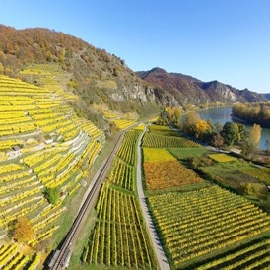
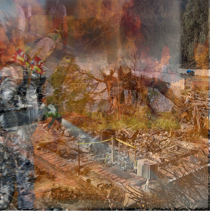
AmeriGEO overview
The AmeriGEO regional initiative promotes collaboration and coordination among GEO members in the Americas.
Disaster risk reduction, particularly for data exchange associated with early warnings and for the generation of regional products of early warnings
Biodiversity and Ecosystem Monitoring including biodiversity observation in coastal, marine, and continental habitats, in the context of capacity building for better monitoring, management, and maintenance of ecosystems and biodiversity they support; also to predict future changes.
Agriculture, associated with climate variability, climate change, and food security.
Water, associated with the management approach of water resources and data management.
Agriculture
Water
Disasters
Biodiversity
AmeriGEO focuses its efforts on four strategic Social Benefit Areas (SBAs) selected by the member countries

Slide 3
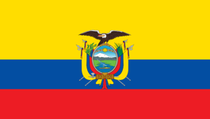
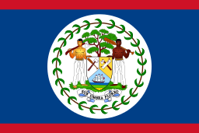
AmeriGEO overview
Argentina
Bahamas
Belize
Brazil
Canada
Chile
Colombia
Costa Rica
Ecuador
Honduras
Mexico
Panama
Paraguay
Peru
United States
Uruguay
16 member countries
2 observers: Bolivia, Guatemala
AmeriGEO members
Non-AmeriGEO members

Slide 4
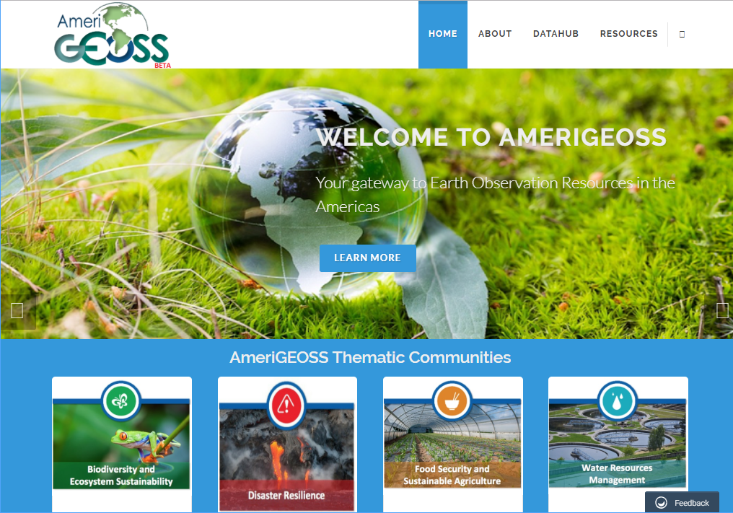
Community platform:
www.amerigeoss.org

Slide 5
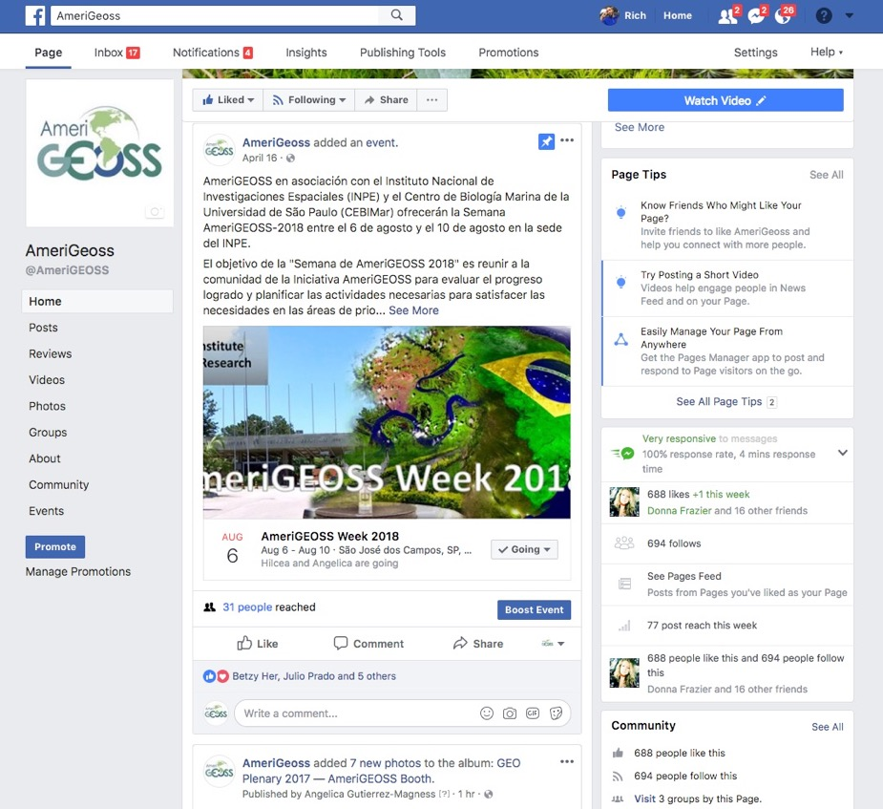
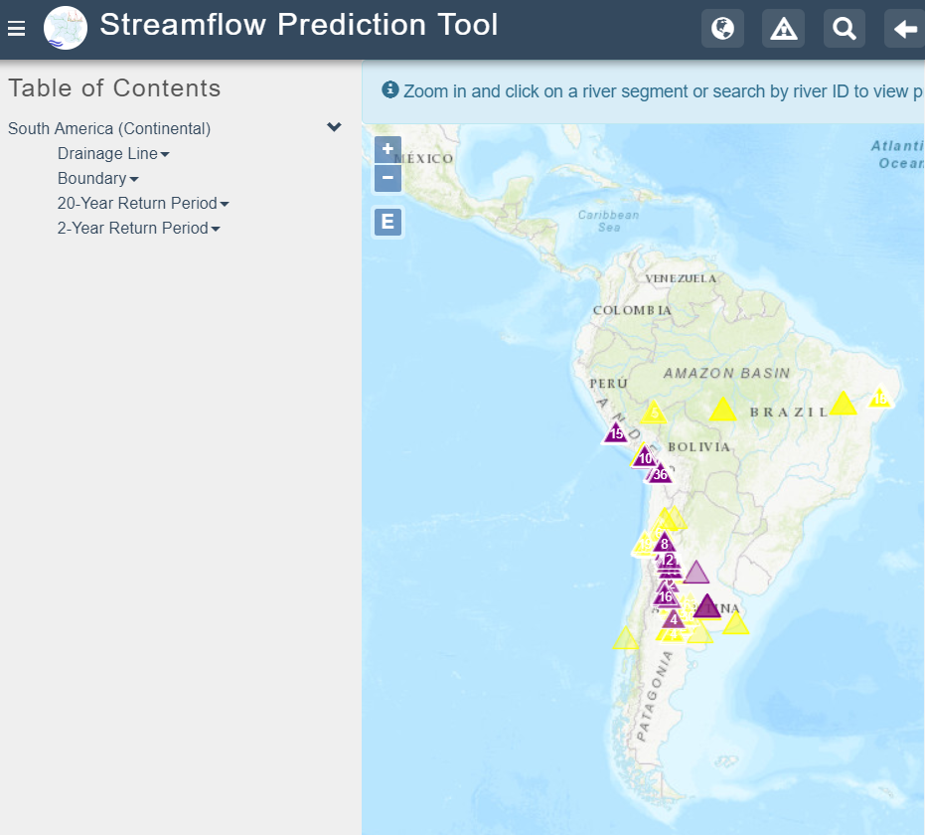
AmeriGEO links w/ CEOS WGCapD
AmeriGEO and data democracy:
Access to open data from the region’s countries provided through the AmeriGEO Community Platform
Spatial and non-spatial data
Use of social media channels (e.g. Facebook, Twitter) to engage, advocate for, and inform about open data
Engagement w/ other GEO initiatives (e.g. GEOGLOWS) which provide access to open data -> global Streamflow Prediction Tool

Slide 6
AmeriGEO links w/ CEOS WGCapD
Capacity building in the framework of AmeriGEO* (1):
AmeriGEO Week Symposia: focused trainings of 3-5 day duration (3 iterations: 2016-2018) -> some trainings co-executed w/ CEOS WGCapD
NASA ARSET courses: webinars, generally of a few hours spread over multiple days, and can be self-paced
NASA DEVELOP: involves some co-development w/ teams based in the USA, teams based in other countries
Ad hoc training courses: e.g. in framework of 4 NASA-funded AmeriGEO projects, other collaborations
* CB activities generally prioritized by the 4 strategic SBAs for the region.

Slide 7
AmeriGEO links w/ CEOS WGCapD
Capacity building in the framework of AmeriGEO (2):
AmeriGEO Week Symposia: annual, in-person trainings for those who could finance participation in the symposia
Attendance at the CEOS WGCapD workshops at the Symposia have gone from 25 in 2016 to 14 in 2017 to 5 in 2018
NASA ARSET courses: reaches more people, but may not be as in-depth as in-person trainings -> reached all countries in the Americas in 2018
NASA DEVELOP: co-development, and focused on limited number of countries per 10-week term
Ad hoc training courses: generally in-person

Slide 8
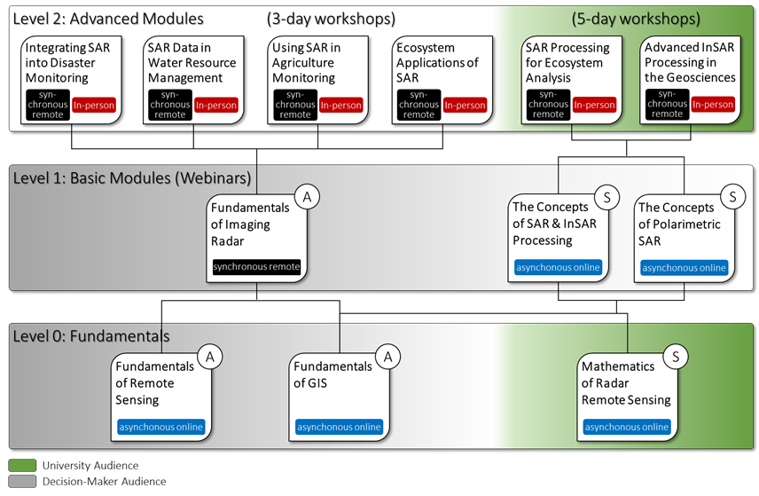
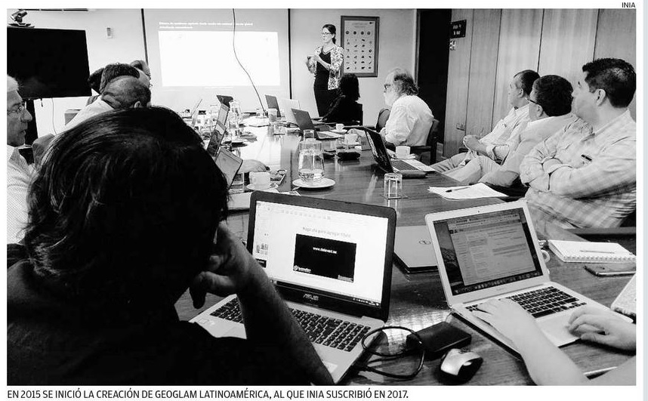
USGEO / NASA-supported AmeriGEO projects
All 4 projects have CB focus:
SAR-CBC: A Capacity Building Center for the Use of SAR in Decision Making
Laying the Foundations of the Pole-to-Pole Marine Biodiversity Observation Network (MBON) of the Americas
Harnessing Earth Observations to Support Indigenous-Led Land Management (EO4IM)
Supporting the Vision for GEOSS in the Americas: Community Building and Capacity Development in Support of AmeriGEO’s Food Security and Sustainable Agriculture Area
SAR-CBC course concept
GEOGLAM workshop in Chile (2019)
Notes:
These projects are running from 2018 to 2020 and all have both research and capacity building component.

Slide 9
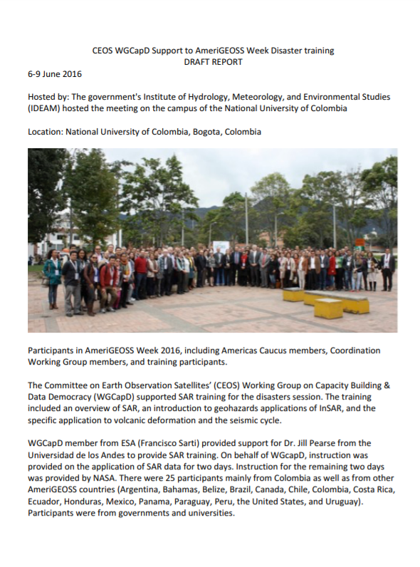
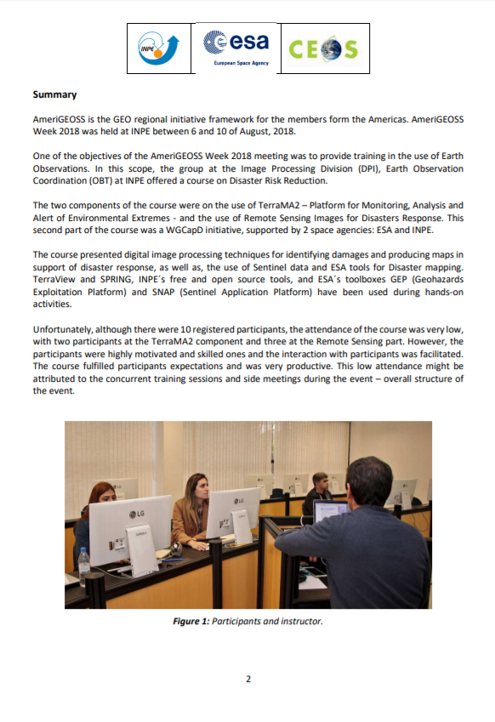
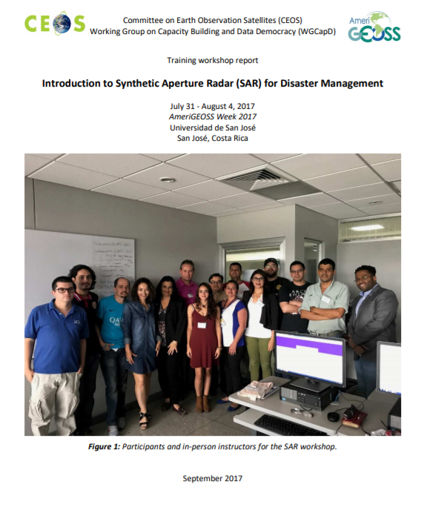
AmeriGEO links w/ CEOS WGCapD
http://ceos.org/ourwork/workinggroups/wgcapd/training-workshops/
Notes:
Reports from the trainings at the past 3 AmeriGEO week symposia are all on the CEOS WGCapD webpage, and at each of the symposia, trainings were done in conjunction with the WGCapD.

Slide 10
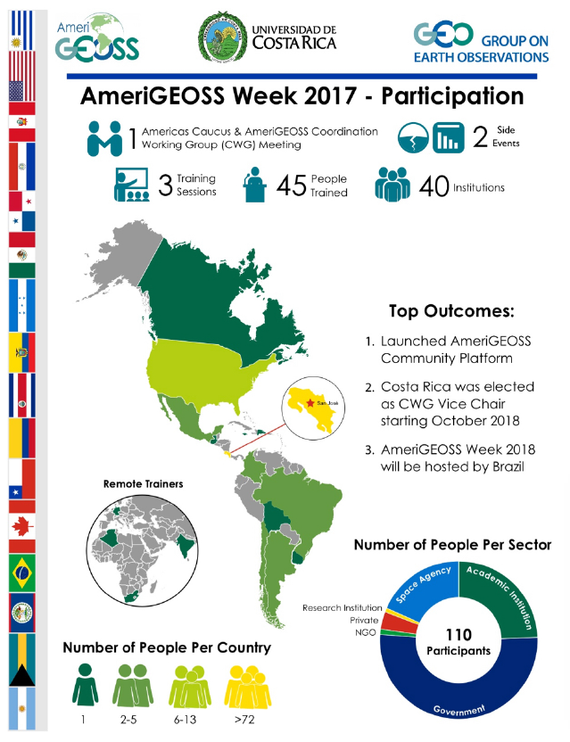
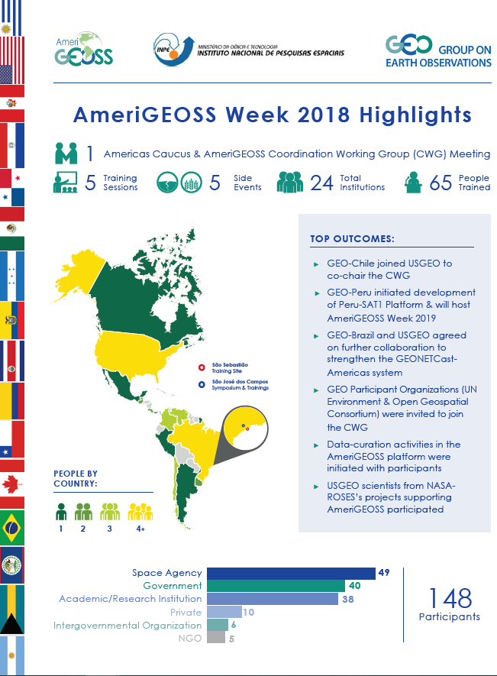
AmeriGEO links w/ CEOS WGCapD
Notes:
Here are some statistics on how many training sessions were held and how many people attended the last 2 AmeriGEO Week Symposia, in Costa Rica and in Brazil.

Slide 11
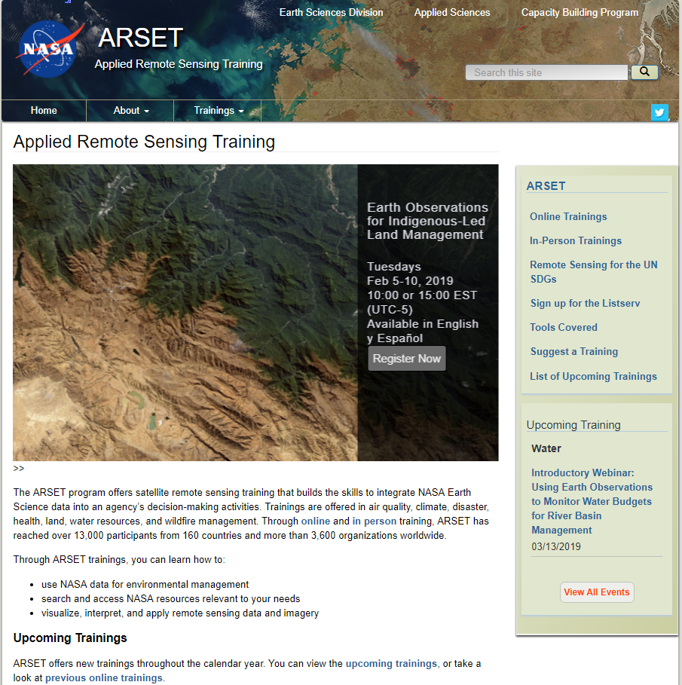
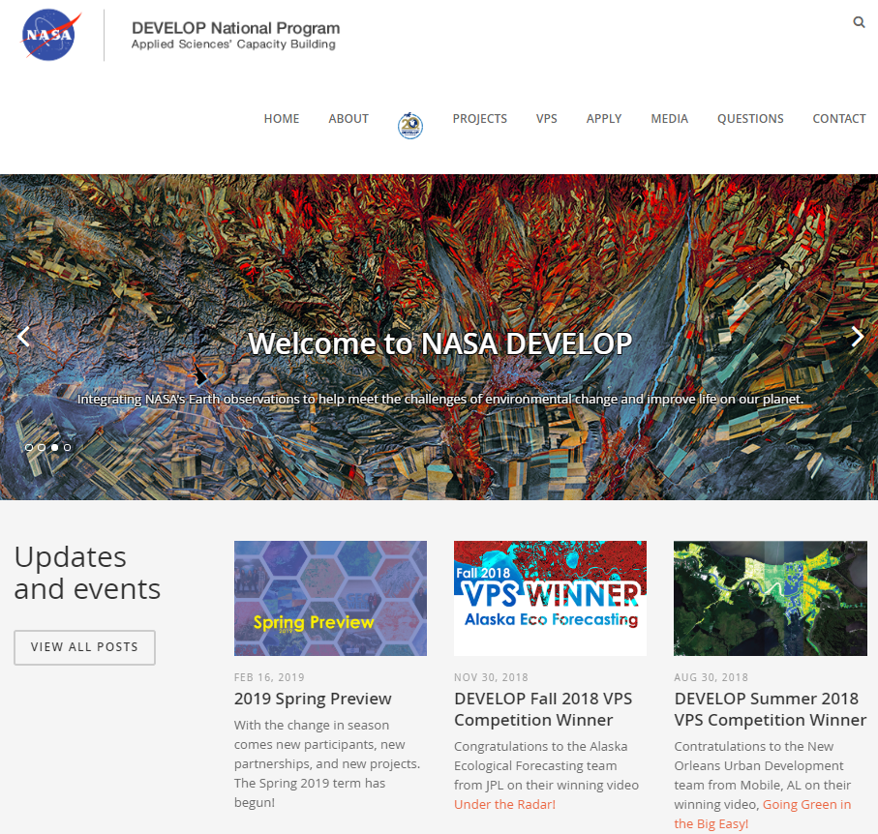
AmeriGEO links w/ CEOS WGCapD
-Bilingual webinars w/ participants in the Americas
-Webinars focused on AmeriGEO projects (e.g. EO4IM webinar series)
-A number of DEVELOP projects seeking to help co-develop tools for stakeholders in the Americas
Notes:
From the standpoint of AmeriGEO, there are 2 kinds of modalities of ARSET courses: general ARSET courses, and ARSET courses focused on AmeriGEO.

Slide 12
AmeriGEO links w/ CEOS WGCapD
2019 planned activities:
Training calendar
Database of training materials, reports from previous workshops
Surveys to better understand priorities and gaps
Engagement opportunities:
AmeriGEOSS Week 2019
Targeted ARSET courses
Coordination on training calendar, database, surveys

