Slide 1
CapD in Vietnam
Committee on Earth Observation Satellites
Vietnam National Space Center (VNSC)
CEOS WGCapD-8 Annual Meeting
Activities – Technology, Tools & Methods
Working Group on
Capacity Building & Data Democracy
Indian Institute of Remote Sensing
Indian Space Research Organisation
Dehradun, India
March 06th – 08th, 2019

Slide 2
WGCapD-8 Annual Meeting
IIRS, Dehradun, India March 06th – 08th, 2019
Objectives & Target
Objectives
Building capacity for Vietnamese remote sensing technical experts from academies and universities in applying EO data (especially SAR data) and processing technology
Target participants:
Remote sensing experts from Academy in VAST, ministries and universities in Viet Nam includes: VNSC, FIPI, National Center for remote sensing (MONRE), STI, NIAPP, VNU, Can Tho University, Hue University…
Topic:
Rice monitoring
Forest monitoring
Flood
Subsidence

Slide 3
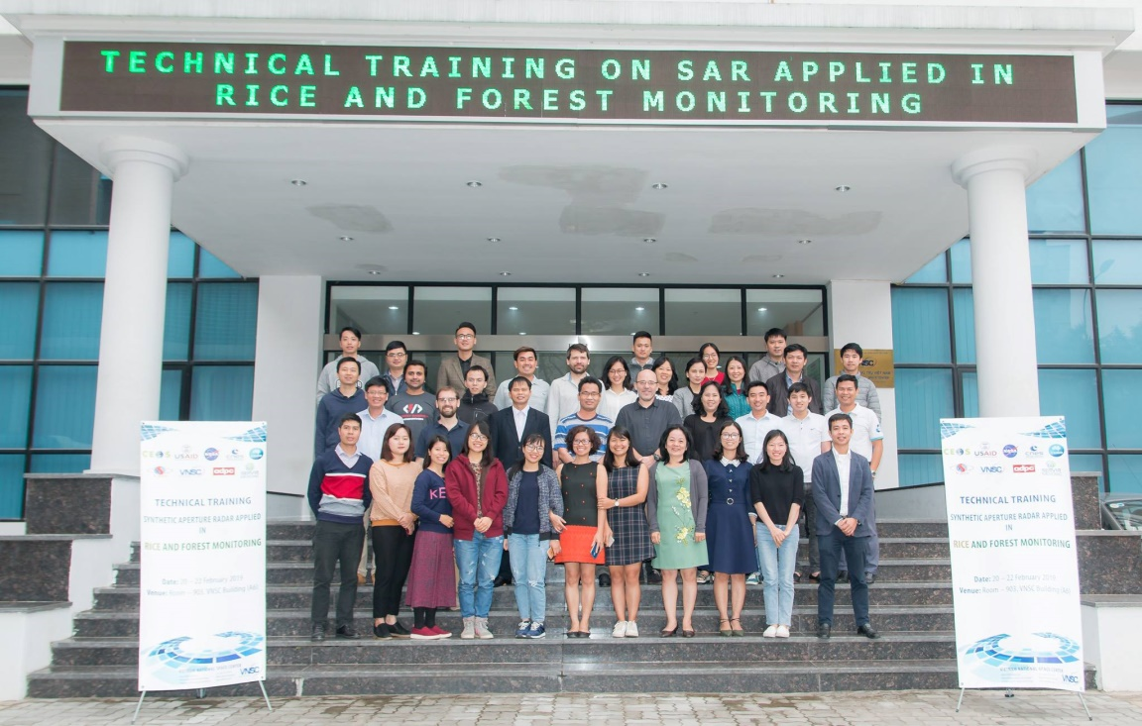
WGCapD-8 Annual Meeting
IIRS, Dehradun, India March 06th – 08th, 2019
Outcomes of training
Connect experts and EO community
Understand the physical information content of SAR data and statistical properties of SAR images.
Access and download available EO data portal and free softwares.
Able to conduct time series processing of training topics
Technical training: synthetic aperture radar applied in rice and forest monitoring
Hanoi, 20th – 22nd february 2019

