Slide 1

NASA Highlights
Committee on Earth Observation Satellites
Nancy D. Searby, National Aeronautics and Space Administration
CEOS WGCapD-8 Annual Meeting
#18
Working Group on
Capacity Building & Data Democracy
Indian Institute of Remote Sensing
Indian Space Research Organisation
Dehradun, India
March 06th – 08th, 2019

Slide 2







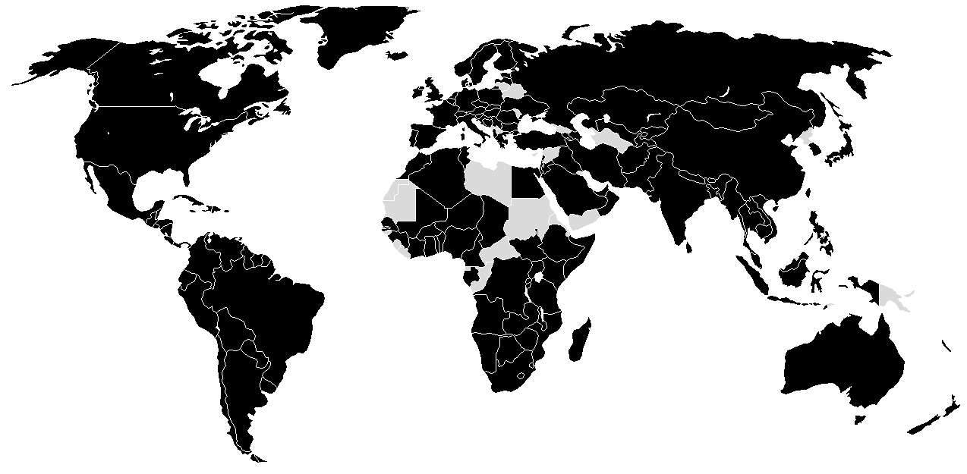


WGCapD-8 Annual Meeting
IIRS, Dehradun, India
March 06th – 08th, 2019
2018 Highlights
2018 Reach
85
8,600
Trainings Conducted
Individuals
59
2,944
Custom Services Created
Institutions
65
146
10-Week Feasibility Studies
Countries Engaged
55
Earth Observations Applied
31
Articles Published
78
Conferences Attended
Country Impacted

Slide 3
WGCapD-8 Annual Meeting
IIRS, Dehradun, India
March 06th – 08th, 2019
Methods
CB Method | Target Audience | Expected Outcomes | Best Practices | Monitoring & Evaluation | Partners
Trainings | Academia State & Local Govt. Central/Federal Govt. Non-Profits/NGOs Private Sector | Improved Awareness of EO Resources Enhanced Access to EO Resources Strengthened Capacity to use EO Resources Increased Use of EO in Decision-Making | https://arset.gsfc.nasa.gov/all/webinars/best-practices-2016 | Annual Targets Post-Training Surveys | Central/Federal Govt.
10-Week Feasibility Projects | State & Local Govt. Central/Federal Govt. Non-Profits/NGOs Private Sector Students & Recent Graduates |  | https://earthzine.org/assessing-the-impacts-of-building-capacity-in-the-use-of-earth-observations-through-the-nasa-develop-program/ | Annual Targets Pre/Post-Project Surveys Participant Growth Assessments Exit Surveys | State & Local Govt. Central/Federal Govt. Non-Profits/NGOs Private Sect
Multi-Year Projects | Central/Federal Govt. |  | https://www.servirglobal.net/Portals/0/Documents/ServicePlanningToolkit_2017-09-19.pdf | Formal M&E Program | Regional Hubs Central/Federal Govt. in Developing Countries
Awareness
Use

Slide 4
Opportunities for Collaboration
Trainings
  Design and host in-person ARSET trainings
  E.g. ARSET trainings in India on satellite remote sensing of air quality and flood monitoring and management (https://arset.gsfc.nasa.gov/workshops)
Training Expertise
  SERVIR network can provide regional training expertise when WGCapD trainings align with SERVIR hubs
  Indigenous Peoples Pilot can provide expertise and best practices for engagement of indigenous communities in trainings
10-Week Feasibility Study Collaboration
  Virtually connect DEVELOP to decision makers in your country for 10-week feasibility studies that identify EO applications relating to a specific need and decision making process
  E.g. DEVELOP project using satellite data to evaluate effects of land use change on watershed health and carbon sequestration in Costa Rica (https://develop.larc.nasa.gov/2018/summer/OsaPeninsulaWaterII.html)
  E.g. DEVELOP conducted a 10-week feasibility project in the summer of 2018 to support refinement of Colombia’s land change algorithms and vegetation indices (https://develop.larc.nasa.gov/2018/summer/ColombiaEco.html)
Support to Regional Activities
  Regional activities can leverage each other
  E.g. ARSET providing trainings and DEVELOP conducting projects in the Americas
  E.g. SERVIR supporting AfriGEO activities

