Slide 1
Technology, Tools & Methods Used for Capacity Building at ISRO
Committee on Earth Observation Satellites
Prakash Chauhan
Agenda Item # 11
CEOS 8th Working Group for Capacity Building and Data Democracy (WGCapD) Annual Meeting
IIRS/ISRO, India
6-8th March, 2019

Slide 2
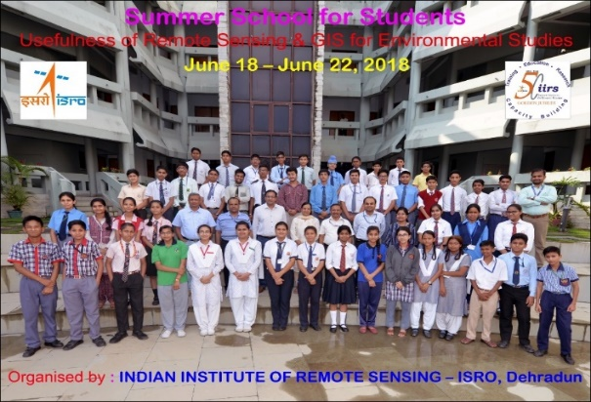
Overview of ISRO CB activities
Target Groups
Individual CB: Education, training, employment and Mentoring
Training of Trainers: School, UG teachers, Academia
Decision Makers’: For senior executives
Institutional Capacity building :,Ministries of GOI & State Govts,
academic institutions
Outreach through interactive Learning & MOOC
Outcomes to be Achieved
Expand the Earth observations & Geoinfomatics user base in Indian institutions and the developing world to expand the, and increase the awareness about Earth observations data and products of ISRO missions
Provide high quality education to students of India and developing countries
Promote space science and technology among citizens
Best practices followed
Structured training programs for different target
groups
Training on demand, thematic workshops etc.
Measures for capacity Building
Feed back mechanism, quantitative approach
Emphasis on skill development by more practicals
Geographical outreach and success stories
Implementing Partners & Potential future collaborates
Universities, S&T Institutes, Schools, UNOOSA, MEA, UNESCAPE, UN-CSSTEAP, Govt. departments
Space agencies through CEOS WGCapD, GEO, WMO, IOCCG etc.

Slide 3
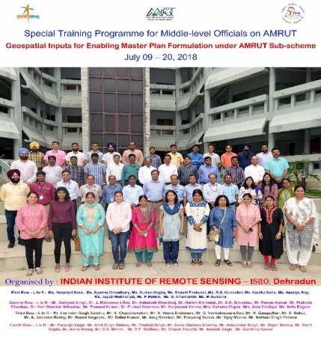
ISRO Capacity Building Initiatives
ATAL MISSION FOR REJUVENATION AND URBAN TRANSFORMATION (AMRUT)
Capacity Building for Sub-Scheme of Formulation of GIS Based Master Plan
CSSTEAP Program for Asia Pacific region for RS/GIS, Sat. Meteorology,
Space science
PGD (RS & GIS, SATCOM, SATMET, Space & Atmospheric Sciences); 2 and 4 weeks short
courses (DRR, Satellite Engg. & Small Satellites)
New Capacity Building Program Office : UNNATI ( UNispace Nanosatellite
Assembly & Training by ISRO) program
APRSAF/SEWG ISRO-JAXA Seminar (November 15-16, 2018), Dehradun
ISPRS TC V 2018
Nov 20-23, 2018, Dehradun
Space Education to Educators
Geospatial Technology – Pixel to People
Jointly organized by ISRO & JAXA at IIRS Dehradun
Total 80 participants, 73 from India and 7 from Nepal participated in the Seminar. The Indian participation was from 16 States.
The contents were presented/ delivered through lectures, demonstrations, hands-on sessions.
Hands-on/ Demonstration on Water Rocket, Celestial Observations & Vacuum Experiment were conducted.
Jointly organized by International Soc. Of Photogrammetry and Remote Sensing (ISPRS), Indian Society of Remote Sensing (ISRS) and Co-hosted by ISRO.
About 450 international and national researchers, professionals, academician and students attended the four-day long international event. There were 169 invitees, out of which 37 were foreign delegates participated from 17 countries.
New infrastructure for Capacity Building
NRSC established a new outreach facility at Jeedimetla near Hyderabad
NESAC has started a new program for short courses in RS/GIS
World Space Week Oct. 04-10, 2018), nation wide events
Space Unites the World
Celebrated by ISRO across the country by various Centers of ISRO
Thiruvananthapuram, Ahmedabad, Delhi, Hyderabad and Bangalore

Slide 4
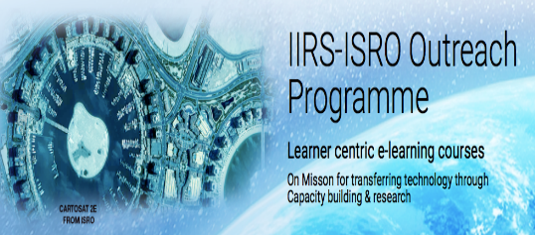
ISRO Capacity Building Initiatives
Targeted CB Programs:
Capacity Building
at ISRO
(32,812)
Students' Academic Programme
(88)
Medium-term Trainings
(2-8 Weeks)
(113)
Short-term
(1-2 Weeks)
(953)
Decision Makers'
(1-2 Days)
(169)
e-learning/ DLP
(31,033)
International
(161)
Individual CB: Education, training, employment and Mentoring
Training of Trainers: School, UG teachers, Academia, (399)
Decision Makers’: For senior executives (5416)
Outreach through interactive Learning & MOOC (16,671)
Country | Total
ASIA | 2288
AFRICA | 342
EUROPE | 47
NORTH AMERICA | 32
SOUTH AMERICA | 97
AUSTRALIA & OCEANIA | 20
Grand Total | 2826
Demand Based Training (15 Courses by IIRS)
Courses information;
Course contents/syllabus;
Outreach activities;
Lecture Notes;
Practical Demonstrations;
Presentation Materials;
Listing of Student’s Project;
Newsletters; Brochures;
Campus information;
Course announcements;
Partner Institutions;
International linkages;
Special Training Course on Atmospheric Remote Sensing for Weather & Climate
Special Course on Remote Sensing Analysis & Python Programming
Special Course on Customised Training Programme on Applications of Geospatial Technology for JNTU, Hyderabad
Special Course on Space Technology Applications in Disaster Management Support
Special Course on Geospatial Inputs for enabling Master Plan Formulation
One week refresher course for IFS Officers on Advances in RS & GIS and GNSS Applications in Forestry
Special Course on RS, GIS & GNSS Application for Disaster Management
Short Course on Remote Sensing with special emphasis on Digital Image Proc. (ITEC-Sponsored) (S-RS)
Short Course on Remote Sensing and Image Interpretation (C-RS)
Knowledge Repository

Slide 5
Thank you for your kind attention

