Slide 1
Open Data and Capacity development for Zero Hunger Aim
Committee on Earth Observation Satellites
Dr Suchith Anand
Global Open Data for Agriculture and Nutrition
CEOS WGCapD-8 Annual Meeting
Agenda Item # 18
Working Group on
Capacity Building & Data Democracy
Indian Institute of Remote Sensing
Indian Space Research Organisation
Dehradun, India
March 06th – 08th, 2019

Slide 2
Capacity development
How can we build Capacity Development synergies to ensure Zero Hunger for all?
Need for multidisciplinary inputs as well as local practices into the capacity development process.
The training programs and platforms used should be focussed on reducing digital divides so that researchers in developing countries can also benefit.

Slide 3
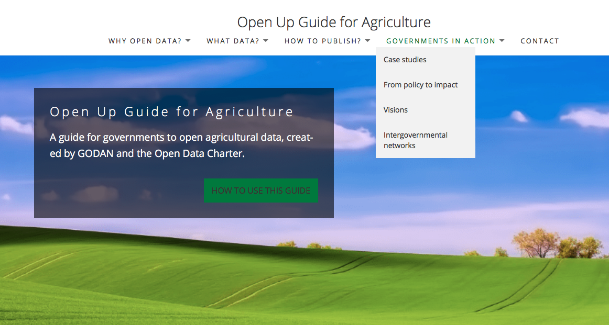
An example of open data Capacity building tool
https://openupguideforag.info

Slide 4
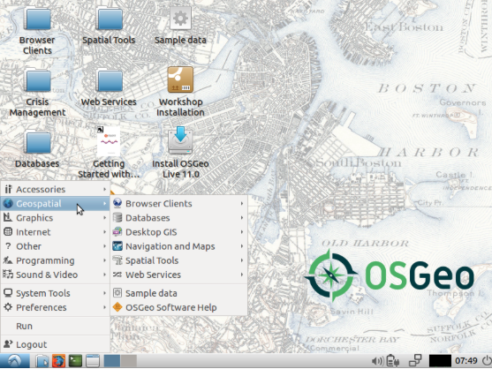
Open tools and resources for capacity development
Teachinghttps://www.osgeo.org/initiatives/geo-for-all/in-your-classroom/
Researchhttps://www.osgeo.org/initiatives/geo-for-all/in-your-research/
Projectshttps://www.osgeo.org/initiatives/geo-for-all/for-your-class-project/
OSGeo Live is self-contained bootable DVD, USB thumb drive or Virtual Machine based on Lubuntu, that allows you to try a wide variety of open source geospatial software without installing anything. It is composed entirely of free software, allowing it to be freely distributed, duplicated and passed around.
See all contents at https://live.osgeo.org/en/overview/overview.html

